Slide 1

Spaces to GROW:
Library Student Employment as a High Impact Educational Practice
Mark Sanders, Assistant Director for Public Services
Katy Webb, Head of Research and Instructional Services

Slide 2


What are High Impact Practices?
First Year Experiences
Common Intellectual Experiences
Learning Communities
Writing Intensive Courses
Collaborative Assignments and Projects
Undergraduate Research
Diversity/Global Learning
Service Learning
Internships
Capstone Courses and Projects
And the newest: ePortfolios

Slide 3
Put Another Way…
First Year
Courses in the Major
Core Courses
Gearing Up for Graduation
Undergraduate Research
Capstones
Internships
Writing Intensive Courses
Service Learning
Collaborative Assignments and Projects
Common Intellectual Experiences
Diversity and Global Learning
First Year Experiences
Living Learning Communities

Slide 4
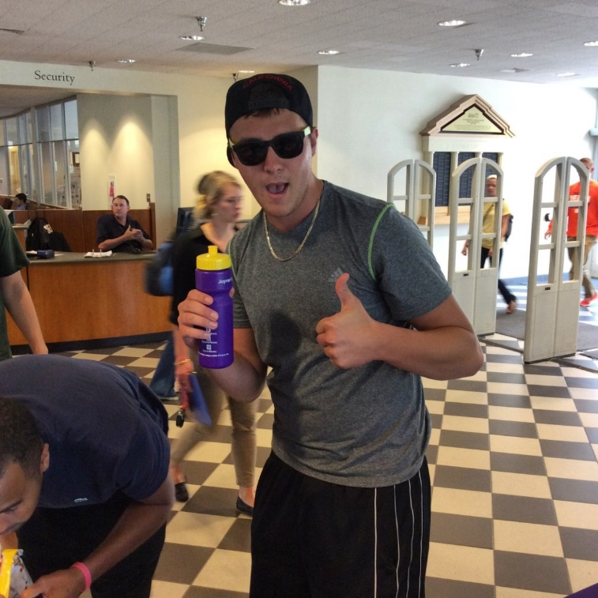
Library Student Workers and HIPs
Student Success defined:
…..acquisition of desired learning outcomes that prepare one to live an economically self-sufficient, civically responsible, and rewarding life. (Kuh, 2017)
From ALS strategic plan:
Encourage engagement in relevant high-impact educational practices by the ECU Libraries’ student employees as part of their employment and document examples of such engagement.

Slide 5
Characteristics of HIPs that Align with Student Employment
Time and Effort
Faculty and Peer Interaction
Diversity
Formal and Informal Feedback
Integration, Synthesis, Application, and Connection
Life Skills - balancing priorities, communication, conflict resolution
      critical thinking, decision making, time management
Benjamin, M., & McDevitt, T. (2018). The benefits and challenges of working in an academic library: A study of student library assistant experience. The Journal of Academic Librarianship, 44 (2)

Slide 6
Library Student Employees at ECU
85 students
Undergraduate $8-10/hr.; Graduate $12.50/hr.
Student employee annual budget $350K
ASERL rank (37 total libraries)
  Salaries & Wages – rank #18
  FTE (n=13.5) – rank #26

Slide 7


Slide 8
Goals of the Program
To make student employment a high-impact activity by providing structured opportunities for students to engage in reflect on and integrate what they are learning
To help students better articulate what they have learned from their job

Slide 9

Guided Reflection on Work
Two brief, structured conversations per semester
Guided by four questions.
Conversations are scheduled 1:1
An average conversation takes 10 minutes

Slide 10
Guided Reflection on Work
How is this job fitting in with your academics?
What are you learning here that’s helping you in school?
What are you learning in class that you can apply here at work?
Can you give me a couple of examples of things you’ve learned here that you think you’ll use in your chosen profession?

Slide 11
Supervisor’s Role
Supervisors are educators, and help students learn real-world skills
Many supervisors are already having conversations with their student employees
Through GROW supervisors can help make even deeper connections between work and academics

Slide 12

March 2019 – NASPA report found that “student supervisors are the linchpin of the student employee experience….. [serving] as the primary facilitators of professional development and learning opportunities for student employees, and the extent to which supervisors are supported can determine whether an employment experience is menial or meaningful. Therefore, institutions should identify and develop helpful resources and tools to better prepare and engage supervisors for their critical role.

Slide 13
Benefits for Supervisors
When students make connections to the workplace, they are more invested.
Invested employees do better work and feel more committed and responsible.
These conversations also open the line of communication between student supervisors and their employees.

Slide 14
Best Practices
Don’t do it at the desk
Send out the questions in advance and let students know you will discuss their responses at your meeting.
Put the questions into your own words
Weave the questions into your conversation
Mention at the end of the conversation that you will be discussing this again later in the semester.

Slide 15
Assessment of Iowa GROW at ECU
Supervisors wrote a short summary of the experience and any observations, suggestions, or other feedback after the meeting
88 total responses

Slide 16
Conversation Ratings by Supervisor – Spring 2019
Poor & Awkward Average Great Engagement

Slide 17
“We talked about his future plans with his Public Relations career. He expressed his appreciation for being able to work on projects that sharpened his Excel skills and being able to have flexible work hours. He said this job has helped him develop better time management skills (he also works as a RA and interns with the ECU Athletics. Also he expressed that working here has helped him develop communication skills.”
“She specifically has enjoyed learning the different resources such as databases and cataloging systems. She also stated that working with patrons has taught her more patience and that people learn things differently.”

Slide 18
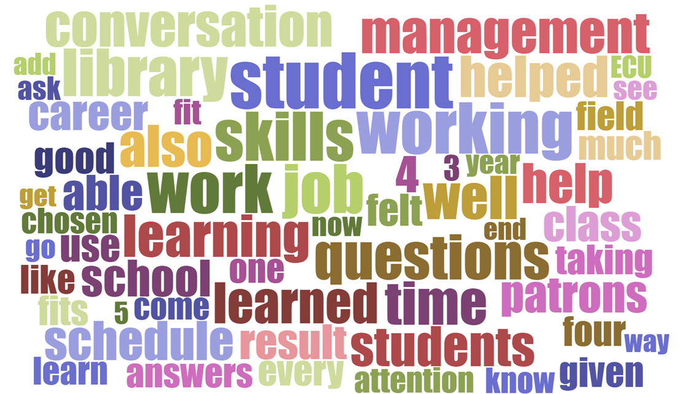

Slide 19
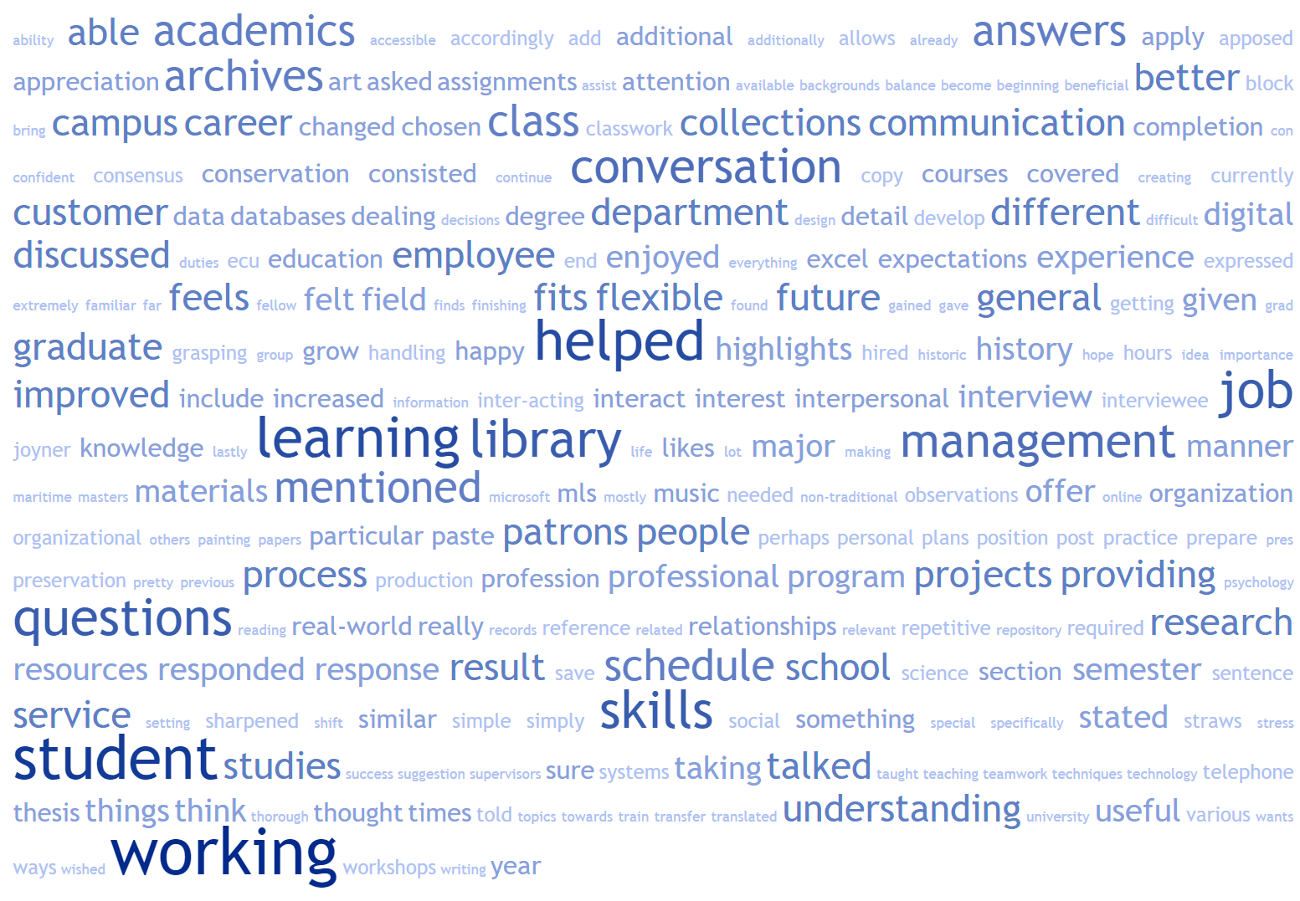

Slide 20
Topics Mentioned: Frequency
schedule flexibility, people skills, time management > 20
teamwork, org skills, employment prep., database/research skills > 10
attention to detail, grad school, problem solving > 5

Slide 21
Personal Development and More
Orientation event for student employees
Strategies for coping with stress
Communication and customer service
Using virtual reality to introduce new library furnishings
Reserved group study room during exams
Flu Clinic

Slide 22
James and Marie Thompson Student Employee Awards
To be eligible for the $500 awards, students must have a GPA of 3.0 or higher and have worked at least one semester of the most recent academic year and be committed to continuing their employment at the library for the fall semester.

Slide 23
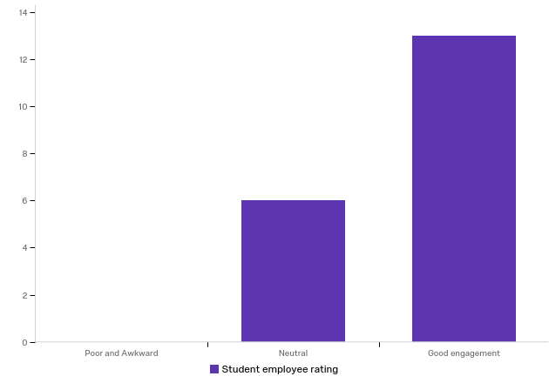
New for Fall 2019
Experienced student panel with advice on work/life balance, academic and professional benefits of working in the library, Q&A, and returning student-led tour
Students evaluate GROW conversations

Slide 24
We discussed how my job, school, and future career were integrated. I learned how I could utilize my skills from tracking payments and filling out forms in my future accounting career, as well as my customer service skills.
I had an excellent conversation with my advisor and we got to talk about the job a lot more, and how it will fit into my future education. This job requires me to be good with hand tools and to have the basic knowledge to fix and repair things around the library so naturally it is a perfect fit for me. My major is construction so this job is basically an extension of what I want to do in the future so I feel at home.

Slide 25
Think/Pair/Share
What does your library currently do to engage with student employees beyond punching a clock?
2. How could you see Iowa GROW working at your library? Opportunities? Challenges?

Slide 26
Thank you! Questions!

