Slide 1

PRENATAL
NUTRITION
October 10, 2023
Kathryn M Kolasa PhD, RDN, LDN
Professor Emerita, Brody School of Medicine, ECU
Brittany Smith MS, RDN, LDN
Nutrition Specialist, ECU Family Medicine Center
Dukes McCoy MS
ECU Dietetic Intern
Notes:
This session was an education session for Family Medicine Faculty and Residents, ECU Family Medicine, Brody School of Medicine

Slide 2



Objectives
Review weight gain guidelines during pregnancy and concerns (e.g. pica, food insecurity).
Summarize basic guidelines for prenatal nutrition.
Discuss the importance of choline in the maternal diet and what you can tell your patients about choline.
Examine dietary recommendations for gestational diabetes.
Discuss prenatal vitamins and minerals.

Slide 3



Prenatal Nutrition
NASEM - Nutrition during pregnancy and lactation: Exploring new evidence: Proceedings of a workshop National Academies of Sciences, Engineering, and Medicine 2020. Washington, DC: The National Academies Press.
https://doi.org/10.17226/25831
First update by the Institute of Medicine since 1990 report Nutrition During Pregnancy.
ACOG Expert Review, 2022 – The importance of nutrition in pregnancy and lactation: Lifelong consequences.
https://doi.org/10.1016/j.ajog.2021.12.035
KM Kolasa, ECU Fam Med, 2023
Notes:
Marshall NE, Abrams B, Barbour LA et al. The importance of nutrition in pregnancy and lactation: lifelong consequences. ACOG. 2022; doi.org/10.1016/j.ajog.2021.21.035
The NASEM documents were the most authoritative describing appropriate weight gain guidelines and dietary supplement guidelines. The ACOG review is the first of its kind from ACOG.
We also distributed an overview of prenatal care published in the American Family Physician in 2023. This type of article has been published at intervals in Am Fam Phys but this is the most extensive discussion of weight gain, diet quality and dietary supplements. (see reference list for the citation)

Slide 4

Give weight gain
(total and rate) advice
  Women with overweight and obesity often blame their size based on the weight they gained with children (some even name the pounds).
    The association between obesity and higher risk for severe COVID-19 should make us consider where we can work smarter to prevent obesity and severe infections in the future
  CDC weight gain trackers and advice for patients at:
    https://www.cdc.gov/reproductivehealth/maternalinfanthealth/pregnancy-weight-gain.htm#trackers
KM Kolasa, ECU Fam Med, 2023
Notes:
It is important to give patients a weight tracker. There are a variety of trackers available on the web.

Slide 5
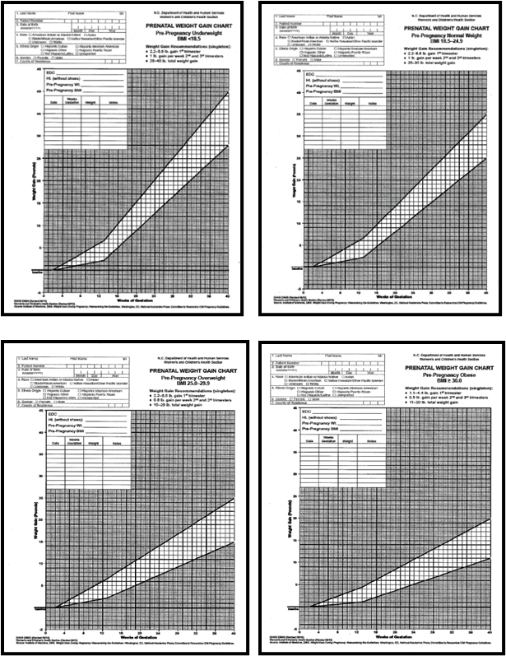

Weight Gain in Pregnancy
ASSESS/ADVISE
IOM, 2009
Pre-Pregnancy BMI Category | BMI (kg/m2) | Total Weight Gain (lbs) | Rate of Gain in 2nd and 3rd Trimester (lbs/wk)
Underweight | < 18.5 | 28 -40 | 1 (1 - 1.5)
Normal Weight | 18.5 - 24.9 | 25 - 35 | 1 (0.8 - 1)
Overweight | 25 - 29.9 | 15 - 25 | 0.6 (0.5 - 0.7)
Obese (all classes) | > 30 | 11 - 20 | 0.5 (0.4 - 0.6)
https://nap.nationalacademies.org/catalog/12584/weight-gain-during-pregnancy-reexamining-the-guidelines
O weight gain and weight loss can be safe during pregnancy
KM Kolasa, ECU Fam Med, 2023
Notes:
The weight gain guidelines were issued in 2009 and have not changed although there has been discussion about the safety of zero weight gain and/or weight loss by women starting their pregnancy in the obese class. There is not firm consensus but there is evidence that no weigh gain and supervised healthy weight loss can be accomplished without harming mom or baby.
It is equally important but less talked about, to help women lose their weigh gain after delivery.

Slide 6



Other Considerations
  FOOD SAFETY – greater susceptibility to foodborne illness
    NO raw or undercooked meat, poultry, seafood, eggs.
    NO pre-made meat or seafood salads. Deli meat should be heated to steaming.
    NO unpasteurized juices, milks, cheeses (soft cheeses like queso, brie, feta), or raw sprouts
  BARRIERS
    Time
    Finances
    Access to healthy/safe food
    Food Insecurity
    N/V/D/C
    Pica
    Aversions
SCREENING FOR FOOD INSECURITY IN THE CLINICAL SETTING
  Within the last 12 months, I worried that food would run out before I got money to buy more.
  Within the last 12 months, the food I bought just didn’t last and I didn’t have money to get more.
  USE OF AVAILABLE RESOURCES
    WIC
    SNAP
    Local food banks (organized by county in Krames)
    Community meal programs
    RDN
A response of “sometimes” or “always” to either or both questions indicates a positive screen for FI
B Smith, ECU Fam Med, 2023
U.S. Department of Agriculture and U.S. Department of Health and Human Services. Dietary Guidelines for Americans, 2020-2025. 9th Edition. December 2020. Available at DietaryGuidelines.gov.
Notes:
Food Insecurity can lead to both excess weight gain (eating high calorie low nutrients foods when available) and/or too little weight gain with just a lack of calories. Assess for Food Insecurity. Make sure those who screen positive are signed up for WIC and SNAP benefits

Slide 7

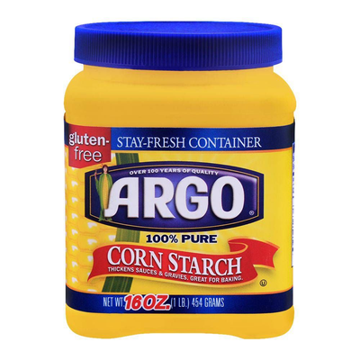

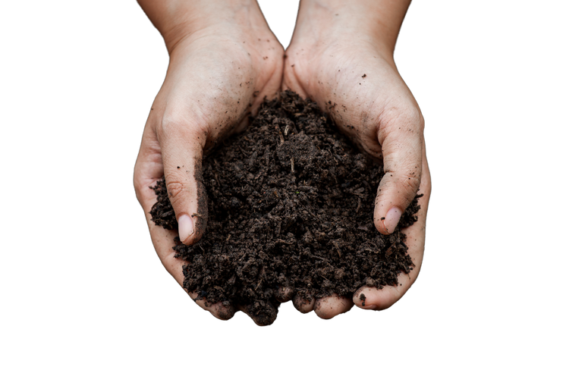

Pica:
Psychiatric eating disorder or hunger or cultural habit?
  The most common effects of pica can be classified as
    Nutritional deprivation
    Inadequate caloric intake leading to insufficient weight gain
    Excessive caloric intake leading to excess weight gain
    Toxicity
    Other effects such as obstruction, parasitic infection and dental injury
  What do you do? Know what is in your area.
Amount of Pica Substances Consumed | Amount of Pica Substances Consumes
Dirt, Soil, Clay | 0.7-2.42 oz (20 - 40 g)
Laundry Starch | Up to 1 pound per day
Ice | Several glasses to several kilograms
Magnesium Carbonate | 4 - 5 blocks (1 block is usually 2oz)
KM Kolasa, ECU Fam Med, 2023
Notes:
Pica can lead to too high or too low intake

Slide 8
Possible Next Steps after Identifying Pica
Eating dirt, clay, paint chips
Eating ice
Eating starch
  Consider tests for anemia, lead, hypokalemia
  Examine teeth
  Monitor weight gain
  Refer to dietitian (RDN) for MNT
  Test for anemia
  Monitor weight gain
  Examine teeth
  Refer to RDN for MNT
  Test for anemia
  Monitor for excessive weight gain
  Monitor for elevated blood sugar levels
  Refer to RDN for MNT
Fatigue, muscle weakness
Constipation
Lead levels > 5mcg/dL
  Ask about dirt and clay
  Test for anemia, hypokalemia
  Ask about dirt and clay
  Counsel to eliminate source of exposure
  Refer to RDN for MNT (ensure diet meets recs for Fe, Ca, Vitamins C and D
Sensitive or broken teeth
  Ask about dirt and clay and ice
Lead levels > 45mcg/dL
  Consider chelation therapy
Corbett Webb R, Kolasa KM. Nutr Today. 2014;49(3):101-108
KM Kolasa, ECU Fam Med, 2023

Slide 9
PICA
Assessment and Counseling Mnemonic
P
Patient-centered.
I
Ice.
Wait for the patient to reply. Ask how consumption helps her. Consumption of clay might soothe stomach upset during morning sickness, provide minerals like calcium., comply with mother or other relatives or friends’ insistence, calm heart burn, satisfy a craving, and prevent excess weight gain.
Ice is the most coming item ingested in the US.
But ask about other items like dirt, baked clay, or laundry or corn starch.
C
Communication.
A
Anemia
Monitor both your own and the patient’s verbal and non-verbal communication.
If hematocrit/hemoglobin level is low, ask about total diet and about pica.
Corbett Webb R, Kolasa KM. Nutr Today. 2014;49(3):101-108
KM Kolasa, ECU Fam Med, 2023
Notes:
Its always been a chicken and egg question. Does the pica cause the anemia or does the anemia lead to women craving and looking for something that will “treat” it.

Slide 10


Basic Guidelines from the DGA
  Optimum nutrition is important to meet the mother’s increased nutrient requirements, support fetal growth and development, and improve pregnancy outcomes.
  Core nutrition recommendations are the same as for women who are not pregnant
    Consume a variety of fruits and vegetables, whole grains, dairy, lean & plant protein, and healthy fats
    Limit calories from refined grains, added sugars, and saturated fat
    Focus on nutrient-rich forms of whole foods, while considering preference, lifestyle, tradition, culture, budget, and tolerance (nausea, vomiting, food aversions)
In the US, many women who are pregnant have diets that are below recommendations for healthful food groups while exceeding recommendations for added sugars, saturated fat, and sodium
Summary of the findings and recommendations from a 2020 workshop exploring the relationship between nutrition and maternal and fetal outcomes during pregnancy and lactation
NASEM - Nutrition during pregnancy and lactation: Exploring new evidence: Proceedings of a workshop National Academies of Sciences, Engineering, and Medicine 2020. Washington, DC: The National Academies Press.
DGA 2020-2025, Chapter 5: Women who are Pregnant or Lactating
https://www.dietaryguidelines.gov/sites/default/files/2021-03/Dietary_Guidelines_for_Americans-2020-2025.pdf
B Smith, ECU Fam Med, 2023

Slide 11
Basic Guidelines from the DGA - Supplementation
  Nutrient needs should primarily be met through a healthful diet, but this can be difficult
  Recommend a daily Prenatal Vitamin (PNV) in addition to a healthy diet for all women who are planning to become or are pregnant
    Especially to help meet requirements for nutrients that are essential but often lacking in the diets of even healthy (and food secure) pregnant women
      Folate
      Iron
      Iodine
      Vitamin D
      Calcium
      Choline
      Omega-3s/DHA
      B12*
Summary of the findings and recommendations from a 2020 workshop exploring the relationship between nutrition and maternal and fetal outcomes during pregnancy and lactation
NASEM - Nutrition during pregnancy and lactation: Exploring new evidence: Proceedings of a workshop National Academies of Sciences, Engineering, and Medicine 2020. Washington, DC: The National Academies Press.
DGA 2020-2025, Chapter 5: Women who are Pregnant or Lactating
https://www.dietaryguidelines.gov/sites/default/files/2021-03/Dietary_Guidelines_for_Americans-2020-2025.pdf
B Smith, ECU Fam Med, 2023
Notes:
Best to avoid restrictive diets that limit variety and exclude food groups (keto, paleo, etc)
Certain nutrients which are important in fetal growth and development are commonly consumed in inadequate amounts among even healthy, food secure women – folate, iron, iodine, vitamin D, calcium, choline, omega-3s (DHA), and in some populations, vitamin B12.

Slide 12




Key Short-Fall Nutrients
FOLIC ACID
IRON
IODINE
B12
400-800 mcg/d
27 mg/d
220-250 mcg/d
2.6 mcg/d
1 month preconception to at least 12 weeks gestation
Anemia: +40-200mg/d
Supports neurocognitive development and TH synthesis
Most women are likely meeting RDA
Necessary for blood volume expansion and fetal development
Key nutrient in brain functioning and development and preventing neural tube defects
Populations at risk of deficiency are those who exclude or limit animal sources
Risk of deficiency if not regularly consuming dairy, eggs, seafood, or iodized salt
Absorption of non-heme iron is enhanced with heme and Vitamin C
Include in your PNV rec
Animal products (fish, meat, poultry, eggs, dairy), nutritional yeast, fortified breakfast cereals
Include in your PNV rec
Include in your PNV rec
May be best not to exceed 500mcg/d
Leafy greens, legumes, fortified breakfast cereal
Fortified breakfast cereal, meats, legumes, leafy greens
Iodized salt, dairy products, seaweed, seafood (cod)
B Smith, ECU Fam Med, 2023
U.S. Department of Agriculture and U.S. Department of Health and Human Services. Dietary Guidelines for Americans, 2020-2025. 9th Edition. December 2020. Available at DietaryGuidelines.gov.
Notes:
Function and food sources of common short-fall nutrients

Slide 13



Key Short-Fall Nutrients
Vitamin D
Calcium
Omega-3/DHA
Choline
15 mcg/d (600 IU)
1000-1300 mg/d
1.4g/d / 300mg/d
450mg/d
Supports maternal and fetal bone health
Supports maternal and fetal bone health and may reduce risk of pre-eclampsia and pre-term delivery
Supports fetal brain, eye, and CNS development
Replenish mom’s stores, and support fetal growth and brain and spinal cord development
Deficiencies are associated with risk of pre-eclampsia and LBW
To meet DHA requirements, recommend weekly consumption of at least 1-2 servings of low-mercury fatty fish like salmon, herring, and sardines
Dairy is one of the best sources in the SAD - recommend that women are meeting the DGA
(3 servings/day)
Some research suggests greater benefit with intake ~900mg/d
No consensus on routine supplementation.
Supplementation is necessary in cases of deficiency
Found in small amounts in food, and largely missing from PNV
Dairy, fortified nondairy milk/juice, fish (with bones), tofu, leafy greens
Fatty fish, fortified milks and breakfast cereals
Fatty fish, sardines, enriched eggs or fortified milk
Eggs, soybeans, meat, dairy
B Smith, ECU Fam Med, 2023
U.S. Department of Agriculture and U.S. Department of Health and Human Services. Dietary Guidelines for Americans, 2020-2025. 9th Edition. December 2020. Available at DietaryGuidelines.gov.
Notes:
Function and food sources of common short-fall nutrients
Seafood (at least 8 and up to 12oz/week of low-mercury fish). The unintended consequence of focusing on avoiding mercury in fish is that women stopped eating any seafood. They need it for DHA.

Slide 14
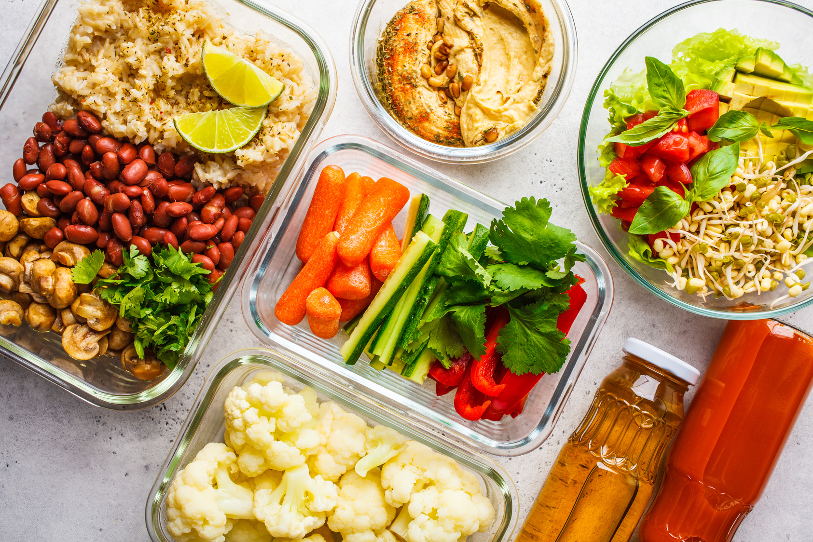
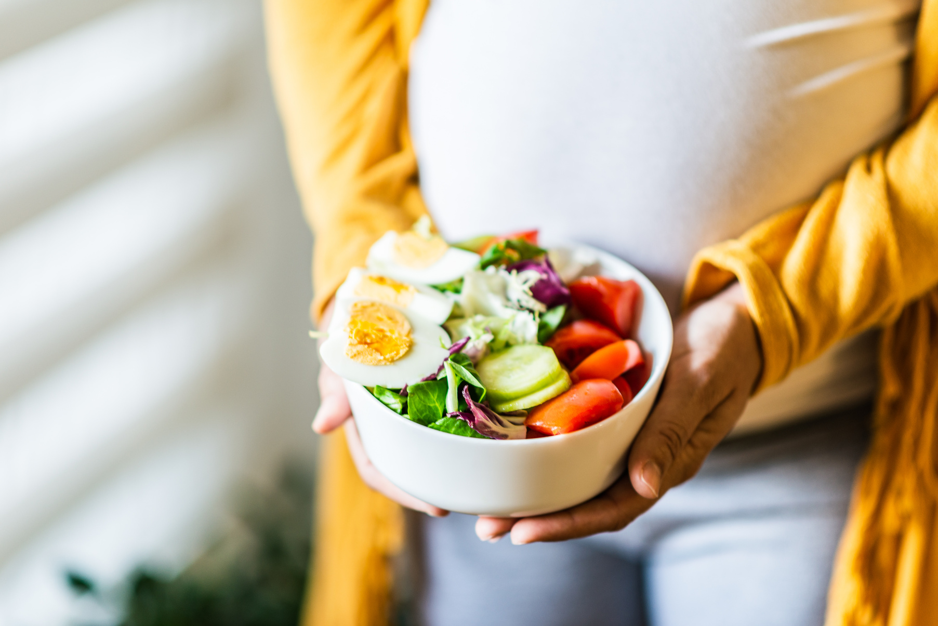
A WORD ON
Vegan/Vegetarian Diets
  Properly planned plant-based diets can be safe during pregnancy
  Take special care to ensure nutrient adequacy through foods and supplements
    Iron and Zinc: ensure adequate in a prenatal vitamin (PNV)
    B12: 25mcg/d supplement or in fortified foods
    Iodine: ensure at least 150mcg in your PNV
    DHA: 200-300mg from a supplement
    Calcium: encourage calcium-fortified foods
    Choline: will likely benefit from a supplement
    Protein
    Vitamin D: will likely benefit from a supplement
  Refer to an RDN for nutrition counseling
B Smith, ECU Fam Med, 2023
U.S. Department of Agriculture and U.S. Department of Health and Human Services. Dietary Guidelines for Americans, 2020-2025. 9th Edition. December 2020. Available at DietaryGuidelines.gov.
Notes:
Diet assessment to ensure adequate intake of nutrients that are almost exclusively found in animal-derived foods. Refer to an RDN for diet assessment and to develop a safe vegetarian diet plan during pregnancy.

Slide 15
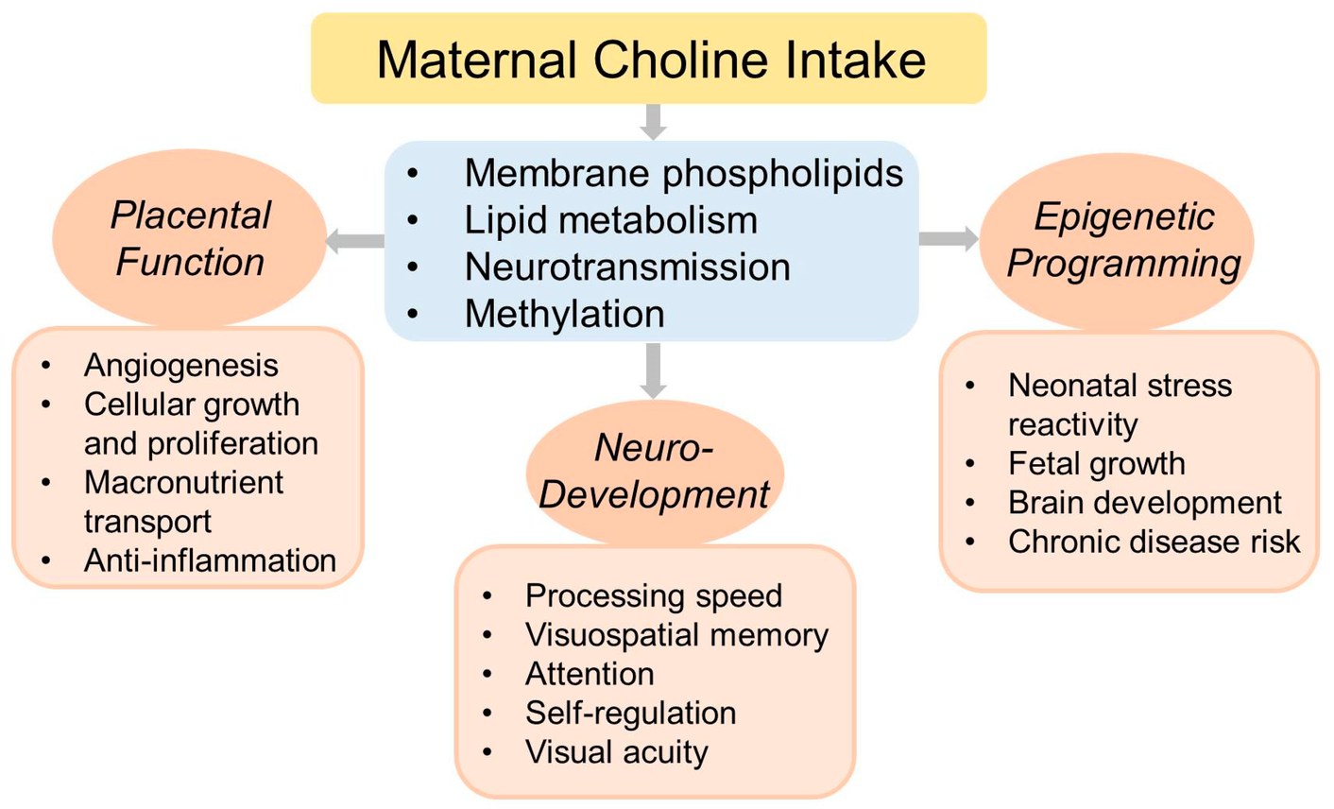
CHOLINE
  An essential nutrient throughout the lifespan, but especially critical during pregnancy
  Endogenous synthesis not adequate to meet increased demands during pregnancy
Needed for cell membrane structure and signaling, lipid transport and metabolism, gene expression, and production of neurotransmitters (ACh)
Early brain development
Supplementation in the 3rd trimester is associated with better cognitive function in infants at 1yo and into school years
Associated with reduce risk of neural tube defects, independent of folate intake
Associated with reduced stress reactivity, which can lower risk of depression, T2DM, HTN, and immunological disorders
Support development and function of the placenta
B Smith, ECU Fam Med, 2023
Korsmo HW, Jiang X, Caudill MA. Choline: Exploring the Growing Science on Its Benefits for Moms and Babies. Nutrients. 2019; 11(8):1823. https://doi.org/10.3390/nu11081823

Slide 16

CHOLINE - INTAKES
AI
450mg/d
Amount assumed to ensure adequacy
  Human studies suggest that the AI may not be sufficient to meet increased demands during pregnancy
  930mg/d may be optimum
U.S. intake
278mg/d
Average intake among women
  An estimated 90-95% of pregnant women consume <AI
  Intake is lowest among vegetarians (192mg/d)
UL
3.5g/d
Tolerable upper limit
  Hypotension and fishy body odor
Intake/supplementation around 450-1000mg/d likely adequate to support fetal development and pregnancy outcomes
B Smith, ECU Fam Med, 2023
Choline Fact Sheet for Health Professionals. NIH ODS. Updated June 2022. https://ods.od.nih.gov/factsheets/Choline-HealthProfessional/
Notes:
AI for choline based on prevention of liver damage.
Research studies have used higher amounts and suggest that intake around 930mg/d may be optimum for fetal development pregnancy outcomes.

Slide 17

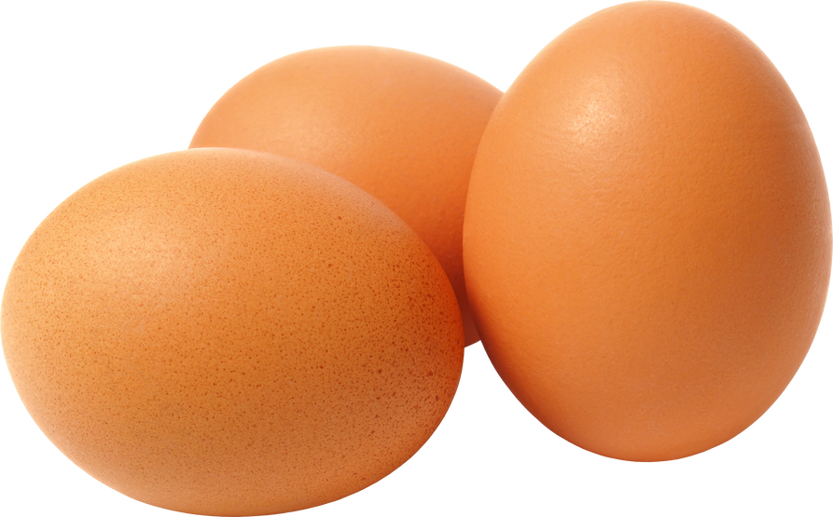
FOOD SOURCES
Choline in the Diet
Egg (1 large) | 150mg
Soybeans (1/2 cup) | 107mg
Pork loin (3oz) Canned salmon (3oz) Chicken breast (3oz) 93% lean ground beef (3oz) Cod (3oz) | 78mg 75mg 72mg 72mg 71mg
Red potato (1 large) | 57mg
Kidney beans (1/2 cup) | 45mg
Quinoa (1 cup) | 43mg
1% milk (1 cup) Nonfat yogurt (1 cup) | 43mg 38mg
Broccoli, brussel sprouts, mushrooms, cauliflower, asparagus (1/2 cup) | about 30mg
Tuna, canned (3oz) | 25mg
Peanuts (1/4 cup) | 24mg
  Widely distributed
  Primarily found in animal sources and to a lesser degree in plant foods
Incorporating 1-2 eggs per day may help bring a healthy US-style diet closer to the DRI for Choline
B Smith, ECU Fam Med, 2023
Choline Fact Sheet for Health Professionals. NIH ODS. Updated June 2022. https://ods.od.nih.gov/factsheets/Choline-HealthProfessional/
Abridged List Ordered by Nutrient Content in Household Measure, Source: USDA National Nutrient Database for Standard Reference Legacy, Choline, total (mg). USDA ARS. Updated 2018. https://www.nal.usda.gov/sites/www.nal.usda.gov/files/choline.pdf

Slide 18



Choline in the Health Setting
Prenatal Vitamins on the Market
One-a-Day PNV (folic acid, DHA, Fe, Vit D) | 0mg Choline | $16.97/mo (1 soft-gel/d)
Spring Valley PNV (folic acid, DHA, Fe, Vit D) | 0mg Choline | $6.24/mo (2 soft-gels/d)
Nature Made PNV (folic acid, DHA, Fe, Vit D) | 0mg Choline | $6.87/mo (1 soft-gel/d)
Ritual PNV (not complete) (folic acid, DHA, Fe, Vit D) | 55mg Choline | $39/mo (2 soft-gels/d)
Full Well PNV (folic acid, Vit D, NO DHA or Fe) | 300mg Choline | $49.95/mo (8 soft-gels/d)
One-a-Day PNV adv. (folic acid, DHA, iron, Vit D) | 110mg Choline | $21.88/mo (2 pills/d)
Major Prenatal (ECU OTC) (folic acid, iron, Vit D) | 0mg Choline | $1.20/mo (1 tablet/d)
M-Natal Plus (ECU Rx) (folic acid, iron, Vit D) | 0mg Choline | $1.20/mo (1 tablet/d)
  About 10% of health professionals indicate moderate familiarity with choline
    6% of OBGYNs report that they are likely to recommend choline-rich foods to pregnant women
Prenatal Vitamins
  Do NOT routinely contain choline or contain small amounts
  Limited in part by space (AI in mg vs mcg)
June 2017 AMA annual meeting - voted to support evidence-based amounts of choline in all prenatal vitamins
Cost as of September 2023
B Smith, ECU Fam Med, 2023
Wallace TC, Blusztajn JK, Caudill MA, Klatt KC, Natker E, Zeisel SH, Zelman KM. Choline: The Underconsumed and Underappreciated Essential Nutrient. Nutr Today. 2018 Nov-Dec;53(6):240-253. doi: 10.1097/NT.0000000000000302.
Choline and Lecithin Supplements Review ConsumerLab.com. Updated April 2023. https://www.consumerlab.com/reviews/choline-review/choline/?search=Choline%20(many%20forms)
Notes:
Many common prenatal vitamins do not contain choline, or contain little amounts. Those that do contain choline in meaningful amounts are expensive, lack other essential nutrients, and require administration of multiple tablets/day.

Slide 19
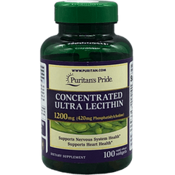
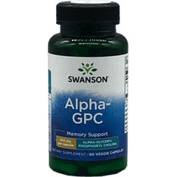
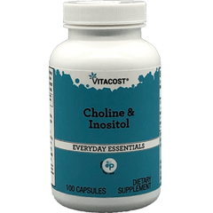
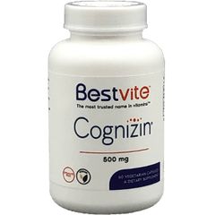
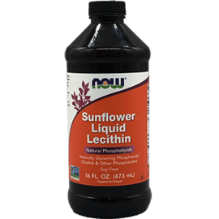

Choline through Supplementation
In single supplements
  Typically range from 60-250mg choline/serving
    Bottles may list the amount of “choline-containing” compounds rather than the amount of choline
  Cost ranges from $0.02 to $0.58 per 100mg choline
  (1 lg egg is about $0.10 and provides ~150mg choline)
60mg
121.5mg
250mg
213.3mg
Sunflower
Liquid Lecithin
Soy Lecithin Powder
In food-based products
1 Tbsp
434mg
$0.11/100mg
2 tsp
134mg
$0.05/100mg
  Contain choline in the form of phosphatidylcholine, which is better absorbed and so has a reduced risk of being converted to TMAO
  Good option for vegan/vegetarian pregnant women
B Smith, ECU Fam Med, 2023
Choline and Lecithin Supplements Review ConsumerLab.com. Updated April 2023. https://www.consumerlab.com/reviews/choline-review/choline/?search=Choline%20(many%20forms)
Notes:
Check the amount of choline as supplements usually list the amount of choline-containing compounds.
Food-based products like sunflower liquid lecithin and soy lecithin powder may be good options for vegan/vegetarian women.
TMAO - (a compound associated with increased CVD risk)

Slide 20


What should you tell your patients?
about CHOLINE
Choline is an essential nutrient that supports fetal brain development and cognitive function
But is likely missing from your PNV
A healthy, well-balanced eating pattern can promote intake of short-fall nutrients, including choline
Including nutrient-dense animal-derived foods can support adequate choline intake
(e.g. eggs, lean meat, poulty, fish, dairy)
You might recommend incorporating 1-2 eggs/d
Pregnant women with restrictive diets or diets which lack animal-derived foods will likely benefit from supplementation
B Smith, ECU Fam Med, 2023

Slide 21
Dietary Guidelines for GDM
Carbohydrates
Fat
  DRI: ≥ 175g /day (minimum)(AND & ADA)
    15-30g at breakfast
    45-60g at lunch
    45-60g at dinner
    15-30g at snacks
  Fiber: ≥ 28g /day
  Educate on the amount and type of CHO
    Recommend nutrient-dense CHO’s
      Whole grains, starchy vegetables
    Avoid refined CHO’s
      Candy, sweets, SSB’s
  33%-40% of daily calories (ACOG)
  DRI (AND & ADA)
  Utilize mono/polyunsaturated fats
    nuts/seeds
    avocado
    olive oil
  40% of daily calories (ACOG)
Protein
  DRI: ≥71 g/day (AND & ADA)
or
  ≥ 1.1 g/kg BW/day
  20% of daily calories (ACOG)
Bottom Line: If blood sugar cannot be controlled with minimum CHO intake, use insulin.
AND: Academy of Nutrition & Dietetics
ADA: American Diabetes Association
ACOG: The American College of Obstetricians and Gynecologists
Notes:
ACOG Practice Bulletin No. 190: Gestational Diabetes Mellitus. Obstetrics & Gynecology. 2018; 131 (2): e49-e64. doi:10.1097/AOG.0000000000002501.
Notes:
Carbs:
(DRI) 175 g/day is the minimum (ADA & AND)
At least 28 g fiber/day
Focus on good carbs like whole grains and starchy vegetables. Also want to avoid starchy carbohydrates.
If you cant get Blood glucose under control on the minimal carb intake, implement insulin.
ACOG: 33%-40% of daily calories
Fat:
(DRI) (ADA & AND)
Emphasize healthy fats including mono and polyunsaturated fats.
ACOG: 40% of daily calories
Protein:
71 g/day minimum (ADA & AND)
Can also use 1.1 g/kg/BW
ACOG: 20% of daily calories

Slide 22
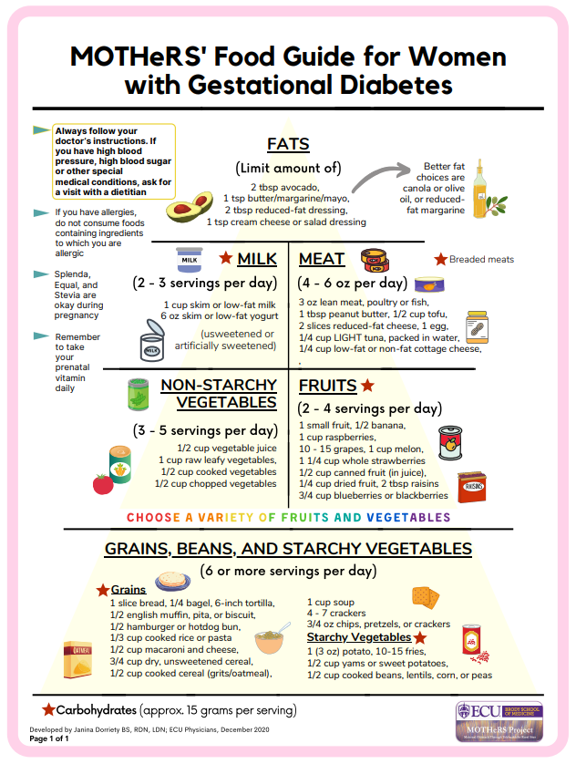
Points to Review with your Patients with GDM
  You may have to modify the composition of your meals, snacks, and drinks to improve outcomes for both you and your baby
    MOTHERS’ Plate and SHOPPING GUIDE
  Use this pyramid as your guide unless indicated otherwise (allergies, intolerances, medical status?)
  Not low/no-carb, but focus on consuming unrefined carbohydrates (whole grains, legumes, fruits, vegetables, and dairy) instead of refined carbohydrates
  Avoid juices, soft drinks, and other sugar-sweetened beverages
  Avoid junk foods (candy, sweets, and fried foods)
  Eat portion-controlled, regularly scheduled meals/snacks
Notes:
Notes:
Changing composition of meals, snacks and drinks
Use MOTHERS’ Plate and SHOPPING GUIDE
Use Pyramid as a guide
Focusing on they type of carbohydrates, we don’t want them consuming little/no carbs
Avoids juices, soft drinks, and SSB's
Avoid junk foods
Portion-controlled, regularly scheduled meals and snacks

Slide 23
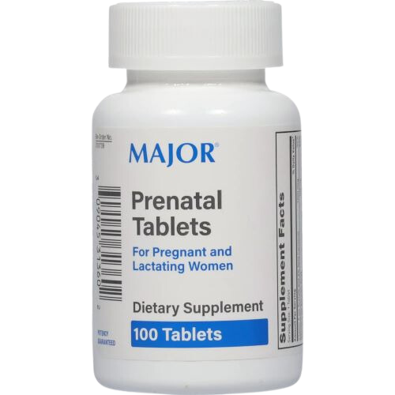
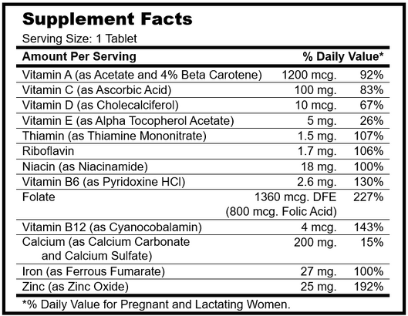
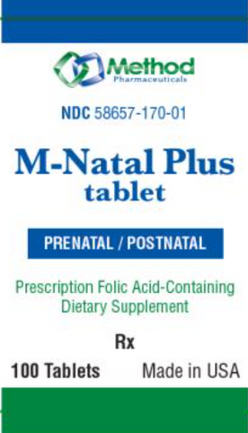
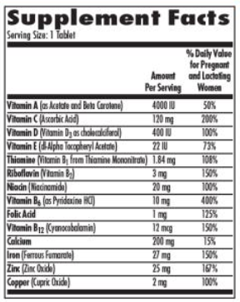
Prenatal Vitamin-Mineral Supplement
and IRON SUPPLEMENT
  Prenatal vitamin-mineral supplement: prescription or OTC (with folic acid)
    >70% of pregnant women take a supplement, at least some of the time
    Inadequate and/or excessive intake of nutrients during pregnancy is associated with adverse maternal and offspring health outcomes
    Strongest evidence for nutrients that are both low in the diet and for which supplementation will make a difference (AJCN; 2023;117:823-829)
      Vitamin A (preformed)
      Vitamin D
      Folate/Folic acid
      Calcium
      Iron
      Omega-3 fatty acids
  During 1st trimester, don’t need added iron unless anemic
    Added iron: dose of 30mg/d, about week 12 of gestation
    If anemic, dose of 60-120mg/d
      Cut back by 30mg when lab values are WNL
    Change brands if not well tolerated
    (325mg ferrous sulfate = 65g elemental iron)
Institute of Medicine (US) Committee on Nutritional Status During Pregnancy and Lactation. Nutrition During Pregnancy: Part I Weight Gain: Part II Nutrient Supplements. Washington (DC): National Academies Press (US); 1990. 14, Iron Nutrition During Pregnancy. Available from: https://www.ncbi.nlm.nih.gov/books/NBK235217/
KM Kolasa, ECU Fam Med, 2023
Notes:
Brittany (10/223): prenatal vitamins currently sold in the Fam Med pharmacy ($4 for Medicaid). The Major vitamins have 400IU vitamin D, folic acid, iron, B12, and some calcium, but no iodine, DHA, or choline. The M-Natal vitamins contain folic acid, iron, B12, 400IU Vit D, and some calcium, but also no iodine, DHA, or choline.
It was thought the high doses of folic acid could mask vitamin B12 deficiency or pernicious anemia. Thus prenatals that had more than 1 gram of folic acid were available only by prescription in many states. This has not been found to be true with the fortification of many foods with folic acid to prevent neural tube defect

Slide 24
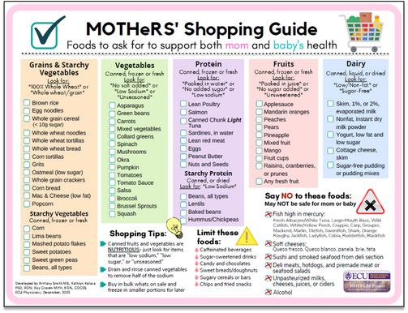
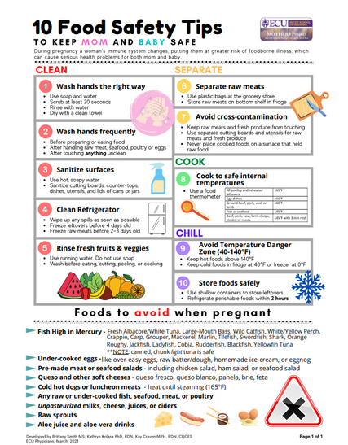
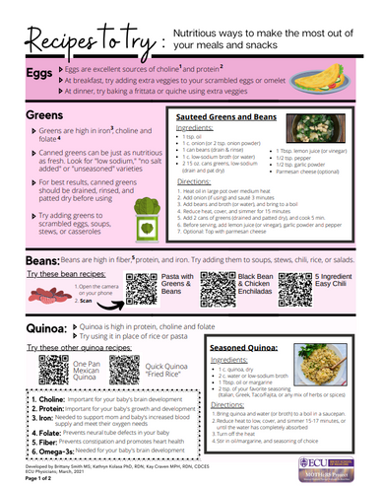
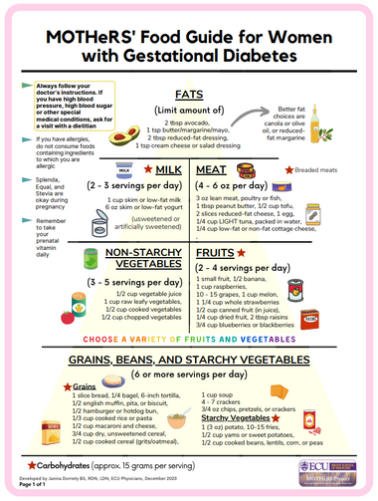
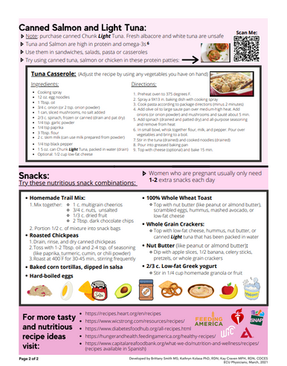
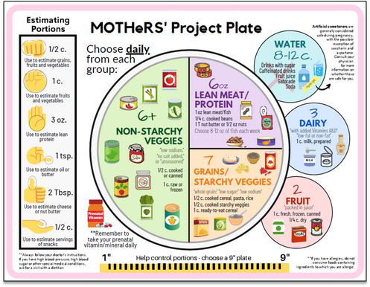
MOTHERS’ HANDOUTS
Available free for use on ECU ScholarShip
In English and Spanish
MOTHERS’ PLATE and
SHOPPING GUIDE
FOOD SAFETY TIPS
RECIPES
using nutrient-rich foods
Guide for women with Gestational Diabetes
http://hdl.handle.net/10342/8944
http://hdl.handle.net/10342/8946
http://hdl.handle.net/10342/8943
http://hdl.handle.net/10342/8941
B Smith, ECU Fam Med, 2023
Notes:
The MOTHeRS Project was developed at East Carolina University, Brody School of Medicine. Kay Craven was the lead investigator of the component to address food insecurity among women living in rural areas. The project demonstrate that screening for and addressing food insecurity through the direct provision of medically tailored emergency food bags is both feasible and acceptable in an ambulatory clinical setting. The materials can be used with other pregnant women and are found on the ECU Repository The Scholarship. There is no copyright and providers should feel free to use with their patients.
Plate and Guide:
http://hdl.handle.net/10342/8944
Food Safety:
http://hdl.handle.net/10342/8946
Recipes:
http://hdl.handle.net/10342/8943
GDM:
http://hdl.handle.net/10342/8941

Slide 25
References
  Abridged List Ordered by Nutrient Content in Household Measure, Source: USDA National Nutrient Database for Standard Reference Legacy, Choline, total (mg). USDA ARS. Updated 2018. https://www.nal.usda.gov/sites/www.nal.usda.gov/files/choline.pdf
  American Dietetic Association. ADA Nutrition Care Manual. Chicago: American Dietetic Association (ADA); 2005.
  Choline and Lecithin Supplements Review ConsumerLab.com. Updated April 2023. https://www.consumerlab.com/reviews/choline-review/choline/?search=Choline%20(many%20forms)
  Choline Fact Sheet for Health Professionals. NIH ODS. Updated June 2022. https://ods.od.nih.gov/factsheets/Choline-HealthProfessional/
  Houchins J. Choline during pregnancy: New study shows lasting cognitive benefit for children. The Incredible Egg. Published February 2022. https://www.incredibleegg.org/articles/choline-during-pregnancy
  Korsmo HW, Jiang X, Caudill MA. Choline: Exploring the Growing Science on Its Benefits for Moms and Babies. Nutrients. 2019; 11(8):1823. https://doi.org/10.3390/nu11081823
  Marshall NE, Abrams B, Barbour LA et al. The importance of nutrition in pregnancy and lactation: lifelong consequences. ACOG. 2022; doi.org/10.1016/j.ajog.2021.21.035
  NASEM - Nutrition during pregnancy and lactation: Exploring new evidence: Proceedings of a workshop National Academies of Sciences, Engineering, and Medicine 2020. Washington, DC: The National Academies Press.
Ramirez SI. Prenatal Care: An evidence-based approach. AM Fam Phys. 2023;108(3):139-150.
  Sauder KA, Couzens GL, Bailey RL. et al. Selecting a dietary supplement with appropriate dosing for 6 key nutrients in pregnancy. Am J Clin Nutr. 2023;117(4):823-829.
  Tsirou E, Grammatikopoulou MG, Theodoridis X, et al. Guidelines for Medical Nutrition Therapy in Gestational Diabetes Mellitus: Systematic Review and Critical Appraisal. Journal of the Academy of Nutrition and Dietetics. 2019;119:1320-1339.
  U.S. Department of Agriculture and U.S. Department of Health and Human Services. Dietary Guidelines for Americans, 2020-2025. 9th Edition. December 2020. Available at DietaryGuidelines.gov.
  Wallace TC, Blusztajn JK, Caudill MA, Klatt KC, Natker E, Zeisel SH, Zelman KM. Choline: The Underconsumed and Underappreciated Essential Nutrient. Nutr Today. 2018 Nov-Dec;53(6):240-253. doi: 10.1097/NT.0000000000000302.

