Slide 1
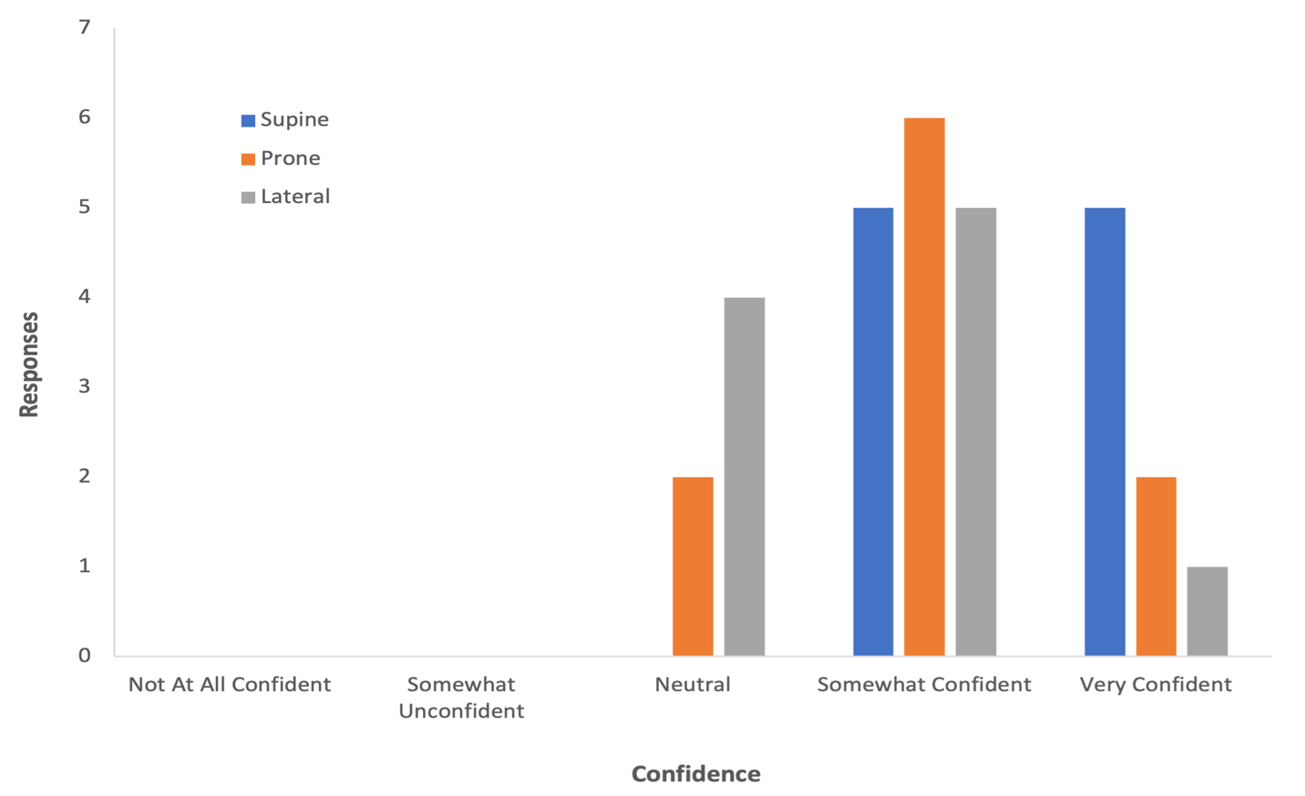
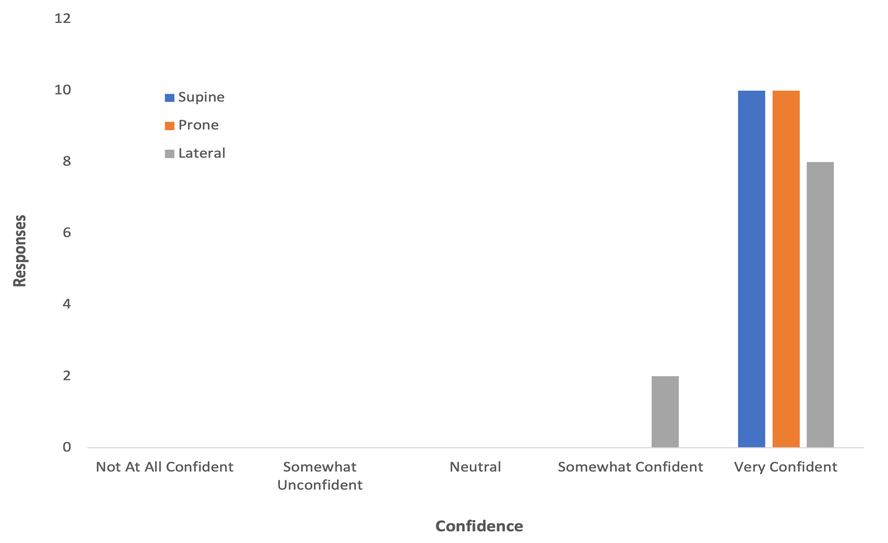
ECG Lead Placement Education Tool
Chad Greene, BSN, SRNA
Travis Chabo, PhD, CRNA, Project Chair
Nurse Anesthesia Program
College of Nursing, East Carolina University
Greenville, North Carolina 27858
greenec21@students.ecu.edu
INTRODUCTION
RESULTS
DISCUSSION
Continuous ECG monitoring is a universally-accepted standard of care in anesthesia ^{1, 2, 3}
The most common error in ECG monitoring is misplaced ECG leads ⁴
Incorrect ECG lead placement causes inappropriate morphology mimicking pathology leading to unnecessary diagnostics⁵
As little as 2 cm away from proper placement is enough to reduce accuracy⁶
Incidence of ECG lead misplacement has been documented as high as 94.2%⁷
Poorly placed ECG leads may represent a financial burden on the healthcare system of approximately $3.2 billion annually⁸
In the operating room, CRNAs are responsible for placing ECG leads on the patient
Figure 1
Confidence Placing ECG Leads Accurately, Pre-intervention (n=10)
Figure 2
Confidence Placing ECG Leads Accurately, Post-intervention (n=10)
Ten CRNAs completed the pre-intervention and post-intervention surveys
All CRNAs reported increases in confidence placing ECG leads in the supine, prone and lateral positions before and after using the educational materials (Fig 1.1 and 1.2, respectively)
All CRNAs agreed the tool was easily accessible and added fewer than 2 minutes to their routine
Most CRNAs agreed the ECG placement tool improved the quality of patient care
The frequency with which CRNAs moved ECG leads before and after the intervention did not change greatly
CONCLUSIONS
The ECG lead placement tool improved the self-reported perceived accuracy of placing ECG leads in supine, prone and lateral positions
Half of CRNAs reported intent to continue using the ECG reference guide in the future
Recommendations for future projects:
  Investigate other factors that influence ECG lead accuracy in the intraoperative setting, i.e., constraints from surgical procedures
  Larger sample size including other healthcare disciplines
  In-person check-off to assess actual ECG lead placement accuracy in addition to perceived accuracy
METHODS
A single plan, do, study, act cycle was performed using a pre-intervention survey → intervention → post-intervention survey design
CRNA participants were emailed the link for the pre-intervention survey hosted by Qualtrics
CRNA participants were emailed PowerPoint presentation with ECG fundamentals and methods for correct placement with associated anatomical landmarks in supine, prone and lateral positions
Quick reference PDF was supplied digitally by email and paper copies were placed in anesthesia work room of participating facility
CRNA participants were emailed the link for the post-intervention survey hosted by Qualtrics
Data were analyzed using Microsoft Excel
REFERENCES
1. American Society of Anesthesiologists. (2020). Standards for basic anesthesia monitoring. https://www.asahq.org/basic-anesthetic-monitoring
2. Anesthesia Patient Safety Foundation. (1987). American Society of Anesthesiologists standards for basic intra-operative monitoring. APSF Newsletter, 2(1). https://www.apsf.org/standards-for-basic-intra-operative-monitoring/
3. American Association of Nurse Anesthesia. (2019) Standards for nurse anesthesia practice. https://www.aana.com/nurse-anesthesia-practice.pdf
4. Rajaganeshan, R., Ludlam, C. L., Francis, D. P., Parasramka, S. V., & Sutton, R. (2008). Accuracy in ECG lead placement among technicians, nurses, general physicians and cardiologists: Accuracy in ECG lead placement. International Journal of Clinical Practice, 62(1), 65-70. https://doi.org/10.1111/j.1742-1241.2007.01390..x
5. Institute for Healthcare Improvement. (2022a). How to improve. https://www.ihi.org/PDSA
6. Kania, M., Rix, H., Fereniec, M., Zavala-Fernandez, H., Janusek, D., Mroczka, T., Stix, G., & Maniewski, R. (2014). The effect of precordial lead displacement on ECG morphology. Medical & Biological Engineering & Computing, 52(2), 109-119. https://doi.org/10.1007/s11517
7. DiLibero, J., DeSanto-Madyea, & O’Dongohue, S. (2016). Improving accuracy of cardiac electrode placement, Clinical Nurse Specialist, 30(1), 45-50. https://doi.org/10.1097/nur.0000000000000172
8. Paget, S., & Kilner, T. (2019). Accuracy of ECG chest lead placements by paramedics [Abstract]. Emergency Medicine Journal, 36(10), e2. https://doi.org/10.1136/emermed-2019-999abs.1
9. Rehman, M., & Rehman, N. (2020). Precordial ECG lead mispositioning: Its incidence and estimated cost to healthcare. Cureus, 12(7), e9040. https://doi.org/10.7759/cureus.9040

