Slide 1
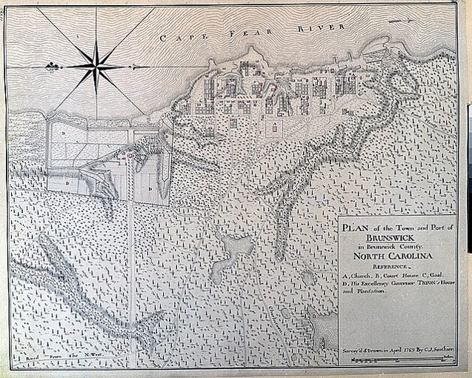
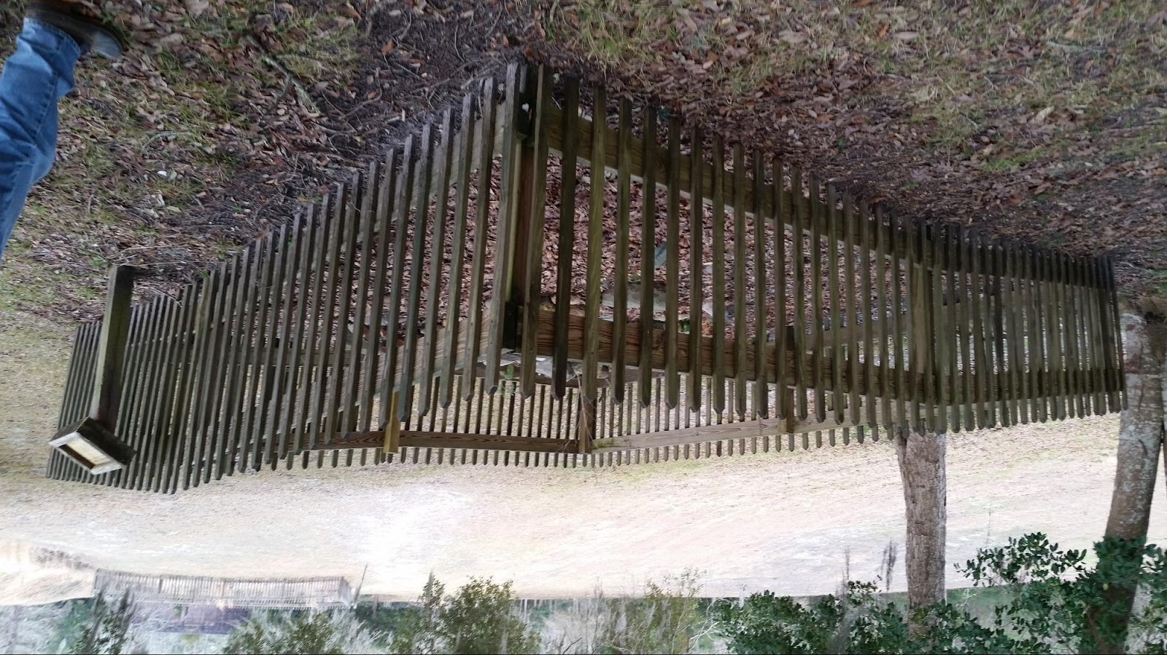
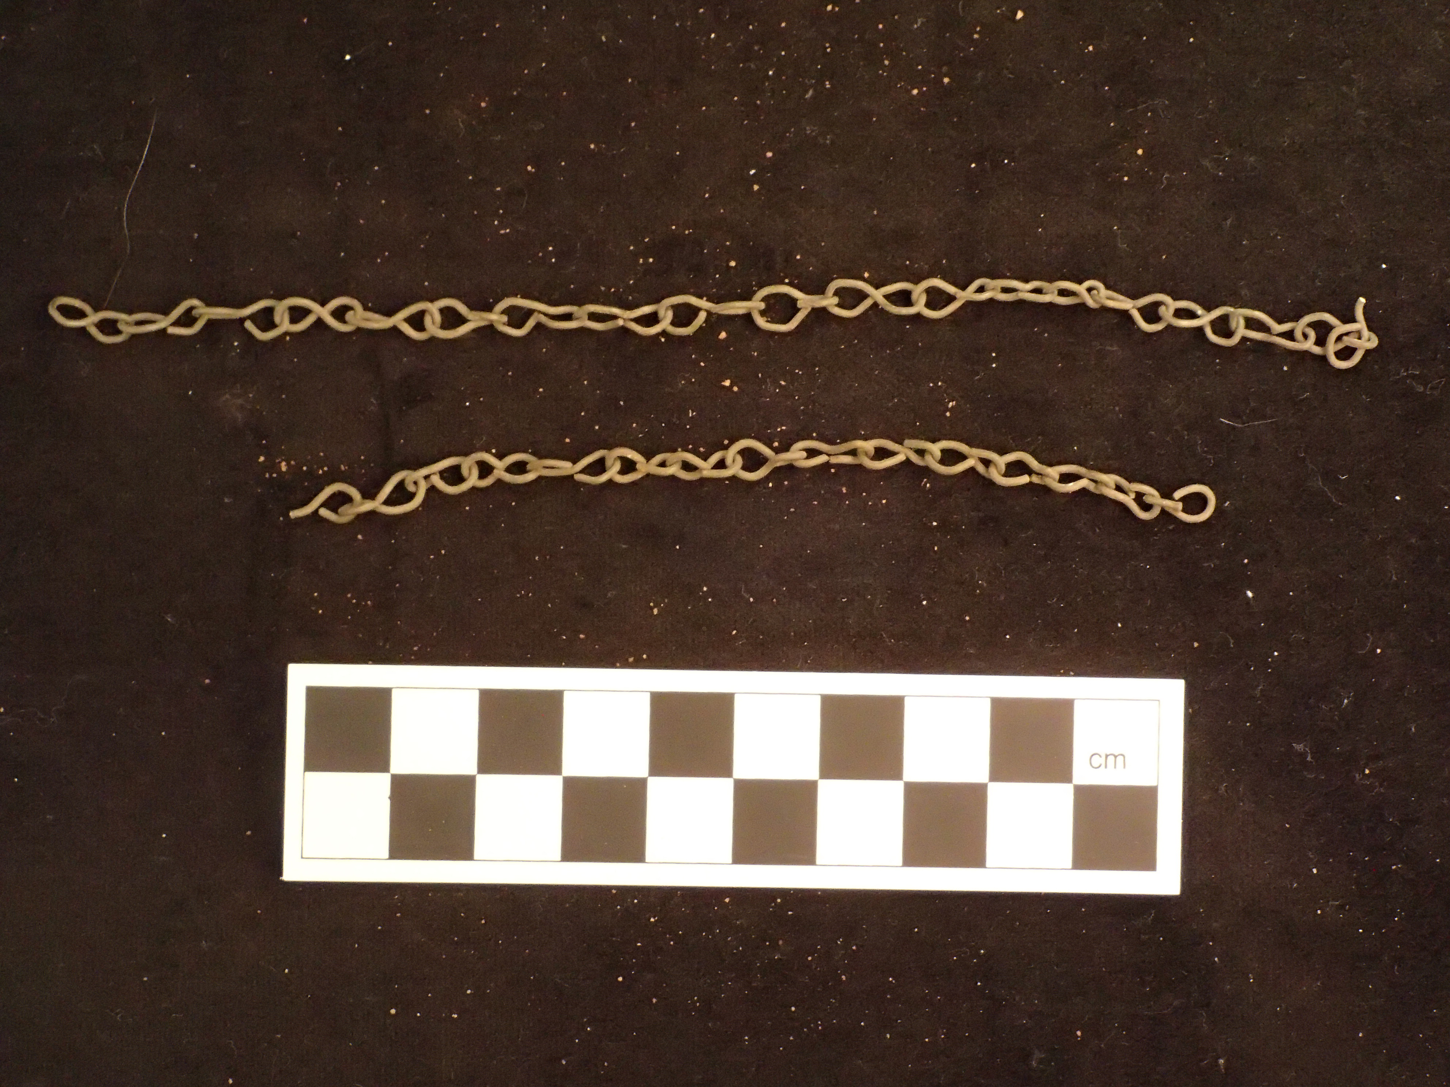
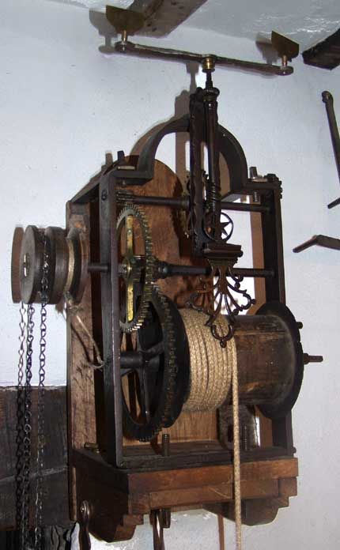
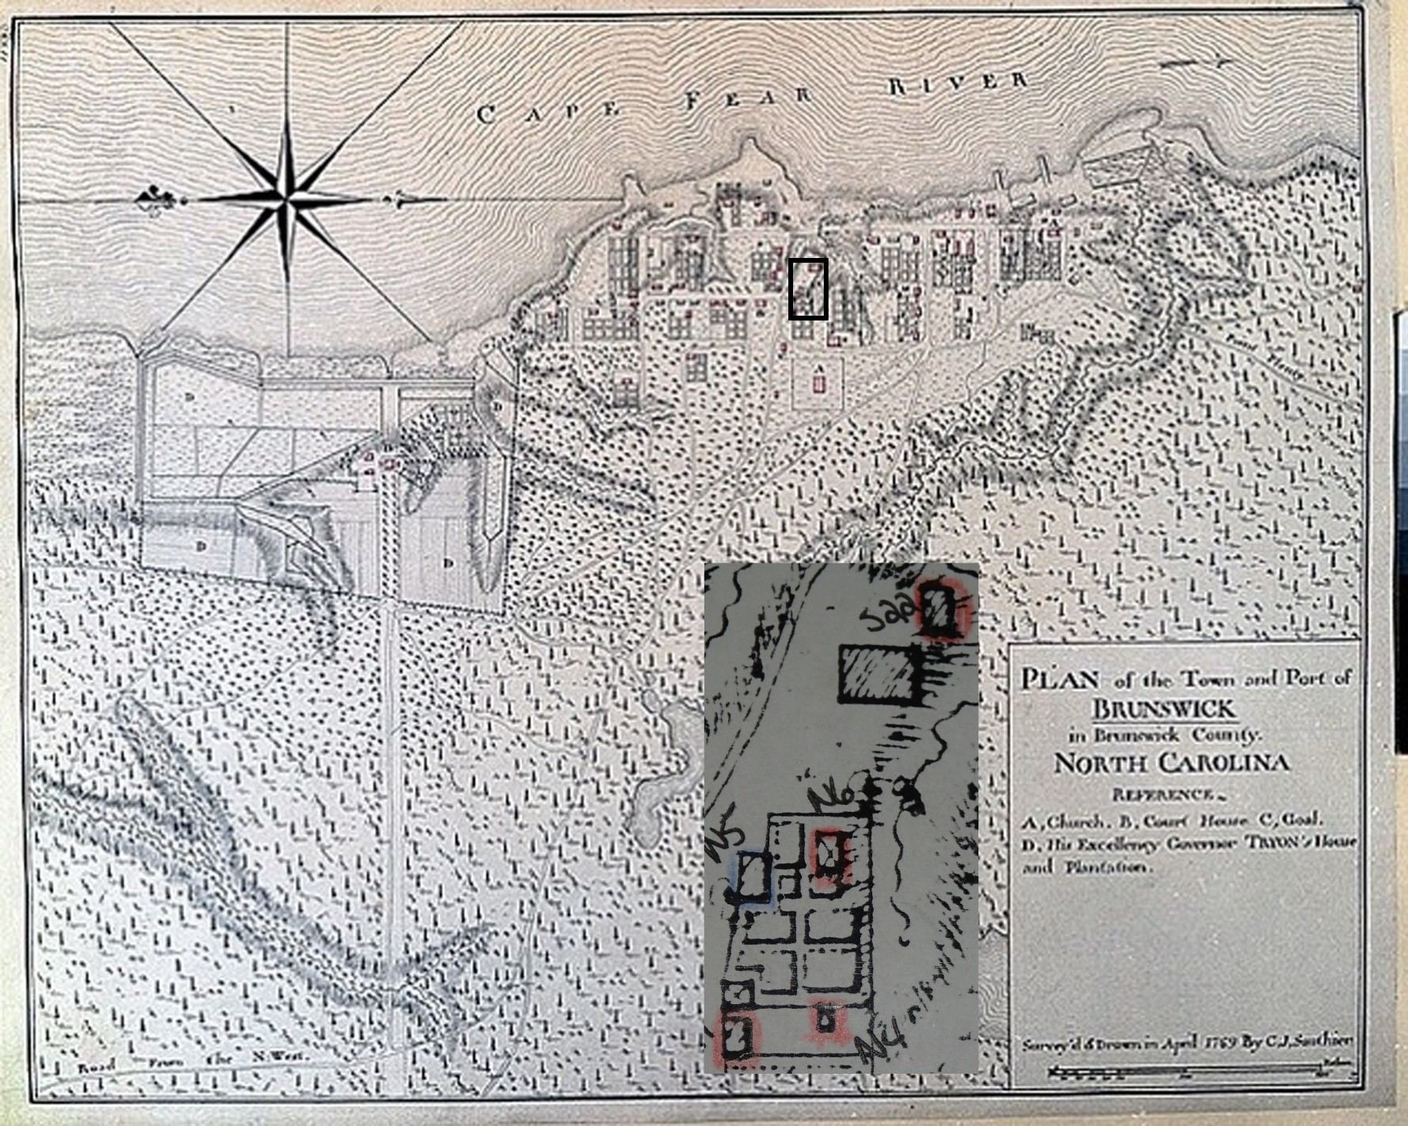
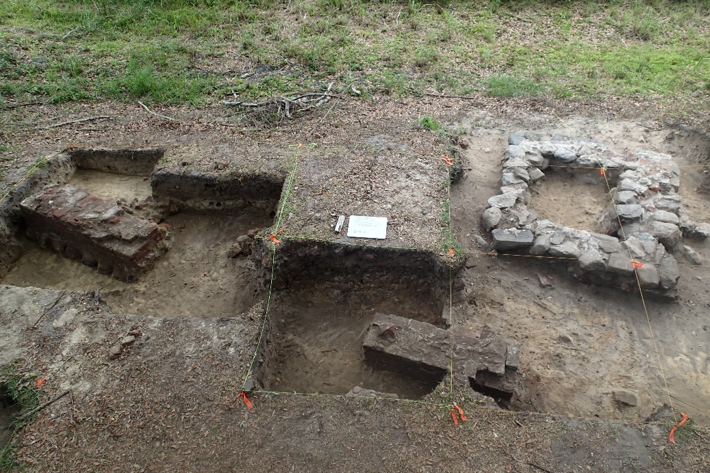
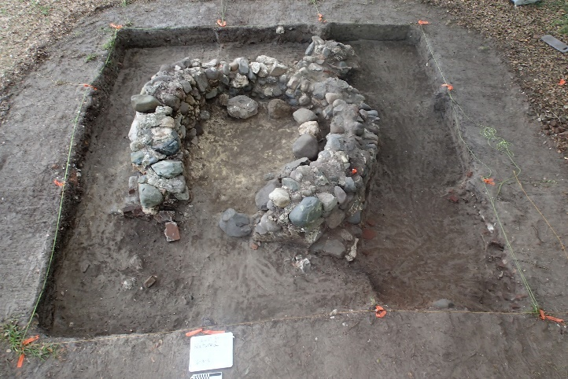
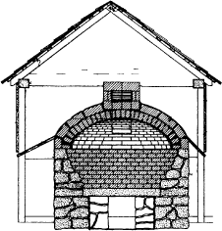
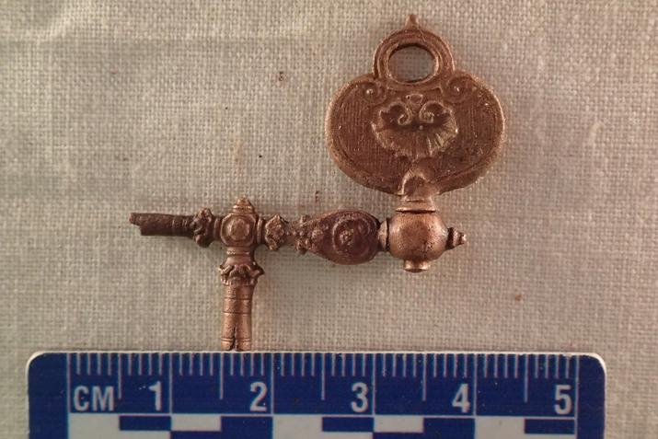
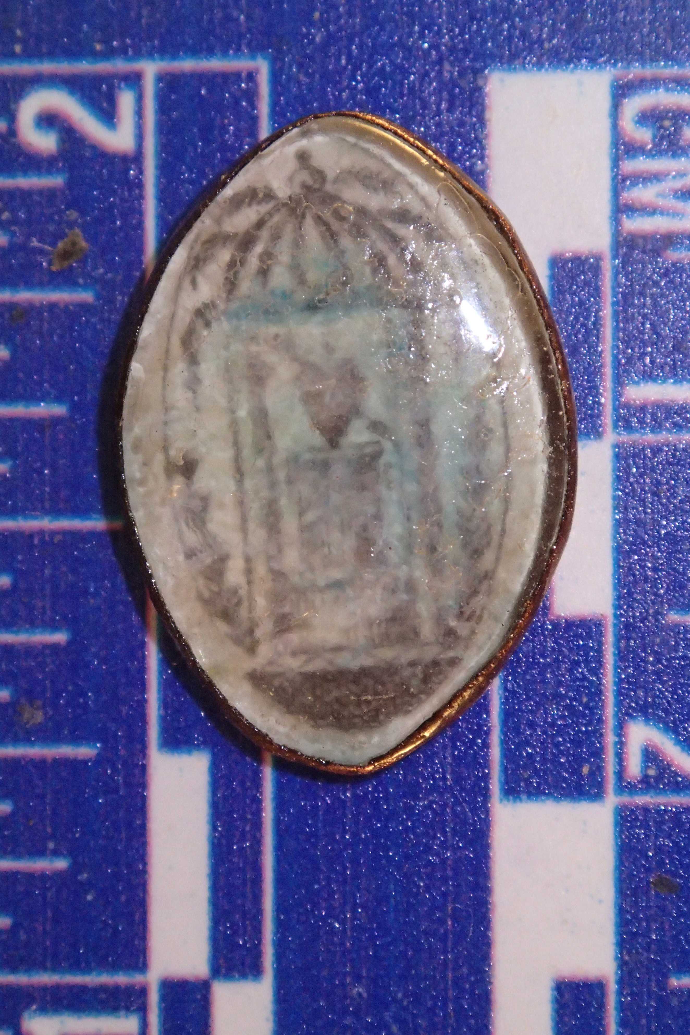
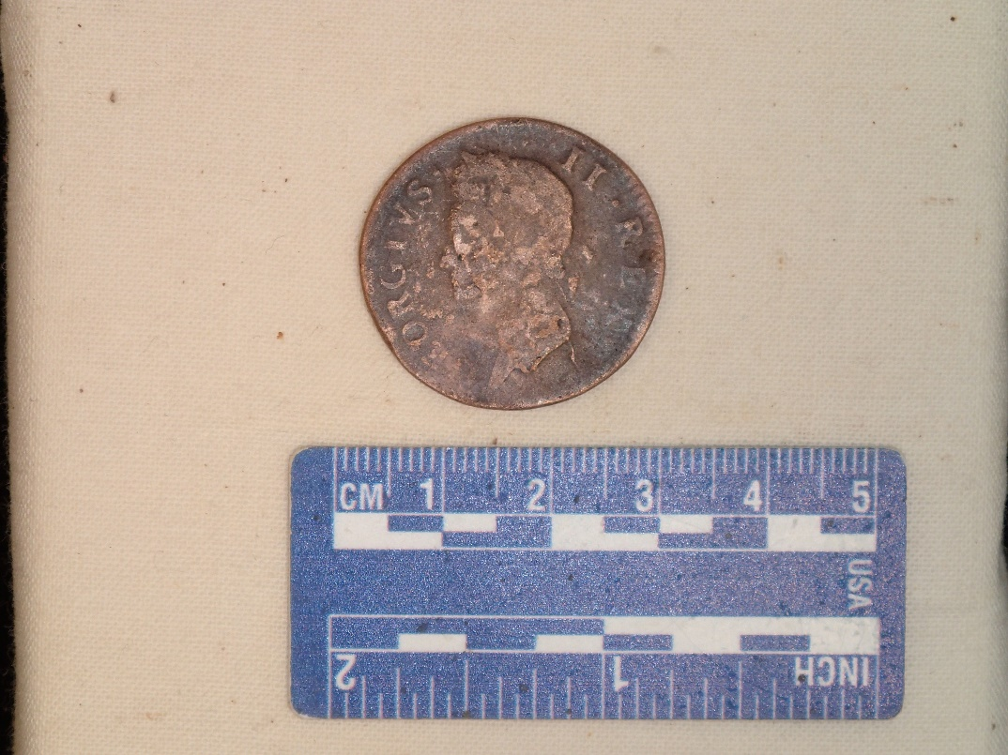


BRUNSWICK’S BAKERS: THE ARCHAEOLOGICAL INVESIGATION OF A DWELLING AND BAKE OVEN AT LOT 35 IN BRUNSWICK TOWN STATE HISTORIC SITE
Andrew J Holloway- Department of Anthropology (Dr. Charles Ewen- Advisor)
Introduction
This past summer, archaeologists
and students from the
Department of Anthropology
at East Carolina University traveled
to Brunswick Town/Fort Anderson
State Historic Site to investigate the
proposed location of the Edward
Moseley house under Dr. Charles
Ewen. A seemingly articulated pile
of ballast stones had been identified
by archaeologists and researchers while preparing the documentation to place Brunswick Town on the National Register of Historic Places in 1973 (Flowers 1973). However, the story that we uncovered was far more exhilarating than the twilight years of an old politician. Halfway through excavations, the recovered evidence forced the researchers to change the interpretation of the site from Edward Moseley’s Lot 34 to Lot 35. By the end of the field season, archaeologists uncovered the remains of a house (structure N5) along with an associated bread oven.
Background
The Town of Brunswick was the brainchild of Maurice Moore, the son of Governor James Moore of South Carolina. Founded in 1725, the town was built on a high bluff at the mouth of the Cape Fear River. Throughout its existence, Brunswick would become the capital of both New Hanover and Brunswick Counties, the principal port in the North Carolina colony, and the de-facto capital of the North Carolina colony when Royal Governor Artur Dobbs moved to Russelborough plantation adjacent to the town in 1758. The forests of longleaf pine surrounding the settlement ensured the importance of Brunswick as an exporter of waterproofing agents comprising the royal naval stores. Wood products, specifically sawn logs, were also a major export from Brunswick. Other exports included peas, corn, indigo, bread, flour, and flax. Imported in return were manufactured goods including cloth and tableware as well as sugar, wine, rum, and salt (Angley 1993:18).
Lot 35
Maurice Moore, the original grantee, deeded Brunswick town lot 35 to Christopher Cains in 1764 (New Hanover County Deed Books 1764). A year before, Cains was mentioned as a blacksmith but as time progressed, his social status rose. In 1769, he was mentioned as "Coroner" and by 1772, he was known as "Sheriff" (Lee 1965: 190). As a high-ranking official, Christopher Cains’ fortunes were directly linked to the governor, William Tryon. Thus, Cains was a staunch loyalist throughout the end of the colonial period, a position that certainly would have extended to his business dealings.
The true identity of the baker on lot 35 might never be known. As the owner of the lot in the 1760's, Elizabeth, the wife of Christopher Cains is a likely candidate. Tax evidence indicates that the Cains’ purchased three slaves between 1769 and 1772 (Miles 2002). This purchase coincides with the regulation in the Carolina piedmont and a rise in bread exports from Brunswick.
By 1775, many residents of the Cape Fear region had become patriots. That same year, the still loyal Christopher Cains sold Lot 35 to Prudence McIlhenny, a resident of Brunswick with links to local tavern keeper James McIlhenny (Brunswick County Deeds, 1775). Prudence likely continued producing bread on the site until her death sometime before 1785 (Brunswick County Deeds, 1785). As a loyalist to the end, Cains' fortunes continued to decrease as the tide of war turned. By 1787, the last of his property was sold at public auction (DeMond, 2009 :243). Shipments of bread continued to leave Brunswick until 1787, long after Brunswick supposedly dissolved in 1776. The last recorded shipment of bread along with building materials and other provisions left Brunswick in 1787 bound for the Eusebio, Guyana near modern day Georgetown (Imports and Exports 1787).
The Remains of Lot 35
The excavations at Lot 35 yielded a total of 19,477 artifacts and ecofacts ranging from ceramics, coins, artillery shot and shell along with everything in between. Artifact patterning analysis along with other tools such as mean ceramic date and pipe stem analysis determined that Structure N5 was the habitation of upper middle class individuals from the mid to late 18th century. This hypothesis was corroborated by the
prescience of expensive ceramics such as porcelain and personal items such as wig curlers, cut glass jewelry pieces, an glass buttons. The kitchen hypothesis was corroborated by the prescience of cast iron cauldron fragments, hardware along with items such as jaw harps, pipes, and wine bottles likely used to pass the long hours observing the baking process.
Discussion
Previous research conducted by Stanley South identified David Jones and a Prudence McIlhenny (or Mackland) as previous residents of the lot. (South 1961:2) David Jones was mentioned in the transfer of Lot 77 occurring in 1775 between Christopher Cains and Prudence McIlhenny as someone “residing in” a house that most likely was structure N5 as a renter (South 1964). In the deed of sale, McIlhenny was listed as a “citizen of Brunswick.” (Brunswick County Deed Books 1775) Port records have indicated that bread as well as other foodstuffs were exported in addition to the naval stores along with timber products between 1765 and 1775. (Lee 1965:149) This information and the presence of the oven on private land may be indicative of a commercial baking operation on Lot 35.
References Cited
Angley, Wilson F.
1998 A History of the Brunswick Town/Fort Anderson Site in Brunswick County, North Carolina. North Carolina Department of Archives and History, Raleigh
<http://digital.ncdcr.gov/cdm/ref/collection/p16062coll6/id/4874>. Accessed 15 November 2016.
DeMond, Robert O.
2009 The Loyalists of North Carolina During the Revolution. Genealogical Publishing, Baltimore, MD.
British National Archives
Ledgers of Imports and Exports, America. Records of the Boards of Customs, Excise, and Customs and Excise, and HM Revenue and Customs, CUST 16/1, < http://discovery.nationalarchives.gov.uk/details/r/C307774>, British National Archives, Richmond, UK.
Lee, Lawrence E.
1965 The Lower Cape Fear in Colonial Days. The University of North Carolina Press, Chapel Hill, NC.
Miles, Natasha
2002 1769 Brunswick County, North Carolina Tax List. NC GenWeb, Brunswick < http://www.ncgenweb.us/brunswick/1769tax.html>. Accessed 30 November 2016.
Miles, Natasha
2002 1772 Brunswick County, North Carolina Tax List. NC GenWeb. Brunswick < http://www.ncgenweb.us/brunswick/1772tax.html>. Accessed 30 November 2016.
Above: Photo of the “Edward Moseley Ruin” before excavations began. The remains were identified as a bread oven after excavation.
Above and right: A small copper chain recovered next
to the oven was possibly used as a spitjack
chain for roasting cuts of meat (Photo from
https://www.pinterest.com/pin/319896379756119734/.)
Above and Background: the 1769 CJ Sauthier map of Brunswick. The detail shows
the location of Lot 35 and the immediate area.
Above: Lot 35 excavation site map. The remains of structure N5 consisted of a series of brick piers.
Only the foundation of the oven remained
Top: The remains of structure N5.
Bottom left and right : The remains of the bread oven at Lot 35 and a conjectural cutaway of what the oven may have looked like (Oven sketch from McGraw-Hill Dictionary of Architecture and Construction http://encyclopedia2.thefreedictionary.com/brick+oven
Above left: Pocket watch winding key.
This artifact was attached to a chain secured
to a gentlemen’s vest
Above center: Decorative Glass button
Above right: Face side of a 1750 King
George II Irish Copper Halfpenny

