Slide 1
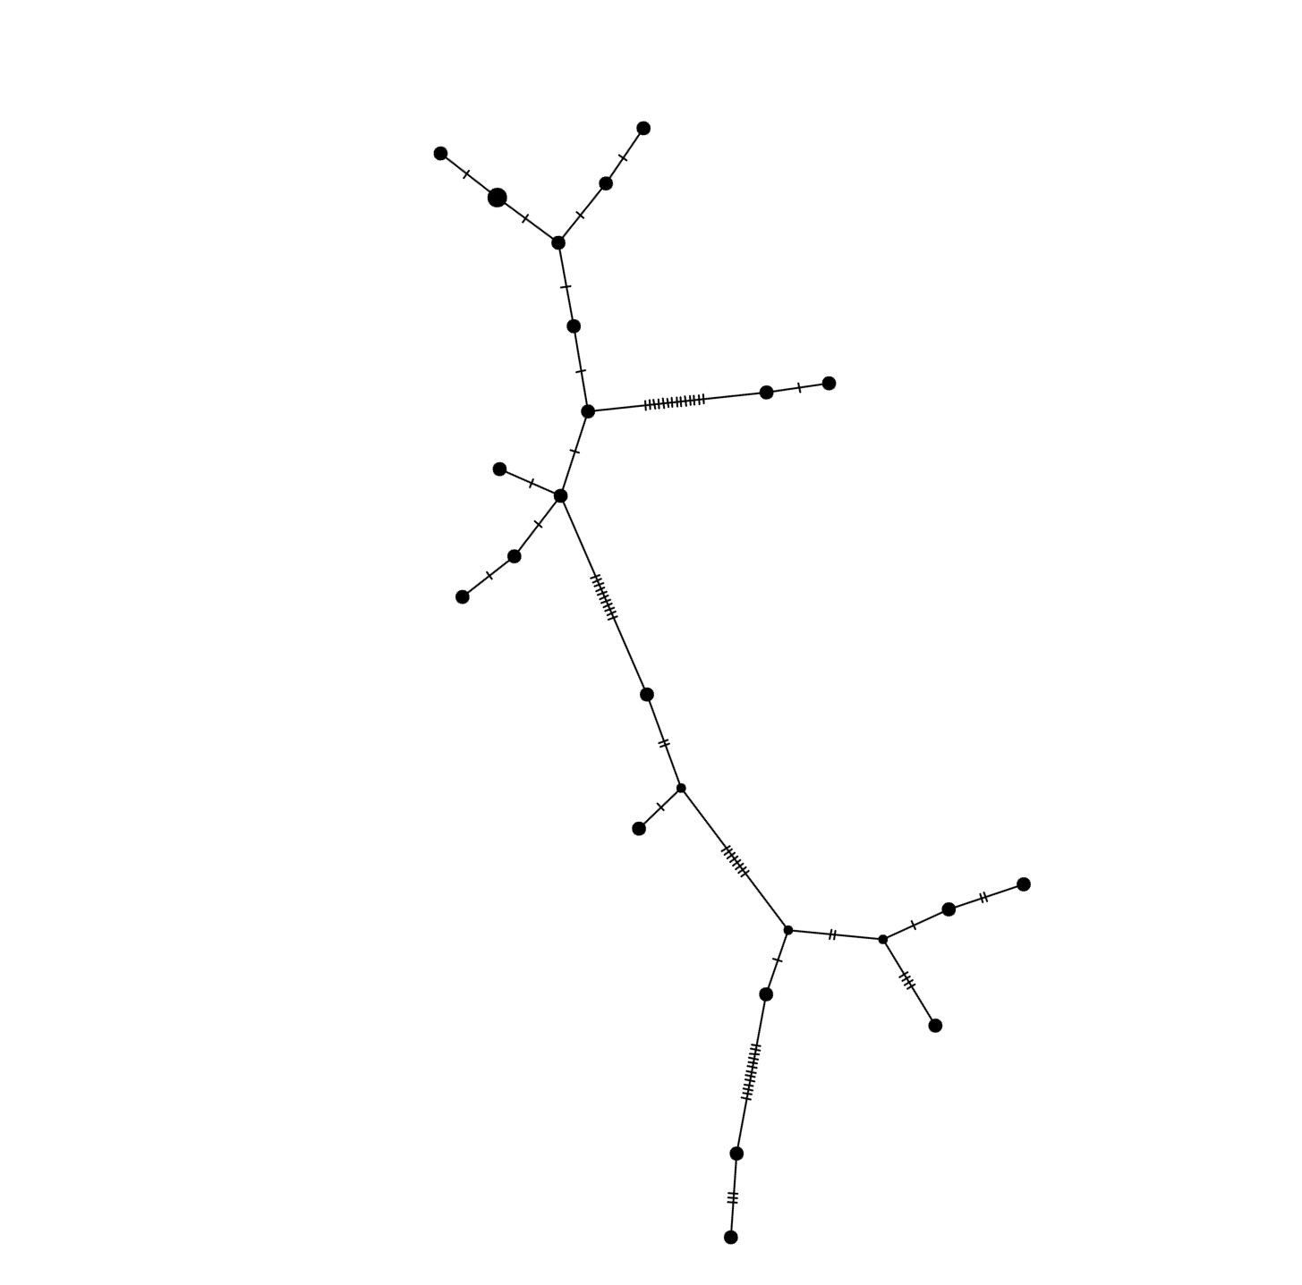
Sequencing and comparative analysis of the mitochondrial cytochrome b gene in the Marion Uplands Florida sand skink (Plestiodon reynoldsi)
Taylor Locklear
(mentored by Trip Lamb)
Department of Biology, East Carolina University
Abstract
The Florida sand skink (Plestiodon reynoldsi)—a small (~10 cm) lizard endemic to the peninsula—is a ‘sand-swimming’ specialist restricted to Florida scrub habitat on the state’s central highland ridges. Florida scrub (Fig. 1) has been severely fragmented through urban growth and citrus farming, and less than 10% of this ecosystem remains. Given the skink’s limited geographic range (Fig. 2) and extensive population fragmentation, P. reynoldsi was listed as a federally threatened species in 1987. I surveyed skink populations from the Marion Uplands, where suitable lizard habitat is naturally (and has been historically) isolated from scrub on nearby Mt. Dora and Lake Wales ridges (Fig. 2). I wanted to determine genetic relatedness of Marion Uplands skinks to those inhabiting these two ridges and hypothesized that Marion populations should be more similar genetically to those on the Mt. Dora ridge, given their geographic proximity. Mitochondrial DNA sequence analysis confirmed this hypothesis but also revealed unexpectedly high levels of genetic divergence between the Marion and Mt. Dora populations. Indeed, observed genetic divergence was comparable to that detected between Marion and Lake Wales populations.
Methods
I isolated DNA from clipped tail tips (N = 23) provided by Paul Moler, a herpetologist with the Florida Game and Fish Commission, who processed and released skinks at their capture sites (Fig. 3). I amplified and sequenced a 405 nucleotide segment of the mitochondrial DNA gene cytochrome b (cytb), an informative genetic marker used in previous population genetic surveys of this species. I aligned and analyzed the Marion Uplands sequences in conjunction with published cytb data for skinks from the Mt. Dora and Lake Wales ridges to determine patterns of genetic relatedness.
Results
I identified 11 cytb haplotypes among the Marion Uplands samples; specimens collected from the same location (and nearby) often shared the same haplotype. A network analysis (median joining network) linking Marion, Mt. Dora, and Lake Wales haplotypes supported the hypothesis that Marion and Mt. Dora populations are more closely related (Fig. 4). However, the degree of genetic divergence between them—at 3.5%—was higher than expected, approaching values observed for Marion and Lake Wales haplotype comparisons (4-5%). Thus, the cytb data on the Marion Uplands skinks revealed genetically distinct populations and contribute significantly to the overall evolutionary profile of this threatened species. In turn, these findings will help refine conservation strategies for Plestiodon reynoldsi and its scrub habitat.
Mt. Dora
ridge
Marion
Uplands
Lakes Wales
ridge
Fig. 2. Geographic range of Plestiodon reynoldsi
imposed over Florida’s major ridges.
Fig. 3. Collection localities for skinks from the Marion Uplands (delimited by red oval). Sites 001 and 002 are on the Mt. Dora ridge.
Fig. 4
Lake Wales
Marion Uplands
Mt. Dora
Fig. 1. Florida scrub, the sand skink’s habitat,
with a close-up aspect; skinks would likely be
found in sand just underneath the foliage.
Fig. 4. Network depicting relatedness among skink haplotypes. Hatch marks represent nucleotide substitutions.

