Slide 1

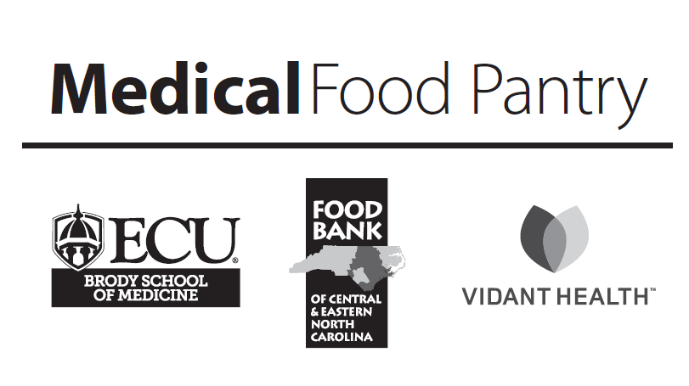
Medical Food Pantry Volunteer Training
Module 2 Healing Food
to gain an understanding of what makes a medical food pantry SPECIAL
September 2018
September 2018

Slide 2
Thank you
for agreeing to be
a Volunteer
at the Medical Food Pantry located at
Vidant Medical Center
September 2018
September 2018

Slide 3
Complete this module to have a better understanding of the special role the Medical Food
Pantry can play in the lives of patients
Healing Food
Module 2
At the end of this module
you will be ready to:
Describe the difference between a food bank and a food pantry
Describe the medical food pantry’s special mission.
Serve as a food safety volunteer if you choose to complete an 1 hour online food safety training from NC State University
Explain the contents of three different emergency bags distributed by the pantry
Describe the foods asked for in a food drive
Briefly explain the value of healthy eating for people with diabetes, heart failure, high blood pressure and recovering from illness or surgery
September 2018

Slide 4
Topic 1:
Overview
September 2018

Slide 5
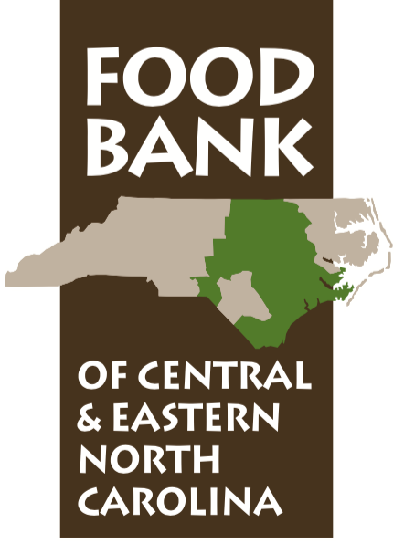
What is a
Food Bank?
Private, nonprofit organization founded in 1980
County branch facilities:
  Craven
  Durham
  Moore
  Pitt
  New Hannover
Rural Delivery Sites:
  Goldsboro
  Henderson
  Rocky Mount
  Sanford
  Tarboro
Learn more about the FOOD BANK and their
Greenville Branch
at their website:
www.foodbankcenc.org
September 2018

Slide 6
Vi
Partner Agencies
The Food Bank does
not directly serve
Individuals but
provides resources to
750 partner agencies
(see examples in diagram)
in 34 counties
in Central and
Eastern NC
Vidant Health and ECU are
Partners with the Food Bank’s Medical Food Pantry located at Vidant Medical Center
Emergency food pantries
Day care centers
Soup kitchens
After school programs
Emergency shelters
Group homes
Elderly nutrition sites
September 2018

Slide 7
Sources of food
for the Food Bank
Manufacturers:
General Mills, Kellogg Co., Kraft Foods, Inc., ConAgra Foods and others
Companies:
Target Corp.,
Wal-Mart Stores Inc., Food Lion LLC, The Kroger Co. abd itgers
Local support:
Community Food Drives with schools, grocers, letter carriers, religious, civic and professional organizations, and major corporations
Find out what donations the Food Bank can accept
www.foodbankcenc.org/site/PageServer?pagename=donate_food
September 2018

Slide 8
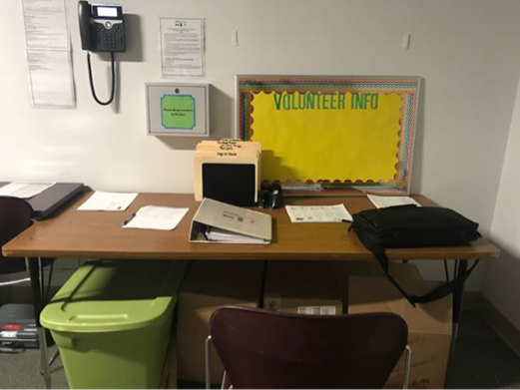
Medical Food Pantry located at
Vidant Medical Center
The Food Bank of Central & Eastern North Carolina is the “owner” of the Medical Food Pantry located at Vidant Medical Center.
If you have not read the white policy manual, please do. It is kept on the desk
in the food pantry and is also available
in this online course/EAHEC website
Our Medical Food Pantry is an
EMERGENCY pantry for patients of
Vidant Health and ECU Physicians, who:
  have been screened by a health care professional
  are deemed to be food insecure and
  would benefit from Food As Medicine
September 2018

Slide 9
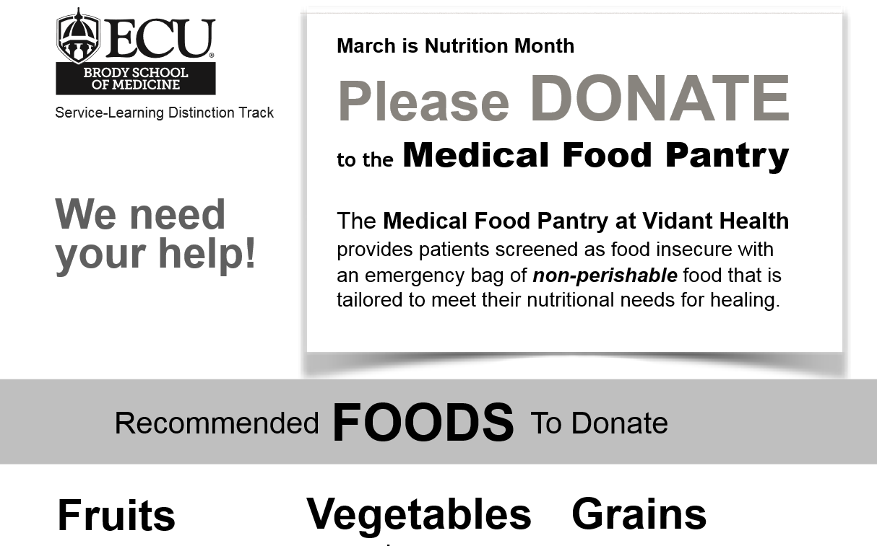
Food as Medicine: tailored to meet nutritional needs for healing
More about types of
Donations needed
Later in this module

Slide 10
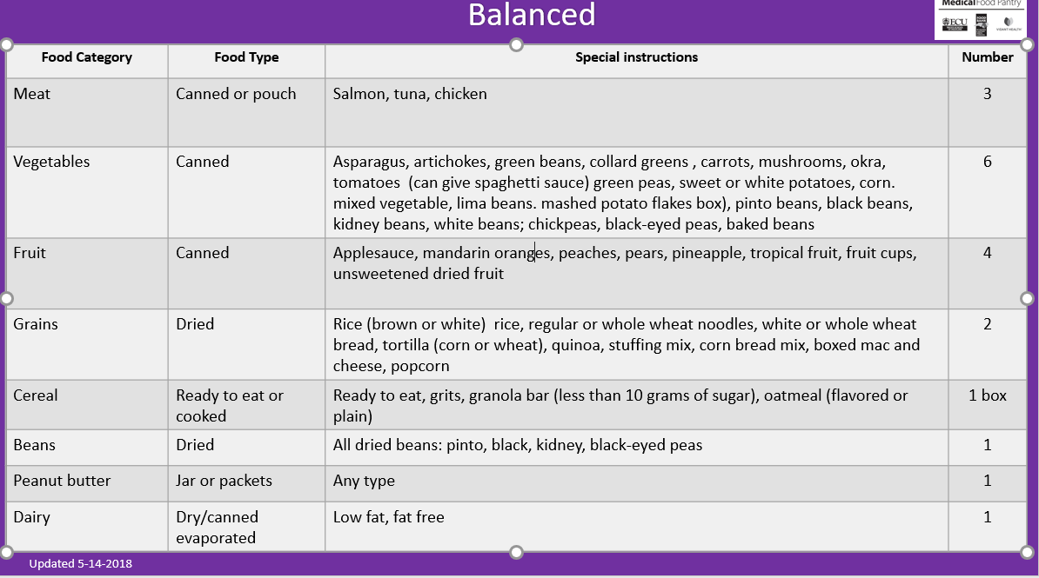
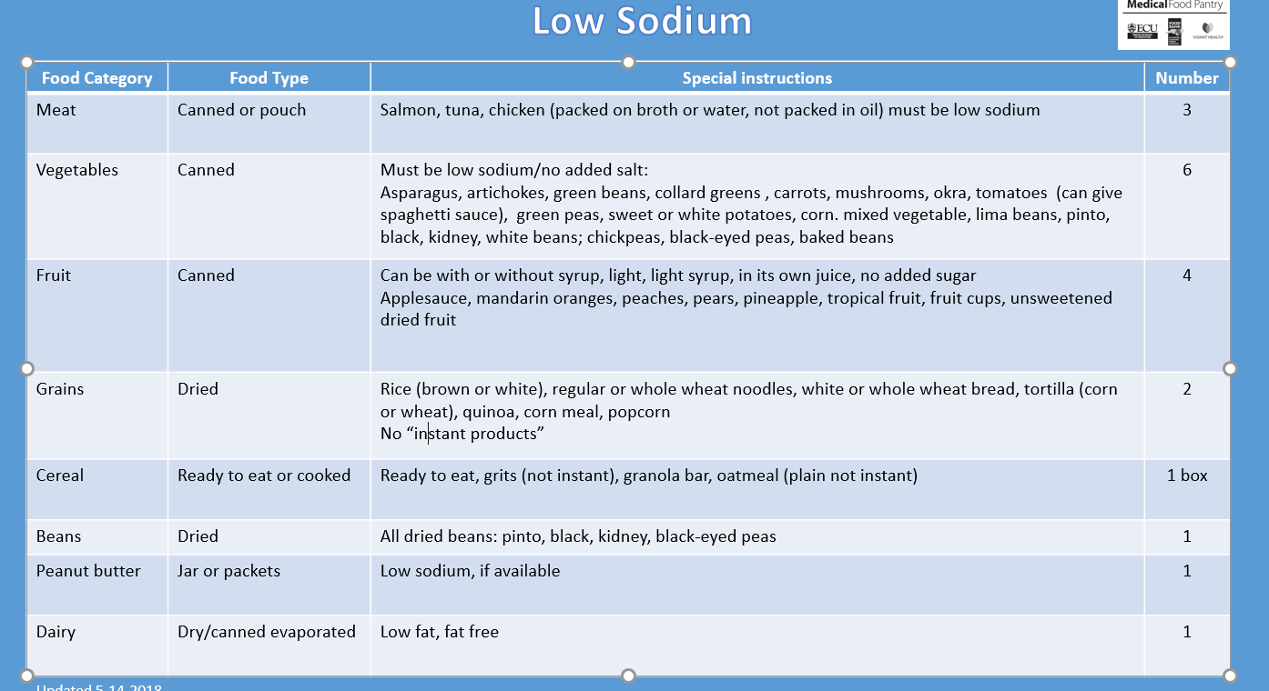
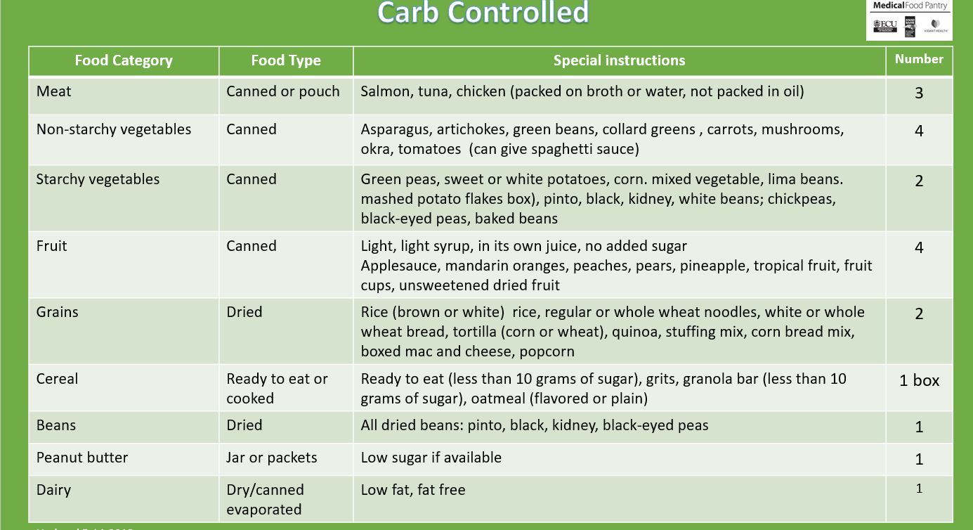
Medical Food Pantry
Food Sources
The Medical Food Pantry fills three “prescriptions” for food: Balanced, Low Sodium and
Carb-Controlled
We accept all donations of foods but will only distribute those deemed as “healthy”
by the Registered Dietitian Nutritionists from ECU Physicians and Vidant Health
Other donated foods will be given to the Food Bank
The food is obtained by
  Food Drives conducted by Brody School of Medicine and other students at least three times a year;
  Drives sponsored by departments within Vidant Health and ECU; and
  By purchase from the CE&NC Food Bank
  at a cost of $0.17 per pound
September 2018

Slide 11
Food Bank Policy
Unauthorized Use
of Food Bank Product
Food bank product is donated for the sole purpose
of feeding the needy, ill or infants
Religious organizations cannot use Food Bank product for religious functions
Food Bank Staff cannot consume this food unless they are working in a group home or shelter when the clients are served. However, if a staff member has an emergency need, food may be distributed.
The product may not be used for fundraising
Agencies may only distribute food to clients, they cannot supply other food pantries or other organizations
Volunteers may not receive food in exchange for
their service. If a volunteer has a need, they must obtain it in the same way as other clients with “no cherry picking”or special privileges
September 2018

Slide 12
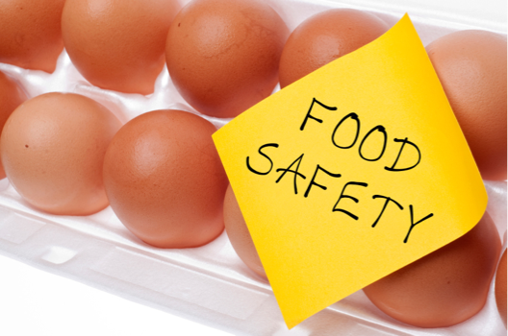
Food Bank Policy
Food Safety Course
Everyone involved in handling food would benefit from completing the course. If you choose to…
The link to the Course is https://foodsafety.ces.ncsu.edu/food-pantries-and-food-banks
Our agency number is: AG3351.
The link to the Test is https://www.classmarker.com/online-test/start/?quiz=y4q56b27a0de919e. You must score 70% or above to pass.
Once you pass the test, the Food Bank will automatically receive a copy of your Certificate of Completion.
Please keep a copy on file for your records.
Submit a copy to myroupe@vidanthealth.com
This certification will expire after two years.
At least one volunteer
must have completed the
NC State online course on
food safety for Food Banks
September 2018

Slide 13
Food Safety for
Food Bank Course
What you will learn if you take the course
This online course in 4 parts, with test, takes about
45-60 minutes to complete.
At this time the Medical Food Pantry only has DRY STORAGE but the information on storing perishable foods is good to know
1
Part
What Food Pantries do for the community
Key terms concerning food safety
Those at a higher risk of illness due to
lack of food safety
Introduction to past-date foods usage
Part
Safe temperatures for refrigerators, freezers, & dry storage
First In, First Out rule
Usage of cans that are dented, without labels, etc.
Proper sanitization to prevent cross-contamination
2
September 2018

Slide 14
Food Safety for
Food Bank Course
What you will learn
This online course in 4 parts, with test, takes about
45-60 minutes to complete.
3
Part
What Food Pantries do for the community
Key terms concerning food safety
Those at a higher risk of illness due to
lack of food safety
Introduction to past-date foods usage
Part
Food dating
Mishandling of food
Storage of food
Refrigeration and freezing of food
4
September 2018

Slide 15
Food Safety Course
Helpful tips
for completing
the course
and test
Wear headphones
The educational videos have sound; you need to listen carefully to them to learn!
Set aside enough time
Complete the course in one sitting
The full course and post-test take about an hour to complete!
September 2018

Slide 16
The Food Bank
GOOD
MANUFACTURING
PROCEDURES
POLICY
All personnel are
encouraged to
practice good
personal hygiene
AT ALL TIMES.
Restroom to wash hands
Is in the front lobby
All employees, volunteers, and visitors (hereafter “personnel”) must adhere to the following requirements in order to avoid becoming a source of contamination.
Personnel shall wash hands with soap and warm water before beginning work, and after eating, drinking, smoking, using the restroom, or otherwise soiling hands.
Personnel shall eat, drink and use tobacco products only in designated areas. Personnel shall not bring food, beverages or personal belongings
into a Pantry Area.
Personnel shall not place any personal items in any cooler or freezer used for product storage or distribution.
Personal items shall be stored in designated areas.
Personnel having boils, sores, infected wounds or any other infection or communicable disease shall not handle food.
Personnel shall notify a supervisor of any infectious disease or conditions
to which they may have been exposed.
Possession of firearms or dangerous weapons of any type are strictly prohibited at all times on our property. Should someone discover an individual carrying a weapon while on Food Bank property, he/she should inform the nearest manager or supervisor.
Signature: ____________________________________ Date: ____________________
September 2018

Slide 17
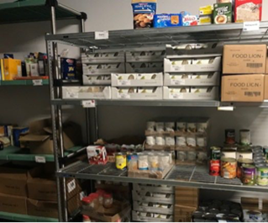
The Food Bank
Policy for
storage and handling of
Product
This policy is followed at
The Medical Food
Pantry
Dry Storage
More than 6 inches off the floor and
away from walls
Use metal or wooden shelves, cabinets
or wooden pallets
Must be secured (locked)
Stored at temperatures near 70 degrees F leads to longer shelf life
Stocking shelves—First in First Out
Dented cans with broken seals are not distributed
September 2018

Slide 18
Topic 2:
Food Drives to Benefit the Medical Food Pantry located at VMC
September 2018

Slide 19
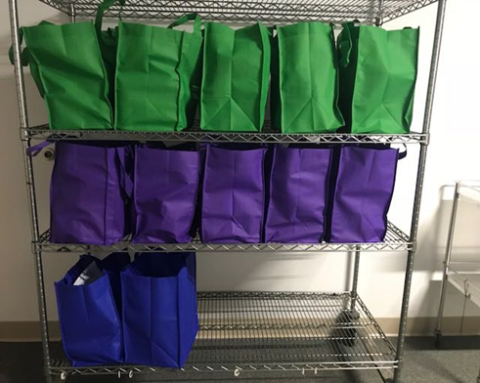
Food Drive Purpose
Collect foods to fill Food Bags with shelf stable healthy foods
Patients will receive one of three “prescribed” diets
  Carbohydrate controlled healthy
  Low sodium healthy
  Balanced
Each bag will have about 20 items in it,
for a total weight of about 20 pounds
Those foods provide:
  About 23,000 healthy calories in each bag
    Most adults need 2,000-2,500 calories per day
About 850 grams of protein
  Most adults need about 60 grams of protein a day
  Healing takes more protein, perhaps 90 grams a day
September 2018

Slide 20
Food Drive
Food
Donations we ask for
The Dietary Guidelines for Americans recognize that all forms of fruits and vegetables—fresh, frozen, canned and dried can be healthy
Fruit: canned or dried
(prefer: light, in its own juice,
no added sugar)
Applesauce
Mandarin oranges
Peaches
Pears
Pineapple
Tropical fruit
Fruit cups
Unsweetened dried fruit,
like raisins, apricots,
apples etc.)
Canned vegetables
(prefer “no added salt”)
Asparagus
Artichokes
Green beans
Collard greens
Carrots
Mixed vegetables
Mushrooms
Okra
Tomatoes
Spaghetti sauce
September 2018

Slide 21
Food Drive
Food
Donations we ask for
Meat / Meat substitute
Canned chicken breast
(low sodium a plus)
Canned or packaged salmon and tuna (in water, low sodium a plus)
Peanut butter
(no sugar added and low sodium a plus)
Nuts and seeds (peanuts, sunflower seeds, almonds, walnuts, unsalted a plus)
Starchy vegetables
canned, bagged, boxed
no added salt preferred
Corn
Lima beans
Mashed potato flakes
Pumpkin
Sweet potatoes
White potatoes
Sweet peas
All dried beans: pinto, black, kidney, white beans; chickpeas, black-eyed peas
All canned beans: pinto, black, kidney, white beans; chickpeas, black-eyed peas
Lentils
Baked beans without pork a plus
Dairy
Dried, powdered, evaporated
in a box, pouch, or can
Milk
(low fat or fat free preferred)
Nonperishable dairy
*Please no glass containers*
September 2018

Slide 22
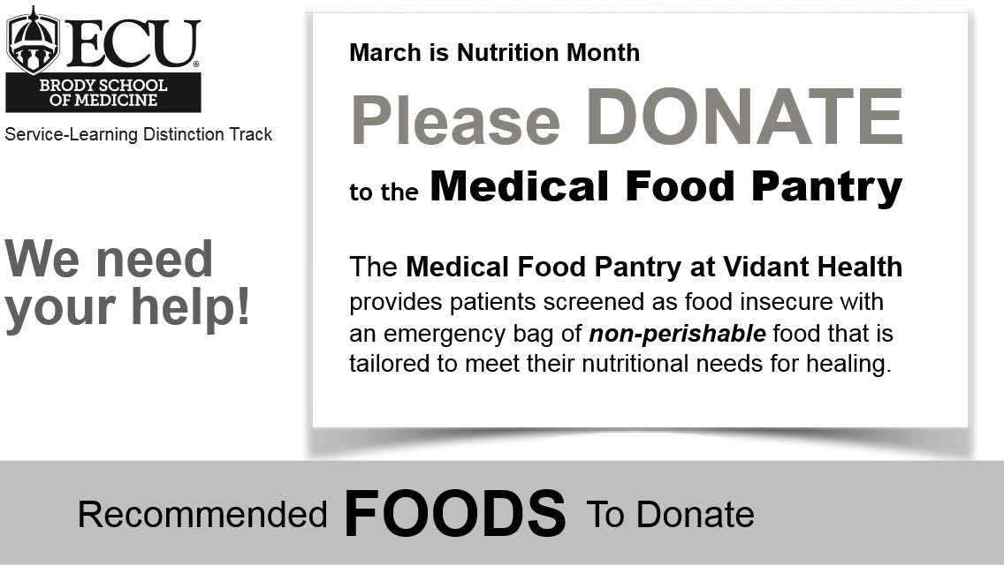
Food Drive
Food
Donations we ask for
Grains
Brown rice
Cereal (<10 g sugar/ serving)
Pasta (Whole Wheat noodles or pasta a plus)
Bread (Whole wheat breads a plus)
Grits, unflavored
Granola bar (<10 g sugar per serving a plus)
Tortilla (corn or wheat)
Quinoa
Oatmeal
(plain unsweetened a plus)
Whole grain crackers
(low sodium a plus)
Stuffing mix
Corn bread mix
Boxed mac n’ cheese
Popcorn kernels
See a sample of a food drive flyer in the
Document section of
this course
September 2018

Slide 23
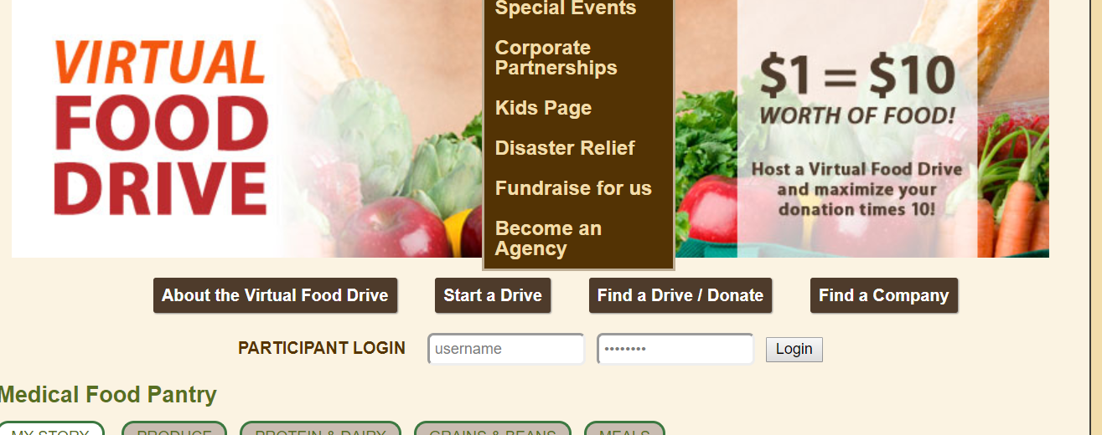
PLEASE
Donate
Food
Money or
Time
The Medical Food Pantry can purchase Healthy Foods in bulk through the Food Bank of Central and Eastern North Carolina--maximizing financial contributions.
Contributions can be made online at
http://www.foodbankcenc.org/goto/medicalfoodpantry
  //////////////////////
September 2018

Slide 24

what is in the bag is
important

Slide 25
Food As Medicine
For people who have been in the hospital eating healthy foods helps in the healing process
Healthy eating during recovery helps a person
feel better physically and mentally. It will help:
Heal your body from damage done by illness or injury , build the immune system back up, and start to treat new or ongoing medical conditions where diet plays a role
Calms the mind, help with your mood, anxiety, depression, and energy level.
Start healthy habits for the self-care and lifestyle changes that will enhance recovery.
September 2018

Slide 26
Food As Medicine
Additional fluids, calories, protein and Vitamin C are are needed for healing.
Almost half the patients in the hospital may
become malnourished.
Nutrition reserves become depleted and food
intake is not enough to meet daily needs for
Optimal health
For patients with severe and multiple wounds,
adequate nutrition is critical as the risk of
depleting nutrition reserves is high.
Under-nutrition results in slow growth/development,
reduced resistance to infection, delayed wound healing
and development of chronic diseases.
September 2018

Slide 27
Fluids As Medicine
Dehydration is a risk factor for pressure ulcer
development.
Adequate fluid intake is necessary to support the
blood flow to wounded tissues and to prevent
additional breakdown of the skin
September 2018

Slide 28
Food As Medicine
For people who have a diagnosed health condition where eating healthy foods helps
There are many diet prescriptions. The ECU
Physicians and Vidant Health dietitians agreed that the three bags balanced, carb controlled and low sodium would help most patients
Some patients who are food insecure have difficulty following the diet prescribed for their health condition because of limited access to healthy food
They are thankful for whatever food others provide and reluctant to ask for healthy food
But without healthy food their conditions only worsen in a vicious cycle
September 2018

Slide 29
Healing Food
Bags are color coded
The registered dietitian nutritionist from ECU Physicians and Vidant Health agreed on the amount and kinds of food to provide
The doctor may have prescribed for the patient as part of their health care:
Diabetes or obesity:
carb controlled/green
No special diet:
balanced/purple
High blood pressure or heart failure: low sodium/blue
September 2018

Slide 30
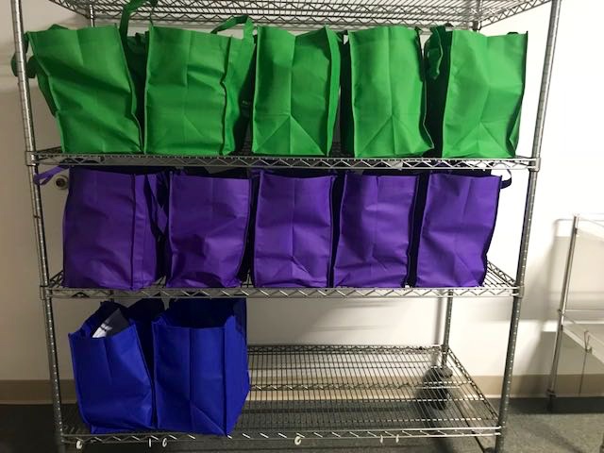
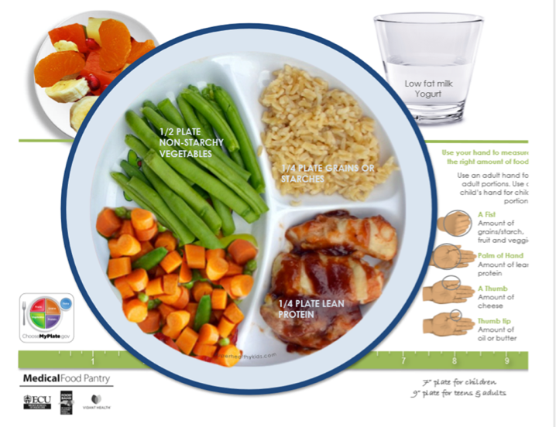
Healing Food
carb-controlled bags
The green laminated card shows the food category and the number of items that will be in the bag
For example, it will have a variety of 3 meat (meat, fish or chicken) items in the bag.
2. There is a copy of the Plate (Build Your Own Healing Box—Carb Controlled)” in the bag
There is at least one recipe labeled as Carb Controlled that uses the meat, vegetable or grain items that is in the bag
September 2018

Slide 31
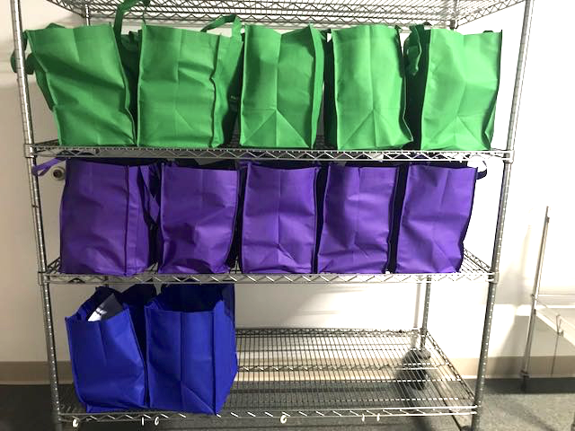
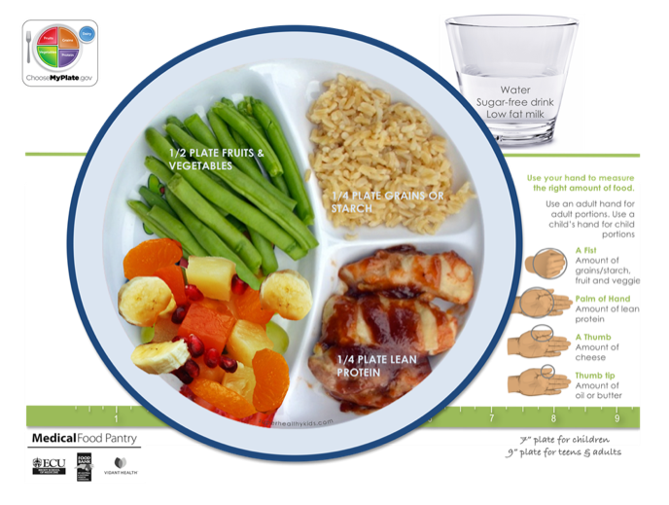
Healing Food
low sodium bags
The blue laminated card and blue bag
shows the food category and the number of items
For example, a variety of 3 meat (meat, fish or chicken) items in bag.
2. A copy of the Plate (Build Your Own Healing Box—Low Sodium)” is in the bag
There is at least one recipe labeled as Low Sodium that uses the meat, vegetable or grain items that you have placed in the bag
September 2018

Slide 32

Healing Food
“No diet prescription”/ balanced Bags
The purple laminated card and purple bag
have the food category and the number of items
For example, a variety of 3 meat (meat, fish or chicken) items in bag.
A copy of the Plate (Build Your Own Healing Box—No diet prescription/balanced) is in the bag
There is at least one recipe labeled as No diet prescription/balanced that uses the meat, vegetable or grain items that is in the bag. All recipes from the file are ok to use in the balanced bag
People who have been ill or injured---even if they do not have a specific diet related condition—need healthy food to heal
September 2018

Slide 33
Build Your Own Healing Box—
Carb Control
Considerations
We help patients know what types of food they should get from their food pantry, friends, family or other organizations
Though we are giving them canned foods,
they may get the same foods in fresh, frozen
or dried forms
Include sugar-free drinks or water to drink
On the Food plate include:
½ non starchy vegetables
a serving of fruit
¼ meats/fish, and
¼ grains
Plate size varies for children vs. adults
Portion sizes can be measured
using the patient’s hand
September 2018

Slide 34
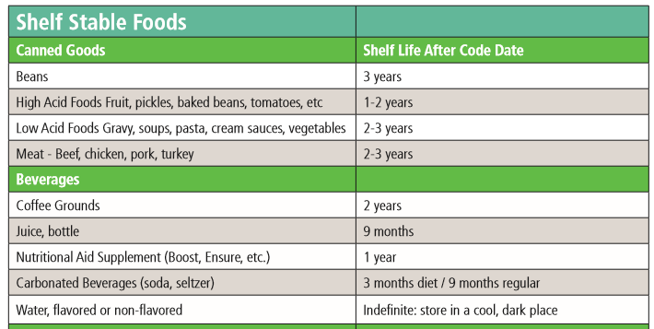
Extension Dates
USDA says foods can be donated and used after expiration date see “Extension
Date” handout from the food bank
The Food Pantry Distributes
shelf-stable foods
that are
Safe to consume
beyond the expiration date
on the product
September 2018

Slide 35

Extension Dates
Manufacturers provide dating like “best if used by” to help consumers and retailers decide when food is of best quality
Do not eat foods that have developed an
odor or off flavor or have visible mold.
Use by Date is not a safety date but indicates peak quality
September 2018

Slide 36
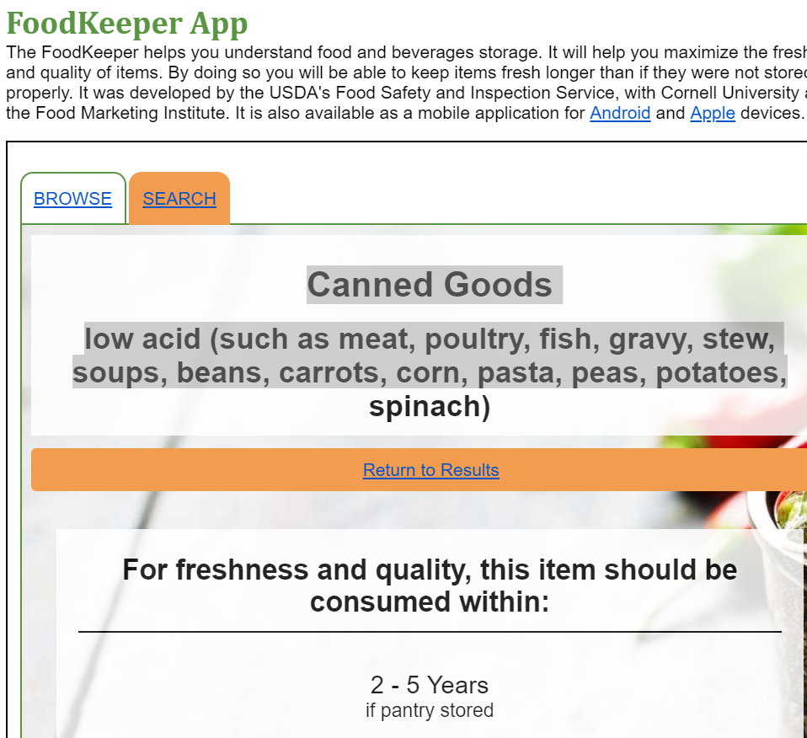
https://www.foodsafety.gov/ keep/ffoodkeeperapp/index.html
You might enjoy using the FoodKeeper
APP to reduce your own
food waste
September 2018

Slide 37
Why does
having enough healthy food matter?
September 2018

Slide 38
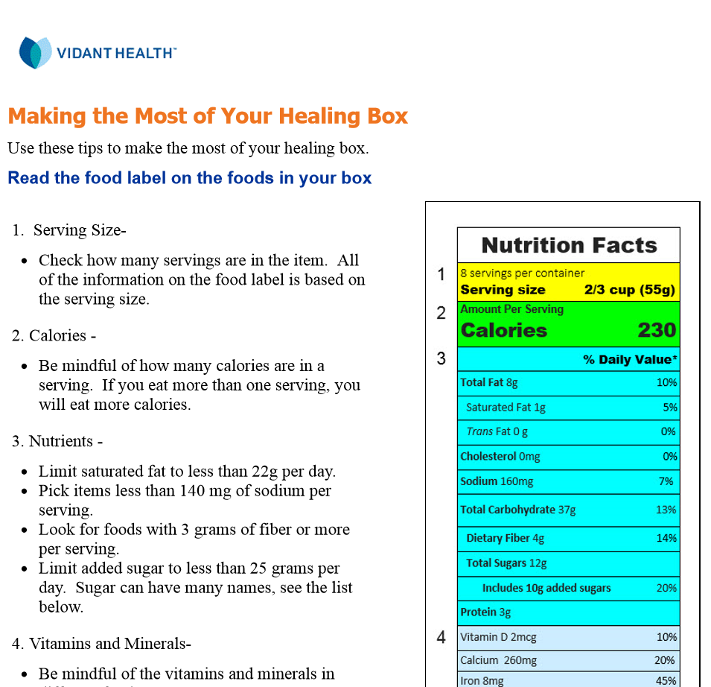
When receiving the voucher the patient will receive a brief instruction from nurse or RDN can see full handout on this website
September 2018

Slide 39
Why might a low sodium diet matter?
Your kidneys filter more than
120 quarts of blood each day.
They pull toxins and unwanted fluid from cells throughout the body, then send them to the bladder.
Eating too much salt
can make it harder
for your kidneys to remove fluid,
which builds up in your system and increases your blood pressure.
September 2018

Slide 40

Over time, excessive salt intake can lead to
high blood pressure (hypertension), which
stiffens and narrows the blood vessels.
Blood and oxygen flow to key organs decreases.
The cycle of damage: How your heart
is affected
by salt intake
The heart tries harder to pump blood throughout the body, which further increases blood pressure.
Elevated blood pressure, over a long period of time, puts a strain on the heart.
It can enlarge the heart’s left pumping chamber
and weaken the heart muscle (heart failure).
Uncontrolled hypertension can also damage the artery walls, which begin to collect fat, leading to heart disease and potentially heart attack or stroke.
The best way to prevent a heart attack is to
stop the arteries from becoming damaged.

Slide 41
What is Diabetes?
Considerations
When diabetes occurs, glucose cannot get into your body cells.
This causes them to lack the energy they need to keep your body working properly.
Glucose is your body’s primary source of energy.
Your body gets glucose from carbohydrates.
You may also know glucose as sugar.
September 2018

Slide 42
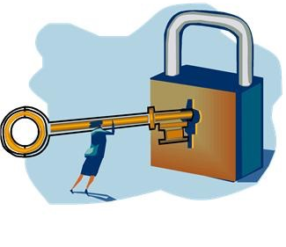
Diabetes
Why doesn’t the glucose move into cells?
Considerations
  Glucose may not move properly into your body cells for two reasons.
  These reasons tell you
  what type of diabetes you have:
  Type 1:
  your pancreas makes little or no insulin.
  Type 2:
  your body cells don’t respond to the insulin produced and your body may not make enough insulin.
September 2018

Slide 43


Diabetes
What does it mean to a patient?
Considerations
Most problems in diabetes are linked
to blood glucose levels that are too high
or too low.
  Hyperglycemia = blood glucose level is too high
  Hypoglycemia = blood glucose level is too low
Patients must eat the right types and
amounts of foods especially foods that are carbohydrates to keep blood glucose levels from going too high or too low.
September 2018

Slide 44
Patients coming from the hospital
Will have been seen by a
Registered
Dietitian
Nutritionist
The RDN will have discussed the prescribed diet
And reviewed the handout
September 2018

Slide 45

Patients coming from a clinic may not have seen a RDN but
A nurse will have reviewed the handout
R
Patients being seen in the clinic will have discussed their diet prescription with their doctor and/or nurse. The nurse giving the patient the voucher will have discussed the Making the Most of Your Healing Box handout.
September 2018

Slide 46
Questions
Patients have asked
R
Q: Can I trade some of the foods in the bag for other foods I like better?
A: No. The foods in the bag are specific to the diet your doctor has ordered for you.
Q: I thought canned goods were filled with preservatives and that’s not healthy.
A: Only heat is needed to preserve fruits and vegetables. The amount of nutrients lost in this process are little to none. Nutritionist say it is good to eat fruits and vegetables—canned, frozen, dried or fresh. If salt or sugar has been added, it is good to rinse them off
September 2018

Slide 47

Questions?
General, Food Drive, Food Inventory questions: MedfoodpantryVMC@gmail.com
Nutrition questions: Dr. Kathy Kolasa at kolasaka@ecu.edu
September 2018

