Slide 1
ORCID Identifiers: Planned and Potential Uses by Associations, Publishers, and Librarians
Barbara Chen, Modern Language Association
Gail Clement, Texas A&M University
Wm. Joseph Thomas, East Carolina University

Slide 2
What is ORCID?
ORCID is an independent non-profit organization supported by member fees
ORCID provides:
Registry of unique persistent identifiers
API’s that support system-to-system communication and authentication

Slide 3

What Is an ORCID iD?
A unique persistent identifier that can be used to:
Disambiguate authors
Associate all works with the right author
Enable discoverability within and across databases
Manage records of publication outputs across funders, universities, associations….

Slide 4

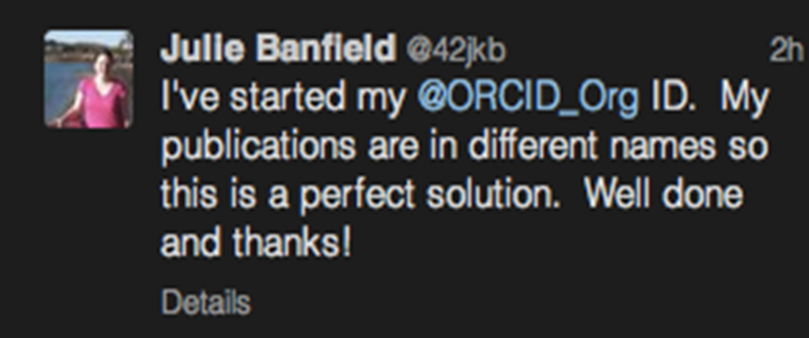

Need to Disambiguate Authors?
“Estimates by China's Ministry of Public Security suggest that more than 1.1 billion people — around 85% of China's population — share just 129 surnames. Problems with abbreviations, ordering of given names and surnames and inconsistent journal practices heighten the confusion.”
http://www.nature.com/news/2008/080213/full/451766a.html

Slide 5
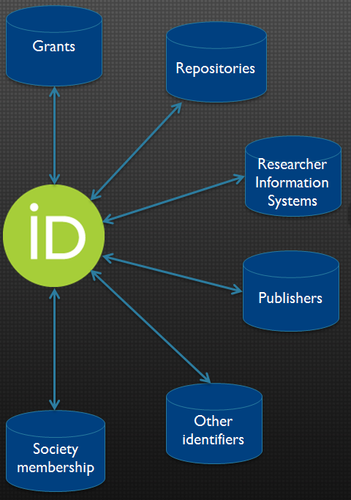
The ORCID API enables the exchange of information between systems:
-Less time re-keying
-Improved data
-Easier maintenance
-Better sharing across systems

Slide 6

How Can Associations Use ORCID?
How Can Publishers Use ORCID?

Slide 7
at a Glance
Over 28,000 members in 100 countries
Programs serving English and foreign language teachers
An annual convention, with meetings on a wide variety of subjects, and smaller seminars across the country
The MLA International Bibliography, the only comprehensive bibliography in language and literature, available online
MLA Commons – vehicle for scholarly communication
Book publication program issuing about 12 new books each year and maintaining a backlist of over 200 titles
4 major periodicals: the ADE Bulletin; the ADFL Bulletin; Profession; and PMLA, one of the most distinguished journals in the humanities
A quarterly newsletter providing association news, lists of deadlines, and items of interest to members
136 divisions and discussion groups for specialized scholarly and teaching interests of members
47 membership committees overseeing association activities and publications
Leadership in the national education community

Slide 8


Slide 9
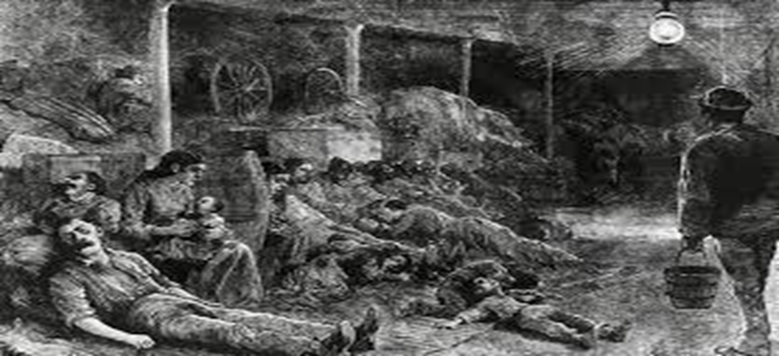
Authentication and identity management issues plague us all.

Slide 10

MLA Bibliography Author Names

Slide 11
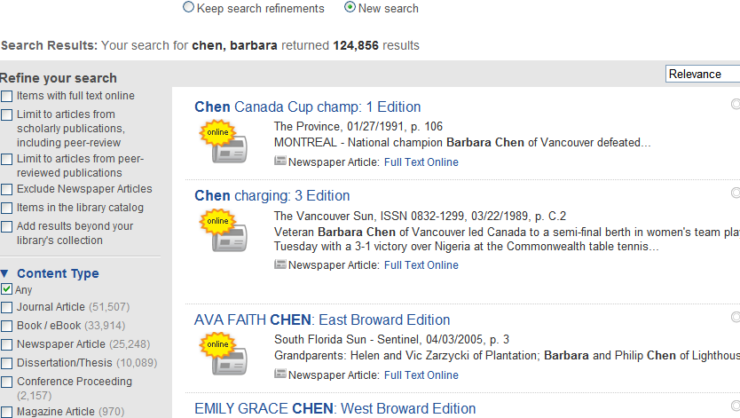
Discovery Services

Slide 12

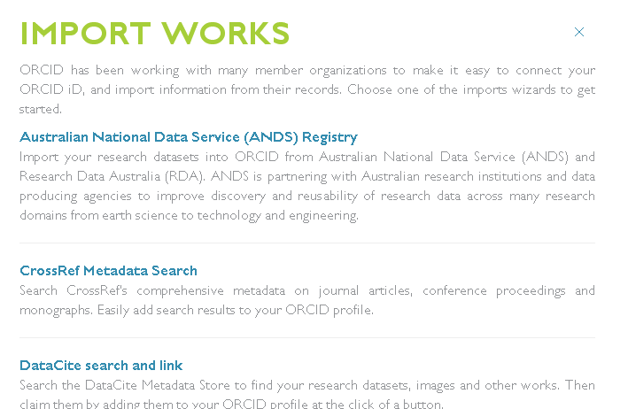

Slide 13
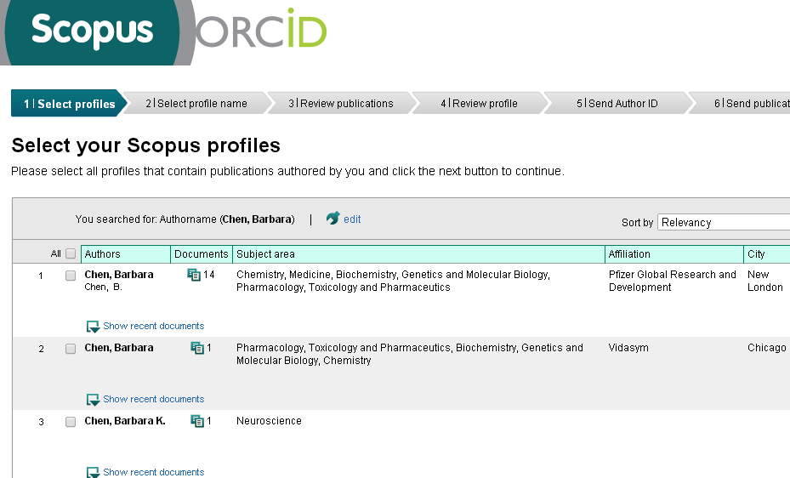

Slide 14


Slide 15
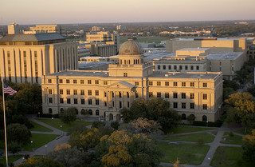

ORCiD Integration at TAMU
Top tier flagship research university
Triple designation as land-, sea-, and space-grant
Agricultural & Mechanical = knowledge in service to society
Long and proud legacy of global leaders and problem solvers

Slide 16
ORCID Integration at TAMU
University role supports campus authors to excel in their research, scholarship, and practice
University is committed to advancing scholarly communication in the Digital Age
University and Libraries help campus authors establish and curate their scholarly identities
University committed to assessing outcomes and effectiveness in fulfilling university mission in teaching, research, and service

Slide 17
ORCID ID’s for Early Career Researchers
10,000+ graduate students
  One-third are international
  Largest percent from Asia and the Mideast
Lots of post-docs (de-centralized)
Residents and interns in Medical and Vet Med Colleges

Slide 18
Goals of Campus ORCID Integration for early career scholars & professionals
Establish scholarly identity at start of career
Position new scholars for ready success with publishers, funding agencies, and other research support systems requiring ORCIDs
Develop scalable and trusted infrastructure for tracking student outcomes over time
Build greater publishing capacity for Libraries and University

Slide 19

ORCID Implementation Plan
Clear policy hurdles with university administration
Join ORCID for access to API and Tech support
Mint ORCIDs for 10,000+ graduate students
Conduct outreach and training to new and existing ORCID owners
Integrate ORCIDs into key information systems, incl. Vireo ETD submission and management system
Develop ORCID app for sustainable management of ORCIDs over time
Expand program to cover faculty and research staff

Slide 20
Progress To Date
10,334 ORCiDs minted for graduate students
2138 claimed in first 9 days
Unclaimed ORCIDs due to variety of reasons:
  Email not working (120)
  Email not checked despite university requirement (lots)
  Email checked but instructions not followed (some)
Students who claim almost universally pleased to have an ORCID
One student objected to our minting the ORCID

Slide 21
Lessons Learned So Far
Technical approach needed to success at scale
  ORCID minting system
Early adoption of ORCiDs : Expect the unexpected!
High-touch system equally essential as technology to reach and engage users

Slide 22
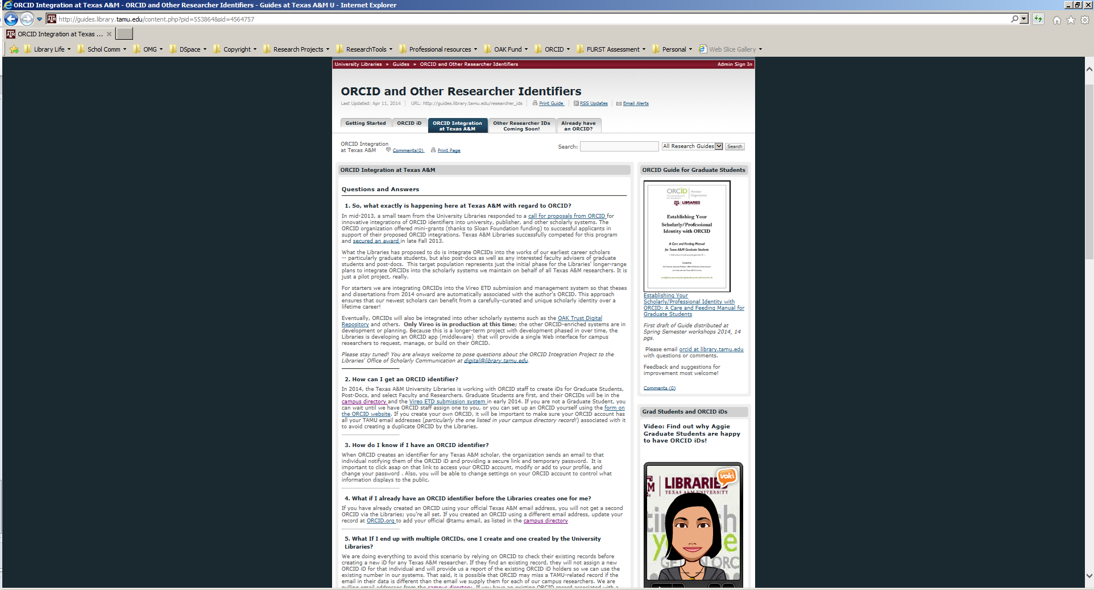
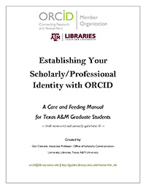
Outreach and User Support

Slide 23
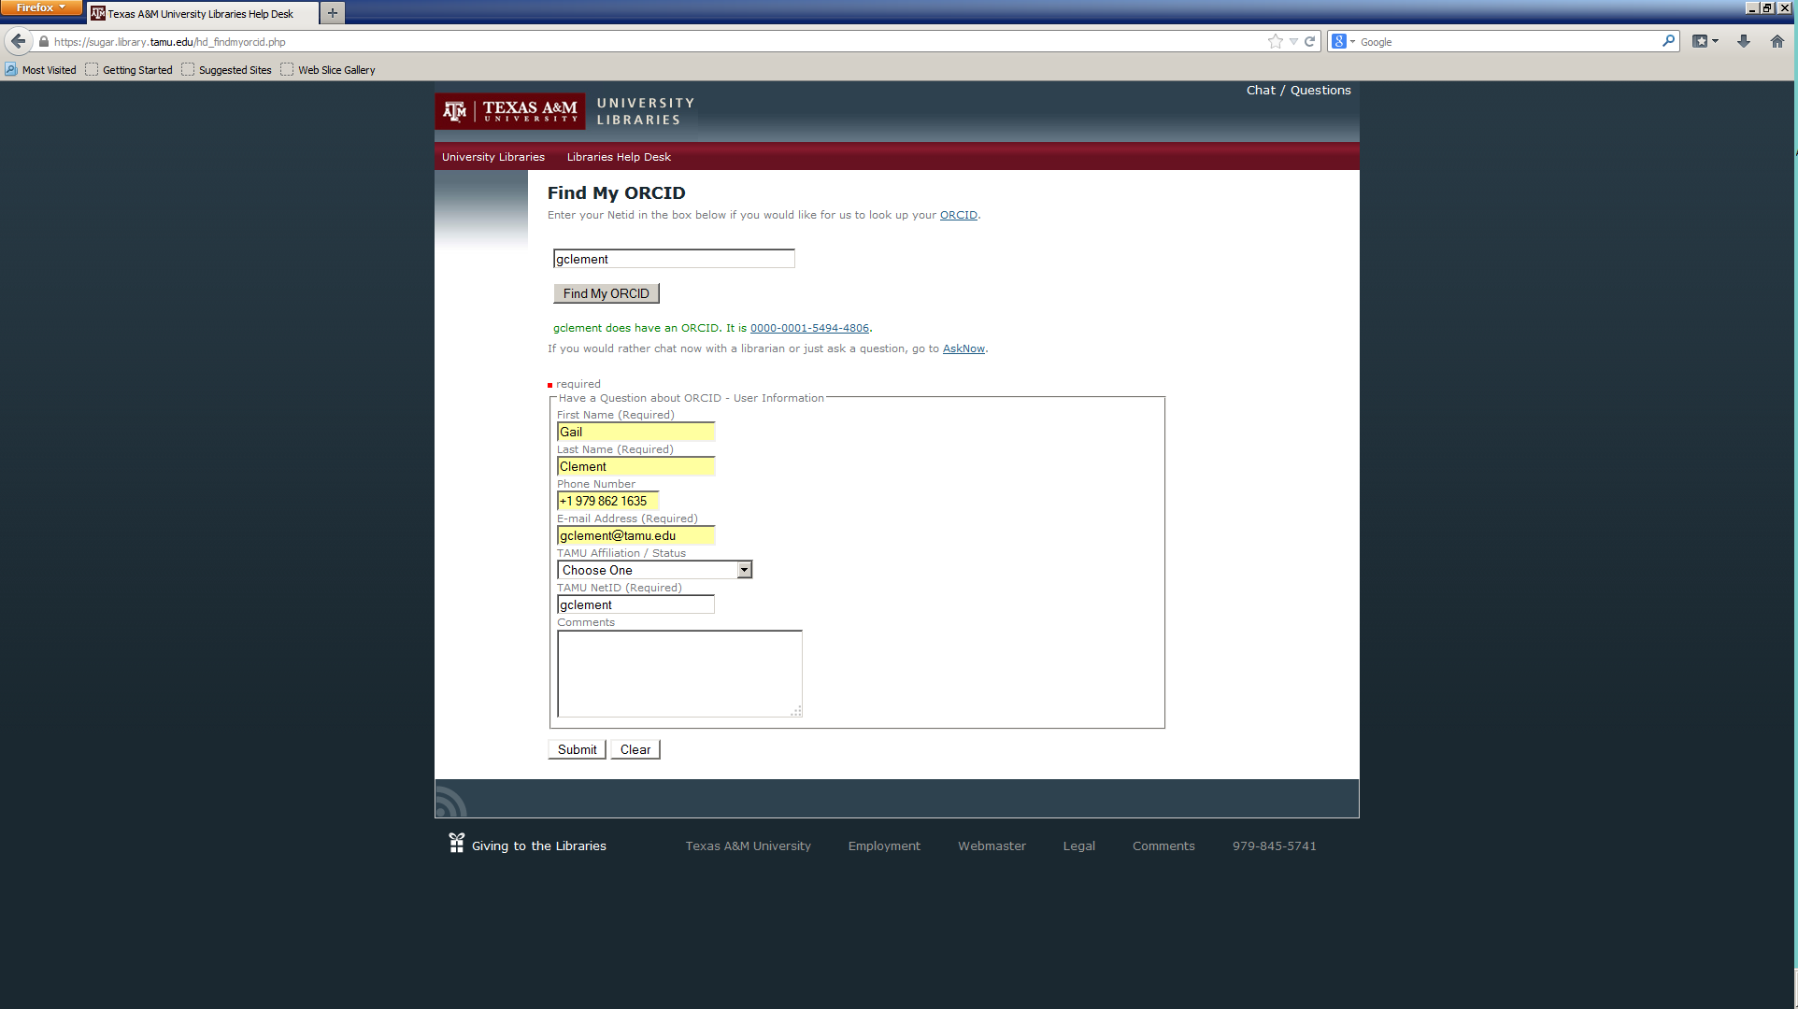
Support at Point of Need

Slide 24
Integration with Library Public Services

Slide 25
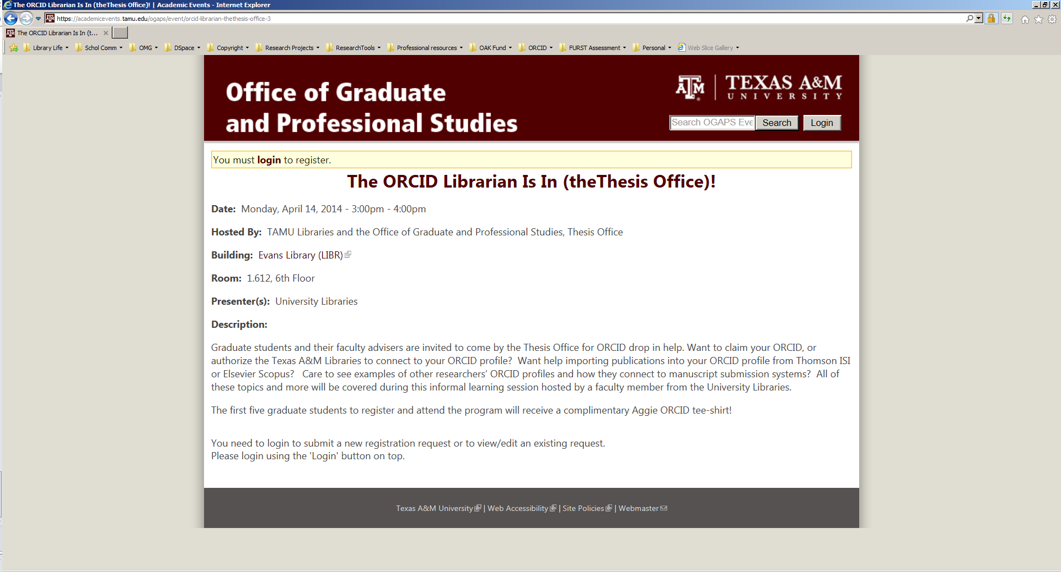
Integration with Graduate School Services

Slide 26
Evidence of Impact
I was in attendance last night at the Graduate Student Council meeting. Thank you for your presentation in regards to ORCID. I am hoping to attend one of your workshops to register for ORCID. Please let me know when they workshops are scheduled.
Thank you, Doctoral Student, Ag Economics
We currently have 47 people registered for this Wednesday’s ORCID workshop. Please let me know if there is anything else we can help you with in preparation for the workshop.
Graduate Assistant / Event Assistant
Office of Graduate and Professional Studies
Subject: today’s CVM-GSA attendance
Official signed in attendance was 53!
By the way, I've been mentioning ORCID in scientific-writing classes and workshops for a while. And a few months ago, as part of my work with the AuthorAID project, I featured ORCID as a Resource of the Week (http://www.authoraid.info/en/news/details/35/).
Professor, Integrative BioSciences
These services are good tools to make us more scientifically visible.
Thanks and I really appreciate your hard work,
Doctoral Student, Construction Engineering

Slide 27
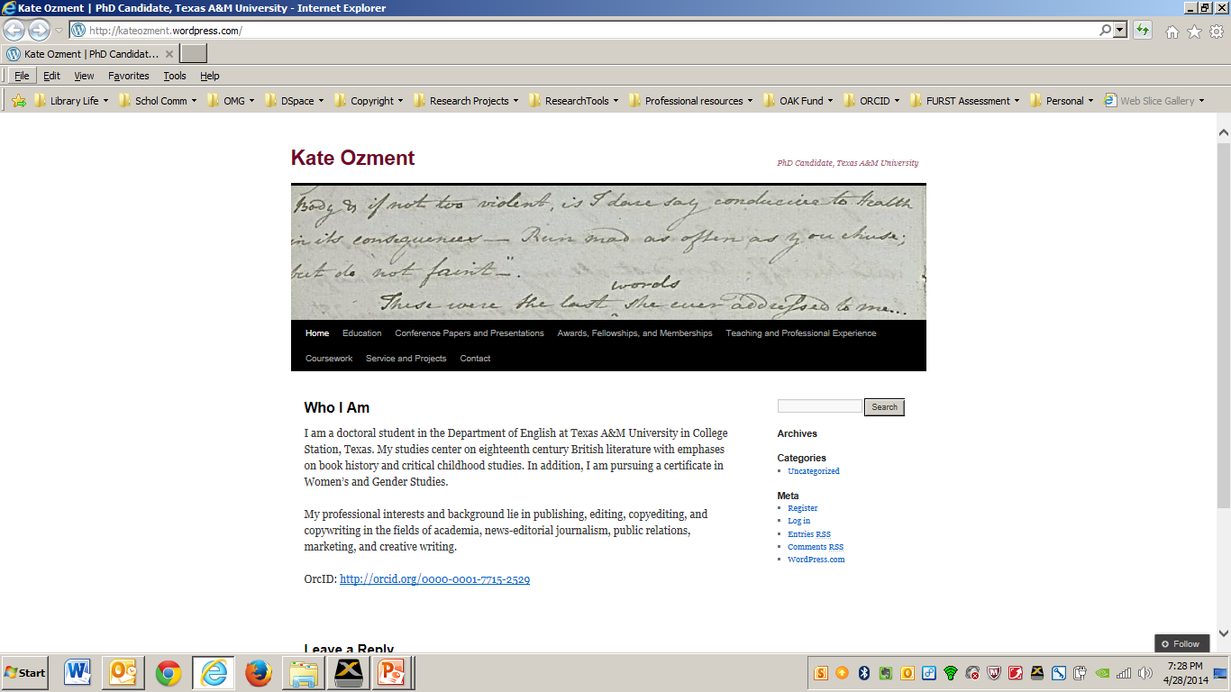

Slide 28


ORCiD @
East Carolina
  Largest programs: Education and Nursing
  Carnegie Class DRU
  2,043 FT, PT, and temp faculty (Fall 2013)
  26,887 total student enrollment (Fall 2013)
    5,379 graduate students

Slide 29
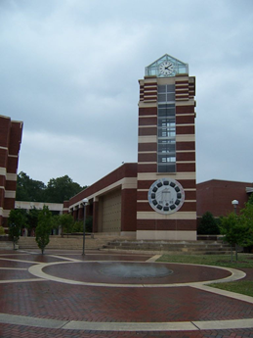


Librarian Outreach @ ECU
Outreach Efforts:
  Individuals
  Departments
  Part of Scheduled Presentations
Key Related Project: REACH NC profiles
Luca Masters
Notes:
Scheduled presentations with the Office of Faculty Excellence on topics like Researcher Profiles and Measuring Research Impact.

Slide 30
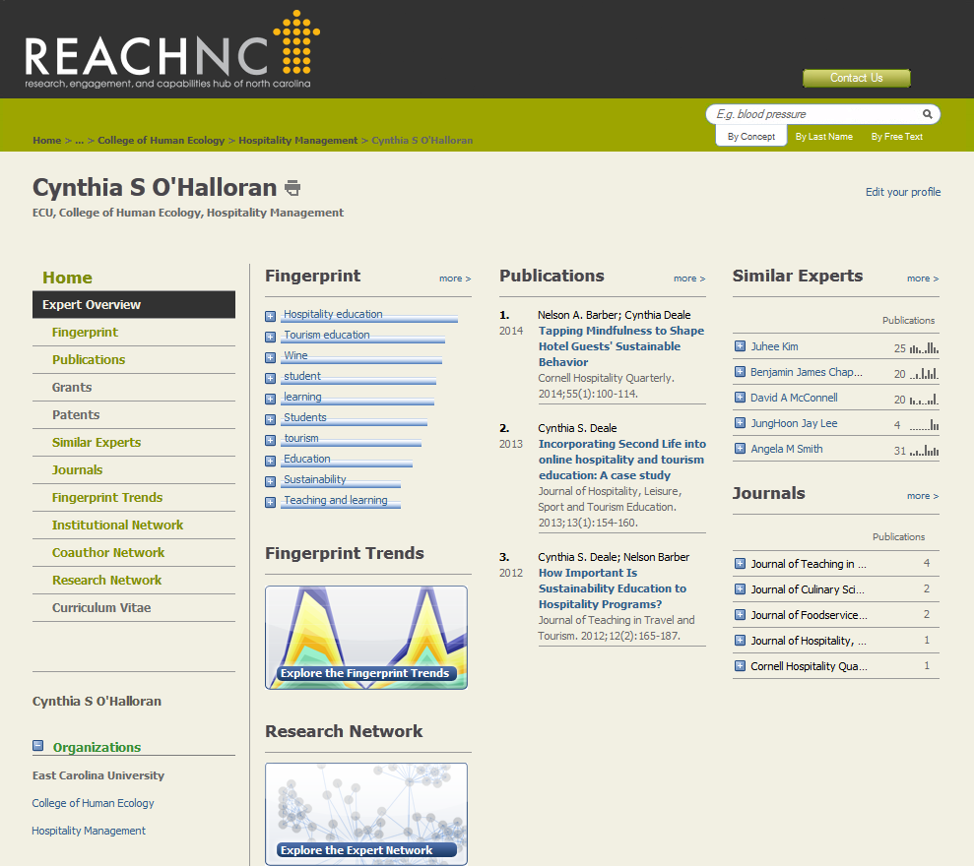

Shared instance of SciVal Experts
-Publications List

Slide 31
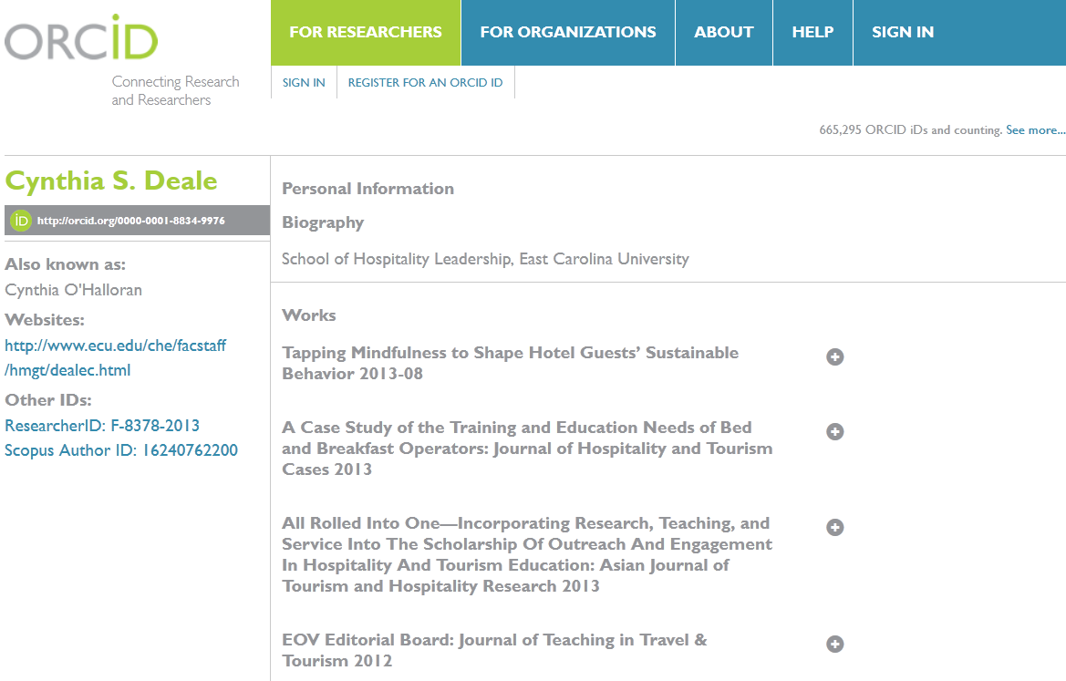

Slide 32
Results So Far
Administrative support key
Tie in to what they already care about
Working with individuals:
Richer Connections Trade-off: Slower / Fewer

Slide 33
Additional Resources:
Credit Where credit is due, Nature 462, 825 (17 December 2009): http://dx.doi.org/10.1038/462825a
ORCID: a system to uniquely identify researchers, Learned Publishing 25, 4 (2012): http://dx.doi.org/10.1087/20120404
ORCID as the proposed researcher identifier solution, JISC: http://www.jisc.ac.uk/whatwedo/programmes/di_researchmanagement/researchinformation/orcid.aspx
Scientists, Your Number is Up, Nature News (31 May 2012): http://dx.doi.org/10.1038/485564a
Why Every Researcher Should Sign Up for their ORCID ID: http://blogs.lse.ac.uk/impactofsocialsciences/2013/01/30/why-every-researcher-should-sign-up-for-their-orcid-id/

Slide 34

Questions?
Get in touch!
Barbara: bchen@mla.org
Gail: gclement@library.tamu.edu
Joseph: thomasw@ecu.edu

