Slide 1
Information Moshing:
Heather Seibert
East Carolina University
seiberth17@ecu.edu
Open Educational Resources; What they are, Where they are, and What can we do with them.

Slide 2
Today
What are OERs?
What are some Myths and Concerns?
Where can we find OERs?
Who cares?
What can we do with OERs?
Why us?

Slide 3
What are OERs?
Open Educational Resources are educational materials found in the Public Domain or have an open license (i.e. Creative Commons) that legally allows anyone to freely use, copy, adapt and re-share those resources with others.

Slide 4

Can Include
Textbooks
Syllabi
Curricula
Tests
Projects
Animation
Video
Audio
Lecture notes
And MORE

Slide 5

Myths and Concerns
They are not free!
Authors will not agree
Deepen the divide
Force schools to adopt other standards
Cannot generate revenue
Will replace developed models
Low quality
ADA compliance

Slide 6
Breakdown
They are not free!
Authors will not agree
Deepen the divide
Force schools to adopt other standards
Cannot generate revenue
Will replace developed models
Low quality
ADA compliance
Free does not mean without restriction
Authors are agreeing
Working on it
Adapt
(insert eye roll here!)
Supplemental materials
Peer Reviewed
Yes
Notes:
Authors agreeing- since early 1990s when they began talking about it till now, there has been has been a significant rise, in 2015 it was estimated that 45% of all scholarly literature is open. With at least 28% being open now. There is a rise in more and more universities with Alternative Text and OER authors
Digital divide,
97% access in Urban, but falls to 65% in rural, and 60% in tribal lands,
Over 30 million Americans don’t have access…
Initiatives in place, like the mobility fund framework from FCC for a 4.53 Billion dollar allocation to being ww to rural areas, Connect America which will provide an additional 2 billion, and NY will partner for 170 for rural broadband and 220 million from the state
Springer Nature creating materials to supplement OERs
Open Stax is peer reviewed. Other materials are peer reviewed as well.

Slide 7

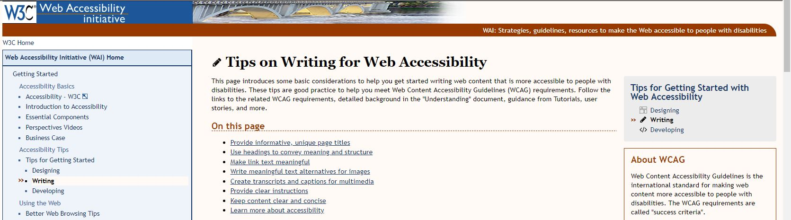
Let’s talk Accessibility
“Establish requirements for making the goods, services, facilities, privileges, accommodations, or advantages offered by public accommodations via the Internet, specifically at sites on the World Wide Web (Web), accessible to individuals with disabilities.”
Advanced Notice of Proposed Rulemaking- Department of Justice: 2010 (2018 upcoming ruling)
Notes:
2010 Department of Justice proposed an addition to the ADA
2018 Upcoming ruling
Web accessibility Initiative, Constorium, best practice
Just do your best

Slide 8
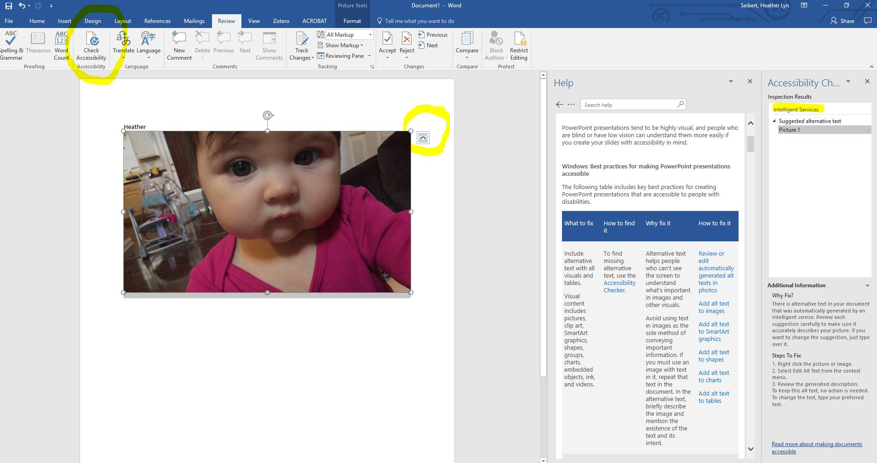
Notes:
Word before migration

Slide 9

Where can we find OERs?

Slide 10





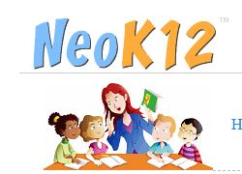




Slide 11
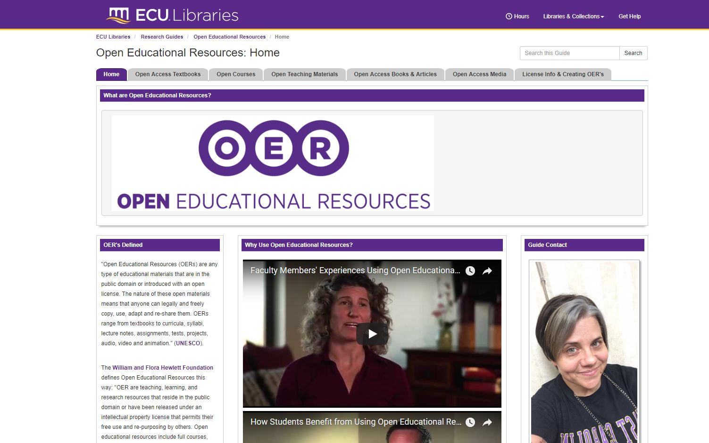
Joyner Library Open Educational Resources Libguide:
Open Access Textbooks
Open Courses
Open Teaching Materials
Open Access Books & Articles
Open Access Media
License information & Creating OERs

Slide 12
A number of search engines exist to search Open Educational Resources. These include:
DiscoverEd - "Discover the Universe of Open Educational Resources"
Jorum - "free learning and teaching resources, created and contributed by teaching staff from UK Further and Higher Education Institutions"
OCWFinder - "search, recommend, collaborate, remix"
OER Commons - "Find Free-to-Use Teaching and Learning Content from around the World. Organize K-12 Lessons, College Courses, and more."
Temoa - "a knowledge hub that eases a public and multilingual catalog of Open Educational Resources (OER) which aims to support the education community to find those resources and materials that meet their needs for teaching and learning through a specialized and collaborative search system and social tools."
University Learning = OCW+OER = Free custom search engine - a meta-search engine incorporating many different OER repositories (uses Google Custom Search)
XPERT - "a JISC funded rapid innovation project (summer 2009) to explore the potential of delivering and supporting a distributed repository of e-learning resources created and seamlessly published through the open source e-learning development tool called Xerte Online Toolkits. The aim of XPERT is to progress the vision of a distributed architecture of e-learning resources for sharing and re-use."
OER Dynamic Search Engine - a wiki page of OER sites with accompanied search engine (powered by Google Custom Search)
JISC Digital Media maintain guidance on finding video, audio and images online, including those licensed as Creative Commons.
Open Educational Resources - PBWorks
Notes:
Not reading this to you, but there are various search engines you can use for OERs

Slide 13
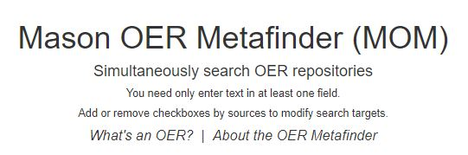
GMU OER Metafinder
Searches 16 targets in Real-Time
Gives several hundred hits from each site
Includes
American memory project
BC Campus: Open Ed
World Digital Library
OAOpen.org
Directory of Open Access Books
MIT OpenCourseware

Slide 14

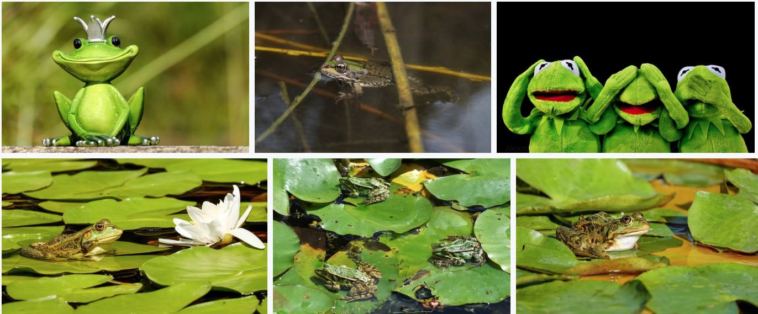
Pixabay.com CC0
Notes:
CC) Liscense for all pictures and photography on pixaby

Slide 15
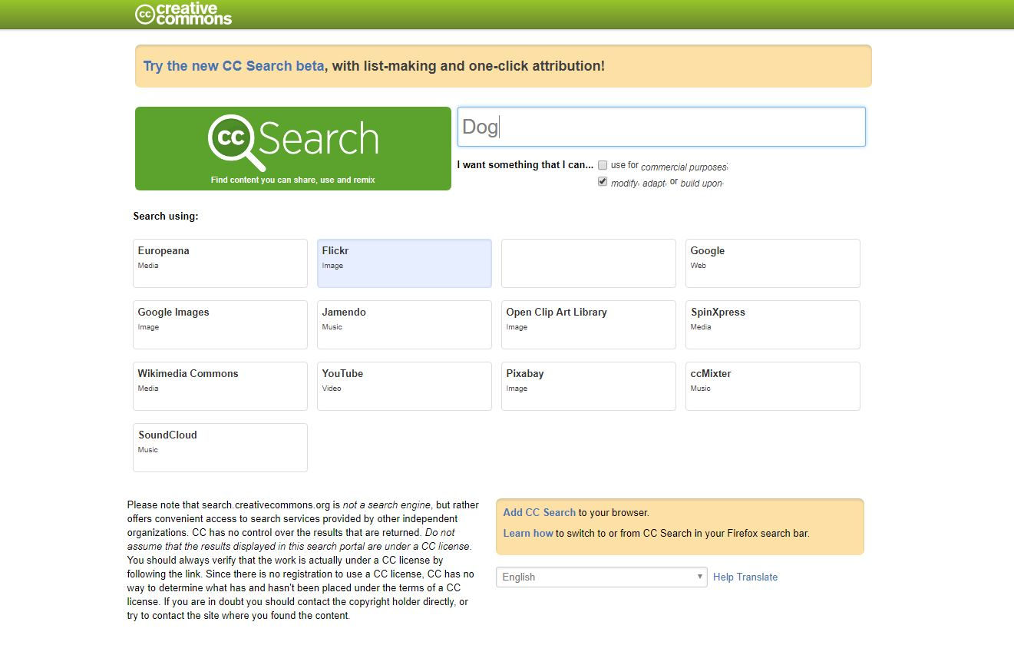
CC Search - Creative Commons Search: DOG – Flickr
New beta search CC

Slide 16

Who Cares?

Slide 17
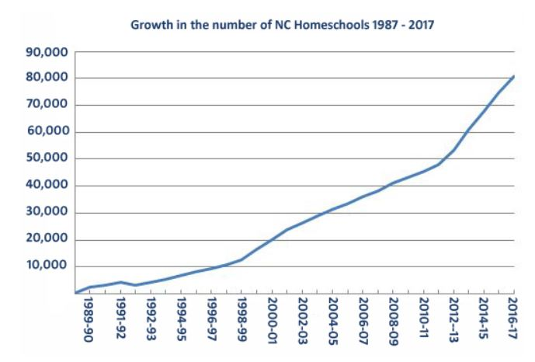
Homeschooling Families
January 1988 – 1046 Registered homeschools
End of 1989 – 32% increase
14% estimated growth per year
Average up to thousands of dollars
Notes:
January 1988 1046 homeschools
End of 89 32% increase
74,653 homeschools in 2015-2016
8.5% growth … now 80,973 registered homeschool
Estimates that there an estimated 127,847 homeschooled students
Note: not all are registered
Compulsory age is 7, do not have to register
14% average annual growth
Now more Homeschool students than those that attend private schools in NC

Slide 18
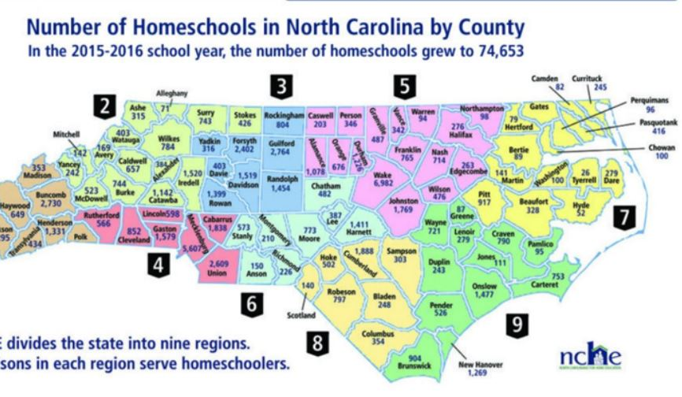
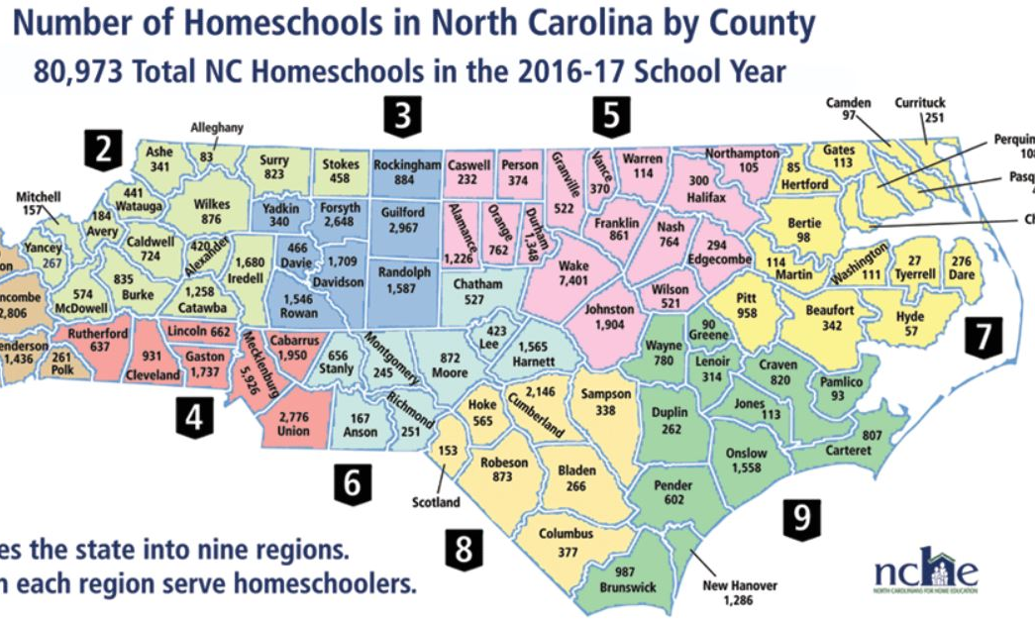
Growth in North Carolina
2015-2016 – 74,653
2016-2017 – 80,973
Today -127,847*
Registration
Compulsory age
North Carolina
Notes:
Note: not all are registered
Now more Homeschool students than those that attend private schools in NC
*202,433 and more homeschooled students estimated
NC has the highest Homeschool population in the nation and is rising.

Slide 19

Over 30 Million people are using libraries each year to seek information on careers and to seek employment

Slide 20

Military, Veterans and their families

Slide 21

Who else?
Educators
Students
University Faculty
Researchers
Life-long learners
University Students

Slide 22

Storytime
Notes:
Tim

Slide 23

Let’s talk textbooks
28 hours for a 200.00 textbook?
Average 1,200 per year on Textbooks
65% skipping buying textbooks
14% have dropped a class
88% between 2006-2016
82% feel would do better
94% Students Concerned
Ripple effect
Notes:
82% of students felt they would do significantly better in a course if the textbook was available free online and buying a hard copy was optional. This is exactly how open textbooks are designed.
The survey found that 94% of students who had foregone purchasing a textbook were concerned that doing so would hurt their grade in a course. More than half of the students felt significant concern for their grade.
Nearly half of all students surveyed said that the cost of textbooks impacted how many/which classes they took each semester.
Nearly half of all students surveyed said that the cost of textbooks impacted how many/which classes they took each semester.
Students attend college seeking job preparation and/or degree attainment.

Slide 24

What can we do with OERs?

Slide 25

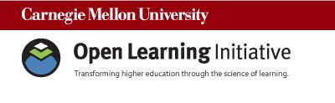
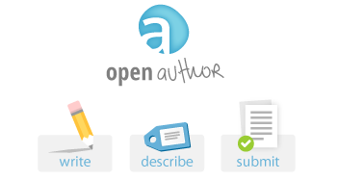

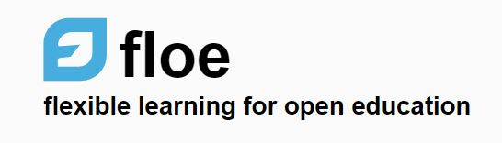

Slide 26
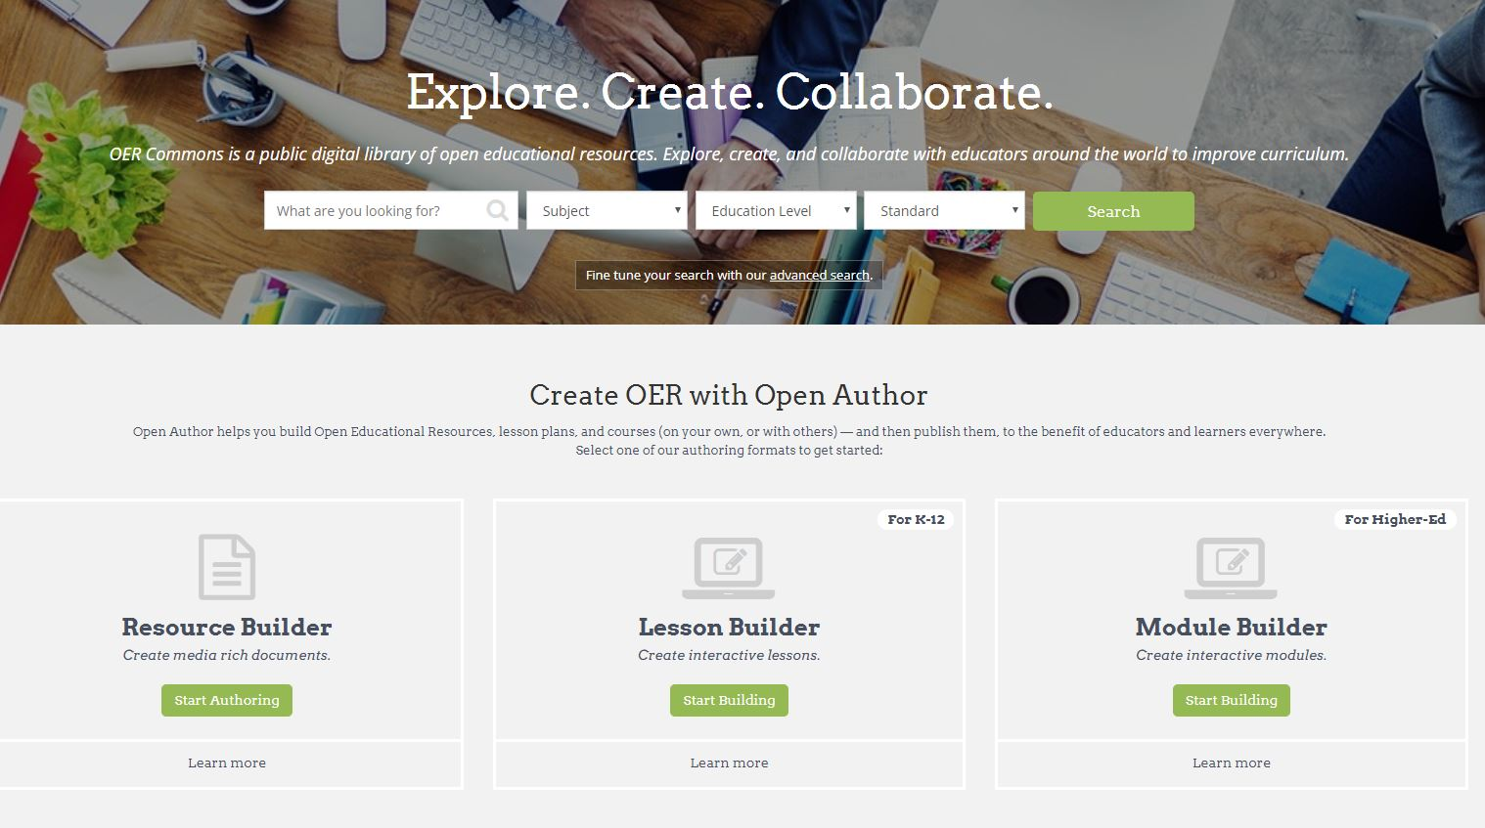
OER Commons – Open Author

Slide 27
5 Steps to an OER creation
1. Find: search engines, repositories, and individual websites, as well as offline materials.
2. Compose: resources that you've found with others that you may have created yourself.
3. Adapt: If you are using other resources adapt them to your needs (we’ll talk about this soon)
4. Use: Use the resource
5. Share: Publish your OER so others can find and reuse it.

Slide 28

Where do we put them?
Pressbooks
Canvas/WSA LMS
Flickr
Wikimedia Commons
YouTube
Teachertube
Canvas Commons
Pixabay
Screencast
Research Exchange
Scalar
Omeka
Notes:
Open source and open publishing platforms
* Note Youtube.

Slide 29

That’s MINE!
Notes:
Here is where it can get a little tricky

Slide 30

Licensing
Freely accessible = free to read
Re-usable = Openly licensed (CC)
Retain, reuse, revise, remix, and redistribute
Creative Commons is an American non-profit organization devoted to expanding the range of creative works available for others to build upon legally and to share.

Slide 31

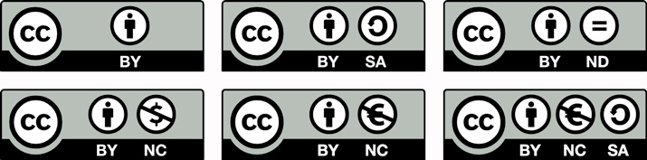
Open licenses for re-use
“some rights reserved” creativecommons.org
Notes:
Symbol based liscening

Slide 32
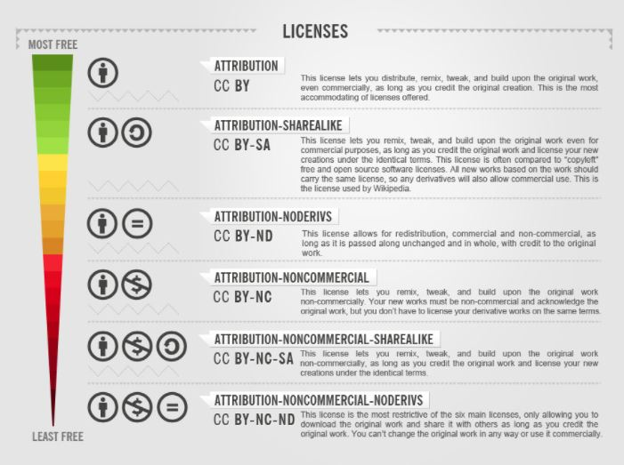
Notes:
Least restrictive to most restrictive

Slide 33
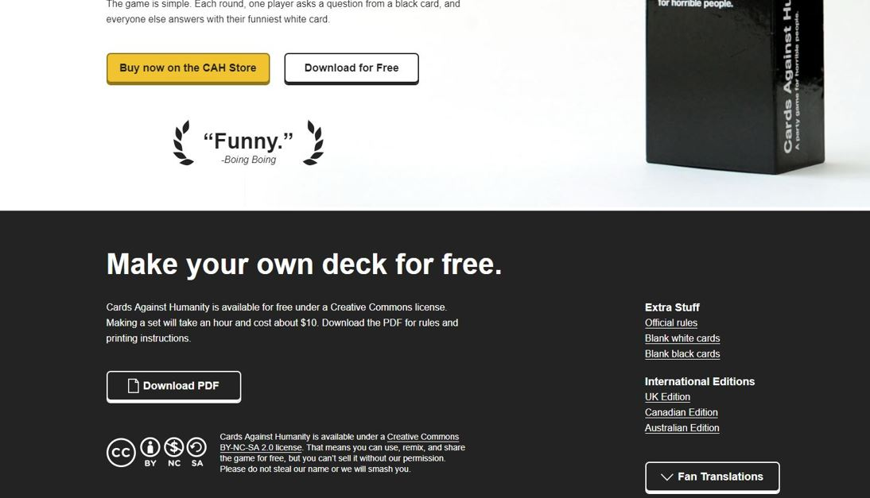
Notes:
Can be found everywhere

Slide 34
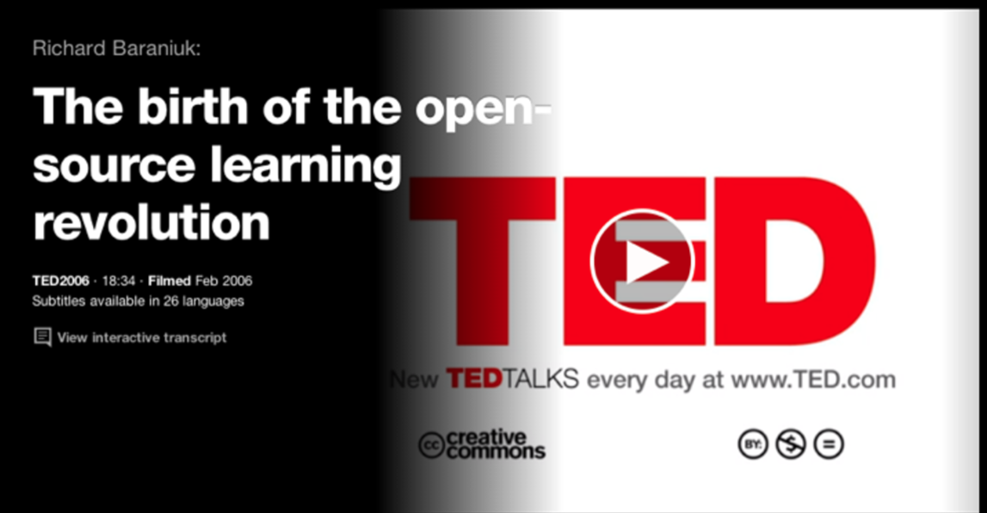
Notes:
Have to show the entire video

Slide 35


“Daisy” by Thomas Hawk

Slide 36
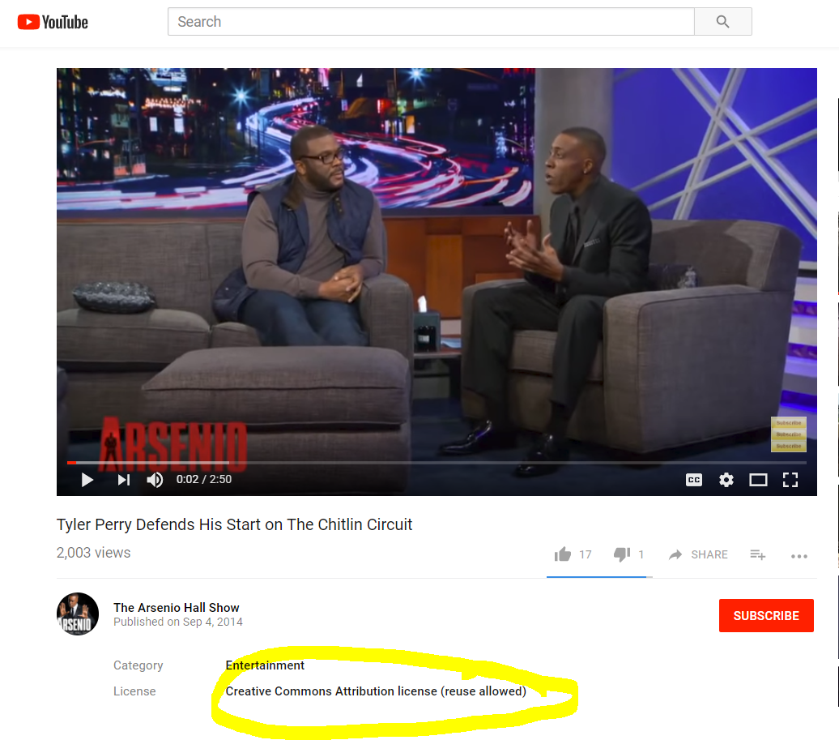

“Tyler Perry Defends His Start on The Chitlin Circuit” by The Arsenio Hall Show
Notes:
CC liscene on Youtube is very different than a Youtube standard liscense

Slide 37
Why us?
We find resources
We evaluate resources
We curate resources
We see the big picture
We are the advocates
We teach the process
We teach the creation
We provide the opportunity
We have the hard talks
We are invested in the 3 Es!
Notes:
Ensuring equal education

Slide 38

Today
What are OERs?
What are some Myths and Concerns?
Where can we find OERs?
Who cares?
What can we do with OERs?
Why us?

Slide 39

Heather Seibert
seiberth17@ecu.edu
Questions?
Thank you!

