Slide 1
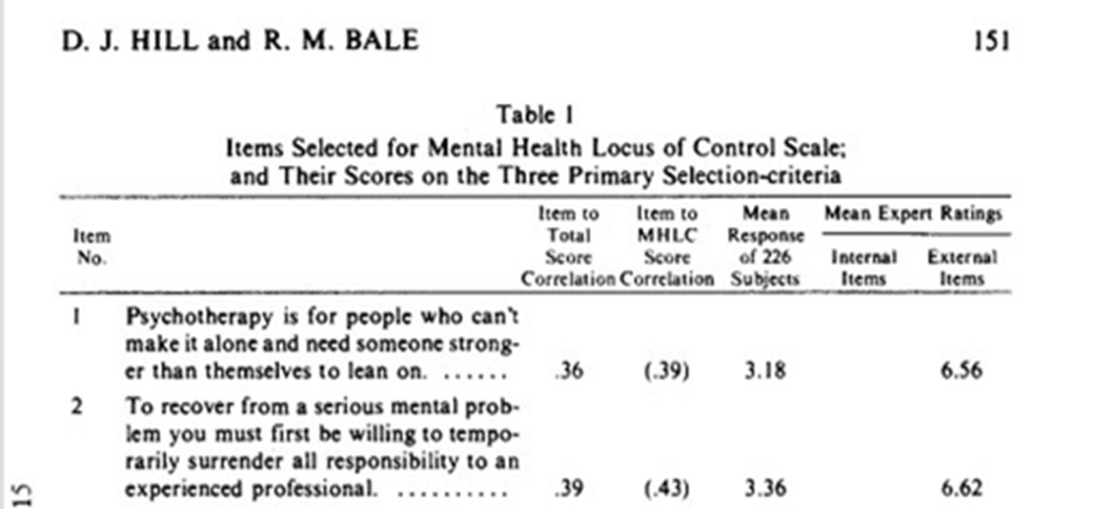
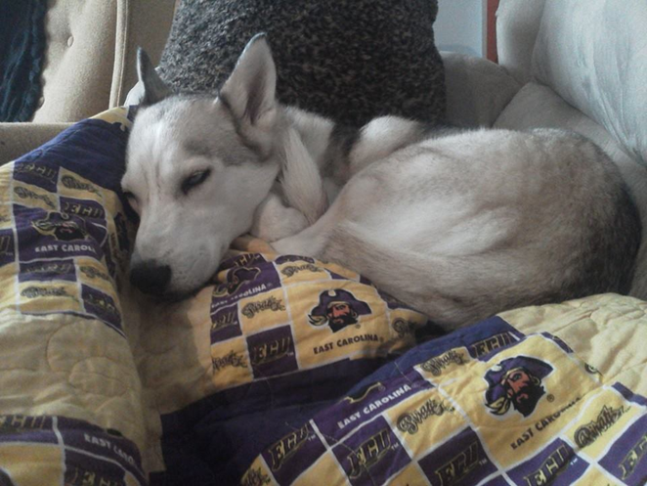
Beliefs about the rehabilitation of aggressive canines:
Development of the canine aggression locus of control and locus of origin scales
Destiny DeHart
Senior Honors College Psychology, Undergraduate Major
Mentor: Dr. Karl Wuensch
Abstract
Research addressing threatening or hostile behavior in dogs involving actual and or potential harm to another, otherwise known as canine aggression, often includes assessing various methods of treatments, behavior modifications, and the applications of treatments. By inviting, through email, former Pitt County Animal Shelter adopters to participate in a public online survey, this research will develop the canine aggression locus of control and canine aggression locus of origin scales to better understand the impact of human beliefs in regards to the treatments of aggression in canines. An analysis supporting beliefs skewed towards CALC or ACLO could propose that owners have particular expectations for the treatments of animal aggression particularly in dogs. And, by also incorporating questions concerning the role of Implicit Personality Theory, the relationship between owners and aggressive canines will be better understood regarding the impact the application of treatments by owners and the types of treatments owners use when faced with and aggressive canine situation.
“[T]here are almost as many cats and dogs in households as televisions.”
      McKenna 2013
“…right to protect their persons and property from aggressive roaming dogs…”
      Canine Control Ordinance
Results
If data shows a skew towards the developed canine aggression locus of control (CALC) or canine aggression locus of origin scales (CALO), we could be lead to conclude that owners may have particular expectations for the treatments of animal aggression particularly in dogs.
These expectations could influence the application of treatments by owners or even the types of treatments owners consider when faced with and aggressive canine situation.
Introduction
Throughout the late 20th century the research conducted in regards to animal aggression focused identifying, classifying, and understanding the canine behaviors while beginning to assess treatment methods (Uchida, Dodman, DeNapoli, & Aronson, 1997; Dodman, Donnelly, Shuster, Mertens, Rand, & Miczek, 1996; Tortora, 1983). In the early 2000s, research regarding comparisons and manipulations of treatment methods focused on the improvement and applications of aggression rehabilitation for the general public while attempting to address treatments that could be administered but the owner at home (Reisner, 2003; Ibanez & Anzola, 2009). This research fails to address the influence of human beliefs about canine aggression which could have important implications regarding the successful applications of treatment methods. The Mental Health Locus of Control and Mental Health Locus of Origin Scales was researched and developed to understand the relationship between expectations of the client and the potential acceptance of treatment methods in the mental health field (Hill &Bale, 1980). This scale will be adapted to address the relationship between beliefs about aggressive canine, in regards to internal or external assessments, and confidence in the treatment and treatment methods in behavior modification in aggressive canines. The IPT was similarly adapted to fit the motivation and goals of this study.
Implications
By understanding public opinions, understandings, expectations, and often unconscious views, we can elicit change in:
  What knowledge the public has
  How the public is informed
  How to approach misconceptions
  Dealing with canine aggression problems
Development of the Mental Health Locus of Control and Mental Health Locus of Origin Scales
Why Should We Care?
Legislation
  Pit Bull Ordinance in Boston
  Domestic prejudice
  Breed restrictions in residential areas
  Euthanasia practices
  Understanding your options
  Veterinary recommendations
  Proper relay of information
Methods
The MHLO was used as a template for the format of this research and the survey. A five point Likert scale format was applied. The items will be reviewed by a panel of faculty members then rated on the relevance of each item in regards to the canine aggression locus of control and canine aggression locus of origin internal vs. external). The items selected for the final survey will be chosen on the scoring of this panel.
IPT or Implicit Personality Theory addresses the individual’s beliefs of internal vs. external control of the self, of situations, and by extension rehabilitation of canines.
The survey will be conducted using the Qualtrics surveying program approved by the institution. Requests for individuals to complete this survey will be sent via email using a list of past Pitt County Animal Shelter adopters.
Resources
Canine Control Ordinance, Animal Control, Ordinance No. 4. Retrieved From: http://www.pittcountync.gov/bcc/ordinance/amcontrol/4.pdf
Dodman, N., Donnelly, R., Shuster, L., Mertens, P., Rand, W., Miczek, K. (1996). Use of fluoxetine to treat dominance aggression in dogs. J Am Vet Med Assoc, 209(9). 1585–1587.
Hill, D. J., Bale, R. M. (2010). Development of the mental health locus of control and mental health locus of origin scales. Journal of Personality Assessment, 44(2). 148-156
Ibanez, M., Anzola, B., (2009). Use of fluoxetine, diazepam, and behavior modification as therapy for treatment of anxiety-related disorders in dogs. Journal of Veterinary Behavior: Clinical Applications and Research. 4(6). 223-229.
Levy, S. R., Stroessner, S. J., & Dweck, C. S. (1998). Stereotype formation and endorsement: The role of implicit theories. Journal of Personality and Social Psychology. 74(6). 1421-1436
Reisner, I. R., (2003). Differential diagnosis and management of human-directed aggression in dogs. The Veterinary Clinics. 33(2). 303-320.
Mckenna, E. (2013). Pets, people, and pragmatism. New York: Fordham University Press
Tortora, D. F. (1983). Safety training: The elimination of avoidance-motivated aggression in dogs. Journal of Experimental Psychology: General. 112(2). 176-214.
Uchida, Y., Dodman, N., DeNapoli, J., Aronson, L. (1997). Characterization and treatment of 20 canine dominance aggression cases. Journal of Veterinary Medical Science. 59(5). 397-399.
Internal vs External rating:
  “[I]nternal control represents the perception, on the part of the clients, that therapeutic change is a consequence of their own behavior…”
        Hill &Bale, 1980
A Special Thank You to:
Dr. Karl Wuensch, Dr. Fraley, Dr. Edwards, The Honors College, The EC Scholars Program, & Pitt County Animal Shelter

