Slide 1

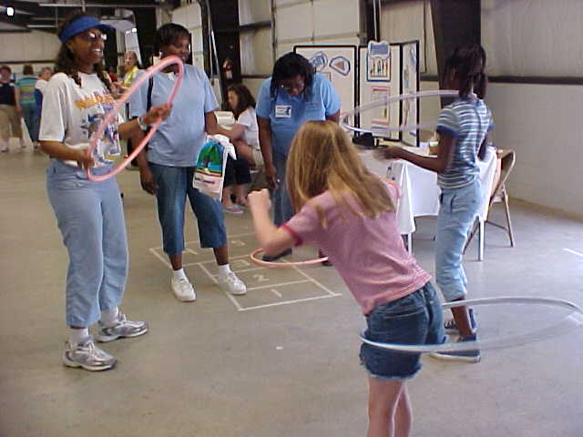
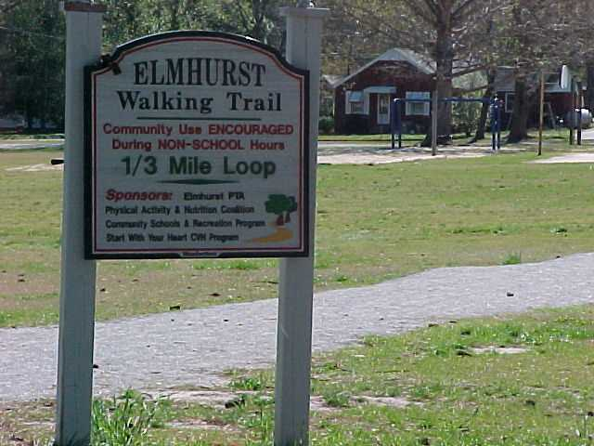


Participation in Community-Originated Interventions is Associated with Positive Changes in Weight Status and Health Behaviors in Youth
Lauren MacKenzie Whetstone, PhD, Kathryn M Kolasa, PhD, RD, LDN, David N Collier, MD, PhD
Departments of Family Medicine and Pediatrics, Brody School of Medicine
Introduction
Results
Conclusions
The North Carolina Health and Wellness Trust Fund established a three year community grant program designed to expand the statewide effort to prevent and reduce childhood obesity.
21 grantees, including school systems, health departments, statewide agencies, community non-profits, hospital systems, and a university each designed and implemented a community-originated intervention to improve physical activity (PA) and/or healthy eating.
Additional focus on policy and environment changes such as policies regarding foods provided in schools and afterschool programs.
Interventions included:
  Active recess
  Increasing PA during school day
  Creating walking trails
  Walking groups
  Healthy cafeteria offerings
  Nutrition education
Characteristic | Longitudinal baseline N-1,144
Average age (years) Range (years) | 9.5 4.1 – 19.6
Female | 51.7%
Caucasian African –American | 64.7% 35.3%
Hispanic/Latino origin | 2.6%
Underweight Healthy weight Overweight Obese | 1.6% 55.0% 16.9% 26.6%
BMI z-score can improve with involvement in community-originated efforts.
For children exceeding a healthy weight at baseline, clinically significant improvements in actual BMI were achieved (1.1 kg/m² lower for boys and 0.88 kg/m² lower for girls) when compared to predicted BMI.
A global approach to childhood obesity prevention and treatment has small but positive influences on target health behaviors.
Results support recommendations to replace high energy density foods with lower energy foods like fruits and vegetables, decrease consumption of sugar-sweetened beverages, and drink 2 to 3 glasses of skim milk daily
Some limitations:
  No control group nor random assignment
  Individual data not linked to participation in specific programmatic activities
Overall, 11.2% improved their weight status; 78.4% stayed in the same category; 10.4% worsened
Among overweight children 36.8% improved their weight status; among obese 16.5% improved
BMI z-scores significantly declined from .821 to .785; t₍₁₁₄₃₎=2.22, p=.027
Change in BMI z-score for children who began at a healthy weight was significantly smaller than change in underweight (p=.0002), overweight (p=.033) and obese (p=.013) children.
Greater improvement in BMI z-score for boys (-.0628) than for girls (-.0121); F_{(1,1110)}=5.27, p=.022
Average BMI for overweight and obese boys was 1.1 kg/m² lower than expected if maintained their baseline weight status; for girls BMI was .88 kg/m² lower
Outcome Evaluation Method
Design: Prospective cohort study
Setting: Schools and community settings in 19 locations in North Carolina
    Participants: Each grantee identified and followed a cohort of children who participated in their community-originated physical activity and nutrition interventions and were exposed to environmental and policy changes
    1,144 children were followed prospectively for an average of 20 months
Measures: Health survey adapted from the Physical Activity and Nutrition (PAN) Monitoring Tool¹ including self-reported physical activity, sedentary and eating behaviors.
Trained staff measured height (to ¼ inch) and weight (to ¼ pound) at baseline and after intervention.
BMI z-score compared with expected growth without intervention.
References
Relationship between behavior change and weight change for participants ≥85th percentile
North Carolina Division of Public Health. Physical Activity & Nutrition Behaviors Monitoring Form, Monitoring and Evaluation Subcommittee of the North Carolina Child and Adolescent Overweight Prevention Initiative (North Carolina Healthy Weight Initiative), North Carolina Division of Public Health and University of North Carolina Chapel Hill, 2003
 | % who lowered their weight status category | Change in z-score
Changed to lower fat milk Did not change to lower fat milk | 39.6 ** 17.9 ** | -.2248 -.0839
Increased fruit Did not increase fruit | 35.8 ** 20.7 ** | -.2207 * -.0793 *
Increased vegetables Did not increase vegetables | 30.6 23.1 | -.2215 * -.0855 *
Decreased soda Did not decrease soda | 30.6 22.2 | -.1985 * -.0912 *
Acknowledgements
This evaluation was commissioned and funded by the North Carolina Health and Wellness Trust Fund.
The authors are grateful to grantees for their commitment to the evaluation and to decreasing childhood obesity in NC.
The evaluation project was approved by the University and Medical Center Institutional Review Board; each grantee obtained IRB approval for their individual projects.
A manuscript based on this study is in press in the American Journal of Health Promotion.
*p<.05; **p<.01
The Art and Science of Health Promotion April 10 – 13, 2012

