Slide 1
The Structure of Scholarly Communications within Academic Libraries
Wm. Joseph Thomas
March 15, 2013

Slide 2
What do we mean by
Scholarly Communications?
“…the creation, transformation, dissemination, and preservation of knowledge related to teaching, research, and scholarly endeavors”
SPEC Kit definition borrowed from the Scholarly Communications Group, Washington University in St. Louis

Slide 3
SPEC Kit 332
Organization of Scholarly Communication Services, November 2013
Surveyed ARL Libraries
http://publications.arl.org/Organization-of-Scholarly-Communication-Services-SPEC-Kit-332/

Slide 4
Libraries Studied
ARL Libraries
61 responses (48%)
46 Carnegie RU/VH – 33 public
8 Carnegie RUH – 6 public
6 Canadian ARL members – all public
Public 45 / Private 15
Library of Congress
Notes:
2 medium-sized, all others large

Slide 5
Libraries Studied
Non-ARL Libraries
64 responses (39%) – 27 from NC
15 Carnegie RU/VH
21 Carnegie RUH (2 NC)
6 Carnegie DRU (3 NC)
14 Master’s (all NC)
8 Baccalaureate (all NC)
Notes:
Librarians from 64 schools started the survey. 3 did not complete it.
For the NC schools—14 private and 13 public.
There are only 21 RUVH schools not ARL—all were invited; 15 responded.
There are 86 RUH schools not ARL—76 invited and 21 did answer survey, but this is a large pool of libraries to study, and websites only reveal so much. UNCG and Wake are the two NC schools.
There are 87 DRU schools; 43 invited but only 6 responded to the survey. Three NC schools—ECU, NCA&T, UNCC
The 14 Master’s schools responding to the survey were all from NC—7 are public and 7 are private
All 8 Bac schools are from NC, two public and the other six private

Slide 6
Leadership of Scholarly Communications
ARL Libraries
Notes:
Single Librarian (17) : Often Dept Head, Asst. Directors, or Scholarly Communications Librarians. 8 have special training, esp. for copyright or they have law degrees. 9 devote half of their time or less to SC duties. 9 have direct reports ranging from .75 FTE to 6 FTE. Other support from committee members and other librarians.
Library Unit (14) : Many have the term Scholarly Communication in the title; other terms include Digital Initiatives/Services/Curation and Publishing. 7 (half) have had special training (law degrees and copyright courses).
Two Or More Librarians (13) : 4 people said two librarians; 6 people said three librarians; 3 people didn’t specify. Position titles included Scholarly Communications, Copyright, and Digital Initiatives. These librarians also report to Directors and Assoc Directors. 8 of the 13 said special training (mostly JD or copyright courses); 5 did not. 10 have direct support.
Library Committee (9) : members from variety of depts across the library, average 8 members. 4 of the 9 had special training.
Not Any Single Person or Group (3) :

Slide 7
Leadership of Scholarly Communications
Non-ARL Libraries
SC Committee?
Notes:
Bar Graph – SC Committee: 47 No, 10 yes librarians only (some are IR working groups or Open Access); only 5 with librarians and other faculty. Group size: 3 have more than ten; 5 have five or fewer; 7 have six to ten. Reporting: 2 are Faculty Senate Committees; 12 report to lib administration; 1 reports to Schol Comm Librarian.
Library leadership generally 1 person (39 of the 61 responses to this question); two or more people, 20; only one department (Oregon State), and two responses were that there was no leadership within the library

Slide 8
Admin Structure and Change
ARL Libraries
Non-ARL Libraries
AD or SC librarian
Reports to Director or AD
Little formal assessment, but “demonstrable outcomes”
39 of 54 had change in structure since 2007
SC, Admin, or Research
Reports to Director, AD or Provost (if Director)
Little formal assessment
66% of positions changed since 2007 (most of them in last two years)
Notes:
ARL Library changes: 24 of those 39 created at least one new position; 16 created a new department. Formal assessments include annual reports and performance reviews, a few surveys to faculty, and review of stats (like number of IR downloads). Demonstrable outcomes include: increase in faculty self-archiving in IR, publishing in OA journals, and support for OA policies.
Non-ARL Libraries:
Titles: (n=54) Schol Comm in title: 12, Research/Reference: 10, Asst/Assoc Dir: 6, Director: 12, Collection Dev title: 6 (3 combined SC,CDV), Digital/Systems: 4
Reporting: 35 report to Director or AD; 5 to dept head; 12 to provost
Position Changes: 16 respondents answered that the position had been in place since 2007 or earlier. 34 position changes reported since 2007; 20 of them 2011 or later.
Assessment: only some people are counting things, mostly the number of items added to the repository (23), and others are counting number of attendees at events (13). A few are counting IR downloads and tracking recipients of OA publishing fund grants. Most are concentrating on building programs and on creating support on campus (eg., getting support for OA policy)
Support—generally parts of people’s time, in particular, liaisons and those doing work on an IR (metadata, systems, programming).

Slide 9
Scholarly Communication
Services Overview
Outreach and Educational Activities
  Inc. Authors Rights
Hosting Digital Content
  Inc. Institutional Repositories
Digital Scholarship Support
  Inc. Open Access Fund

Slide 10
Outreach and Educational Activities
ARL Libraries
Notes:
Light orange shows number of libraries offering this service; dark orange is offered elsewhere on campus. All 56 libraries answering these questions offer authors rights, and all but one consult with faculty on SC issues. Most consult with grad students (53) and most advise authors on meeting funding mandates (50). Note that funding mandates and authors rights discussions (which inevitably include copyright) are also seen as offered elsewhere on campus, most likely a research office and university legal counsel—suggesting partnerships for the libraries. 52 libraries also plan campuswide events, 46 consult with undergrads about SC issues, and 38 prepare SC-related documents for faculty discussion.

Slide 11
Outreach and Educational Activities
Non-ARL Libraries
Notes:
Author’s rights—40 of 60 respondents are engaged in this activity, from a variety of school types. There are 36 libraries that advise authors on how to make their research open access, and as you might expect, there’s a high degree of overlap between schools offering both services. Only 32 libraries plan group events related to scholarly communications. Sample group events include recent presentations to faculty on journal publishing in OA and traditional publishers (ECU, GMU, UNCG forum on OA in tenure process), Open Access Week talks. Only 28 of 60 schools advise researchers on their Data Management Plans—but 20 of these also engage in data management activities as well. Advising grad students about ETDs takes place at 29 schools; 10 other schools said this activity is done by another unit, most likely the Grad School and the faculty advisors. Pattern: Schools of varying sizes are indeed participating in scholarly communications activities, just at varying rates. Something to look for is potential partners within the institution—here, Grad School, University Research Office, and University Legal.

Slide 12
Hosting and Managing Digital Content
ARL Libraries
Notes:
There were 56 responses to these questions as well. You can see that the number of libraries offering each is somewhat lower than the outreach and education services. Highest numbers are for supporting campus ETD’s (53 of 56), providing an IR (51), data management (49) and digitization (48). I am interested in the nearly equal offering by library and other unit for data mining/visualization, GIS—40 for libraries and 34 Other Units. Identifying those other units and clarifying whether the library should be involved or in what way would be very important.

Slide 13
Hosting and Managing Digital Content
Non-ARL Libraries
Notes:
Notice that the IR and digitization are not offered elsewhere, and that digitization (which includes everything from scanning old college yearbooks to participating in Hathi Trust) is the most offered service (54 of 61 responses). IR’s are offered by 43 schools across the span of Carnegie Classes, but in decreasing frequency: only one Baccalaureate school has one, and another indicated that they are planning for one. Only two RUVH schools reported that they did not have an IR. A little over half as many libraries (23) have begun publishing journals compared to the ARL’s, but there were two Master’s colleges and a DRU in addition to the RUVH and RUH schools. A few more libraries report involvement with data management (27), and these also included schools from across a variety of Carnegie Classes. What campus partners are available here? Campus IT, depts on campus? What other units are publishing e-journals? Depts? Maybe the library can add value to those e-journals with services related to indexing, registering for ISSN’s, crafting a preservation plan, etc. Remember that schools of varying sizes are indeed participating in scholarly communications activities, just at varying rates.

Slide 14
Other Digital Publishing and Support
ARL Libraries
Also mentioned:
Production of multimedia
Assist with Lit Reviews
Support Patent Research
Assist with DOIs
Notes:
The SPEC Kit survey combined Digital Humanities, E-Science, and “e-scholarship initiatives” without defining any of these three. 47 of 54 libraries indicated support, and 31 noted other campus units also offering support. This number compares well with number of libraries offering an IR and data management. 43 libraries said that they are working with faculty to develop new forms of publishing, and 20 schools noted that other units on campus are doing this too. There are 41 libraries publishing e-journals, and 18 who said that other units are providing this service. Only 18 of 55 respondents indicated the library administers an OA publishing fund, and 2 said that other units offer such a fund. Who paid page charges or other publishing fees in past? Likely a research office, dean’s office, or other campus source of funding—these might be good partners for a campus OA fund.

Slide 15
Digital Scholarship and Other Services
Non-ARL Libraries
Also mentioned:
Partner with Research Office, Legal
Reserves, Fair Use
New faculty, grad orientation
Notes:
New forms of publication: smaller numbers than ARL schools (21 compared to 43), but spread across RUVH, RUH, DRU, and Masters schools.
Open Access Publishing fund—12 out of 60 (all RUVH or RUH). Other schools indicated that they are looking for opportunities to offer a fund. This compares to 18 ARL schools offering an OA fund.
Also mentioned—one library director talked about watching grant-funded research projects through OSP process and tracking PubMed compliance; several respondents talked about reserves and fair use of materials in teaching.

Slide 16
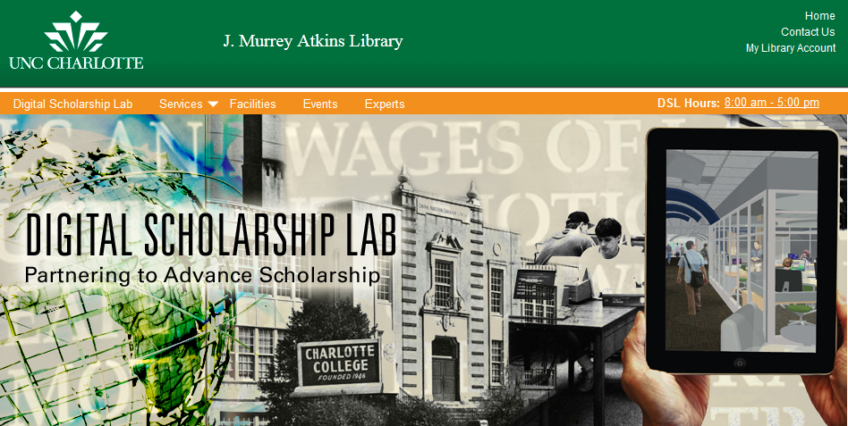
Samples…
Notes:
Mission:
The Digital Scholarship Lab partners with faculty and graduate students in the use of digital and networked research tools to create, disseminate, and store new knowledge.
The DSL can support the research process and projects through advising, digital tools, and a set of services that includes:
Authors' Rights & Copyright Information
Publication services
Data analysis, data curation, and working with large data sets
Geographic information systems (GIS)
Guidance in the digitization of materials and creation of born-digital content
Usability assessment to evaluate the User Interface (UI) of digital content
Dataverse in collaboration with Odum.
Events calendar with a variety of workshops. Some on DH—not noted in the services list.
Anyone here from UNCC to say a bit more about DSL?

Slide 17
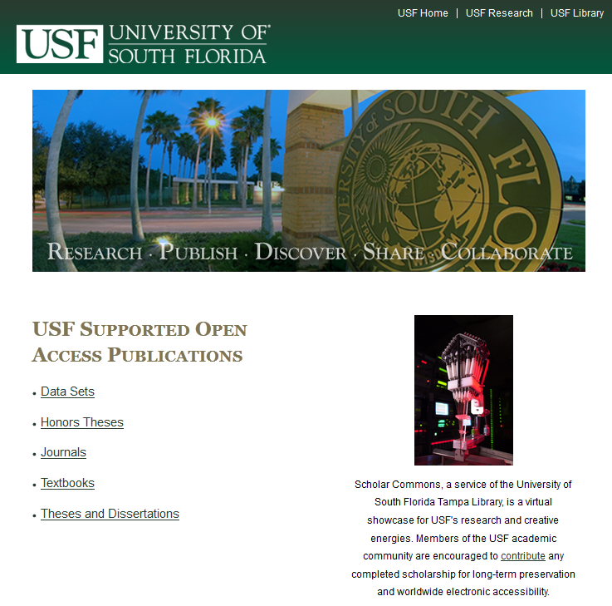
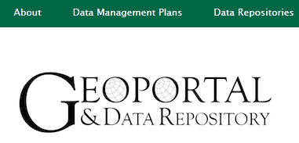

Notes:
10 journals, 5 textbooks among the ETDs in their Bepress IR.
The Geoportal and Data Repository is one of several projects, and includes help for researchers on DMPs, some data collections (including Gulf Oil Spill and Karst info [Karst—terrain usually characterized by barren, rocky ground, caves, sinkholes, underground rivers, and the absence of surface streams and lakes. It results from the excavating effects of underground water on massive soluble limestone]
Textbook Affordability—library receives a portion of TAP funding (from Student Technology fees) to purchase ebook copies of textbooks; library also buys at least some print textbooks to circulate. Site connects faculty to bookstore to make coursepacks—site does not list whether library is involved (licensed journals as part of coursepacks).
Wake ebook publishing

Slide 18

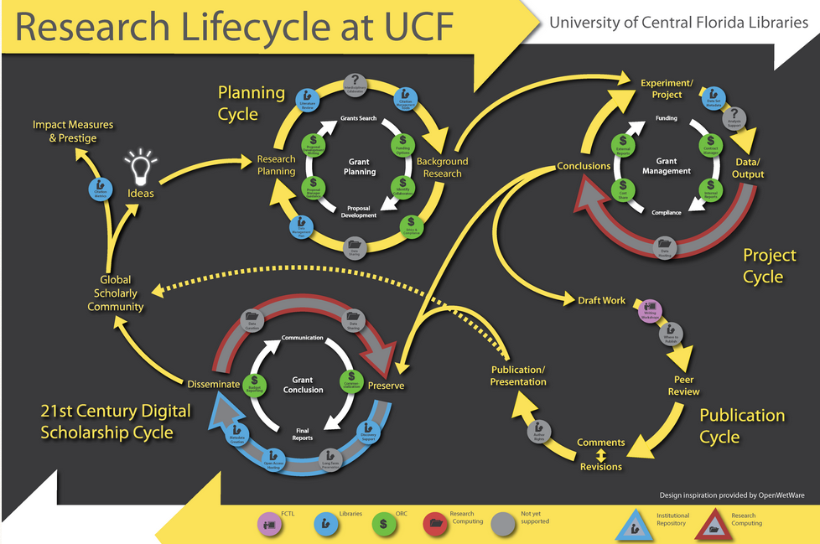
Notes:
Services: Citation management tools, citation metrics, data management plans, discovery support, literature reviewing, metadata, open access hosting
Don’t worry that you can’t make out detail—point is that UCF is planning library services around the research lifecycle itself.
Handy Scholarly Communications glossary: http://library.ucf.edu/ScholarlyCommunication/Glossary.php

Slide 19
Reflections
Can libraries avoid being left out of the loop?
How to bridge gap across such a wide variety of library sizes?
What services to offer, strategically and sustainably?
Perhaps a set of Scholarly Communication Core Services?
Notes:
There’s been a flurry of activity around scholarly communications topics recently, with ASERL selecting a VPO, ULAC deciding to create a SC taskforce, positions posted at VCU and other schools, OA fund initiated at Northern Illinois, the White House directive and FASTR legislation in the news….
Takeaways—schools of all sizes are already offering Scholarly Communications services, so any of us can do this work. We have to decide carefully what services to offer, and who our partners should be.

Slide 20
Potential for Growth
Shared Support for Expertise:
  ACRL’s Scholarly Communication Toolkit
  ASERL’s new VPO for Scholarly Communication
  ARL’s “Developing a Scholarly Communication Program in Your Library”
  ULAC Scholarly Communication Working Group
Notes:
I am pleased to announce that Christine Fruin, J.D., M.S.L.I.S., will serve as our Visiting Program Officer for Scholarly Communications. Christine is the Scholarly Communications Librarian at the University of Florida; her one-year term as VPO will start on/about April 1. As VPO, one of her roles will be to interview scholarly communications/open access leaders within ASERL (and possibly beyond) as the basis for a series of articles on the evolving nature of this work, highlighting the lessons our members have learned, and identifying common themes and possible best practices. ASERL has also created a Scholarly Communication Interest Group, and ULAC is creating a Scholarly Communications Working Group to investigate open access publishing and archiving.
These resources are all external—there are internal resources that we can draw on, as well—each school likely has a research office, the school’s legal counsel, and the grad school to partner with, depending on what SC activity we are tackling.

Slide 21
Potential for Growth
Shared Support for Technical Infrastructure:
  Institutional Repositories
  Open Journal Systems
  Dataverse
Notes:
Shared Tech: At least two consortia also offer shared repositories using DSpace: LASR (Liberal Arts Shared Repository) and the NITLE Network (National Institute for Technology in Liberal Education) offer shared IR’s; Appalachian College Association is a member of NITLE, as is Associated Colleges of the South.
Open Journal Systems is one software (UNCG offering). BEPress also can host e-journals, and there are some libraries publishing e-journals in their DSpace repositories.
Data: DSpace can store data, and there are other free repository software packages, but this is free as in free puppies.

Slide 22
Scholarly Communications
Core Services (?)
Program-Oriented, or
Librarian Competencies?
  Open Access
  Copyright and Publishing Agreements
  Research Support
Notes:
One possibility for describing a set of core services is to consider SC as a program. ACRL has Guidelines for Instruction Programs in Academic Libraries that might serve as a good model—addressing such functions as program design, support, key components of advanced programs, and benchmarks.
There might be more flexibility, though, in concentrating on librarian competencies. Could be stand-alone like the Information Literacy Competency Standards, could recommend that SC competencies be integrated into other competency standards—there are lots of competency sets out there: RUSA’s Professional Competencies for Reference and User Services Libraries has a very good structure, NASIG lists draft competencies for Electronic Resources Librarianship (NASIG); there are competencies for Art librarians, Music Librarians, the Medical Library Association also has competencies. And specific disciplines have their own information literacy competencies, like Anthropology and Sociology, Science and Technology,

Slide 23
Scholarly Communications
Core Services (?)
Open Access:
  Help authors make their works open access (including deposit)
  Understand variety of publishing models
Copyright and Publishing Agreements
Research Support
Notes:
These are deceptively simple, right?

Slide 24
Scholarly Communications
Core Services (?)
Open Access
Copyright and Publishing Agreements:
  Help patrons use copyrighted materials fairly and legally
  Advise authors on their publishing agreements
Research Support
Notes:
Consistent among comments in my survey and on the SPEC Kit survey were remarks about the library’s role as a resource for the use of copyrighted materials—reserves were mentioned a lot, and digitization of physical formats (like VHS), but coursepacks are another area where the library’s licenses can make a big difference to students.

Slide 25
Scholarly Communications
Core Services (?)
Open Access
Copyright and Publishing Agreements
Research Support:
  Help users evaluate OA resources among their lit reviews
  Help authors comply with funding mandates (including DMP)
Notes:
By users in first bullet I mean students doing assignments and faculty conducting a lit review for a grant.

Slide 26
Resources
Radom, Feltner-Reichert, and Stringer-Stanback. Organization of Scholarly Communication Resources, SPEC Kit 332. Association of Research Libraries , Nov. 2012.
ACRL, “Scholarly Communication Toolkit,” http://scholcomm.acrl.ala.org/
ARL Office of Scholarly Communication, “Advancing Scholarly Communication,” http://www.arl.org/sc/index.shtml
SPARC, The Scholarly Publishing and Academic Resources Coalition, http://www.arl.org/sparc/

Slide 27
Contact:
Wm. Joseph Thomas
thomasw@ecu.edu
252-737-2728

