Slide 1
Health at Every Size (HAES)
Kylie Nowicki BS, MD candidate 2023; and Kathryn M Kolasa PhD, RDN, LDN Professor Emeritus
Brody School of Medicine, East Carolina University, Greenville, NC
January 27, 2022
Review of:
Ulian MD, Aburad L, da Sliva Oliveira MS. et al. Effects of health at every size intervention on health-related outcomes of people with overweight and obesity: a systematic review. Obesity Reviews. 2018;19:1659-1666.
Discussion of systematic reviews and meta-analysis
Discussion of how this may apply to primary care practice

Slide 2

People come in a variety of shapes and sizes - a positive characteristic of the human race.
Good health is NOT defined by
Body size. Good health is a state of physical, mental and social well-being
There is no one ideal body
size, shape, or weight that
every individual should
strive to achieve.
Every body is a good body, whatever its
size or shape.
Self-esteem and body image
are strongly linked.
By feeling good about their
bodies and who they are,
people are motivated to
maintain healthy
behaviors.

Slide 3
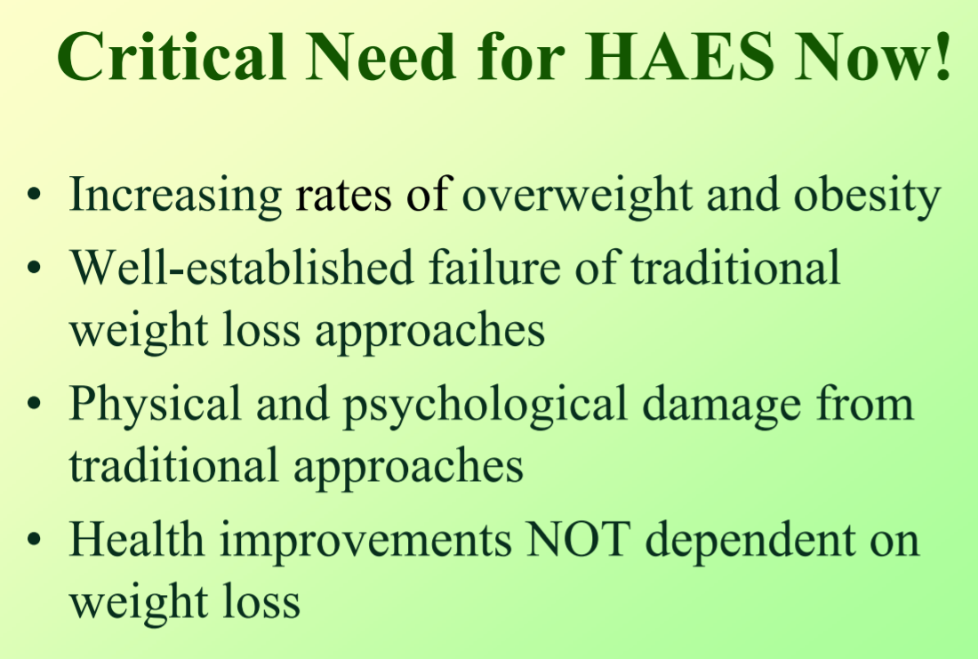
From
WEIGHT REALITIES
GROUP
-Society for
Nutrition Education
Behavior and
Change along with
The Association for Size Diversity and Health (ASDAH), the National Association to Advance Fat Acceptance (NAAFA) offer the Health At Every Size® (HAES) model is a health-focused, weight-neutral approach to health that promotes the right to be peaceful in one’s body.

Slide 4
Research in early 2000s focused on
Metabolic Fitness
Improvements in morbidity and mortality without weight change
Genetics and body size
Outcomes (short and long term) of traditional weight loss interventions
Risks and benefits of “dieting”
Weight Stigmatization especially in health care, employment and education
A need to evaluate non-dieting interventions

Slide 5
Today’s Journal topic: Health at Every Size
Paper: Ulian MD, Aburad L, da Sliva Oliveira MS. et al. Effects of health at every size intervention on health-related outcomes of people with overweight and obesity: a systematic review. Obesity Reviews. 2018;19:1659-1666.
Presenter: Kylie Nowicki, Brody School of Medicine third year student
Comment on systematic reviews prepared by Gina Firnhaber PhD, MSN and Kathryn Kolasa PhD, RDN, LDN

Slide 6
Obesity Reviews (published since 2000)
Impact factor: 9.2 (10 is excellent in a narrow focus). NEJM 91.1; JAMA 56.2; Am J Clin Nutr 6.7; Am Fam Phys 1.9
World Obesity Federation (an academic journal; 10,000 members)
Monthly peer reviewed
Reviews on all disciplines related to obesity and its comorbidities (basic and behavioral sciences, clinical treatment and outcomes, epidemiology, prevention and public health)
Must offer new insights, critical or novel perspectives that will enhance the state of knowledge in the field.
The editorial policy is to publish high quality peer-reviewed manuscripts that provide needed new insight into all aspects of obesity and its related comorbidities while minimizing the period between submission and publication.

Slide 7
Systematic Review
A systematic review is a type of literature review that follows a specific and clearly described method of identifying, pulling together, and synthesizing available literature about a specific topic
  Authors outlined a specific question and methodology be established prior to beginning the process
The search question and limits were specific enough to clearly determine if the work should be included in the review
  Blood profile, blood pressure, anthropometry, eating behavior, energy intake, diet quality, psych and qualitative evaluations
The search and synthesis processes was clearly described using multiple sources and types of information, and not solely traditional publications
Synthesis did include a level of quality appraisal

Slide 8
Defining Characteristics of Systematic Review (Munn et al., 2018, p. 6; https://doi.org/10.1186/s12874-017-0468-4 )
  Clearly articulated objectives and questions to be addressed
  Inclusion and exclusion criteria, stipulated a priori (in a protocol), that determine the eligibility of studies
  A comprehensive search to identify all relevant studies, both published and unpublished
  A process of study screening and selection
  Appraisal of the quality of included studies/ papers (risk of bias) and assessment of the validity of their results/findings/ conclusions
  Analysis of data extracted from the included research
  Presentation and synthesis of the results/ findings extracted
  Interpret the results, potentially establishing the certainty of the results and making and implications for practice and research
  Transparent reporting of the methodology and methods used to conduct the review
-prepared by Dr. Gina Firnhaber, 2021

Slide 9
In comparison a Meta-analysis…
If guidelines established for the systematic review limit inclusion of items to studies similar enough for statistical comparison, a meta-analysis of included works may be performed
  Not the case for this paper
Meta-analysis is used to synthesize the results of different but similar quantitative studies in such a way as to determine an overall effect based on the combined results
Included studies must be sufficiently similar in factors such as population, variables, methods, measures, and outcomes as to be logically combined
Meta-analysis statistically creates a big picture of the results of existing work, including smaller or inconclusive studies that might otherwise be ignored yet provide value in avoiding bias
Multiple methods can be used in performing meta-analysis, including weighting of studies or pooling of subjects (should be part of a priori plan and clearly described in methodology)
prepared by Dr. Gina Firnhaber, 2021

Slide 10
Trusting Results of Systematic Reviews and Meta-analyses
Just because something is published doesn’t mean it’s high quality
Not all systematic reviews and meta-analyses are well done
Look for:
  Submission of methodology to PROSPERO or Open Science Network or other organization prior to initiation of work
    Was done
  Publication in journal requiring authors to meet PRISMA (Preferred Reporting Items for Systematic reviews and Meta-Analyses, 2009, 2020) guidelines; https://doi.org/10.1136/bmj.n71
  Work meeting most requirements of PRISMA guidelines
  Publication by known entity such as the Cochrane Collaboration or a highly respected journal or organization
    Published in Obesity Reviews
prepared by Dr. Gina Firnhaber, 2021

Slide 11
Application in Practice
Realize that guidelines and protocols from respected organizations are generally based on existing literature, often systematic reviews and meta-analyses, and someone has done the work of evaluating the evidence for you
Keeping in mind that some scenarios are higher stakes than others, when considering applying results of a systematic review or meta-analysis within your clinical practice, questions you should ask include:
  Was a strong methodology used in selecting and synthesizing results of included studies to minimize risk of bias so that results are trustworthy and valid?
  Are results similar between studies, are overall results consistent and precise enough to trust, and what is the strength of the findings?
  Were all logical potential outcomes and issues considered and what is the relationship between risk/benefit/cost of a new or different treatment or approach and any current/existing one?
prepared by Dr. Gina Firnhaber, 2021

Slide 12
Should this review change your practice?
Intervention difficult to study
14 studies included but not able to do a meta-analysis
Some positive findings
As always, call for more studies, evidence
Now for a discussion led by Kylie Nowicki, Brody medical student with special interest in HAES

Slide 13
Effects of haes
“Health at every size” interventions
But first, some background information
Kylie Nowicki, MS3
Brody School of Medicine, ECU
January 27, 2022

Slide 14
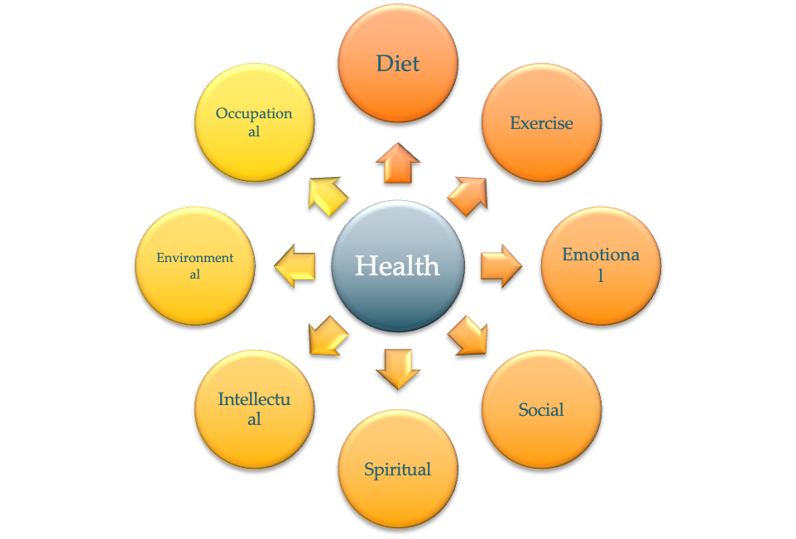


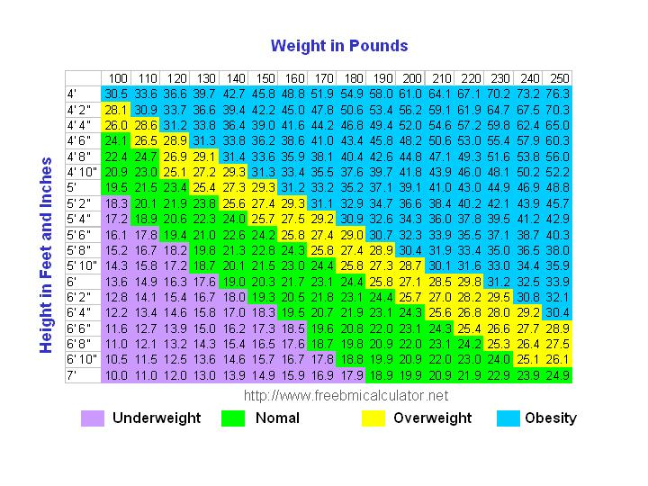
Defining weight and health
Diet & Exercise are only 2 components of health
What are the limitations of using BMI to assess health?
BMI was meant to be an ASSESSMENT tool, NOT a diagnostic tool
Who’s Healthier?
You can’t tell how healthy someone is by looking at them.
Health At Every Size® Curriculum by ASDAH, NAAFA, & SNEB

Slide 15
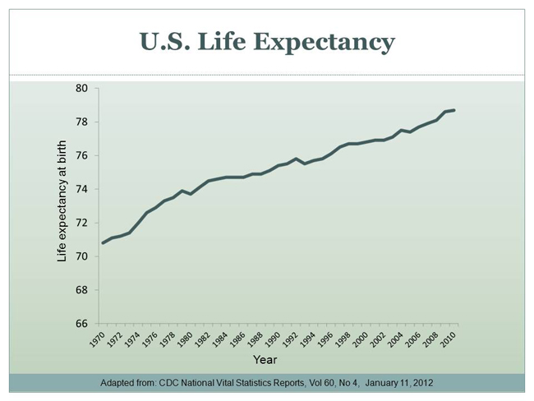

Changes in weight over time
Associations between weight and health
Obesity-Related Conditions Include:
Heart disease
Stroke
Type 2 diabetes
Certain types of cancer
…which are some of the leading causes of preventable death
BUT correlation is NOT causation
But Life-Expectancy is rising?
Health At Every Size® Curriculum by ASDAH, NAAFA, & SNEB

Slide 16
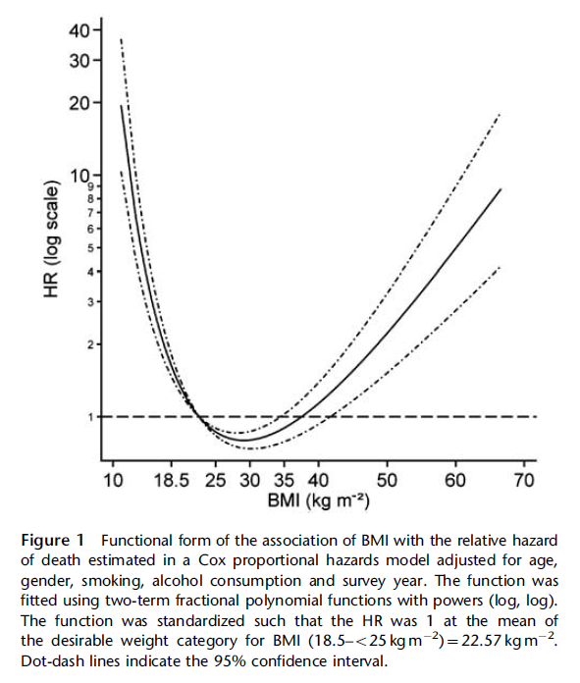
Association between BMI and death
Notice that the lowest incidence of early death is actually in the “overweight” and “obese” categories
Int J Obes (Lond). 2011 Jun; 35(6): 838–851

Slide 17
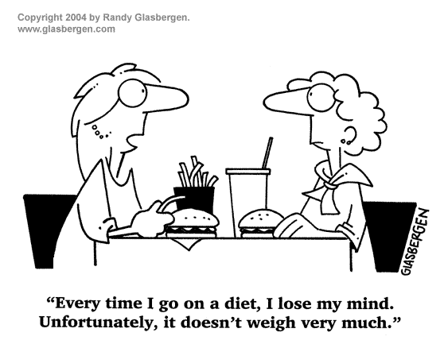
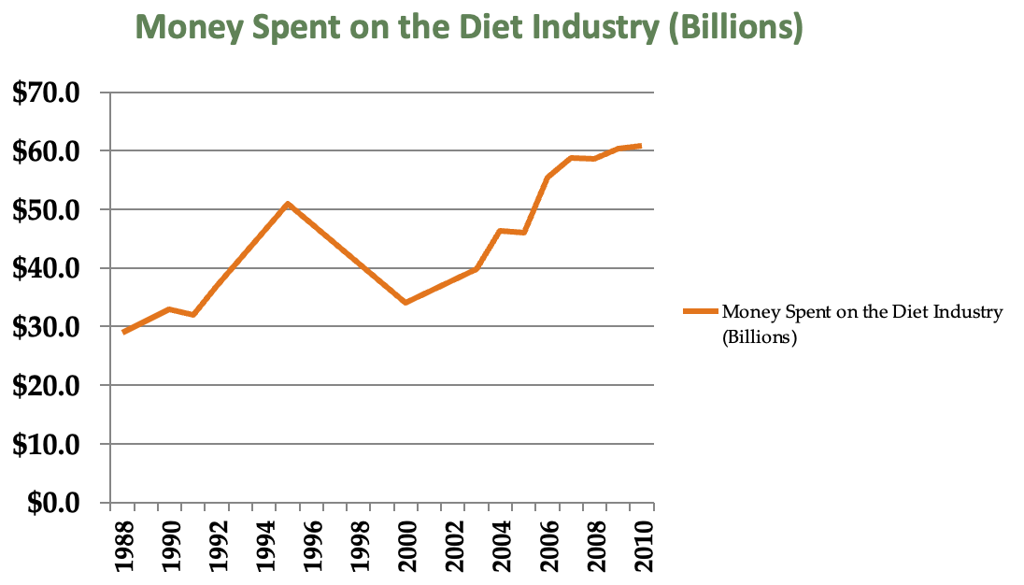
Then why is everyone dieting?
If diets worked, wouldn’t Americans be spending LESS on dieting over time?
Marketdata Enterprises, Inc., 2011

Slide 18
Defining HAES: “Health at Every size”
HAES supports people in adopting health habits for the sake of health and well-being (rather than weight control)
Eating in a flexible manner that values pleasure and honors internal hunger cues, satiety, and appetite
Finding joy in moving one’s body and becoming more physically fit
Accepting and respecting the natural diversity of body shapes and sizes
Aka HAES is a “weight neutral” approach that supports people in feeling good about themselves, no matter the outcome
Health At Every Size® Curriculum by ASDAH, NAAFA, & SNEB
Notes:
HAES is about

Slide 19
What an intervention looks like
Diet Group
Non-Diet (HAES)
Calorie restriction and food diaries
Reading food labels/fat grams/carb counts
Excluding certain food groups/limiting food intake
Stressing the benefits of exercise
Encouraging specific exercise interventions
Body acceptance/self worth, regardless of shape or size
Encouraging techniques to focus on internal vs. external cues for hunger and fullness
Nutrition education focused on the effects of food choices on well-being
Encouraging physical activity that is enjoyable and feels good for your body
Health At Every Size® Curriculum by ASDAH, NAAFA, & SNEB

Slide 20
Common misconceptions of HAES: myths vs facts
MYTH: HAES means everyone is healthy, regardless of weight
FACTS:
Not everyone may be at a weight that is right for them
However, efforts to lose weight are often futile, and can even be harmful
HAES supports people in making good health choices REGARDLESS OF SIZE
MYTH: HAES means people shouldn't be concerned about nutrition and activity
FACTS:
Eating and exercise are important components of health (weight is not)
When eating based on internal cues, certain foods make you feel better than others
Dietary variety is encouraged
Health At Every Size® Curriculum by ASDAH, NAAFA, & SNEB

Slide 21
Reviewing the article
A “Systematic Review”
Participants: Men & Women who were overweight and/or obese
All studies included were tested for risk of bias and validity using the Cochrane Collaboration tool
The review contained 14 papers describing 7 studies
Main goals: investigating the effects of HAES-based interventions on outcomes related to health and well-being
Interventions focused on encouraging healthy eating behaviors and physical activities, while encouraging participants to improve self-acceptance, self-consciousness, and wellbeing, instead of weight loss alone
Control groups focused on prescribing diets for participants +/- physical activity regimens
Ulian et. al., Obes Rev. 2018

Slide 22
Comparing the data
HAES
Both
Improved “well-being”: decreased depression, better QoL
Decreased “drive for thinness” and body-image distortion
Improved eating behavior: reduced cognitive constraint and binge eating; improvement in recognizing and responding to hunger and satiety cues
Clinically significant decrease in systolic BP
Varying outcomes with changes in cholesterol
Improved self-esteem
Clinically significant decreases in body weight and waist-to-hip ratios
Improvements in body weight and satisfaction
Clinically significant decrease in disinhibition with food intake
Increase in physical activity levels
Ulian et. al., Obes Rev. 2018

Slide 23
The conclusions
Body weight reduction is NOT vital for major health benefits
Regardless of BMI, excessive abdominal fat poses great risks to human health, morbidity, and mortality
HAES-based interventions showed superior improvements in QoL, depression, general well-being, perceived stress, and self-esteem (in most of the studies)
→ Also superior to controls in improving eating behavior, energy intake, and diet quality
Ulian et. al., Obes Rev. 2018

Slide 24
Limitations of research
HAES-based approaches cover several aspects of health, which makes choosing specific interventions to study difficult
All participants in these studies were WOMEN (vs. Men & Women, stated as inclusion criteria; age and ethnicity were not specified in the analysis)
Physical activity interventions varied widely among the included studies, and the effects of specific interventions remain unclear
Studies included varied widely in terms of follow-up, interventions utilized, sample size, methodological quality, and outcomes
Efficacy of quantitative vs. qualitative data
Absence of meta-analysis due to methodological heterogenicity
Research findings are limited to the person, rather than the wider social dimension
Ulian et. al., Obes Rev. 2018

Slide 25
A final word
Dr. Jennifer Gaudiani is an eating disorders expert physician and the Founder and Medical Director of the Gaudiani Clinic in Denver, CO.
Board Certified in Internal Medicine, she completed her undergraduate degree at Harvard, medical school at Boston University School of Medicine, and her internal medicine residency and chief residency at Yale, where she won numerous clinical awards.
In 2008, she was one of the founding team members of the ACUTE Center for Eating Disorders in Denver, Colorado. After seven years there, she left as its Medical Director to pursue her vision of outpatient care, founding the Gaudiani Clinic.
Dr. Gaudiani has lectured nationally and internationally and is widely published in the scientific literature as well as on blogs.
https://youtu.be/54Yb8Neryf0
https://www.gaudianiclinic.com/#welcome-2

Slide 26
References
Hotchkiss JW, Leyland AH. The relationship between body size and mortality in the linked Scottish Health Surveys: cross-sectional surveys with follow-up. Int J Obes (Lond). 2011;35(6):838-851. doi:10.1038/ijo.2010.207
Ulian MD, Aburad L, da Silva Oliveira MS, et al. Effects of health at every size® interventions on health-related outcomes of people with overweight and obesity: a systematic review. Obes Rev. 2018;19(12):1659-1666. doi:10.1111/obr.12749

