Slide 1
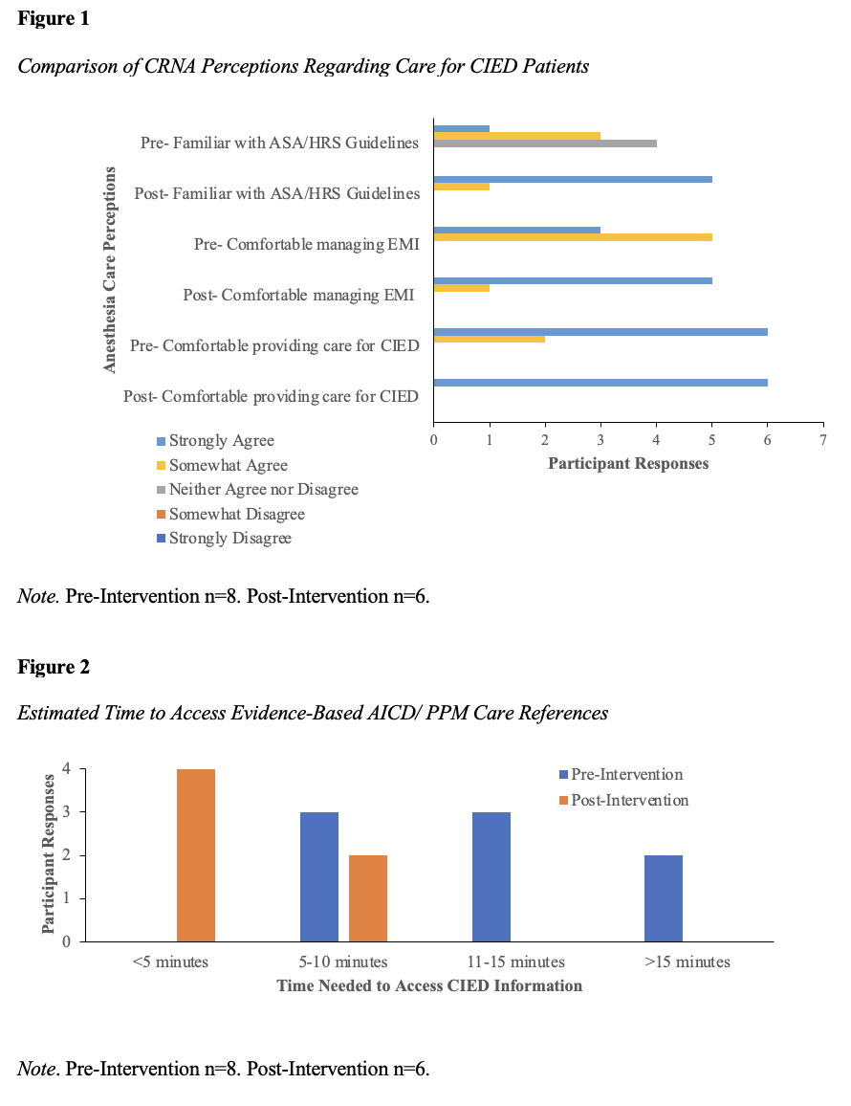
Perioperative Care of Patients with Cardiac Implantable Electronic Devices: A DNP Project
Caroline Flynn, BSN, SRNA
Travis Chabo, PhD, CRNA, Project Chair
Nurse Anesthesia Program
College of Nursing, East Carolina University
Greenville, North Carolina 27858
flynnc14@students.ecu.edu
INTRODUCTION
RESULTS
DISCUSSION
More than three million Americans have a cardiac implantable electronic device (CIED)^{1,2}. Unfortunately, there has been an increase in harms and mortality for this population during the perioperative period².
Factors that contribute to complexity of these patients:
  Preoperative identification of the patient’s device, settings, recent interrogation, as well as the patient’s dependency on the device^{1,3}.
  Difficulty locating appropriate resources for perioperative CIED care^{1,3}.
  Electromagnetic interference (EMI): can cause inappropriate pacing, shocking, and device damage¹. If the damage is severe, the cost of replacing the device averages $25,797⁴.
  Magnet application: Depending on the manufacturer, magnets can cause a variety of changes, including conversion to asynchronous mode or diagnostic testing^{1,2,3}.
The purpose of this quality improvement project was to assess anesthesia providers’ perceptions of an AICD/PPM Handout as an educational tool to improve perioperative CIED management and patient safety.
After utilizing the AICD/ PPM Handout:
  CRNAs had increased comfortability managing EMI (Figure 1).
  CRNAs felt more confident in their preoperative assessments of CIED patients.
  The estimated time spent accessing CIED references decreased (Figure 2).
  The providers had increased awareness of best practice guidelines published by the ASA/HRS (Figure 1).
  CRNAs indicated they were extremely likely (n=3) or somewhat likely (n=3) to utilize the AICD/PPM Handout in the future.
Limitations of this project include small sample size and variation in pre- and post-survey responses.
CONCLUSIONS
CRNA comfortability managing CIEDs perioperatively increased after this educational intervention.
This intervention has the potential to improve perioperative care and patient safety.
CRNAs’ future use of this intervention could be increased if a free-response survey question was added to assess what information they would find useful on a quick-reference handout.
Future QI projects could expand on this project by:
  Further identifying barriers to improving perioperative care for patients with CIEDs.
  Creating a standardized approach, or algorithm, for caring for CIED patients.
  Including a larger sample size.
  Having a more similar number of pre- and post-survey participants.
METHODS
This quality improvement project consisted of a single plan, do, study, act (PDSA) cycle implemented in the Main operating room of the partnering organization over a three-week period⁵.
A pre-test and post-test design with Qualtrics software used to create and administer the pre- and post-intervention surveys.
The AICD/PPM Handout as well as a supplemental educational PowerPoint was sent to participants at the beginning of implementation.
Eight CRNAs responded to the pre-survey and six CRNAs responded to the post-survey.
Data was analyzed through Microsoft Excel
REFERENCES
American Society of Anesthesiologists Task Force on Perioperative Management of Patients with Cardiac Implantable Electronic Devices. (2020). Practice advisory for the perioperative management of patients with cardiac implantable electronic devices: Pacemakers and implantable cardioverter–defibrillators. Anesthesiology, 132(2), 225–252. https://doi.org/10.1097/ALN.0000000000002821
Samuels, J. M., Overbey, D. M., Wikiel, K. J., Jones, T. S., Robinson, T. N., & Jones, E. L. (2021). Electromagnetic interference on cardiac pacemakers and implantable cardioverter defibrillators during endoscopy as reported to the US Federal Drug Administration. Surgical Endoscopy, 35, 3796–3801. https://doi.org/10.1007/s00464-020-07872-2
Bryant, H. C., Roberts, P. R., & Diprose, P. (2016). Perioperative management of patients with cardiac implantable electronic devices. British Journal of Anaesthesia Education, 16(11), 388–396. https://doi.org/10.1093/bjaed/mkw020
Nichols, C., Vose, J., & Mittal, S. (2016). Incidence and costs related to lead damage occurring within the first year after a cardiac implantable electronic device replacement procedure. Journal of the American Heart Association, 5(2). doi:10.1161/JAHA.115.002813
Institute for Healthcare Improvement. (2017). QI essentials toolkit: PDSA worksheet. https://www.ihi.org/resources/Pages/Tools/PlanDoStudyActWorksheet.aspx

