Slide 1

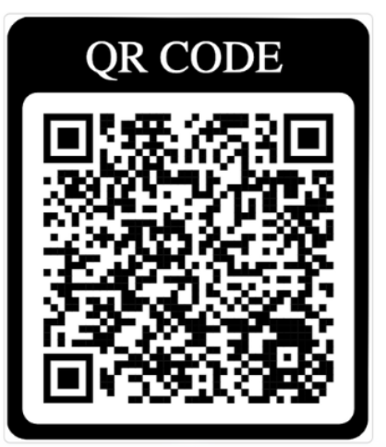
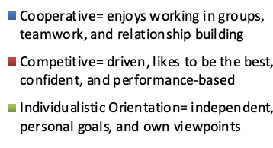
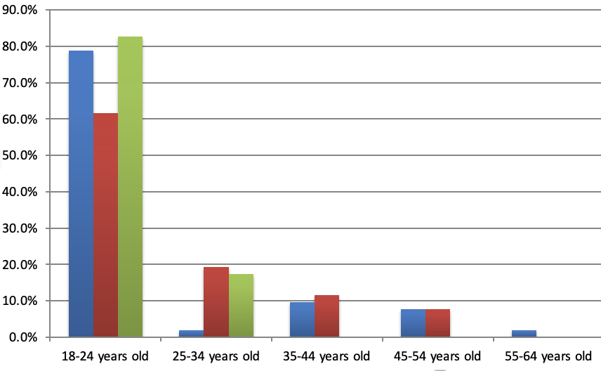
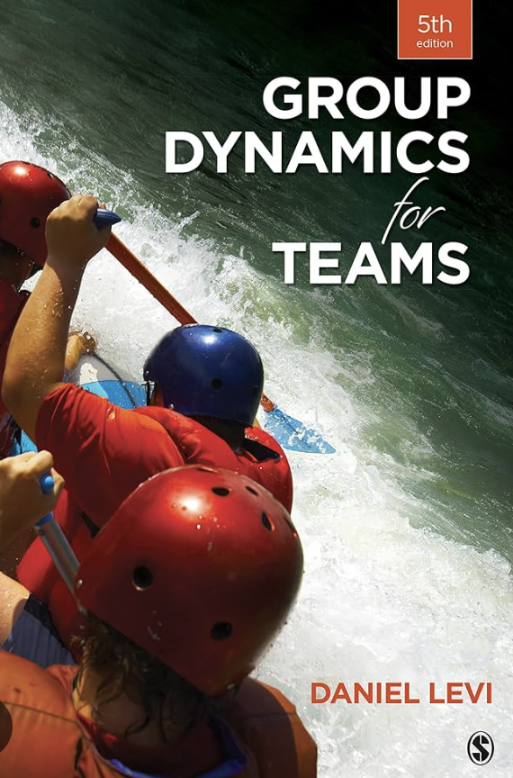
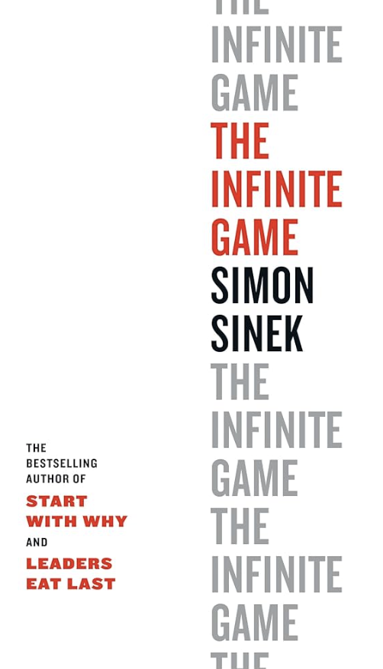
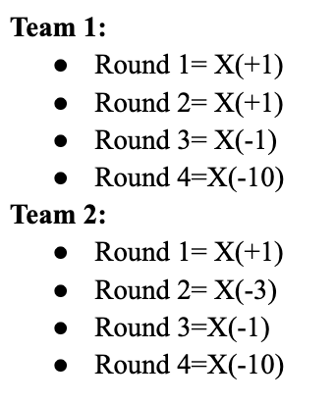
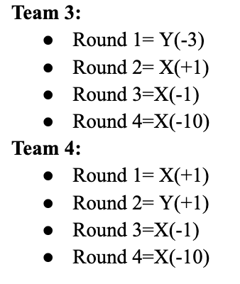
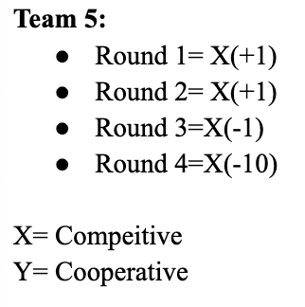
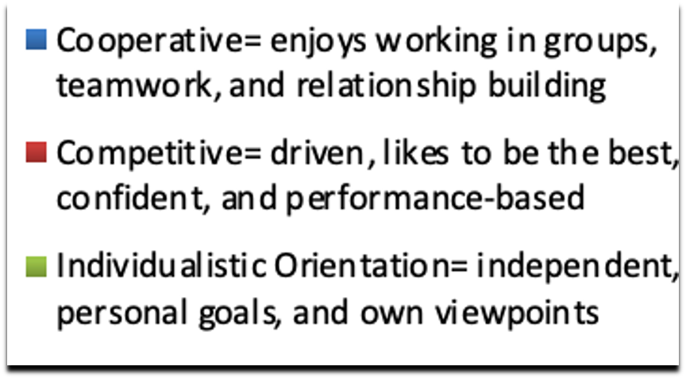
Cooperation vs. Competition in Teams in the Business Environment
Ellen Snipes
Ellen Snipes
Business Management
East Carolina University
Greenville, North Carolina 27858
Snipese21@students.ecu.edu
INTRODUCTION
MATERIALS & METHODS
DISCUSSION
This study examines cooperation and competition in team dynamics with a focus on factors influencing an individual's decision to compete or cooperate. Drawing on theories from “Group Dynamics for Teams” by Daniel Levi and “The Infinite Game” by Simon Sinek, I gained results in understanding what factors are affecting team dynamics. I explored through survey aspects of demographics, employment, industry, styles, trust, relationships, online or in-person working/school, and rewards relating to whether an individual shows cooperation vs. competition. Team dynamics are crucial for the success of any business organization, with cooperation and competition being key drivers of team performance. This research aims to investigate the balance between cooperation and competition examining the factors above that influence an individual to compete or cooperate. While examining research methods, we seek to better understand how different team environments foster cooperation and competition. My degree in business management entails understanding your team of employees to be a successful manager. In understanding team environments, we can learn to produce better team success.
To investigate the dynamics of cooperation and competition within teams, I employed a mixed-methods approach. First, a survey was distributed to participants who were business students and professionals. In addition, a classroom activity using game theory principles (X and Y Game) was conducted and I observed five teams to view competitive and cooperative strategies in real-time. Additionally, interviews were conducted by business professionals to assess balancing cooperative and competitive behavior in their work.
Our findings suggest that more people like to show they are cooperative when they possess competitive characteristics. The stigma with competition is that it often gets associated with selfishness, where one person’s gain must come at another’s expense. To obtain more findings, please fill out my survey!
RESULTS
Survey: Out of 101 Participants, 51% think in a business team they have a cooperative orientation while 26% of participants think they have a competitive orientation, followed by 23% with an individualistic orientation.
Survey: Factors affecting team dynamics include demographics, employment, industry, styles, trust, relationships, online or in-person school/working, and rewards.
Of all 100% of participants, 38.5% of males align with being cooperative, while 61.5% of females do
Of all 100% of participants, 50% of females align with being competitive, while 46.2% of males do, and 3.8% prefer not to say
Full-time employment individuals are more likely to be competitive (34.6%)and less cooperative (25%) than part-time employment (23.1%-Competitive, 28.8%- Cooperative)
Students (Full-Time) are more likely to have an individualist orientation (87%)
Participants believe Online school/working are more likely to be cooperative, while in-person is more likely to be competitive
Survey Link:
https://ecu.az1.qualtrics.com/jfe/form/SV_cTr7VrOqiftMC7I
REFERENCES
Levi, D. (2017). Group Dynamics for Teams (5th ed.). SAGE.
Sinek, S. (2020). The infinite game. Portfolio Penguin.
Survey adapted from Johnson, D., & Johnson, F. (1997). Joining together: Group theory and group skills (6th ed.). Boston, MA: Allyn & Bacon.
Gonzalez, N. I. V., Palma, M. A., & Brown, A. L. (2022). Social Stigma and Subsequent Competitive Behavior. working paper.
Simmons, S. A., Wiklund, J., & Levie, J. (2014). Stigma and business failure: implications for entrepreneurs’ career choices. Small business economics, 42, 485-505.
Heidemeier, Heike, and Jenny V. Bittner. "Competition and achievement goals in work teams." Human Performance 25.2 (2012): 138-158.
Ștefănescu, Roxana. "Aspects Concerning the Competition of Business Operators in the Contemporary Business Environment." Annals of Spiru Haret University. Economic Series 18.3 (2018): 69-80.
Kamkankaew, Pongsiri, et al. "Increasing Competitive Environment Dynamics and the Need of Hyper-Competition for Businesses." International Journal of Sociologies and Anthropologies Science Reviews (IJSASR) 2.5 (2022): 9-20.
Ginsberg, Ari. "Minding the competition: From mapping to mastery." Strategic Management Journal 15.S1 (1994): 153-174.
Lin, Chieh-Peng, et al. "Perceived job effectiveness in coopetition: A survey of virtual teams within business organizations." Computers in Human Behavior 26.6 (2010): 1598-1606.
•Yue, Chen, Patrick SW Fong, and Teng Li. "Meeting the challenge of workplace change: Team cooperation outperforms team competition." Social Behavior and Personality: an international journal 47.7 (2019): 1-15.
Heidemeier, Heike, and Jenny V. Bittner. "Competition and achievement goals in work teams." Human Performance 25.2 (2012): 138-158.
Henning Loeb, I. (2016). Zooming in on the partnership of a successful teaching team: Examining cooperation, action and recognition. Educational Action Research, 24(3), 387-403. https://doi.org/10.1080/09650792.2016.1185377
Duijf, H. (2021). Cooperation, fairness and team reasoning. Economics and Philosophy, 37(3), 413-440. https://doi.org/10.1017/S0266267120000413
Lin, C., He, H., Baruch, Y., & Ashforth, B. E. (2017). The effect of team affective tone on team performance: The roles of team identification and team cooperation. Human Resource Management, 56(6), 931-952. https://doi.org/10.1002/hrm.21810
Zaplata, S., Kunze, C. P., & Lamersdorf, W. (2009). Context-based cooperation in mobile business environments: Managing the distributed execution of mobile processes. Business & Information Systems Engineering, 1(4), 301-314. https://doi.org/10.1007/s12599-009-0060-5
Zaplata, S., Kunze, C. P., & Lamersdorf, W. (2009). Context-based cooperation in mobile business environments: Managing the distributed execution of mobile processes. Business & Information Systems Engineering, 1(4), 301-314. https://doi.org/10.1007/s12599-009-0060-5
Classroom Activity:
Interviews:
Business professionals should incorporate a balance of cooperative and competitive characteristics to strive for team success.
Classroom Activity:
Trust’s Influence on Competition and Cooperation
Business hidden agenda is successful in the short term but long-term relationships ruin
From a game to a group project individuals go from competitive to cooperative (depending on what you’re doing you could switch)
ACKNOWLEDGEMENTS
I would like to thank Professor Winkler for her guidance and support throughout this project. I also want to acknowledge the participants who took the time to complete the survey, classroom activity, and interviews.

