Slide 1
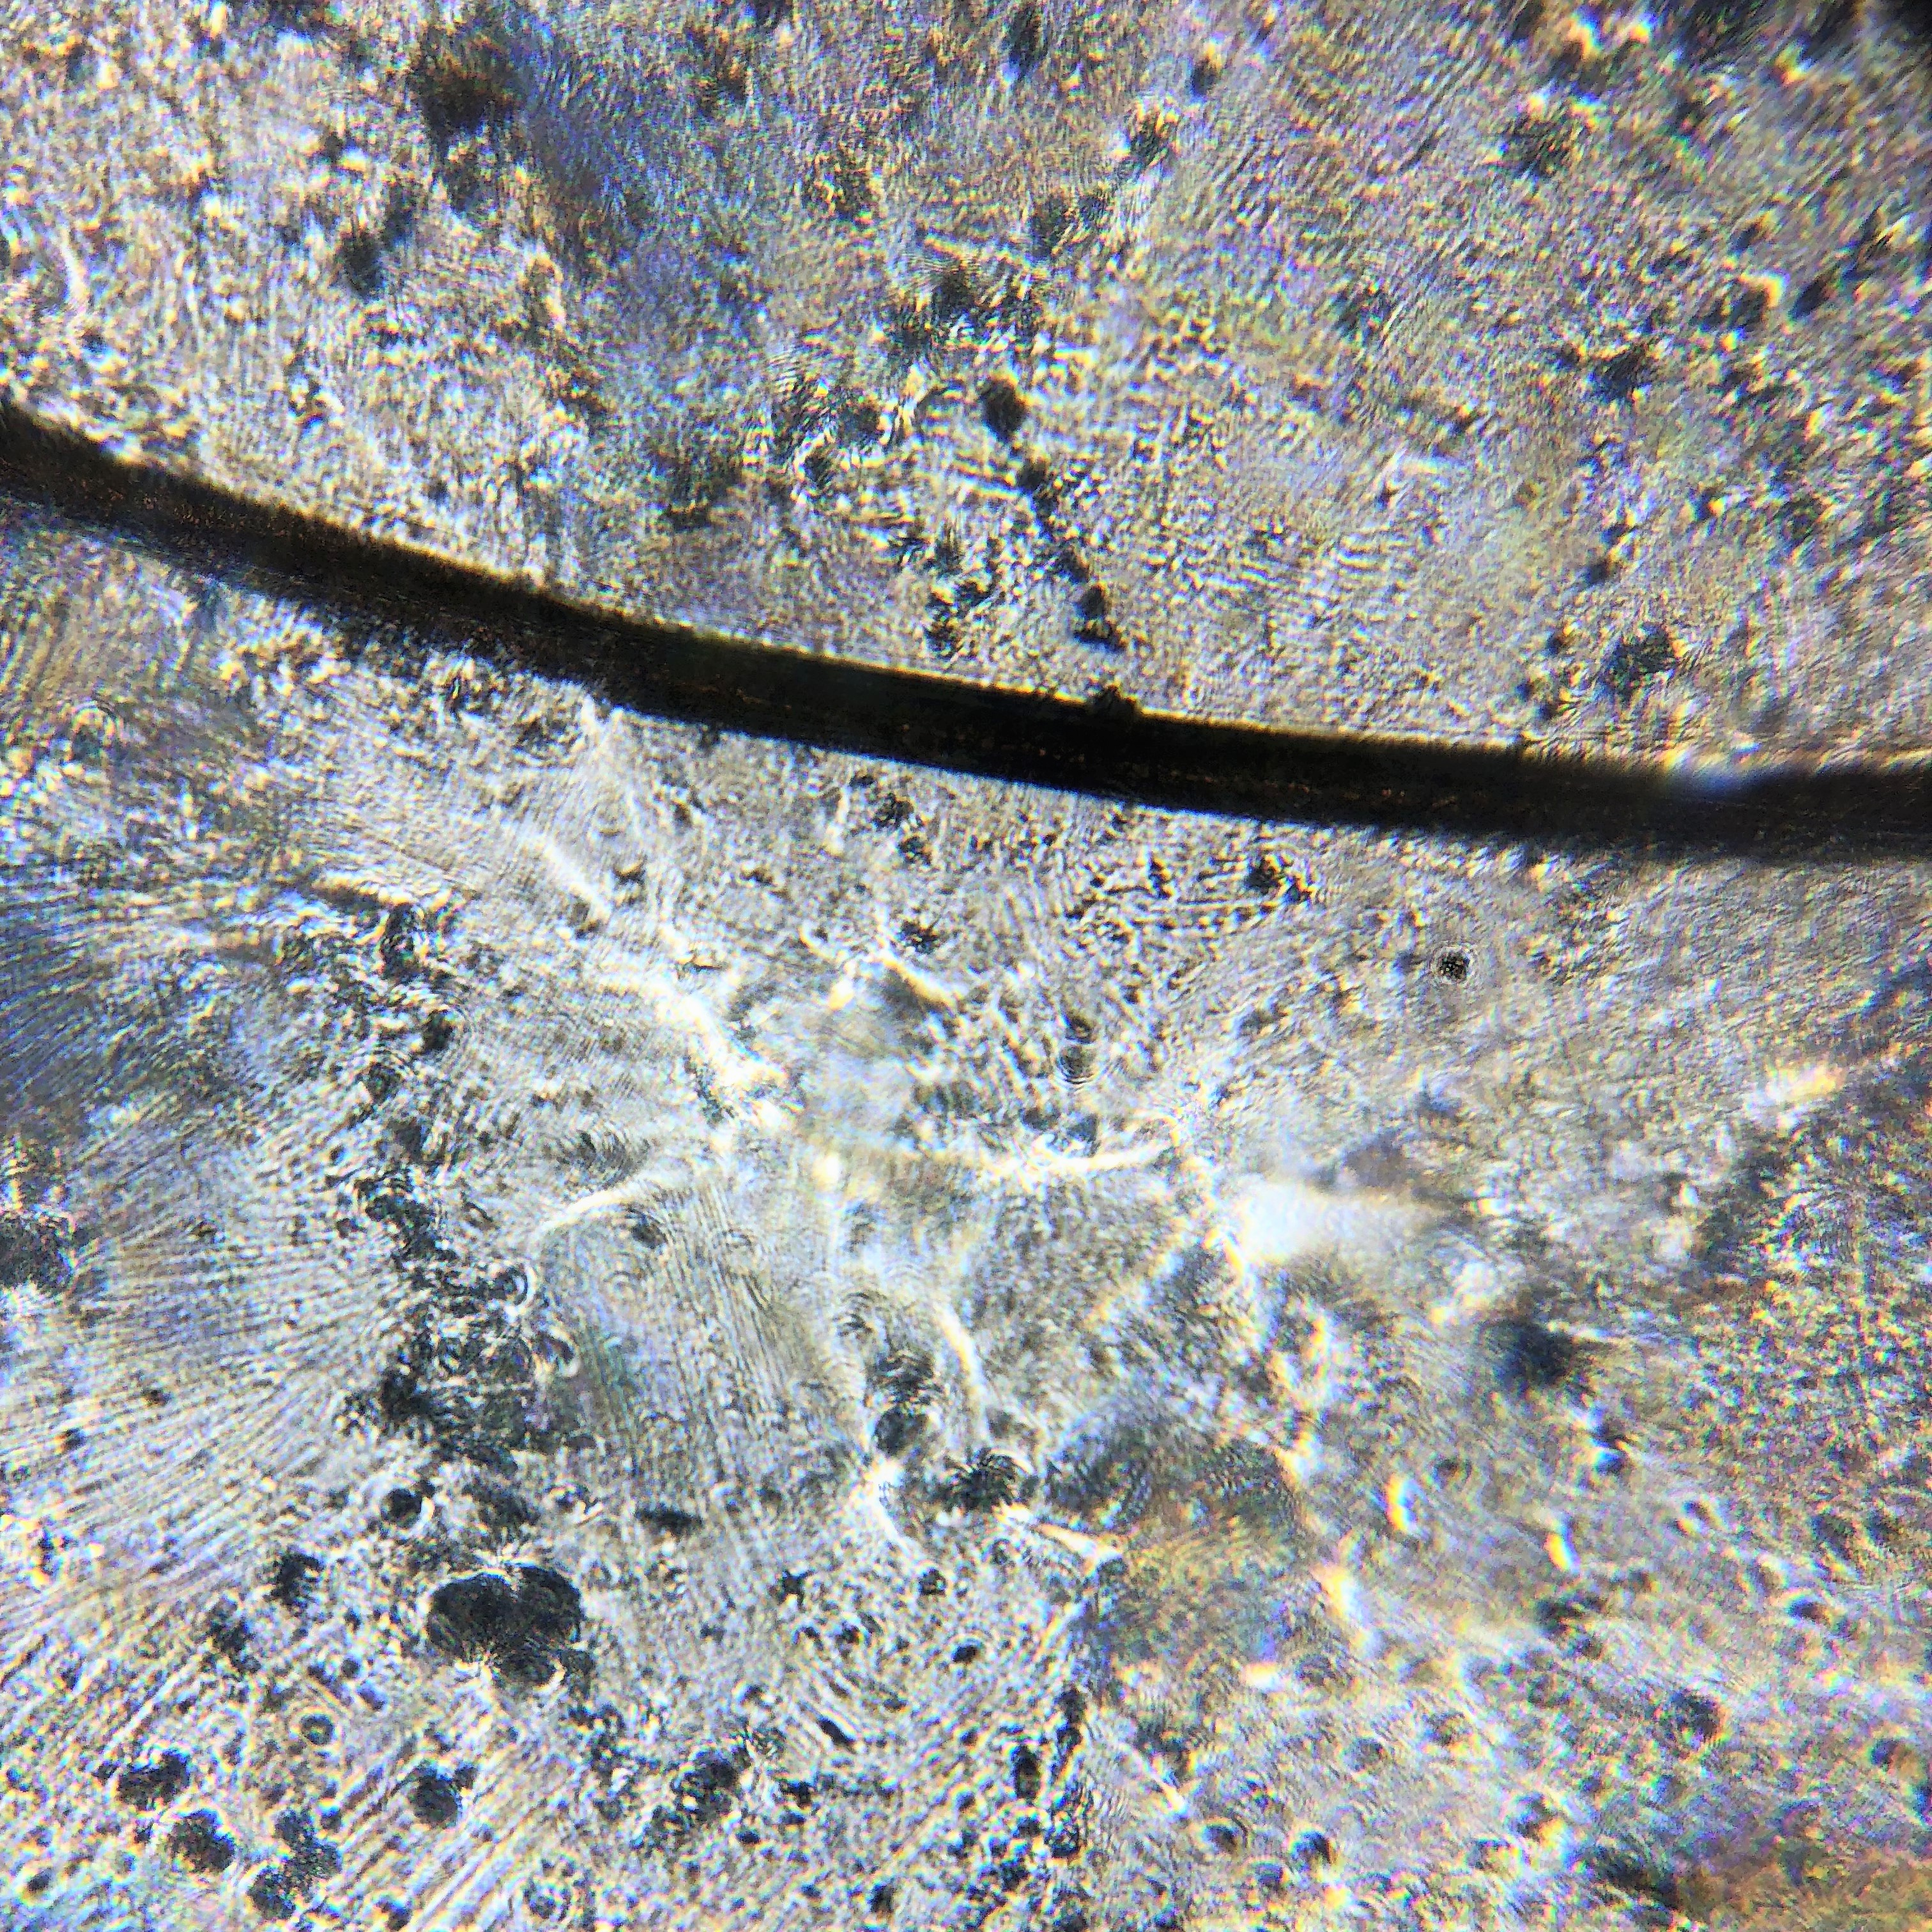
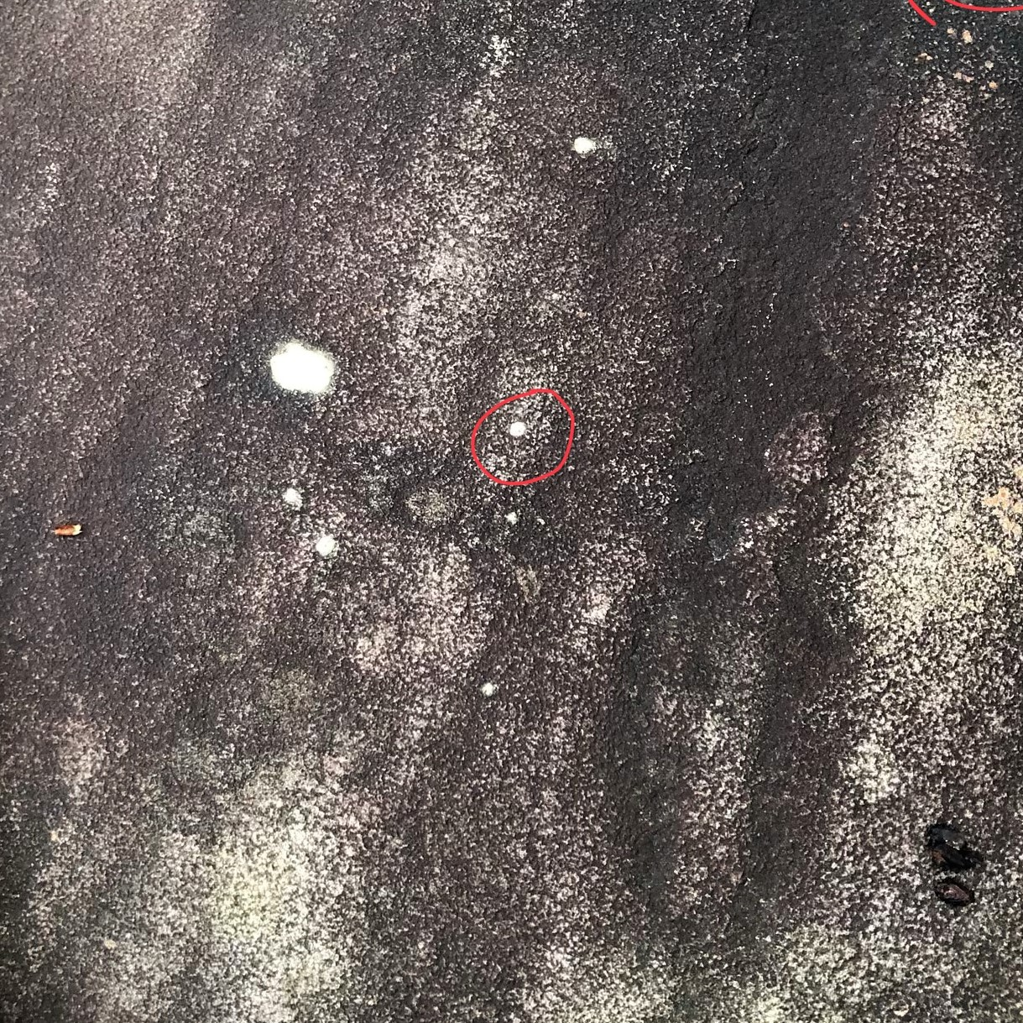
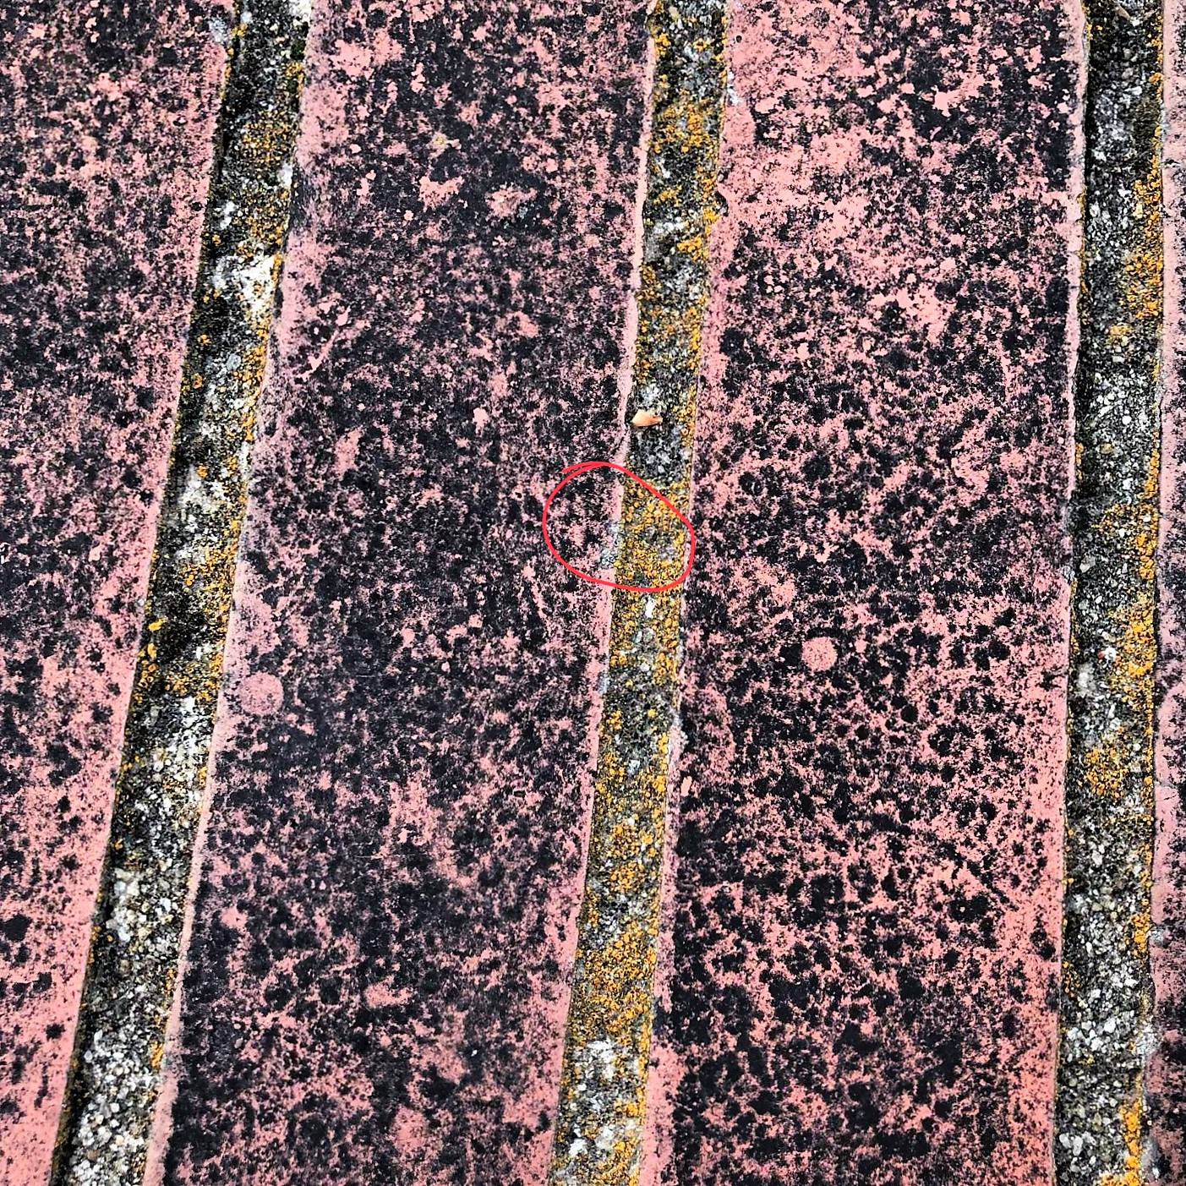
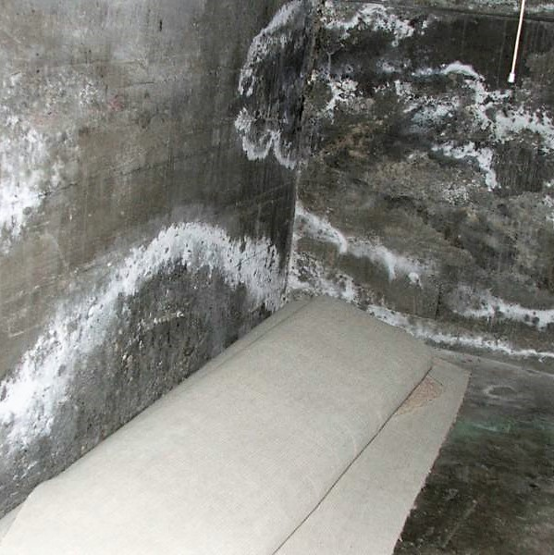
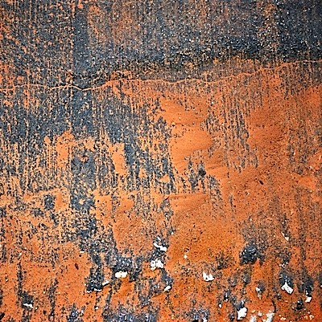
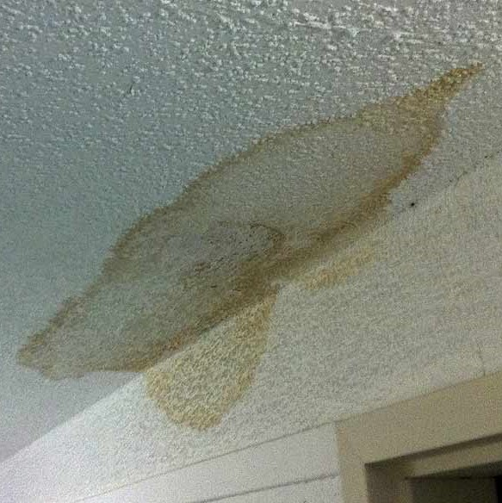
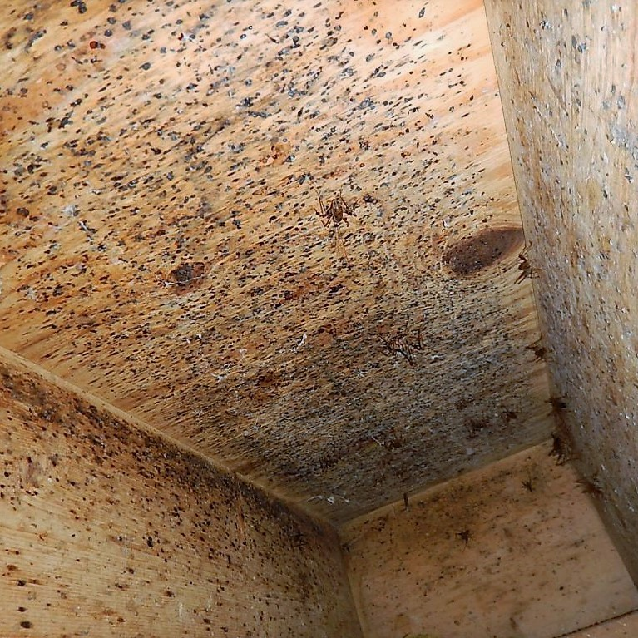
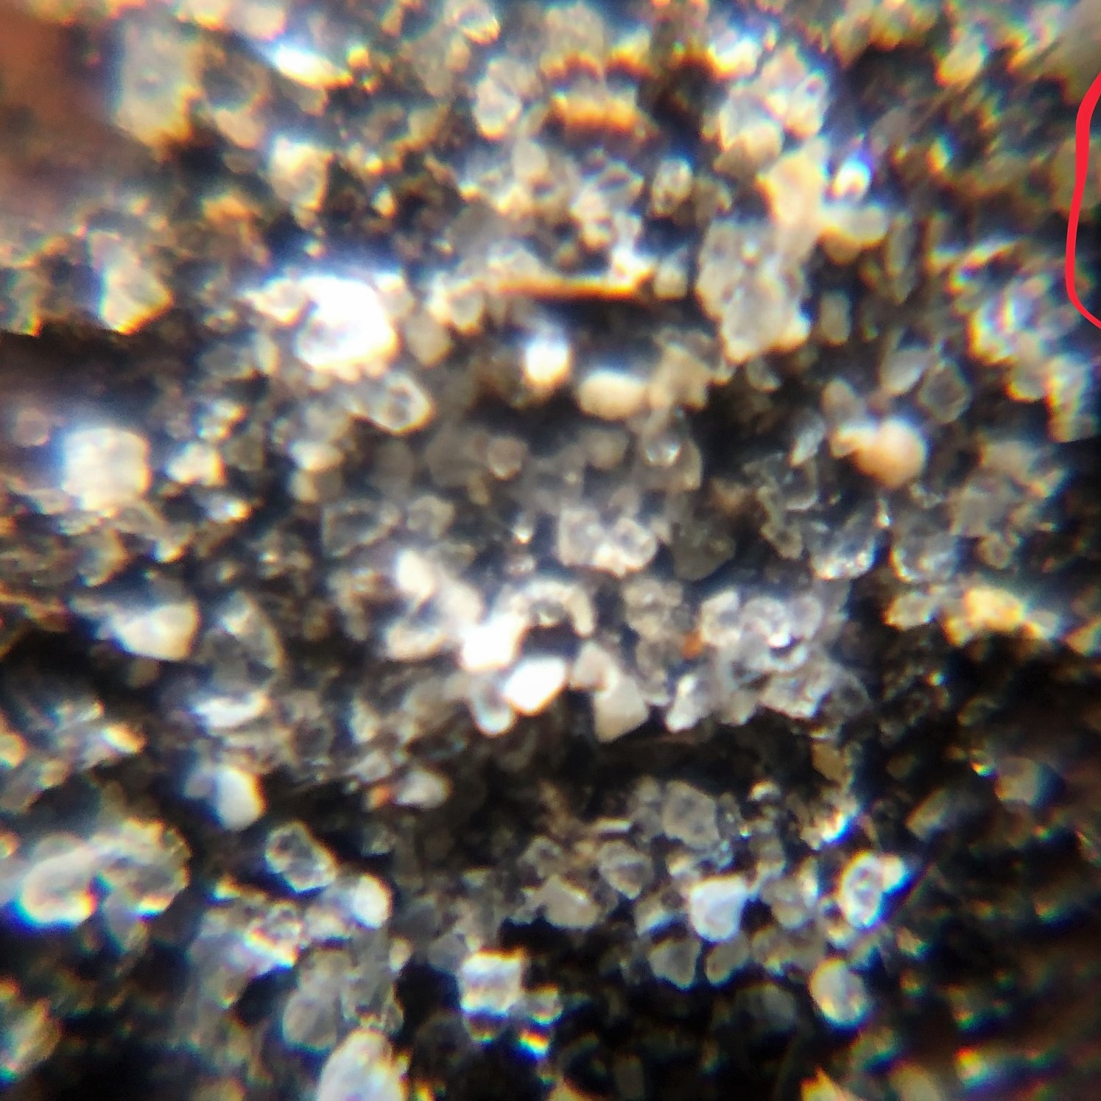
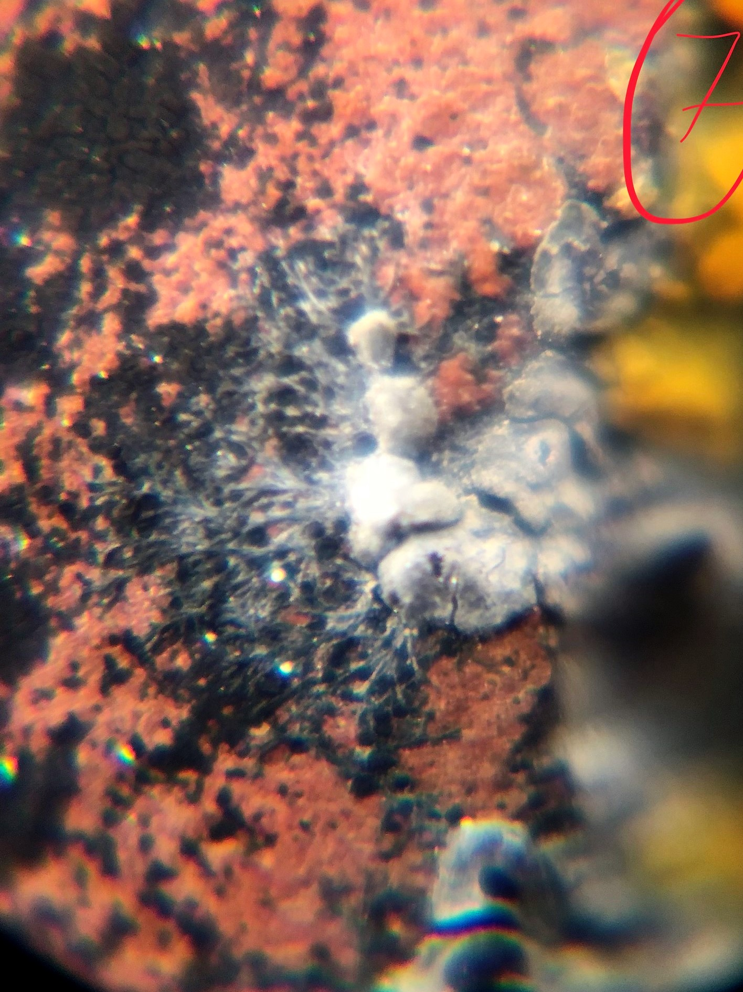
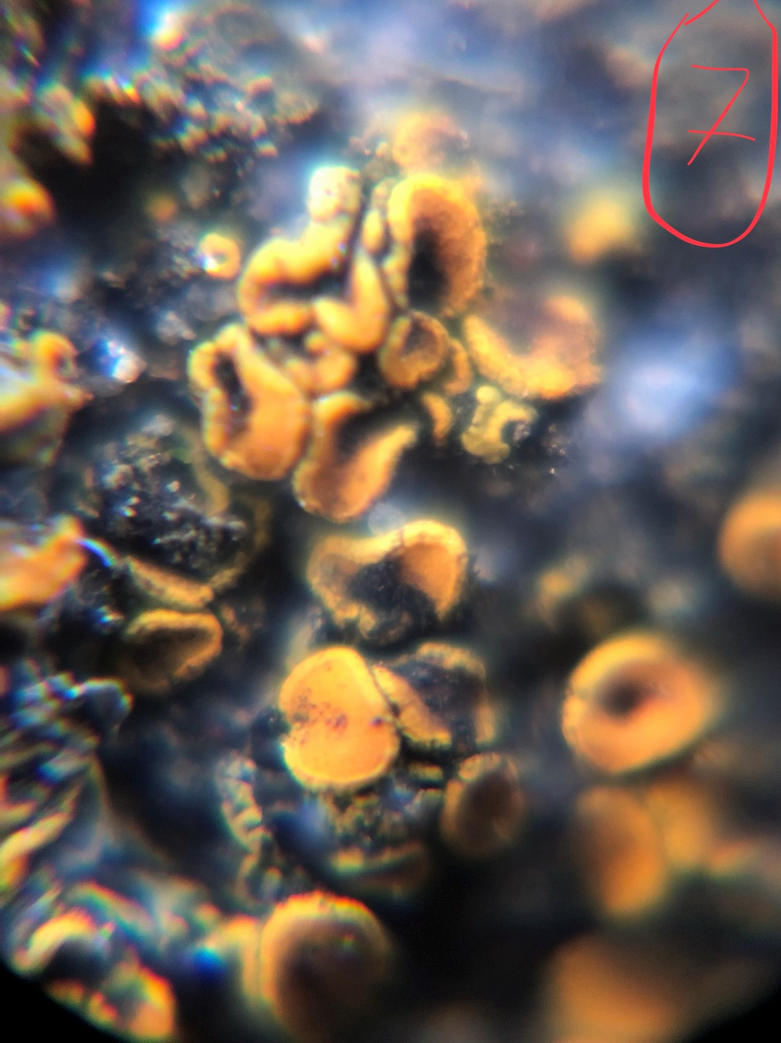
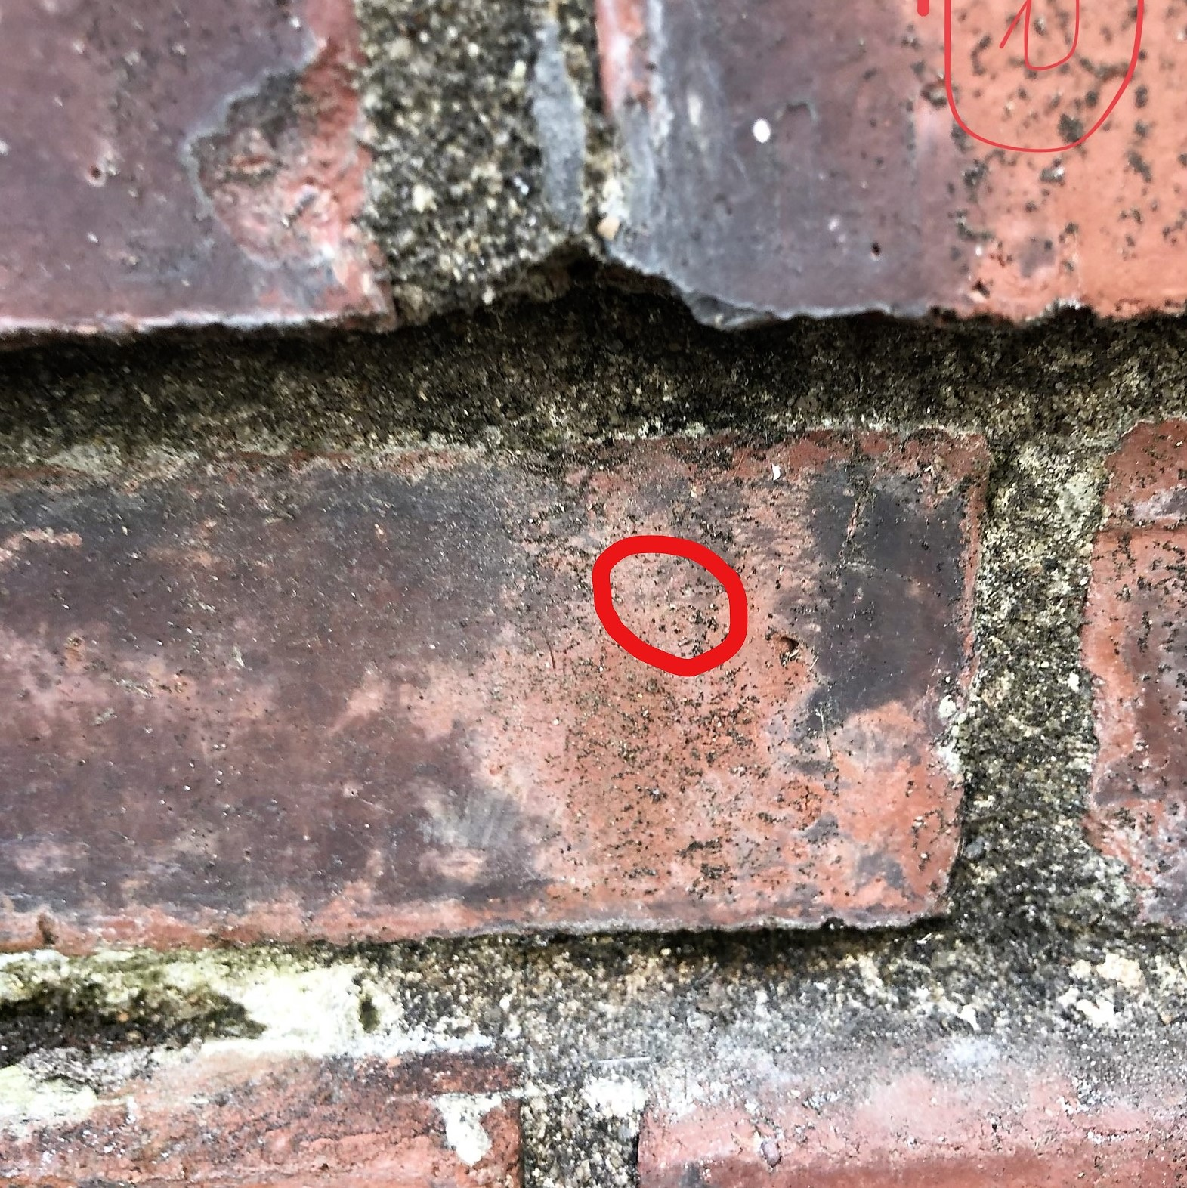
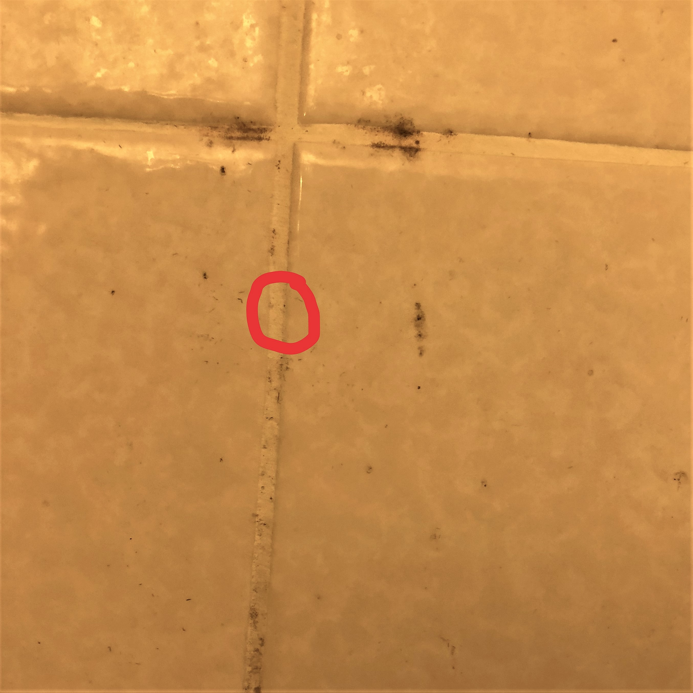
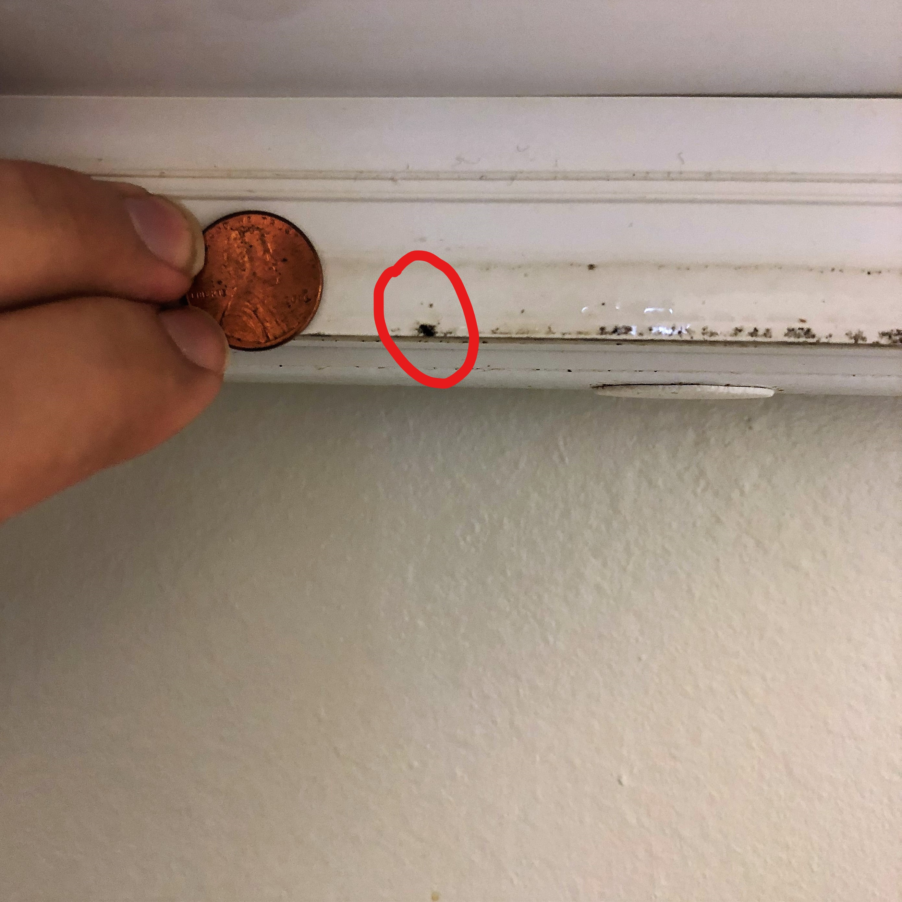
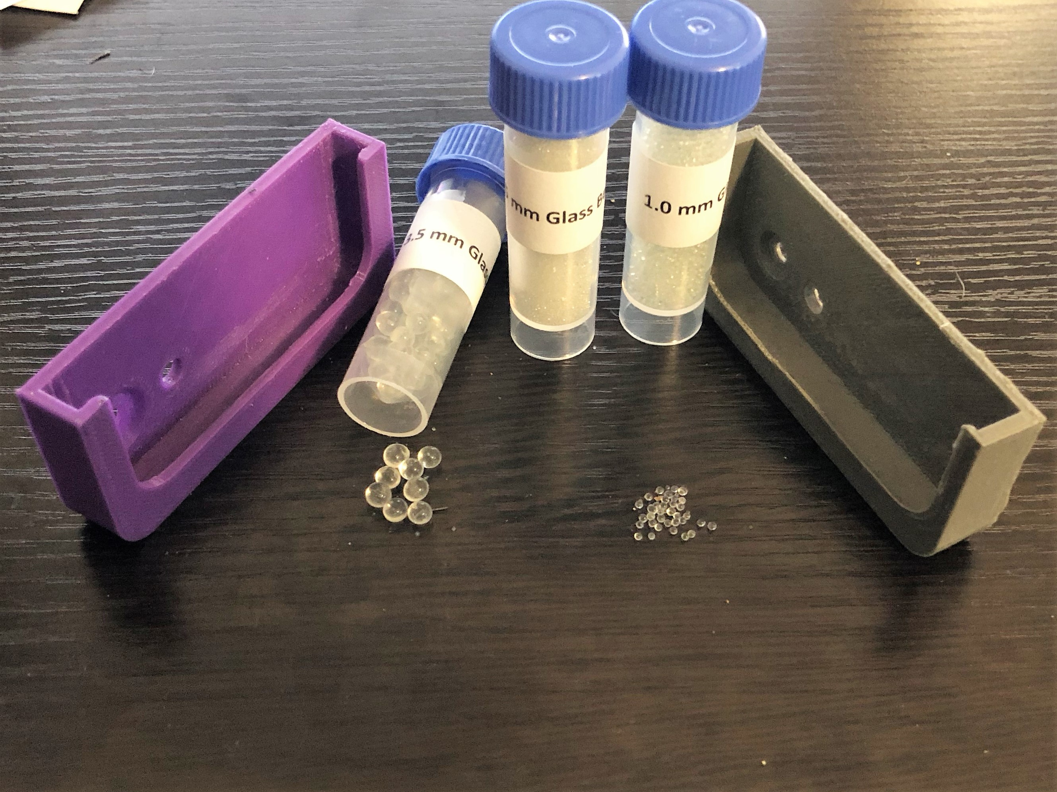
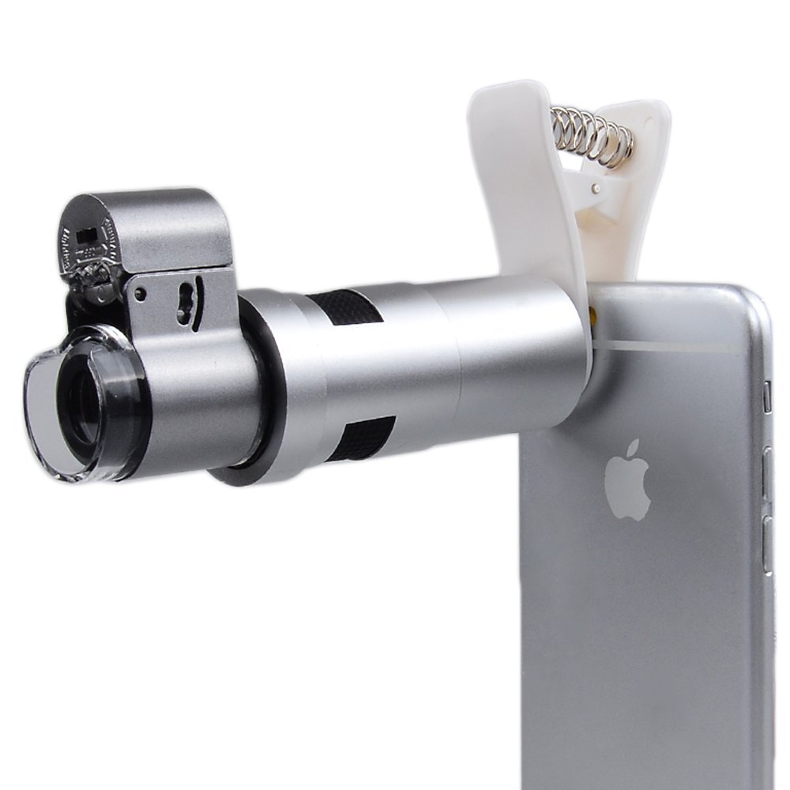
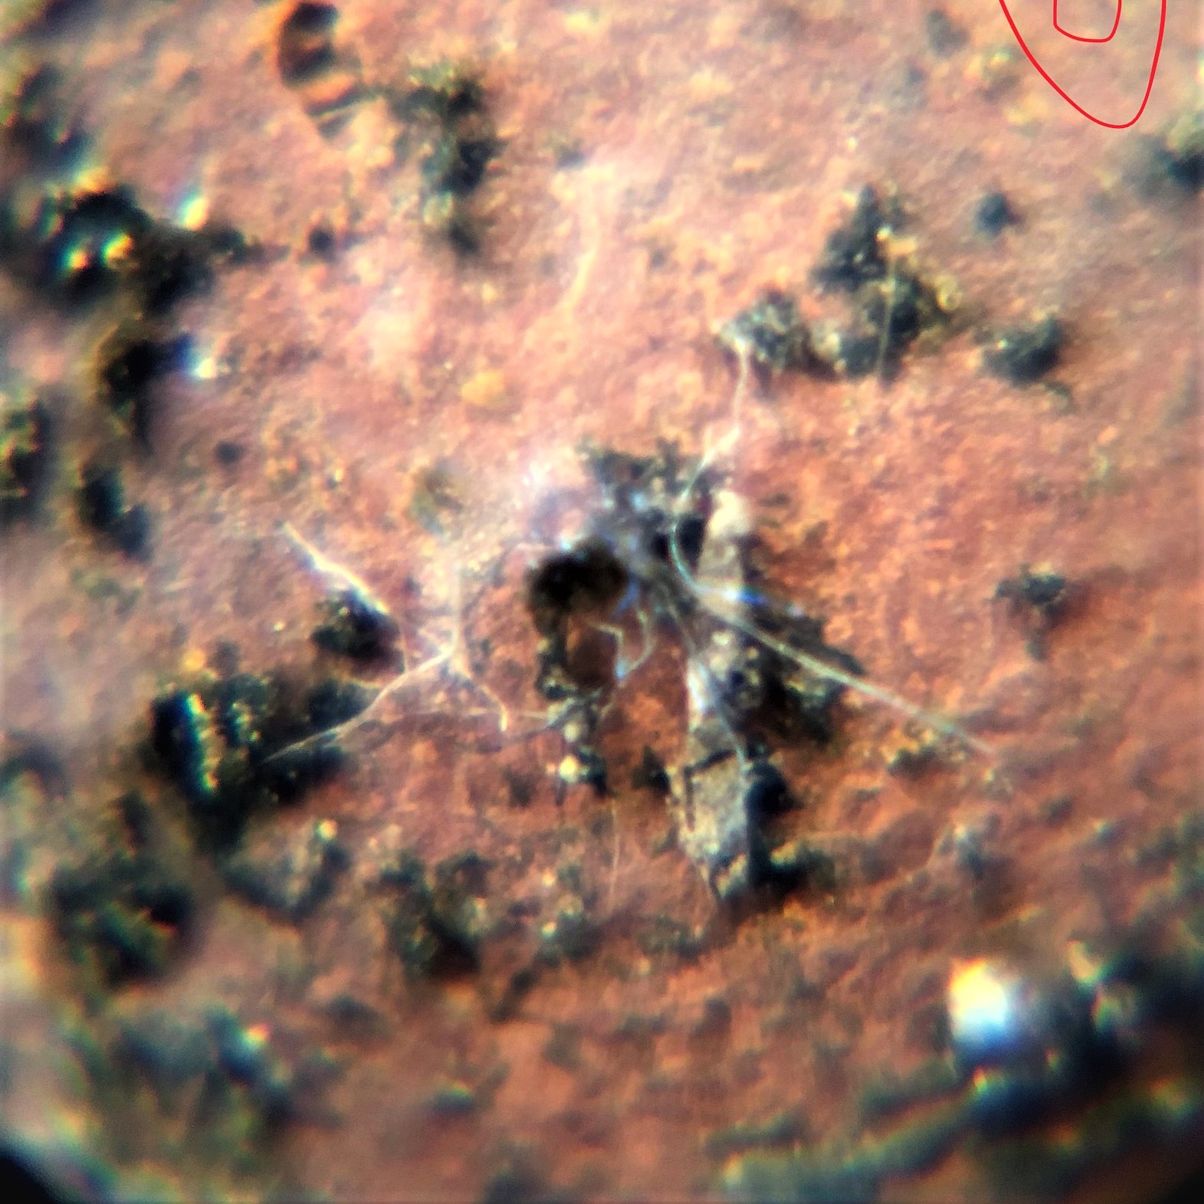
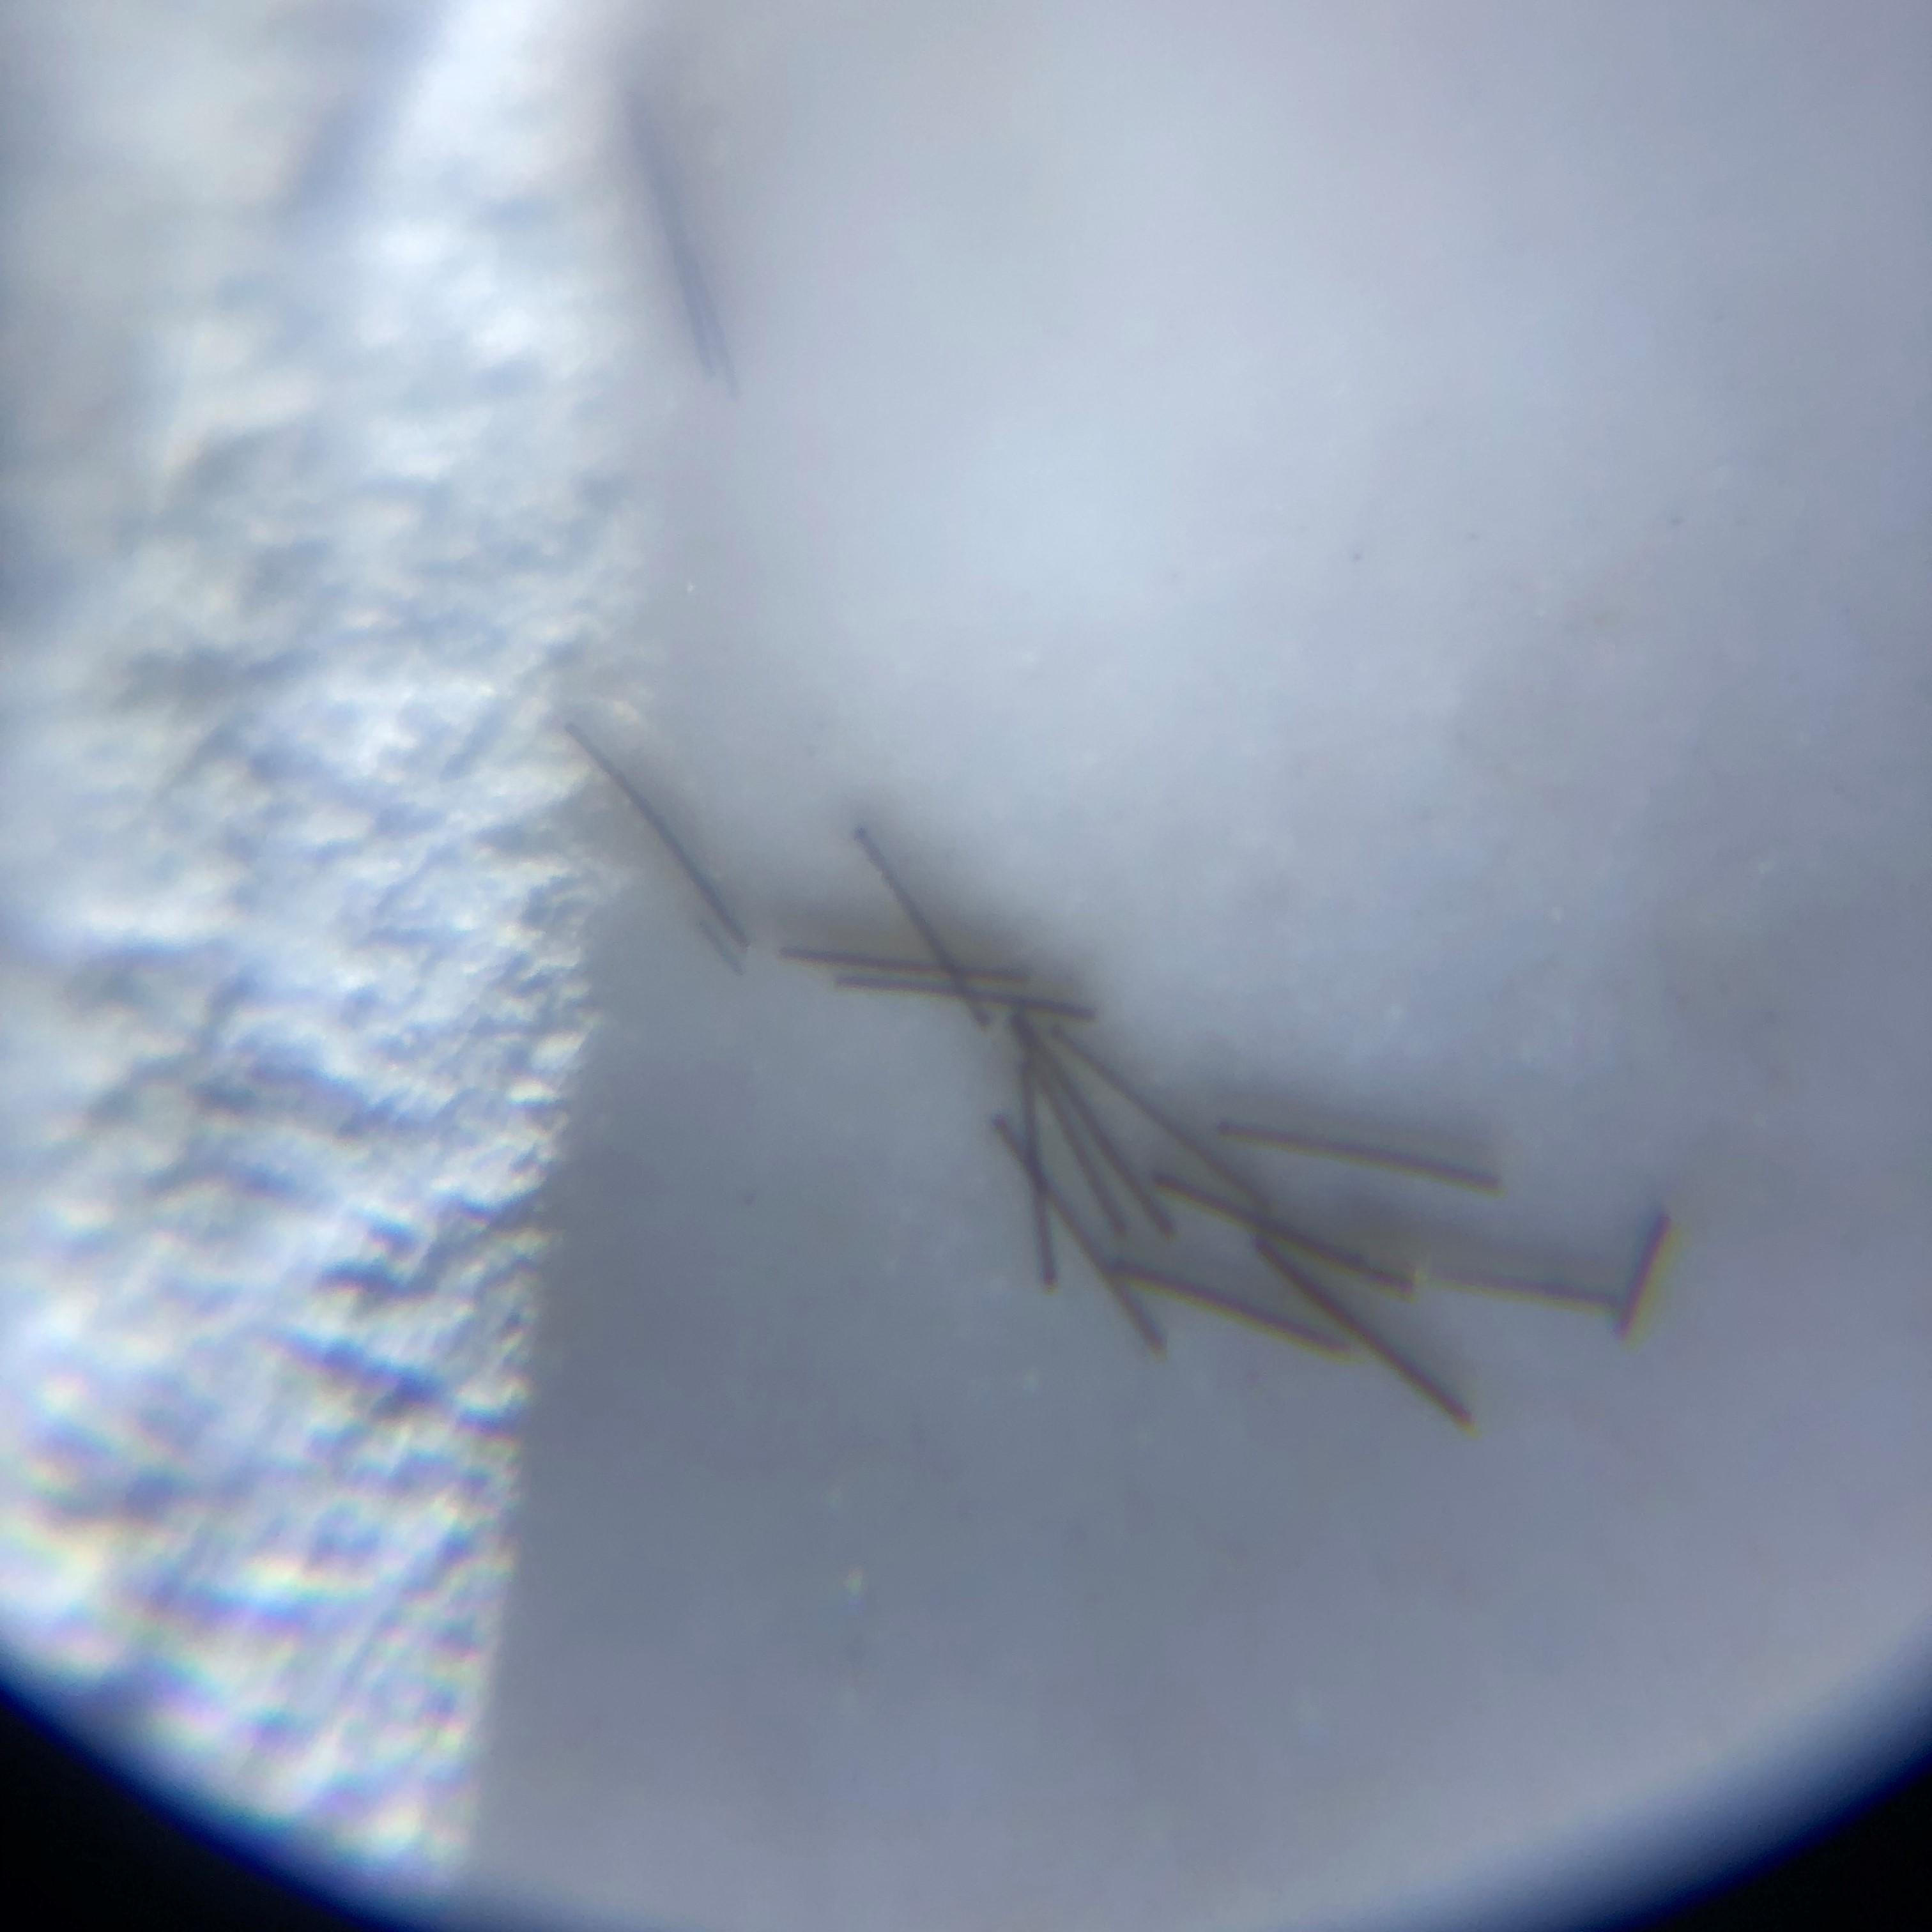
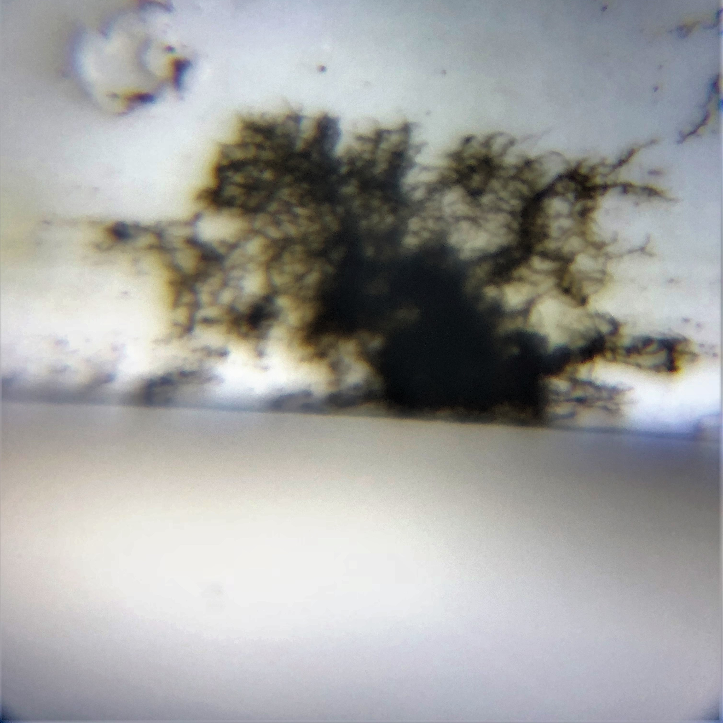
Rouzbeh Beig Heidari and Jianchu (Jason) Yao, PhD
Department of Engineering, College of Engineering and Technology, East Carolina University
Identification of Mold Health Hazards Using a Smartphone-based Microscope
Abstract
The current technological development of smartphones makes it possible to use them in identifying environmental health hazards. Based on the known information about mold types and their reproductive routines, economically affordable smartphone attachable microscope were used in detecting mold types. This microscope kit is designed in compatibility with most of the popular smartphones and it is simple to install. The microscope macro lens system is capable of producing 200X magnification with a satisfying sharpness and resolution. Sample images from various moisture level (wet/dry), surface coarseness (smooth/coarse),and lighting condition (bright/dark) combinations were taken and analyzed to fully examine the capabilities of the microscope to identify molds. The microscope is capable of distinguishing between mold and common categories that could be confused for mold with a bare eye. This design will make mold detection process more convenient and cost beneficial for consumers such as flooding victims.
Samples are collected from wide variety of places such as bench, fridge, bath tub, brick wall, wood, concrete.
Collected samples were then analyzed by comparing them to microscopic mold samples found in online archives.
Discussion
Most of the mold samples found in credible online archives, are taken with advance microscopes with a 1200x magnification and back illumination. Therefore, it is hard to confirm type of mold based on the samples that are taken during this research.
However, the microscope is able to distinguish possible mold from four main other categories that are frequently get mistaken for molds.
Using smartphone technology in detecting possible molds is cost beneficial and allows consumers to take unlimited samples with no extra cost. Consumers can easily use this technology to eliminate 4 categories mentioned above before taking any irrelevant and costly countermeasures to deal with mold problem.
Unlimited sampling option also allows consumers to take sample from areas that are often get ignored or deprioritized, even though sometimes these places could be the main source of mold or contain the most hazardous mold types.
Results
Some examples of taken samples are shown below.
100x magnification using
a 3.5mm glass bead
Efflorescence
Rust
Water Stain
Cricket Feces
Introduction
According to center of disease control and prevention (CDC) molds can cause nasal stuffiness, throat irritation, coughing or wheezing, eye irritation, or, in some cases, skin irritation in some people. People with mold allergies may have more severe reactions. Immune-compromised people and people with chronic lung illnesses, such as obstructive lung disease. Unfortunately options available for mold detection are very limited and costly. National average rate for a professional mold detection service is $684. Mold detection kits costs around $40 for each use. However, the hypothesis is that economically affordable smartphone attachable microscope can be used to detect molds.
Example of Efflorescence
Future Directions
The next step in this research will be using a microscope with a higher resolution and magnification to capture better images.
Secondary future objective is to create an online database of the most common and hazardous mold samples. The online archive will include photos of mold samples that are taken with a front illumination and matching resolution to the final product.
Methods
Glass beads with a 3D printed IPhone 6/7 casing were used to create a microscope.
Numerus mold appearing samples were taken from around the campus and other locations using an Apexel 200X cellphone attachable microscope.
Acknowledgment
This work has been supported by a SPACE grant from the Department of Engineering, College of Engineering and Technology, East Carolina University. The authors acknowledge this financial support. Any opinions, findings, and conclusion or recommendations expressed in this material are those of the authors and do not necessarily reflect the view of the funding agent.

