Slide 1
Professional Selling:
A Study of ECU COB Students
Andrew William Lee
ECU Honors College

Slide 2


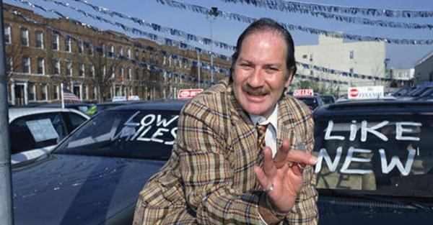
Tell me what you think of when you hear the word:
SALESPERSON
Notes:
*must view show for animated pictures with clicks*
What do you think of when you hear this word? *wait for some answers*
Sleazy car salesman?
Wolf of wall street?
Anyone who wants your money?
Let’s get out of this mindset.

Slide 3

Notes:
Who can explain what this means?
How do B2B sales differ from B2C?
B2C perceptions often keep students from being interested in a sales career.

Slide 4

Background
ECU’s College of Business offers a Professional Selling Certificate to students of any major
The majority of its required classes are already required for a Marketing major
I hypothesized that many students who could benefit from the Professional Selling Certificate would be unaware of it

Slide 5

Methodology
Surveyed ECU COB students to learn specific criteria:
  Are COB students
    Aware of the Professional Selling Certificate?
  Of those who are aware
    Do they view it as a valuable addition to your education?
    Have they signed up for the certificate?
    Where did they hear about the certificate?

Slide 6

Methodology
Also asked:
  Are COB students
    interested in sales as a long term-career?
    willing to work in sales initially?
  Do COB students believe
    most first jobs are sales-related?
    sales skills will be useful in any career?
    their major is doing a good job of preparing them for a position in sales?

Slide 7

Methodology
Provided sample size estimated around 600 students
  Select professors helped to distribute survey to their students, reaching an audience of around 600 students
    Some professors elected to offer an incentive for participation
  Survey was launched April 14, 2019
  Survey was fielded from April 18-May 3 2019

Slide 8
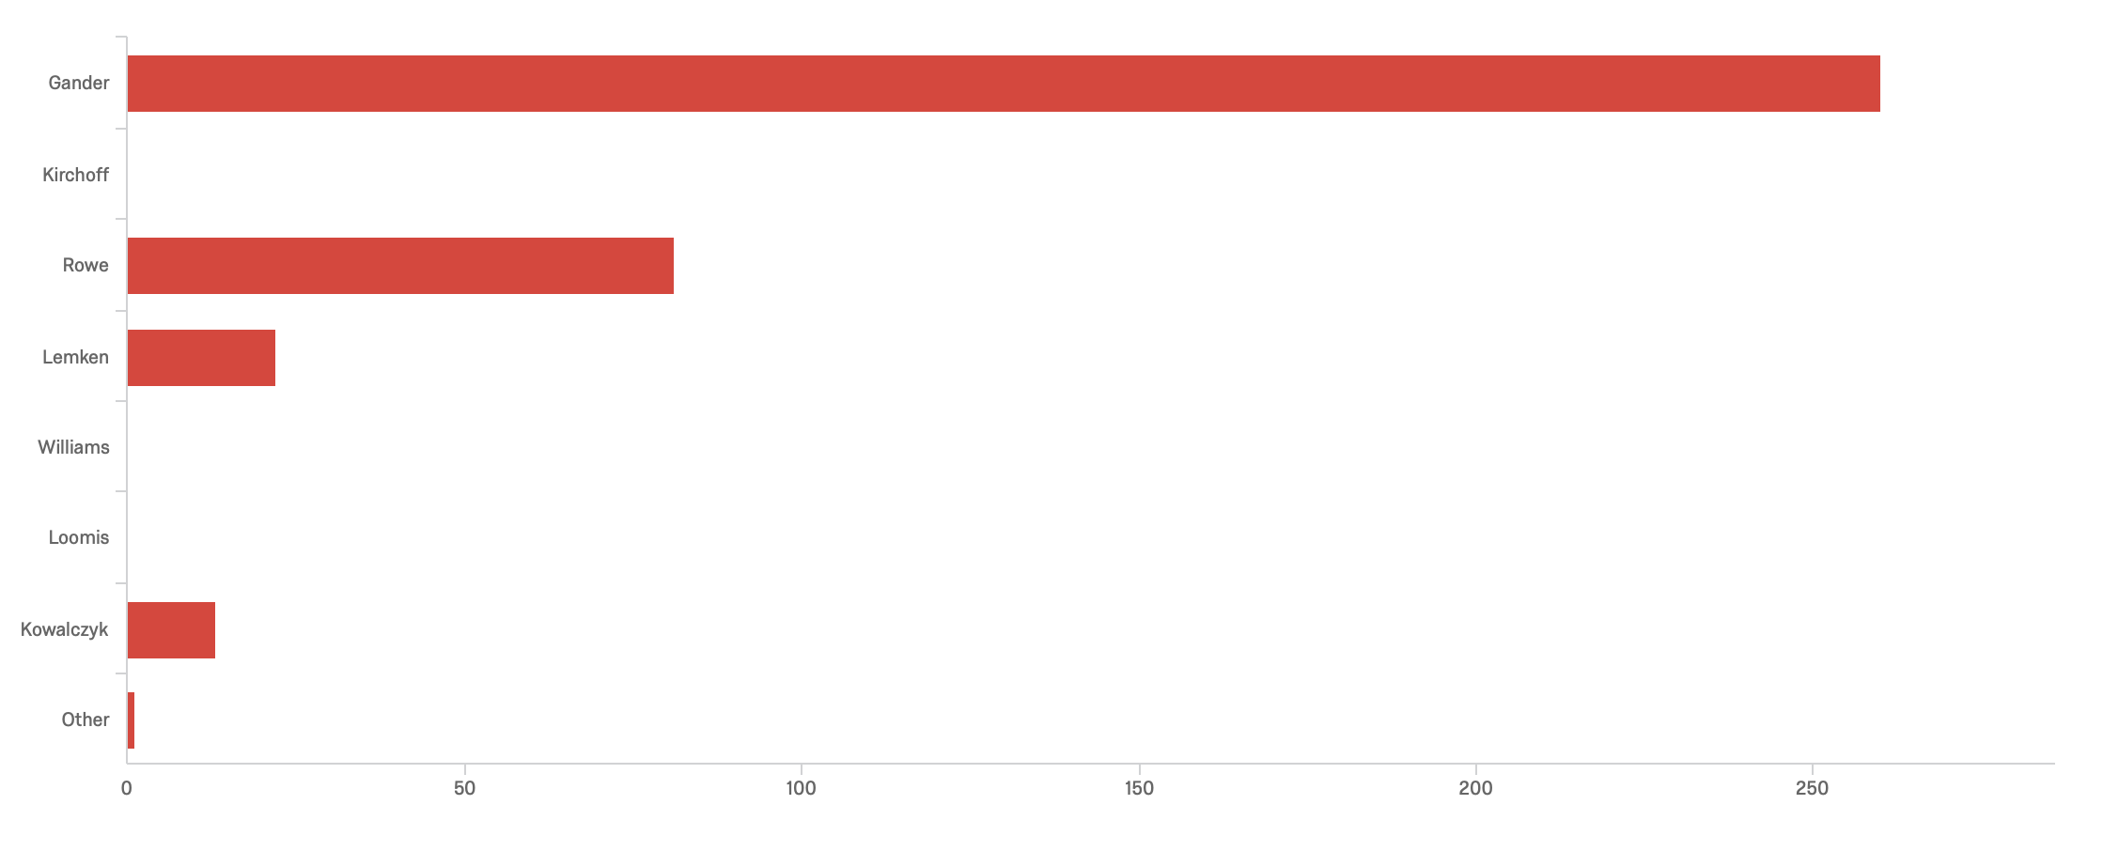
Sample Class Responses

Slide 9


Notes:
*will add Kahoot link to test knowledge before presentation*

Slide 10

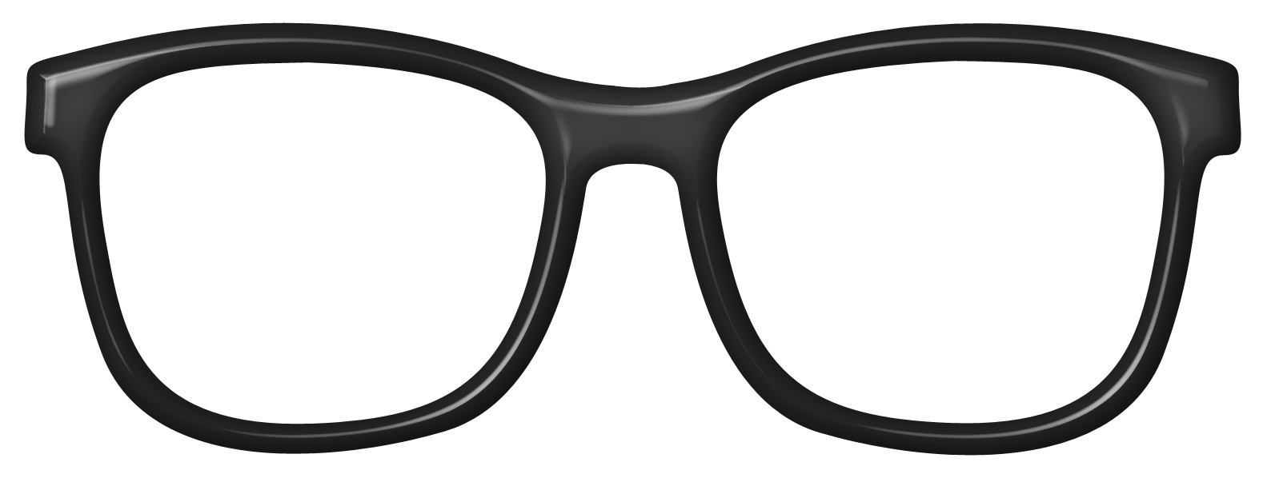


Previous Research
Perceptions of sales as a career greatly influence students’ interest in sales.
Changes in attitude towards sales can occur if sales is presented in a realistic way.
Interest in sales influences a students’ choice to pursue sales education.
Males are more likely to pursue sales education than females.
Notes:
Perceptions- https://www.academia.edu/3272054/A_Cross-National_Investigation_of_Student_Intentions_to_Pursue_a_Sales_Career
Interest- https://www.researchgate.net/publication/263414009_An_Examination_of_Factors_Influencing_Students_Selection_of_Business_Majors_Using_TRA_Framework
Attitude and male v female- Allen et al 2014

Slide 11
Demographics

Slide 12
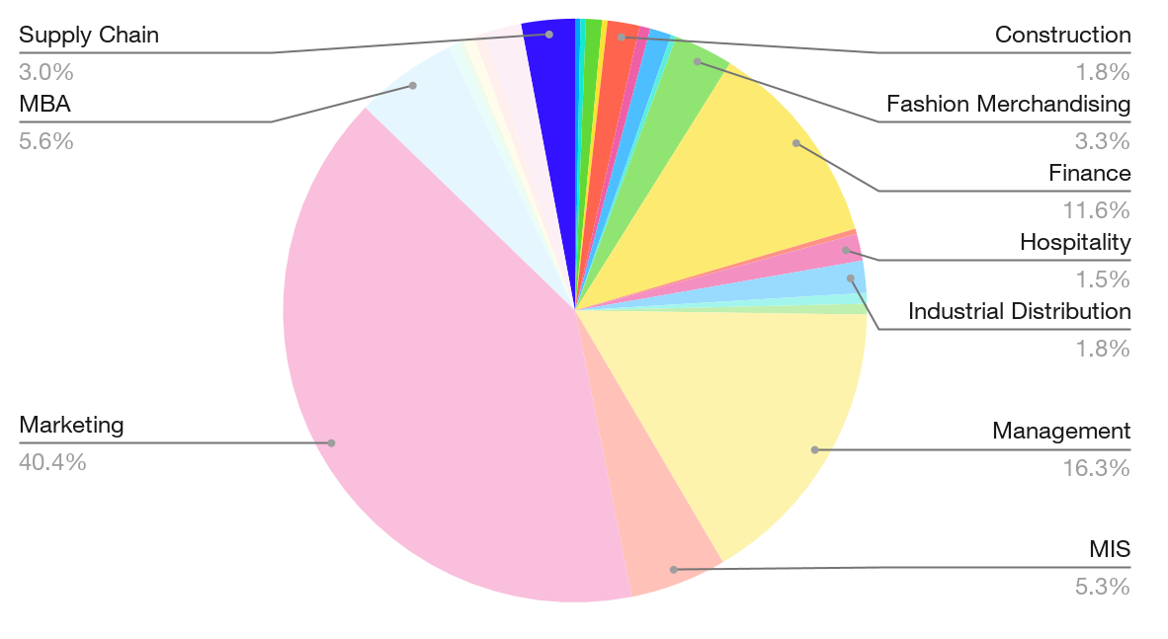
Demographics
Responses by Major
A total of 424 Responses were received for a 70.6% response rate (conservative estimate)
Notes:
Marketing students made up the vast majority of respondents, with Management and FInance majors also making up a significant portion of responses

Slide 13
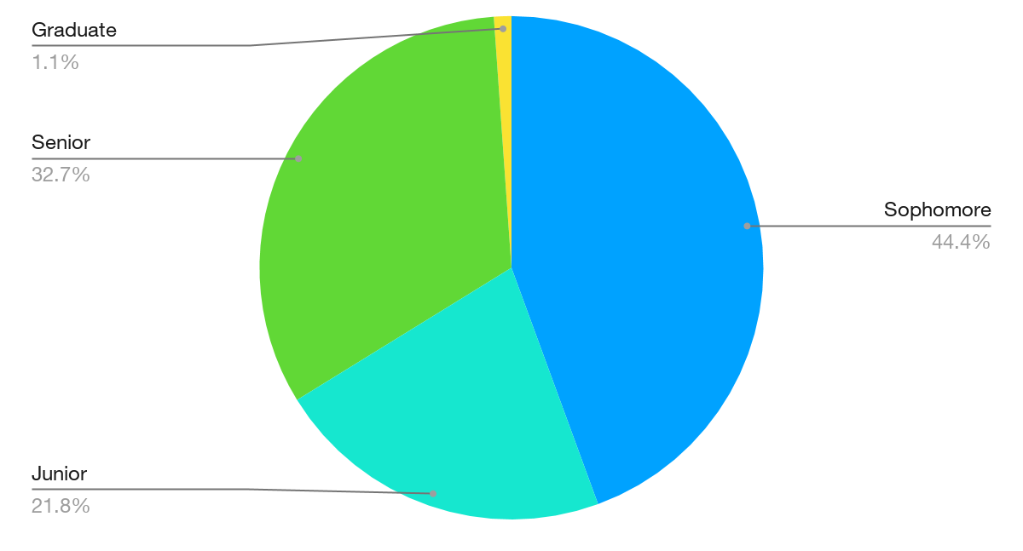
Demographics
Responses by Classification
Notes:
The study included responses from Sophomores to Graduate students in the MBA program

Slide 14
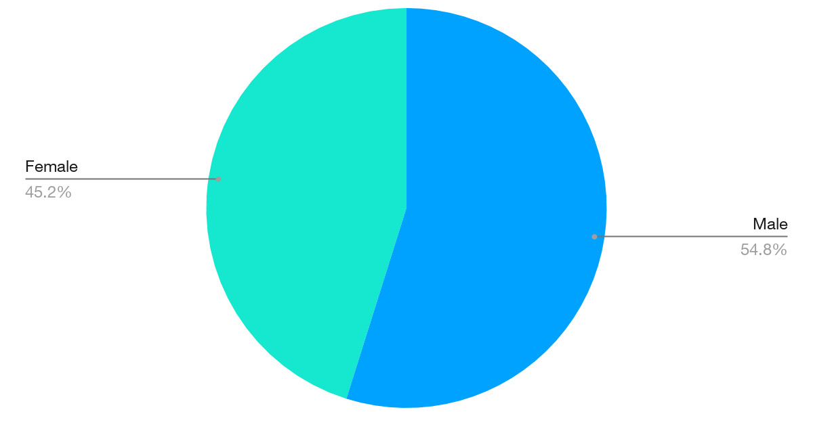
Demographics
Responses by Gender
Notes:
While respondents were split pretty evenly by gender, we had more male respondents than female.

Slide 15
Key Findings

Slide 16

Key Findings - Interests of COB Students
Students believe sales positions are common first jobs
About half of students surveyed are interested in pursuing a career in sales, while more are willing to start in sales after graduation.

Slide 17

Key Findings - Professional Selling Certificate
The majority of ECU COB students have heard of the Professional Selling Certificate
84% of those who have heard of it view it as a valuable addition to their education.
Only 26% of these students have signed up to take the certificate.

Slide 18
Detailed Findings
General Sales Questions

Slide 19
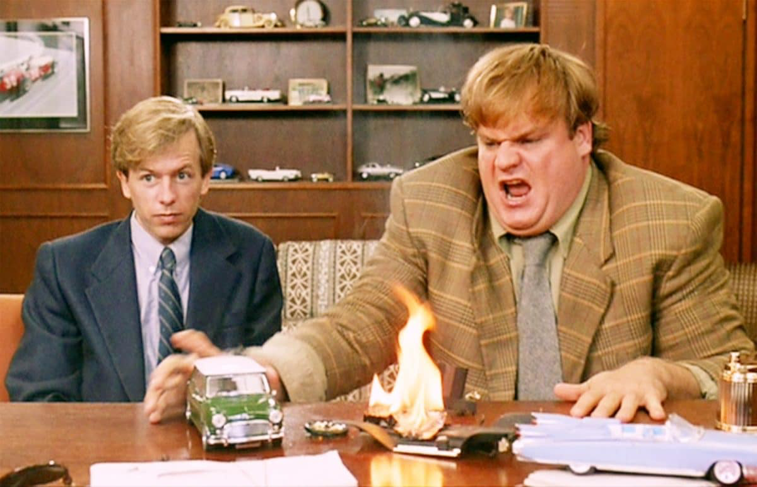
Sales Career Interest

Slide 20
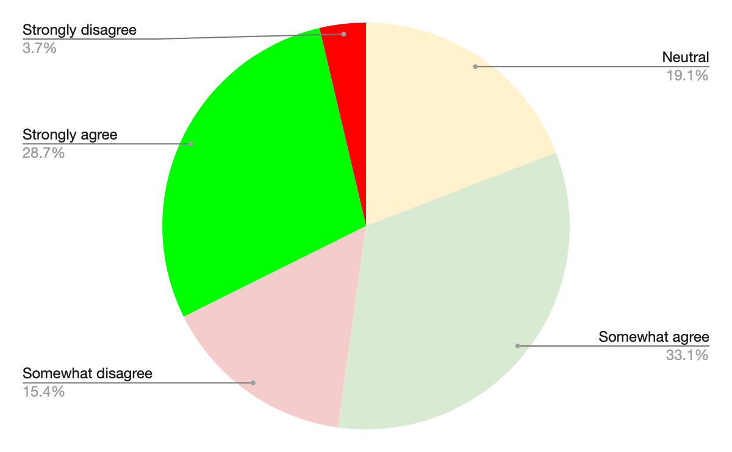
Sales Career Interest
I have an interest in pursuing sales as a career.
Notes:
Students were very split on whether or not they were interested in pursuing sales as a career. In order to make this data easier to digest, I have split it into positive and negative responses in the next slide

Slide 21
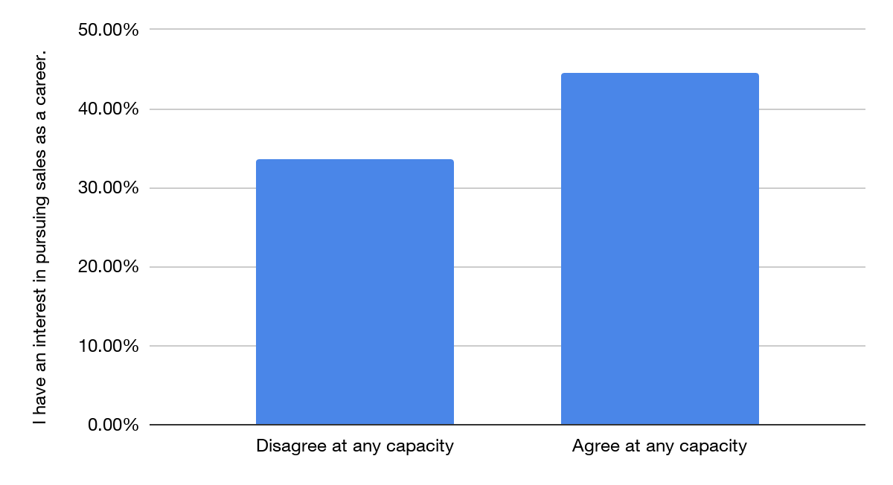
Sales Career Interest
I have an interest in pursuing a career in sales
Notes:
This chart combines “somewhat agree” with “strongly agree” and combines “somewhat disagree” with “strongly disagree”. Excludes neutrals to show positive and negative responses. More students surveyed are interested in pursuing sales as a career than those who were not interested

Slide 22
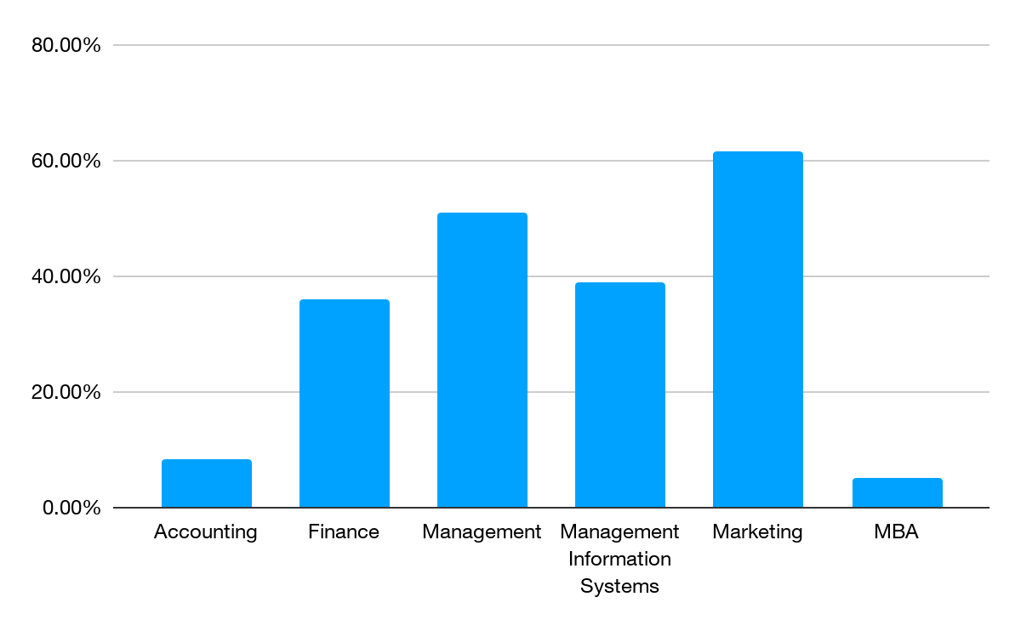
Sales Career Interest by Major
I have an interest in pursuing a career in sales- Somewhat and strongly agree
Notes:
Marketing majors were most interested in pursuing sales as a career, while unsurprisingly Accounting and MBA students were least likely to pursue sales as a career

Slide 23
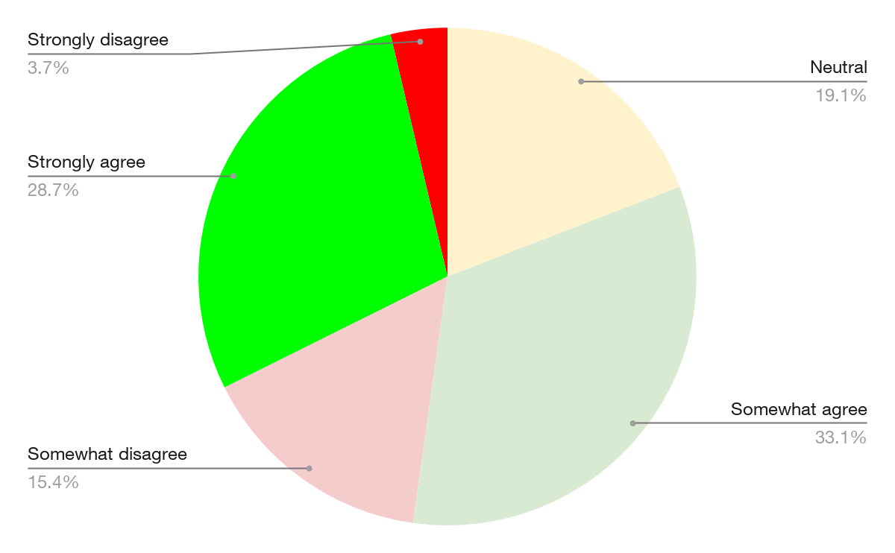
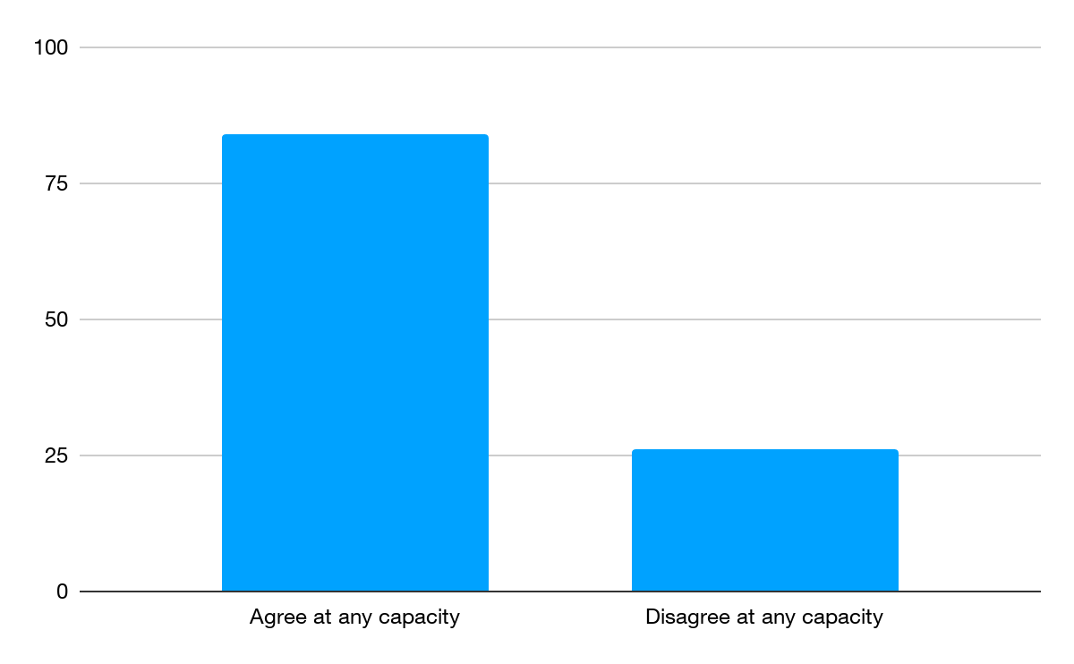
Sales Career Interest - Marketing Majors
I have an interest in pursuing a career in sales
Notes:
Here you see the breakdown of responses specifically from marketing majors. Marketing majors have a strong trend towards agreeing with the statement.

Slide 24
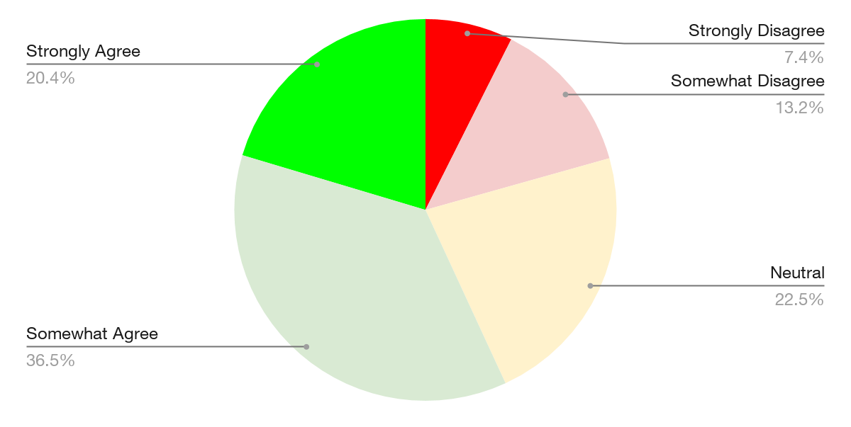
Willingness to Work in Sales
Regardless of my long-term career goals, I would be willing to work in sales initially.
Notes:
This question differs slightly from the last, asking if students would be willing to work in sales as their first position after graduation. I have also broken this down to positive and negative responses.

Slide 25
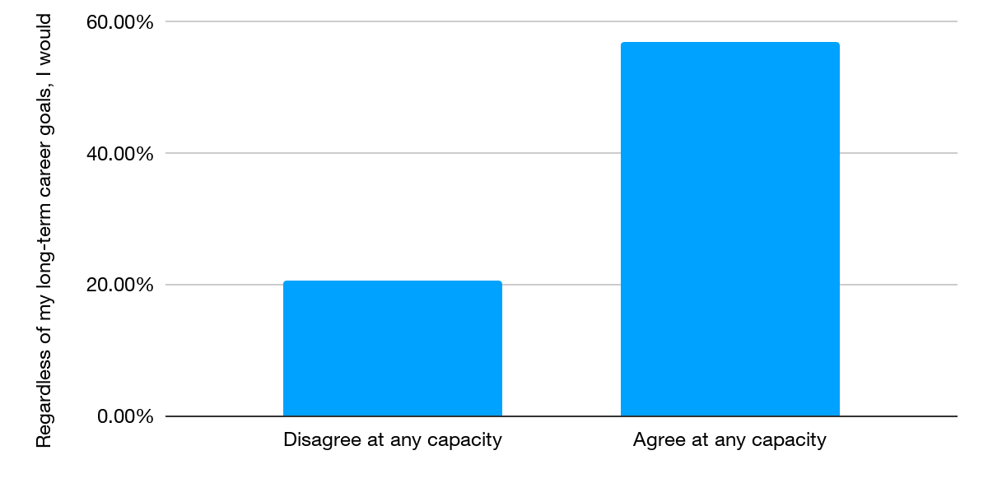
Willingness to Work in Sales
Regardless of my long-term career goals, I would be willing to work in sales initially.
Notes:
This chart combines “somewhat agree” with “strongly agree” and combines “somewhat disagree” with “strongly disagree”. Excludes neutrals. Far more students are willing to work in sales as a first professional job initially, regardless of their long-term plans

Slide 26
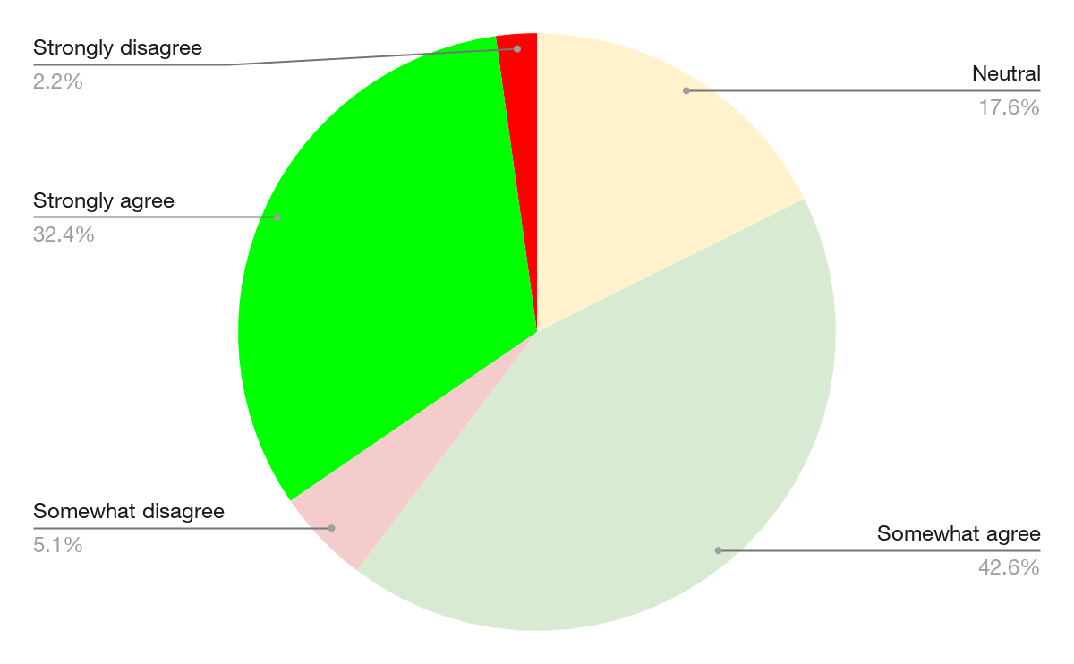
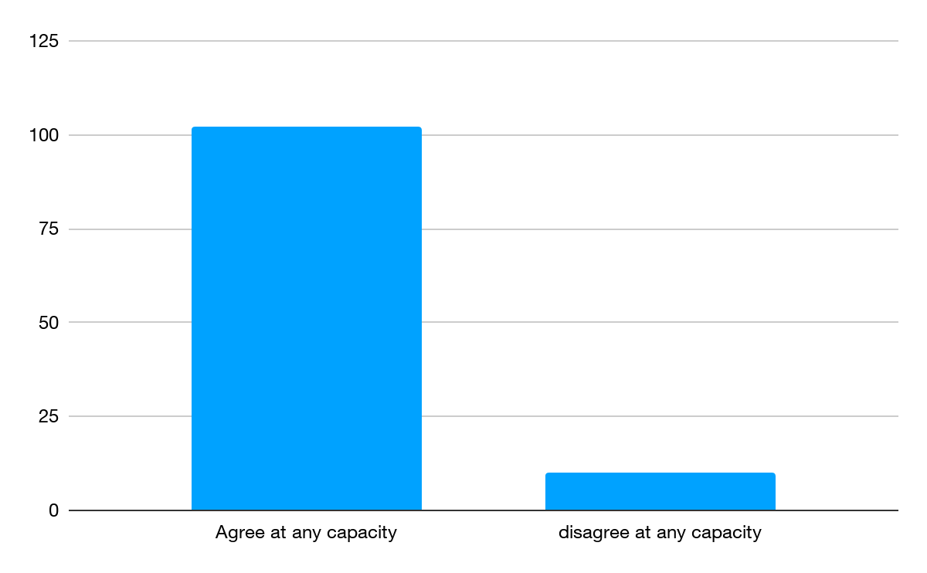
Willingness to Work in Sales - Marketing Majors
Regardless of my long-term career goals, I would be willing to work in sales initially.

Slide 27
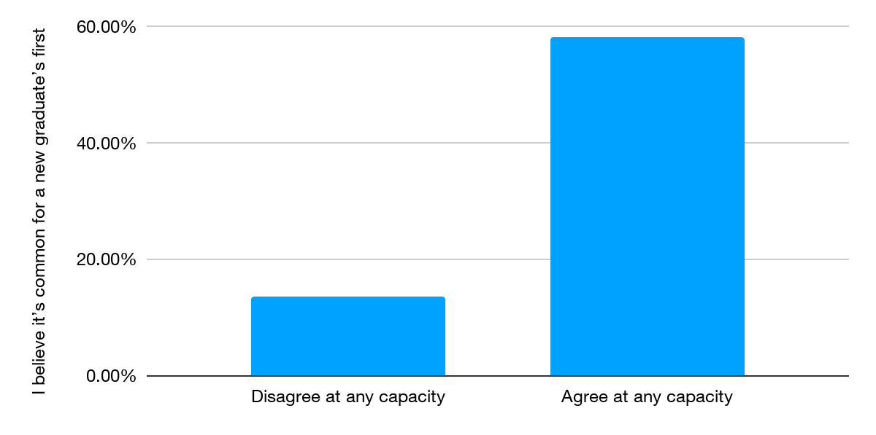
Sales-related first jobs
I believe it’s common for a new graduate’s first job to be sales-related.
Notes:
This chart combines “somewhat agree” with “strongly agree” and combines “somewhat disagree” with “strongly disagree”. Excludes neutrals. Here you can see that nearly 60 percent of respondents believe that sales jobs are common for fresh graduates

Slide 28
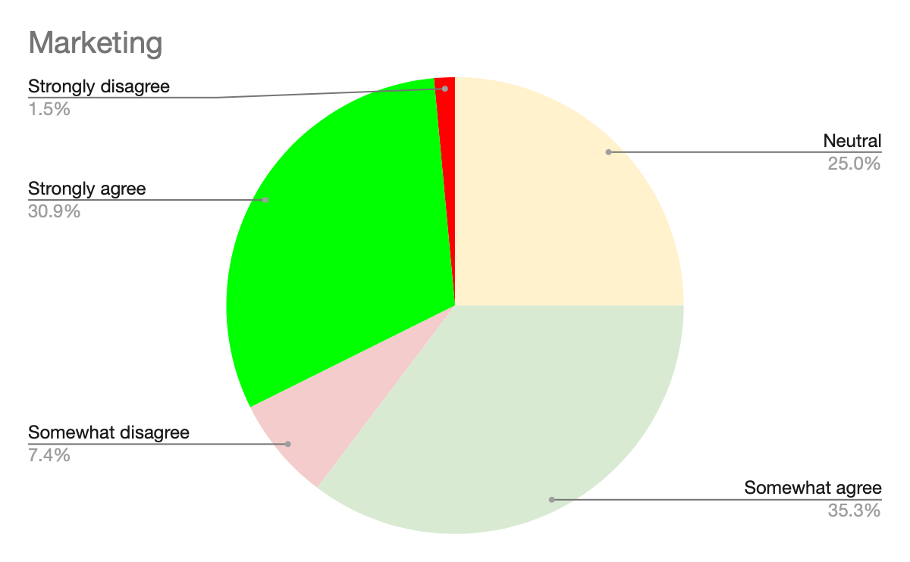
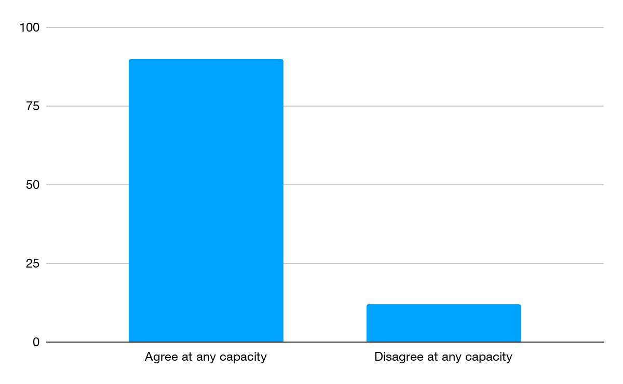
Sales-related first jobs - Marketing Majors
I believe it’s common for a new graduate’s first job to be sales-related.

Slide 29
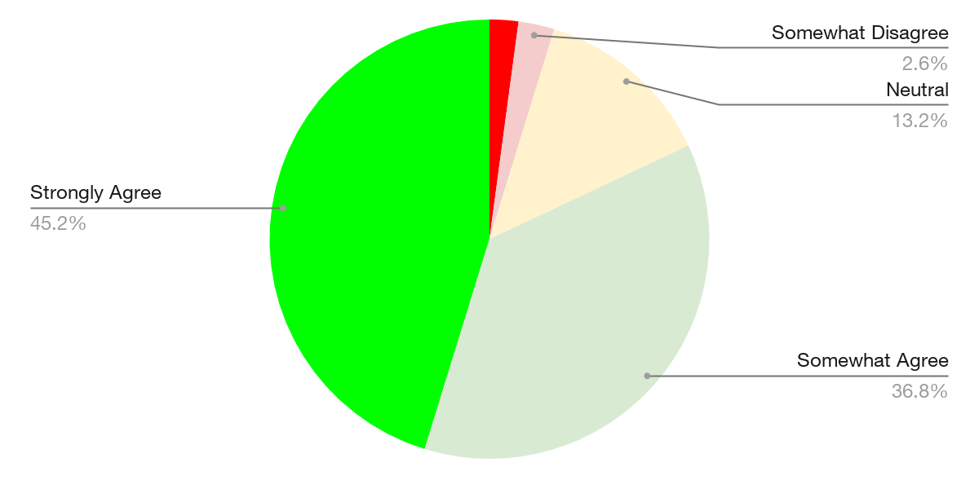
Sales skills in any Career
Even if I never work in a sales role, I believe developing selling skills will help me in my career.
Notes:
Nearly half of respondents strongly agree that sales skills will help them in their career, even of they never work in sales. This is a testament to the versatility of sales skills in any position

Slide 30
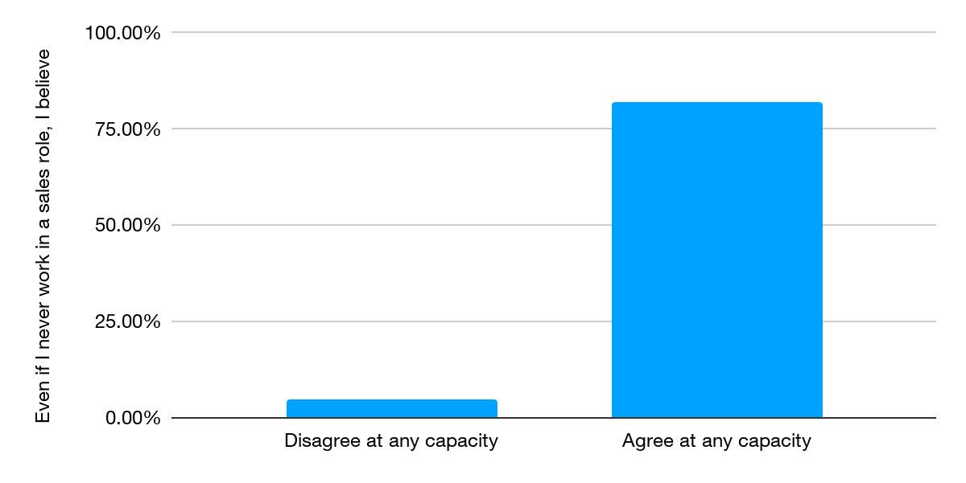
Sales skills in any Career
Even if I never work in a sales role, I believe developing selling skills will help me in my career.
Notes:
This chart combines “somewhat agree” with “strongly agree” and combines “somewhat disagree” with “strongly disagree”. Excludes neutrals.
Sales skills can be useful in any of the following scenarios
Job interviews/job search
Convincing coworkers/managers to accept your proposal
Bringing up ideas in meetings
General networking and conversations

Slide 31
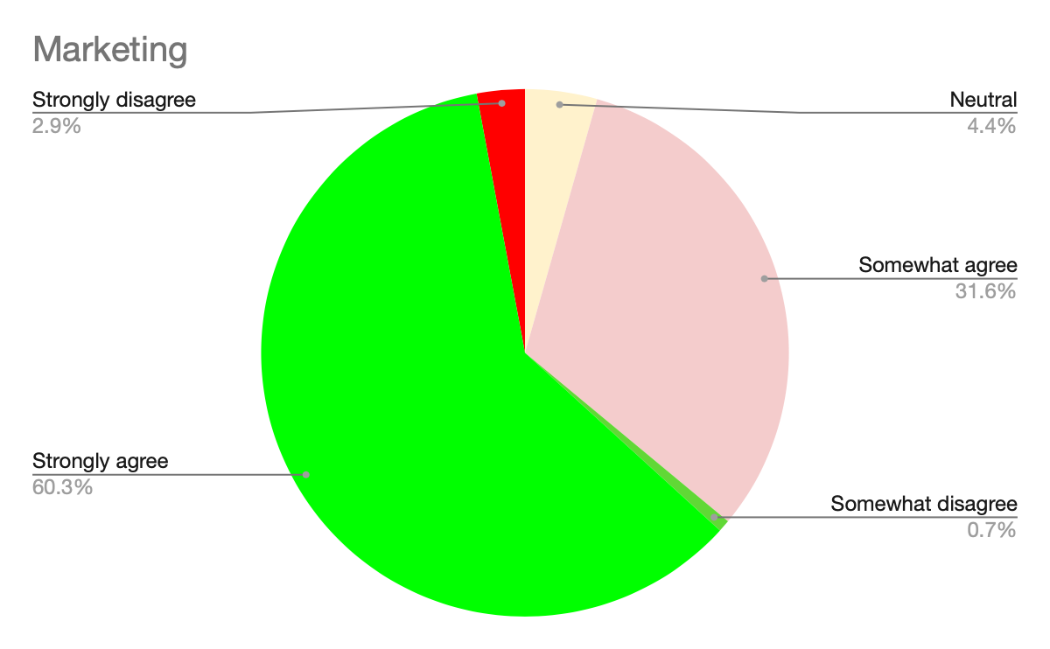
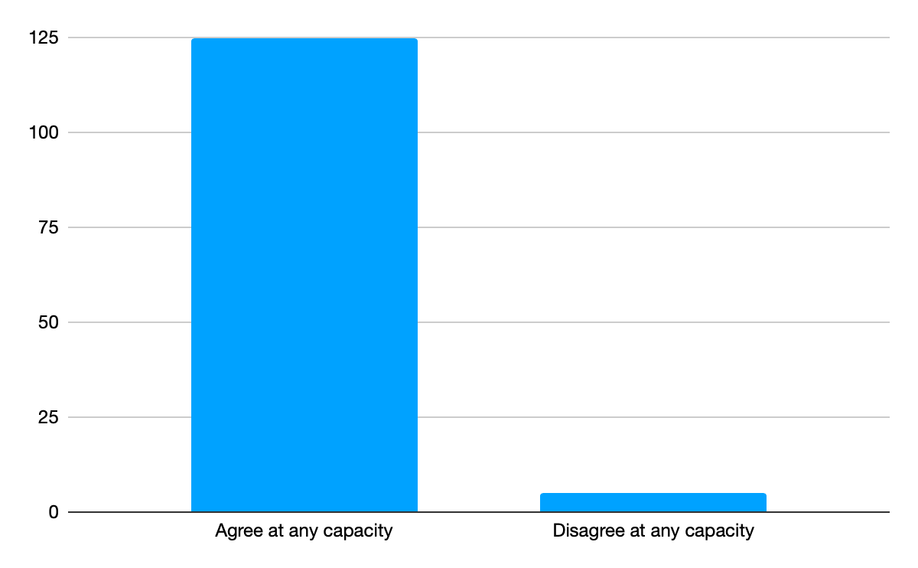
Sales skills in any Career - Marketing Majors
Even if I never work in a sales role, I believe developing selling skills will help me in my career.

Slide 32
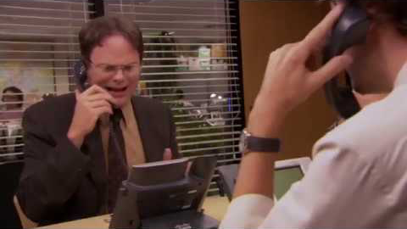
Sales Skills

Slide 33
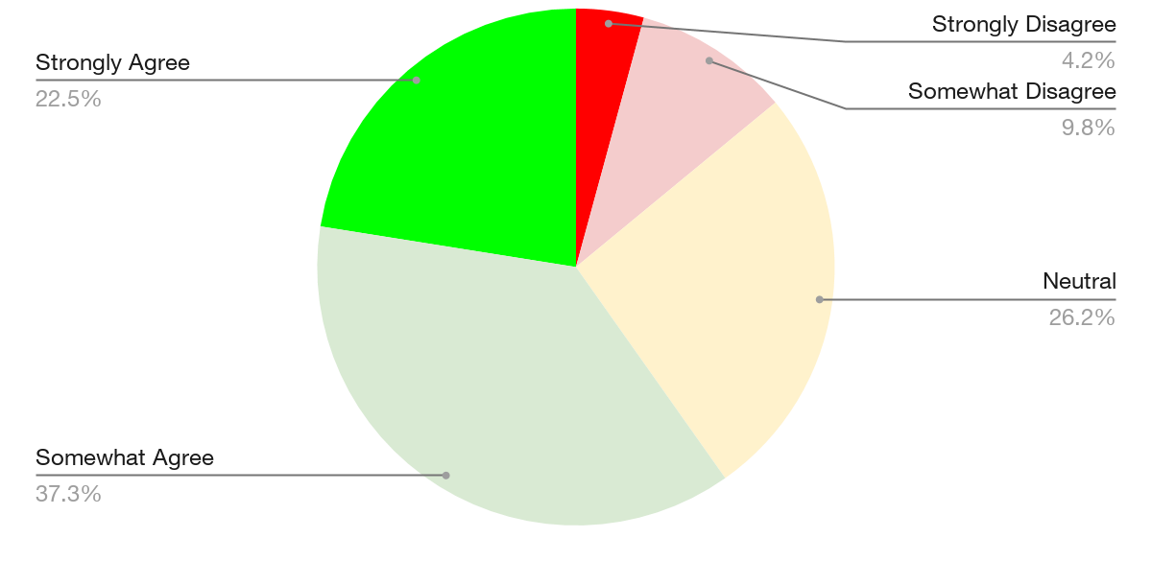
My Major Teaches Sales Skills
The program in my major or concentration does a good job of preparing me for a position in sales.
Notes:
Very few students believe that their program does not prepare them for a position in sales

Slide 34
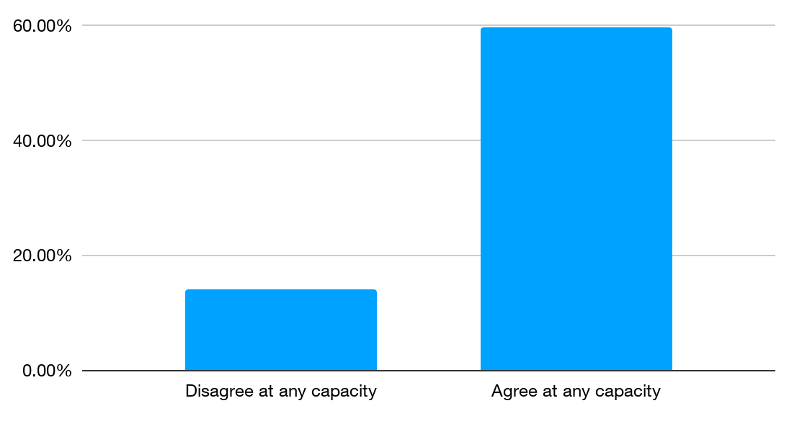
My Major Teaches Sales Skills
The program in my major or concentration does a good job of preparing me for a position in sales.
Notes:
This chart combines “somewhat agree” with “strongly agree” and combines “somewhat disagree” with “strongly disagree”. Excludes neutrals. About 60% of respondents believe that their program in their major goes a good job of preparing them for a position in sales. Because this question asks specifically how their major prepares them, in the next slide I have broken down responses by major.

Slide 35
My Major Teaches Sales Skills
(agree at any capacity)
Notes:
Marketing and management majors believe at a much higher rate than other majors that their major goes a good job of preparing them for a career in sales. Accounting and MBA students have a much lower positive response to this question.

Slide 36
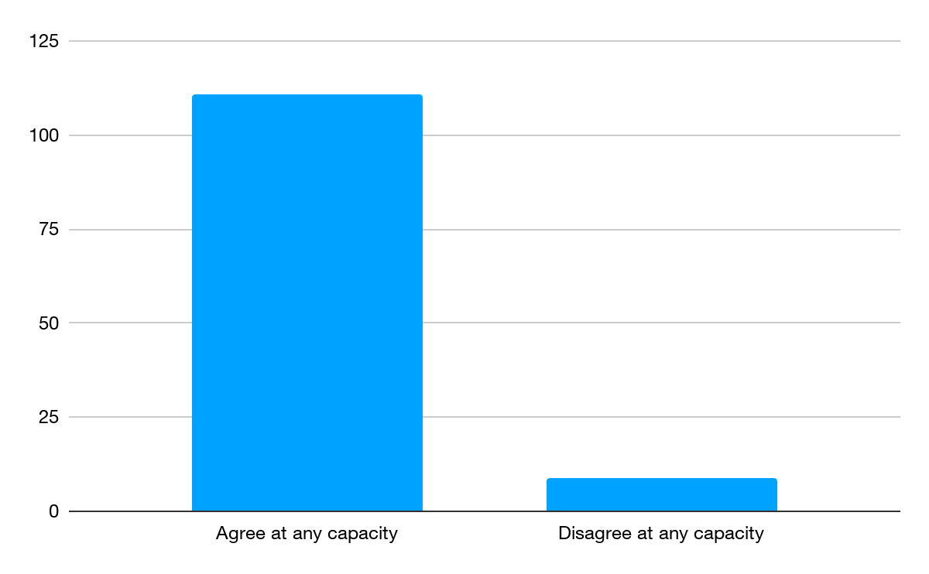
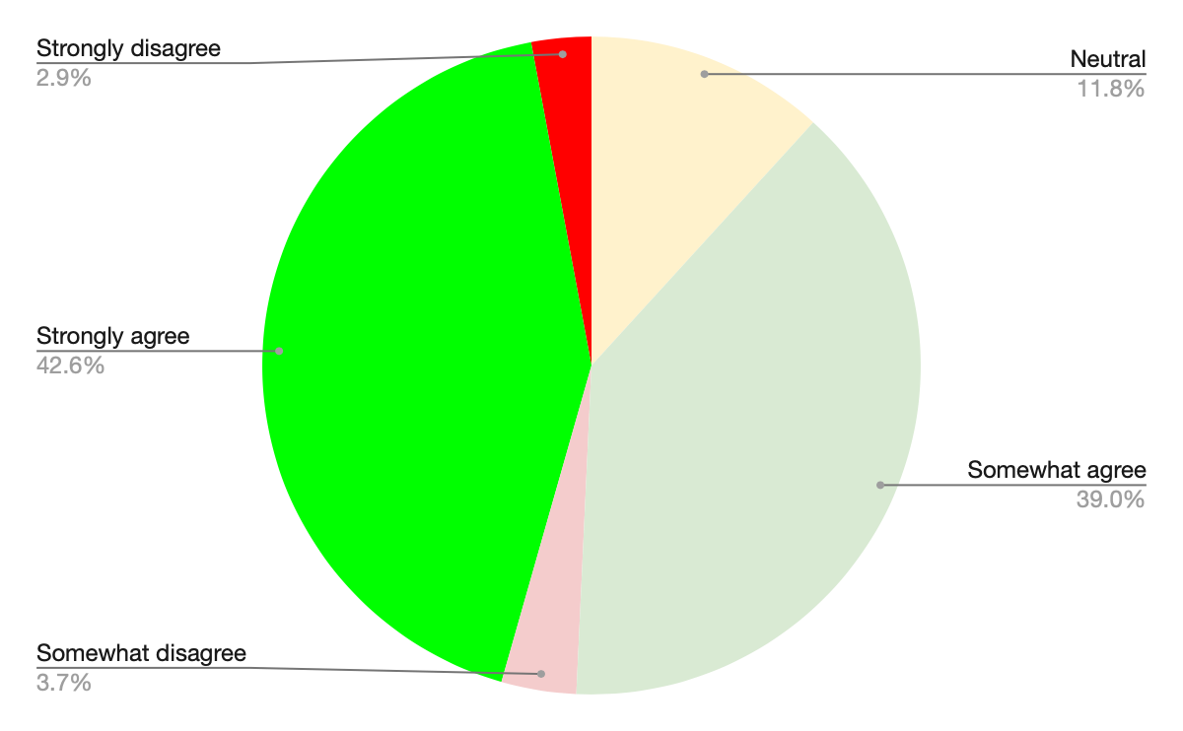
My Major Teaches Sales Skills - Marketing Majors
The program in my major or concentration does a good job of preparing me for a position in sales.

Slide 37
Detailed Findings
Professional Selling Certificate

Slide 38
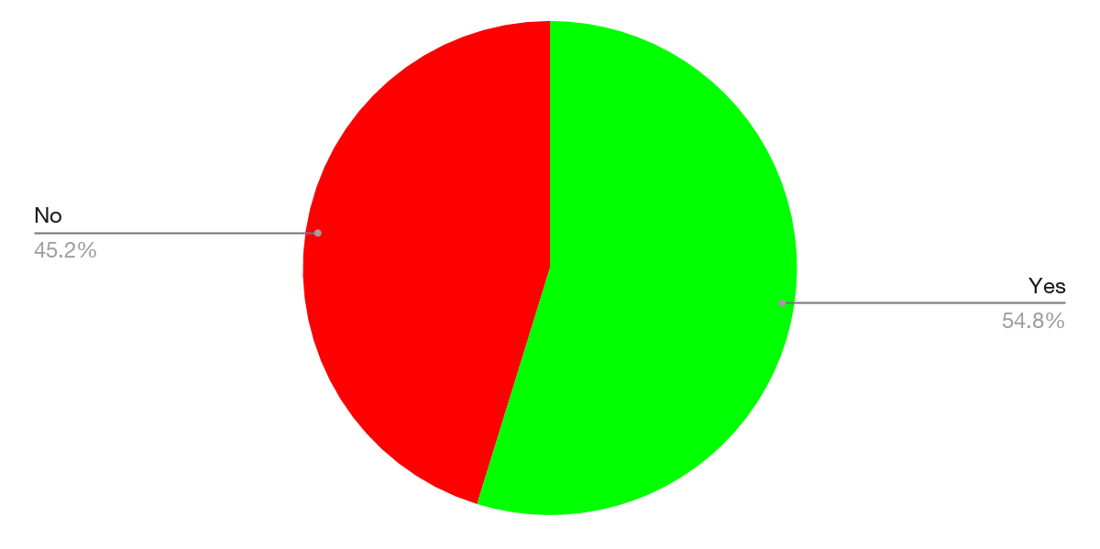
Awareness
Have you heard of ECU’s Professional Selling Certificate before today?

Slide 39
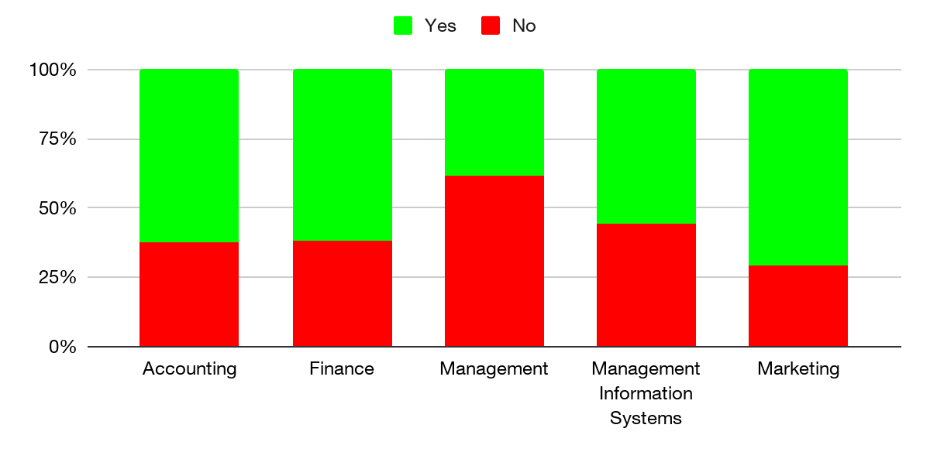
Awareness by Major
Have you heard of the Professional Selling Certificate before today?

Slide 40
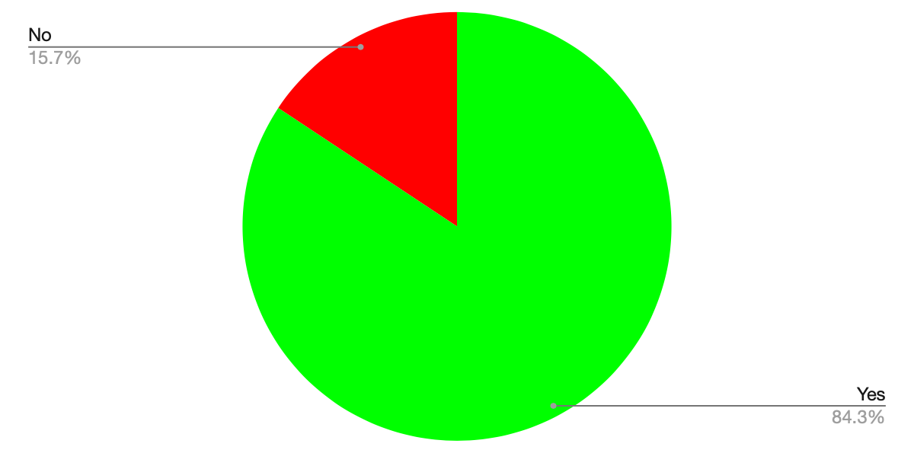
Value
Do you view the certificate as a valuable addition to your education?

Slide 41
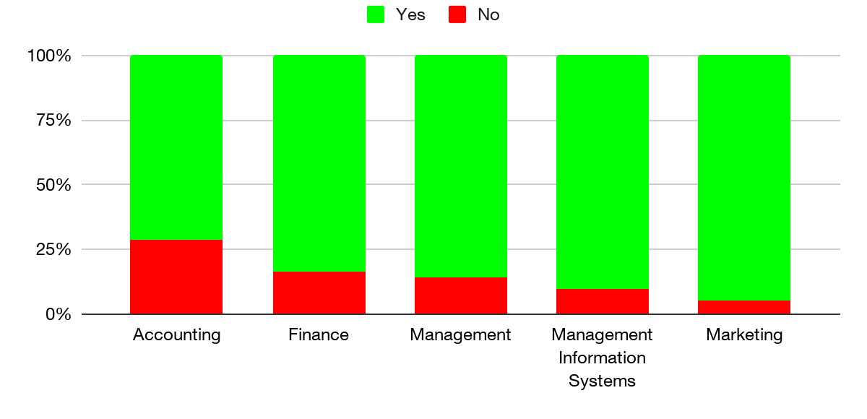
Value by Major
Do you view the certificate as a valuable addition to your education?
Notes:
Opportunity: 62% of management majors have not heard of the professional selling certificate before today, though 86% of them who are aware think it is valuable. If management students are given more exposure to the certificate, many of them will likely enroll.

Slide 42
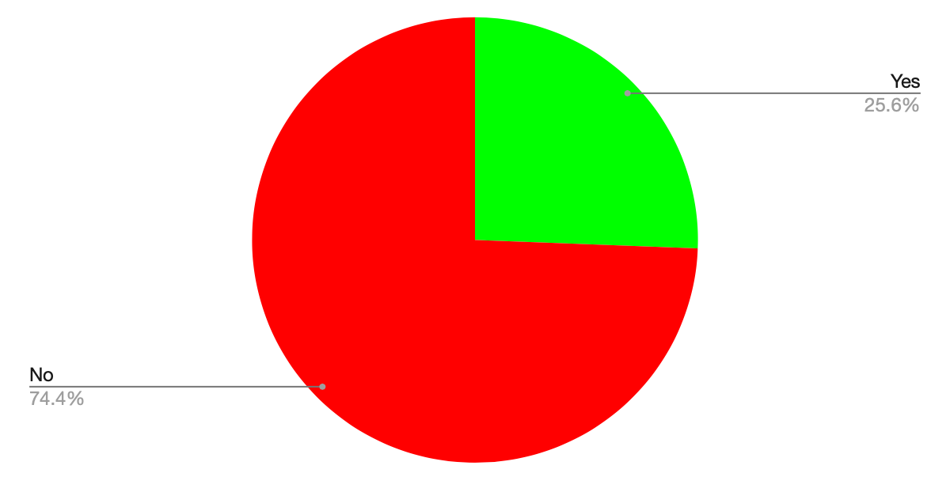
Enrolled
Have you signed up for the professional selling certificate with your advisor?

Slide 43
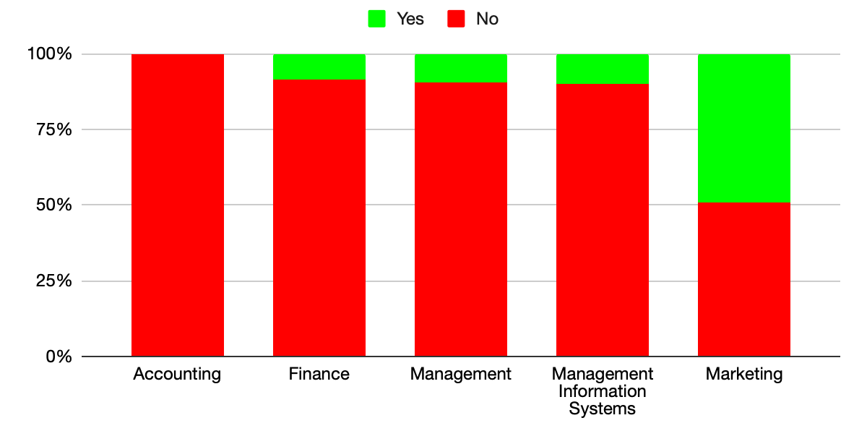
Enrolled by Major
Have you signed up for the professional selling certificate with your advisor?

Slide 44
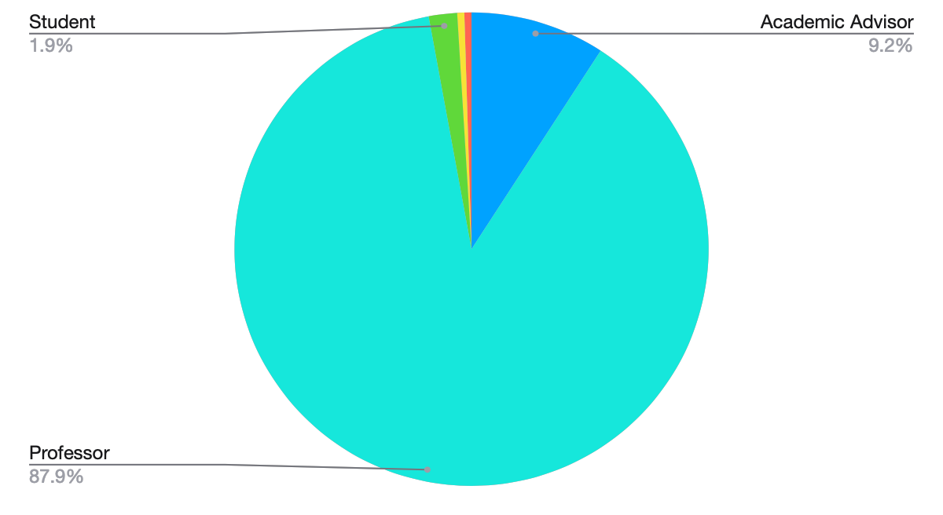
Messenger
Where did you hear about the professional selling certificate?
Notes:
Maybe academic advisors are not promoting it enough?

Slide 45
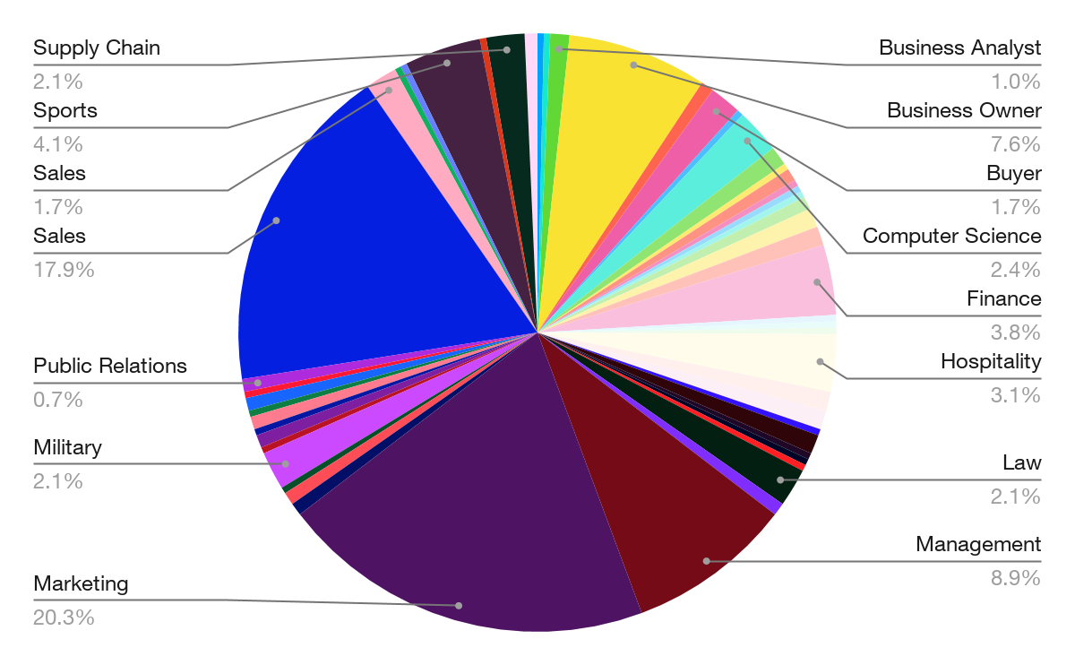
Career Interests

Slide 46
Conclusion

Slide 47
Conclusion
ECU COB students in general feel that their program prepares them for a career in sales
Marketing Majors are more interested in sales careers than other students
The majority of students believe sales positions are common first jobs
While most students believe the PSC would add value to their education, only 26% have signed up for it

Slide 48
Q&A

