Slide 1

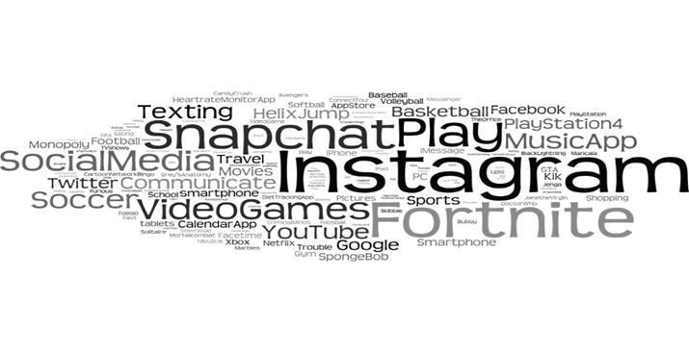
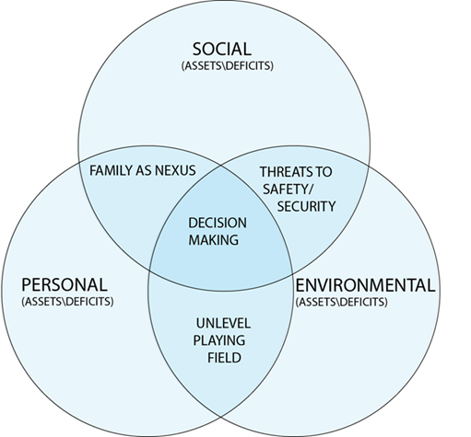
Adolescent Perceptions of Health and Social Concerns
for the Development of a Risk Reduction Mobile Application
APHA Expo & Convention, Philadelphia, PA
K. L. Larson, S. M. Ballard, D. F. Ellis, J. G. Peery, J. E. Cary, R. L. Levy, & T. M. Nelson
Kim L. Larson, PhD, RN
College of Nursing
East Carolina University
Larsonk@ecu.edu
252-744-6527
Introduction
Thematic Findings
Discussion
Rural and economically disadvantaged adolescents have disproportionately higher rates of drug and alcohol misuse (North Carolina HIV/STD/Hepatitis Surveillance Unit, 2018)
Adolescents have access to smartphones which they use as a source of health information (Andrade et al., 2018)
This study explored perceptions of rural adolescents regarding health and social issues to guide development of a risk reduction application for smartphone use
Contextual Nature of Study: Adolescent Decision Making in the Rural South
Theme 1: Family as Nexus
“I see that I need to stop doing certain things…I’m bein’ what my mama is and she’s a strong person…she has self-love.”
“I don’t like it when people talk about anybody in my family.”
“When I was younger, my momma, she actually was using drugs…I kept on getting into drugs…sometimes I think it’s introduced through family.”
Theme 2: Unlevel Playing Field
“It’s sad cause, with us being African American, people don’t want to see us win so we gotta go so hard just to succeed.”
“…just because we Black I feel like they think we can’t do as much as other colors like White and other races.”
“I think the reason they feel like that is ‘cause it’s mostly African Americans in jail…”
Theme 3: Threats to Safety and Security
“All of us, as a community, have suffered from racism…I feel like, we’ve all been targeted for, you know, stealing people’s jobs or for problems.”
“I think everybody has experienced bullying…I usually get called a lot of names, which sucks really bad.”
Actual or perceived poverty increases levels of risk behaviors
Identified determinants of health:
  Structural – racism and cyberbullying
  Proximal – neighborhood, family and peers
Articulated difficult topics: suicide, racism, and global violence (i.e., North Korea, Syria)
Instagram and Snapchat were dominant social media outlets for these adolescents
Findings may inform risk reduction mHealth apps to facilitate healthy relationships and personal safety
Limitations: Convenience sample of youth in outreach programs; few White adolescents
Methods
Qualitative descriptive design
Theory of Triadic Influence: Personal, Social and Environmental
Community-academic research team
Three youth outreach organizations
Five mixed-gender focus groups (N=49)
Semi-structured interview guide: technical questions re: smartphone usage and attitudinal questions re: health and social concerns
Content and thematic analysis; word frequency counts
Implications
Black | 65.3%
Latino | 22.4%
Multiracial | 10.2%
White | 2%
Avg. Age | 13.8
Gender | F: 63%; M: 37%
Phase II:
  Create Game Development Document for mHealth risk reduction application
  Tailor User Interface and User Experience to engage participants use SnapChat format
  With input from youth leaders create narrative storylines based on realistic, contextual nature in which adolescents make decisions and EB risk reduction programs
References
Andrade, E. L., Evans, W. D., Barrett, N. C., Cleary, S. D., Edberg, M. C., Alvayero, R. D., …Beltran, A. (2018). Development of the place-based Adelante social marketing campaign for prevention of substance use, sexual risk and violence among Latino immigrant youth. Health Education Research, 33(2), 125-144. doi:10.1093/her/cyx076
North Carolina HIV/STD/Hepatitis Surveillance Unit. (2018). 2017 North Carolina HIV/STD/Hepatitis Surveillance Report. Retrieved from https://epi.publichealth.nc.gov/cd/stds/figures/std17rpt_rev12142018.pdf
Acknowledgements
We gratefully acknowledge funding by the ECU Office of Research, Economic Development and Engagement. We appreciate the participants for their time and contribution and community leaders for their support of this project.

