Slide 1
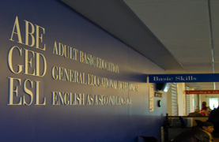
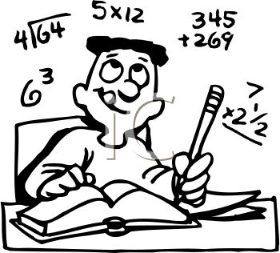
The Benefits of a Face-to-Face
Support Mathematics Class for
Project IDEAL PCC Advanced-level
Adult ESL Students
Enrolled in SkillsTutor Online
Kimberlee Raper
East Carolina University
TALGS Conference
16 February 2013

Slide 2

Background
Preliminary Interview with Jan Fisher, PCC ESL Coordinator
  What is SkillsTutor and why is PCC conducting a SkillsTutor hybrid pilot program at this time?
  How did you select the SkillsTutor instructors for the ESL transition class?
  What are you hoping to accomplish through the SkillsTutor hybrid pilot?

Slide 3


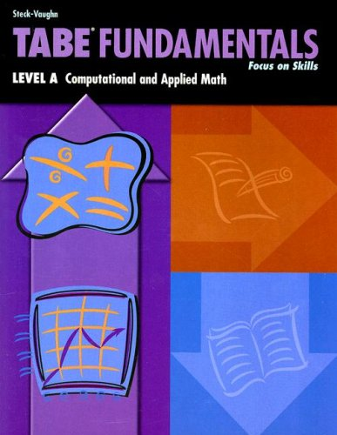

Introduction
Project IDEAL Pilot Study: Advanced ESL Transition Mathematics Class
CASAS Screening
SkillsTutor Online
SkillsTutor Hybrid
TABE pre/post tests
Learner Centered Instruction
Benefits of a Hybrid Class

Slide 4
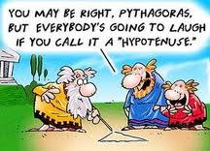
Research Question:
How does the F2F hybrid support mathematics class
benefit and facilitate learning for qualified students
transitioning from ESL to GED?

Slide 5
Research Objectives
TO DETERMINE:
Why students enrolled in the hybrid class
Student weaknesses in mathematics
How the hybrid class helped students learn/relearn concepts.
Whether or not students’ English language proficiency impacted mathematics performance
The most helpful aspects of the hybrid class
Notes:
TO DETERMINE:
Why students enrolled in the hybrid class
Student weaknesses in mathematics
How the hybrid class helped students learn/relearn concepts.
Whether or not students’ English language proficiency impacted mathematics performance
The most helpful aspects of the hybrid class

Slide 6

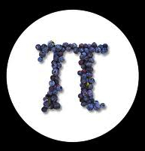
Sample TABE Scores:
Class Average
Mastery of
Computation Concepts:
Pre-test: 44.8
Mid-semester: 67.2
50% Increase in Class Average

Slide 7
Literature Review
Case Study: Using SkillsTutor math for Adult Basic Education programs (Strumminger, 2011)
Case Study: Successful math programming for migrant students (Reyes & Fletcher, 2003)
Investigative: The relationship between English language and mathematics learning (Barton, 2003)
Assessment: Linguistic complexity and graphic representations for English language learners in math tests (Martiniello, 2009)
Technical Report: Language proficiency and mathematics performance (Abedi, et al., 2006)

Slide 8
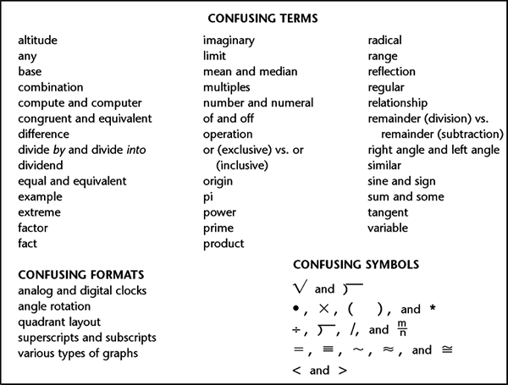
Literature Review:
Main Ideas
Notes:
Case Study: Using SkillsTutor math for Adult Basic Education programs (Strumminger, 2011)
Investigative: The relationship between English language and mathematics learning (Barton, 2003)
Assessment: Linguistic complexity and graphic representations for English language learners in math tests (Martiniello, 2009)
Technical Report: Language proficiency and mathematics performance (Abedi, et al., 2006)
Case Study: Successful math programming for migrant students (Reyes & Fletcher, 2003)

Slide 9
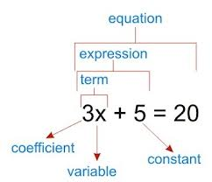
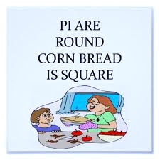
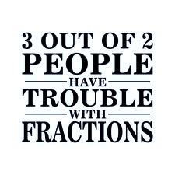
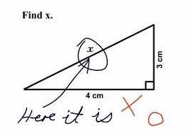
Main Ideas
Being “rusty” in Math being incompetent!!
Notes:
SkillsTutor Hybrid/Face-to-face support math classes
help fill in knowledge gaps
Correlation between math scores and F2F instruction
F2F beneficial to ESL mathematics students, due to regular interaction with peers and teachers
Low-frequency, linguistically complex and unfamiliar L2 technical terms
Linguistically complex mathematical word problems “compromise” understanding of math word problems
ELLs tend to lack knowledge of specific L2 technical terminology

Slide 10
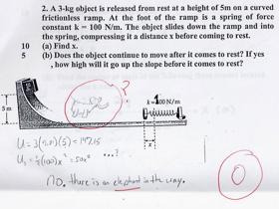
Literature Review:
Main Ideas
Word problems with graphs or illustrations
  Better understood by ELLs even if the text is more linguistically complex
Learning/Relearning math concepts
Prior math education, at any level in the L1, significantly impacts mathematical performance in the L2
  Learning/relearning math: Being “rusty” does not mean being “incompetent”
Notes:
Word problems with graphs or illustrations
Better understood by ELLs even if the text is more linguistically complex
Learning/Relearning math concepts
Prior math education, at any level in the L1, significantly impacts mathematical performance in the L2
Learning/relearning math: Being “rusty” does not mean being “incompetent”

Slide 11

Main Ideas and
Research Findings
Organizational Culture A major factor in ESL student success in mathematics:
    Respect
    Constant reinforcement of concepts
    Peer tutoring and collaboration
    Belief that ALL students can learn
    Teachers genuinely concerned about students
    Student-centered instruction

Slide 12
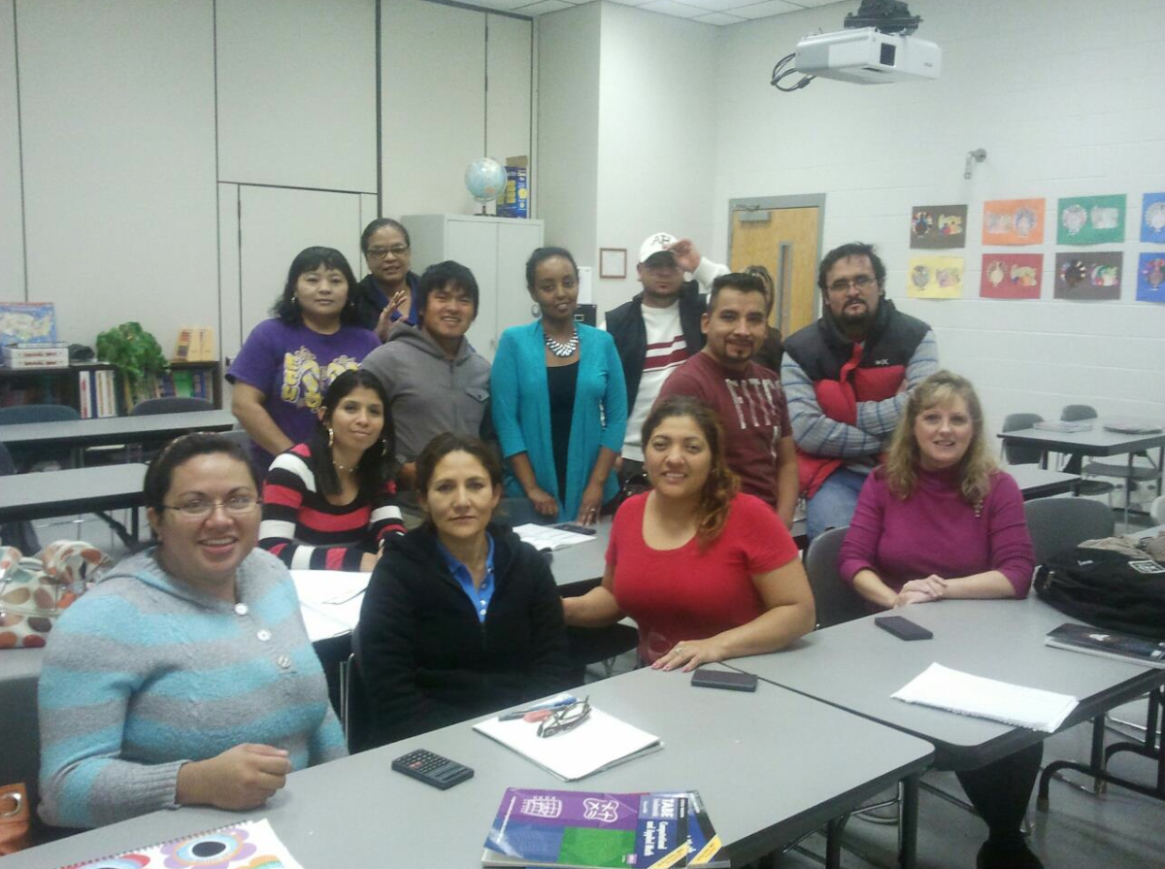
Pitt Community College ESL Transition Math Class Fall 2012
Notes:
Participants:
Project IDEAL Advanced ESL Students
Enrolled in SkillsTutor
Transitioning from ESL to GED
Minimum CASAS English Language score 221-235
Commitment to face-to-face support class
16 weeks
4-hour/week

Slide 13
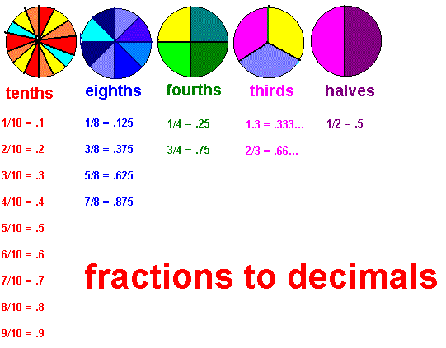
Method: Examples of Instructional Strategies

Slide 14
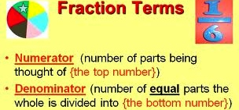
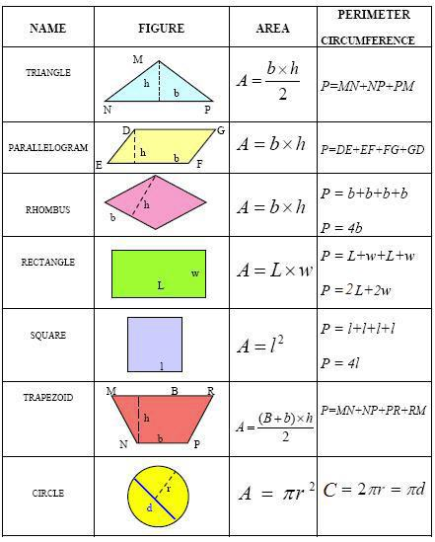
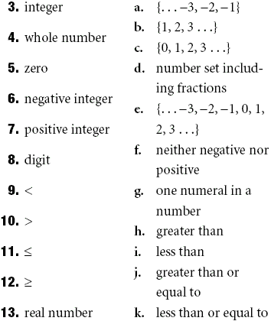
Potentially Difficult
Concepts and Terminology

Slide 15
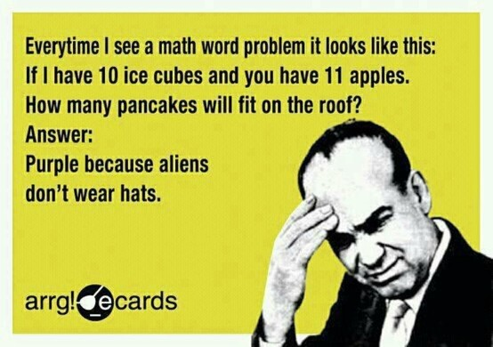
Potential Word Problem Problems

Slide 16
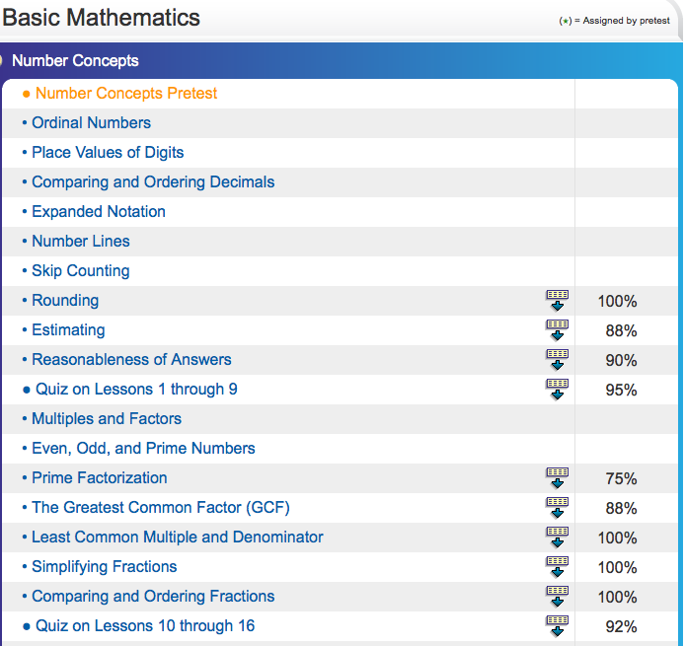

Slide 17
ESL Student Survey Questionnaire Results:
14 responded/4 did not respond
1. Why did you enroll in the SkillsTutor program?
100% GED transition
2. What do you think are your weak areas in math?
Percent/Decimals Division Fractions
14/14 8/14 8/14
Geometry Algebra
7/14 7/14
3. Are you doing SkillsTutor online?
100% Yes
4. As of Nov. 20, 2012, what level were you working on?
Beginning ABC Basic Math Intermediate Algebra
3/14 5/14 5/14 1/14
5. Are you able to complete the ST online before or after the F2F class?
Before After
2/14 15% 12/14 85%
Notes:
Why did you enroll in the SkillsTutor program?
100% GED transition
2. What do you think are your weak areas in math?
Percent/Decimals Division Fractions
14/14 8/14 8/14
Geometry Algebra
7/14 7/14
3. Are you doing SkillsTutor online?
100% Yes
4. As of Nov. 20, 2012, what level were you working on?
Beginning ABC Basic Math Intermediate Algebra
3/14 5/14 5/14 1/14
5. Are you able to complete the SK online before or after the F2F class?
Before After
2/14 15% 12/14 85%

Slide 18
6. Is ST helping you to learn math concepts?
100% Yes, but not enough explanation of concepts, so they just “google” it.
7. Is the F2F class helping you to learn math concepts?
100% Yes, better than online
8. Is F2F better for you?
100% Yes, prefer face-to-face instruction
9. Do you think ST hybrid class should
continue?
100% Yes
10. Would you take this class again? 100% Yes
Notes:
Is ST helping you to learn math concepts?
100% Yes, but not enough explanation of concepts, so they just “google” it.
7. Is the F2F class helping you to learn math concepts?
100% Yes, better than online
8. Is F2F better for you?
100% Yes, prefer face-to-face instruction
9. Do you think ST hybrid class should
continue?
100% Yes
10. Would you take this class again? 100% Yes

Slide 19
11. Do you think you need this class again? Yes Maybe
11/14 77% 3/14 23%
Do you think the F2F teacher is doing a
good job?
100% Yes
13. Would you recommend the Skills Tutor
hybrid class to other ESL students?
100% Yes
14. How long have you been in ESL classes at
PCC?
< year one year >year
21% 14% 65%
15. Do you plan to take the GED in English?
100% Yes, because they want/need to know everything in English
Notes:
11. Do you think you need this class again? Yes Maybe
11/14 77% 3/14 23%
Do you think the F2F teacher is doing a
good job?
100% Yes
13. Would you recommend the Skills Tutor
hybrid class to other ESL students?
100% Yes
14. How long have you been in ESL classes at
PCC?
< year one year >year
21% 14% 65%
15. Do you plan to take the GED in English?
100% Yes, because they want/need to know everything in English

Slide 20
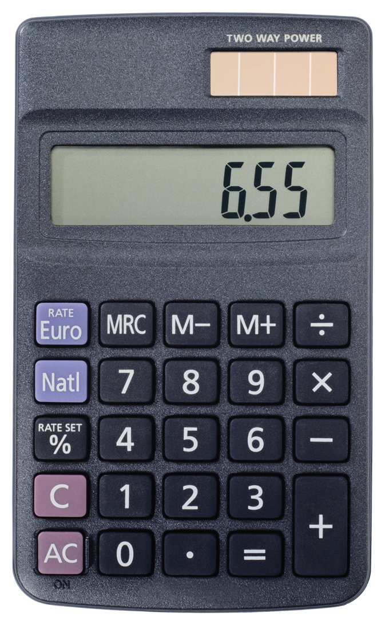

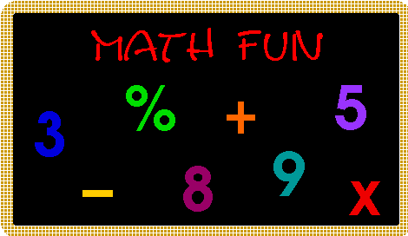
Conclusion:
“THIS CLASS WOKE UP MY MATH”
88% Retention Rate
Notes:
Conclusion: Benefits of a SkillsTutor Hybrid Class
Assists transitioning ESL students facing unique linguistic challenges and potential disadvantages in mathematics
Has the potential to support, encourage, and motivate students transitioning from ESL to GED
SkillsTutor and TABE pre-test scores help identify mathematical weaknesses
A face-to-face support class, specifically targeting mathematics, has the potential to significantly benefit the ESL student during transition
A face-to-face, learner-centered support class group work, peer tutoring, and regular student-teacher interaction with has the potential to significantly benefit the ESL student during transition

Slide 21
Follow-up: Spring 2013
PCC offered advanced ESL students a choice between
English-only classes or a combination
of hybrid transition classes in math, science,
social studies and language arts.
Nineteen students enrolled
One student transitioned to GED
One student transitioned to PCC in Health Sciences
Utilization of SkillsTutor on-line during F2F sessions
for more targeted instruction

Slide 22
References
Abedi, J., Courtney, M., Leon, S., Kao, J., & Azzam, T. (2006). English language learners and math achievement: A study of opportunity to learn and language accommodation (Technical Report 702), 1-94.
Barton, B., & Neville-Barton, P. (2003). Investigating the relationship between English language and mathematics learning. European Research in Mathematics III, 1-10.
Martiniello, M. (2009). Linguistic complexity, schematic representations, and differential item functioning for English language learners in math tests. Educational Assessment, 14, 160-179.
Reyes, P., & Fletcher, C. (2003, June). Successful migrant students: The case of mathematics. Journal of Curriculum and Supervision, 18(4), 306-333.
Schmitt, N. (2010). An Introduction to Applied Linguistics (2nd ed., pp. 252-253). London, England: Hodder & Stroughton, Ltd.
Strumminger, R. (2011, August 3). Skills Tutor Case Study: Using Skills Tutor for Adult Basic Education in Minnesota. SkillsTutor. Boston: Houghton Mifflin Harcourt. www.skillstutor.com

Slide 23
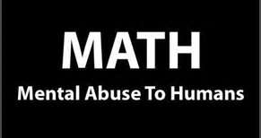
So not true. ☹ Math is fun!! ☺

