Slide 1
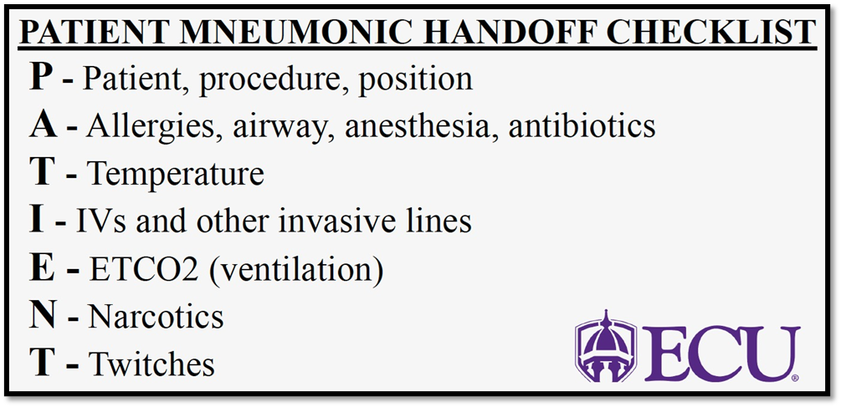
Implementation of a Standardized Handoff Report for Nurse Anesthetists in the Intra-Operative Setting: A Quality Improvement Project
Pierce Do, BSN, SRNA
Maura McAuliffe, PhD, CRNA, FAAN, Project Chair
Nurse Anesthesia Program
College of Nursing, East Carolina University
Greenville, North Carolina 27858
dop14@students.ecu.edu
INTRODUCTION
RESULTS
DISCUSSION
A handoff is considered the transfer of information, data, and responsibility between two health care professionals (Cohen & Hilligoss, 2010).
Handoffs amongst anesthesia providers are often complex, rapid, and frequent.
  Per The Joint Commission, 70% of sentinel events reported over 9 years were attributable to communication issues (Association of periOperative Registered Nurses, 2014).
  More than 50% of these communication breakdowns occurred during the handoff period.
The primary standardized handoff tool dedicated to nurse anesthetists is the PATIENT Transfer of Care Checklist Tool (Wright, 2013).
The purpose of this quality improvement project was to assess anesthesia providers' perceptions of adequacy of the PATIENT Mnemonic to facilitate standardized handoffs of anesthetized patients.
Factors that influence current CRNA handoff practice
  Type of case
  Length of case
  Experience of receiving CRNA
Post-implementation levels of satisfaction regarding PATIENT Mnemonic
Participants deem the PATIENT Mnemonic unnecessary at current medical center
Three primary limitations of this quality improvement project:
    Sample size
    Limited time for implementation
    Reliance on subjective recall from the CRNA participants.
CONCLUSIONS
The consensus regarding the PATIENT Mnemonic is a shorter version that is tailored for anesthesia providers at this facility would do well if it were trialed.
Getting rid of redundant or unnecessary aspects of the tool would:
    Shorten the time it takes to give report
    Make the handoff process more fluid and similar to the way most CRNAs already give report.
The participating CRNAs seem to agree the PATIENT Mnemonic is:
    Easy to use
    Efficient, comprehensive
    Appropriate in length
    Does not lend itself to communication errors.
Having a larger pool of CRNAs and extended implementation period would help bolster the reliability of the collected data.
To truly assess the efficacy of the PATIENT Mnemonic, it would be beneficial to integrate the concept into the EPIC charting system.
METHODS
A single Plan, Do, Study, Act cycle was completed employing a pre-survey and post-survey design (IHI, 2023).
The faculty member serving as the clinical contact person accrued a list of 8 CRNAs
Participants were sent an email which included:
  A Qualtrics link to a pre-implementation survey
  A narrated PowerPoint
Each volunteer was supplied a badge buddy to promote the use of Wright’s tool.
This project was initiated on April 8th, 2024, and it ended on April 19th, 2024.
  During this time, participating volunteers used the PATIENT checklist tool to conduct CRNA to CRNA handoffs for lunches and change of shift report.
At the conclusion of this project, all participating CRNAs were sent a final email which included a Qualtrics post-implementation survey to share their thoughts regarding the efficacy of the PATIENT checklist tool.
REFERENCES
Association of periOperative Registered Nurses. (2014). Patient hand off tool. https://www.aorn.org/docs/default-source/aorn/toolkits/patient-hand-off/patient-hand-off-recommendations.pdf?sfvrsn=bf6c59f0_0
Canale, M. (2018). Implementation of a standardized handoff of anesthetized patients. AANA Journal, 86(2), 137-145. https://www.proquest.com/scholarly-journals/implementation-standardized-handoff-anesthetized/docview/2028119569/se-2
Cohen, M. D., & Hilligoss, P. B. (2010). The published literature on handoffs in hospitals: Deficiencies identified in an extensive review. Quality & Safety in Health Care, 19(6), 493-497. https://doi.org/10.1136/qshc.2009.033480
Durley, T. (2017). Application of the PATIENT Checklist Tool in anesthesia handoffs. Northern Michigan University: DNP Scholarly Projects, 2. https://commons.nmu.edu/dnp/2
Institute for Healthcare Improvement (2023). Science of improvement: Testing changes. https://www.ihi.org/resources/Pages/HowtoImprove/ScienceofImprovementTestingChanges.aspx
Wright, S. M. (2013). Examining transfer of care processes in nurse anesthesia practice: Introducing the PATIENT protocol. AANA Journal, 81(3), 225–232. https://www.proquest.com/scholarly-journals/examining-transfer-care-processes-nurse/docview/1440809897/se-2

