Slide 1
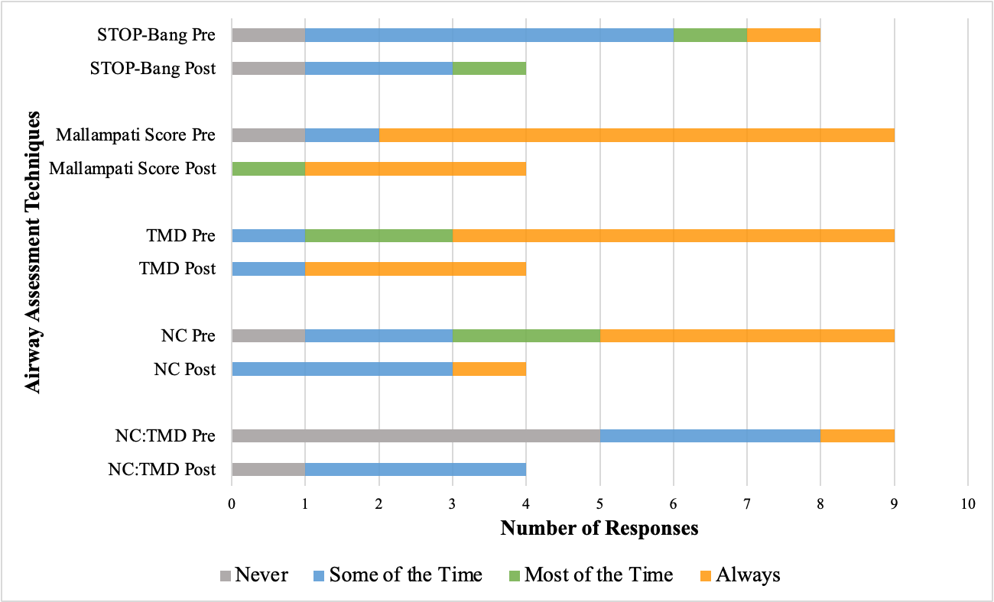
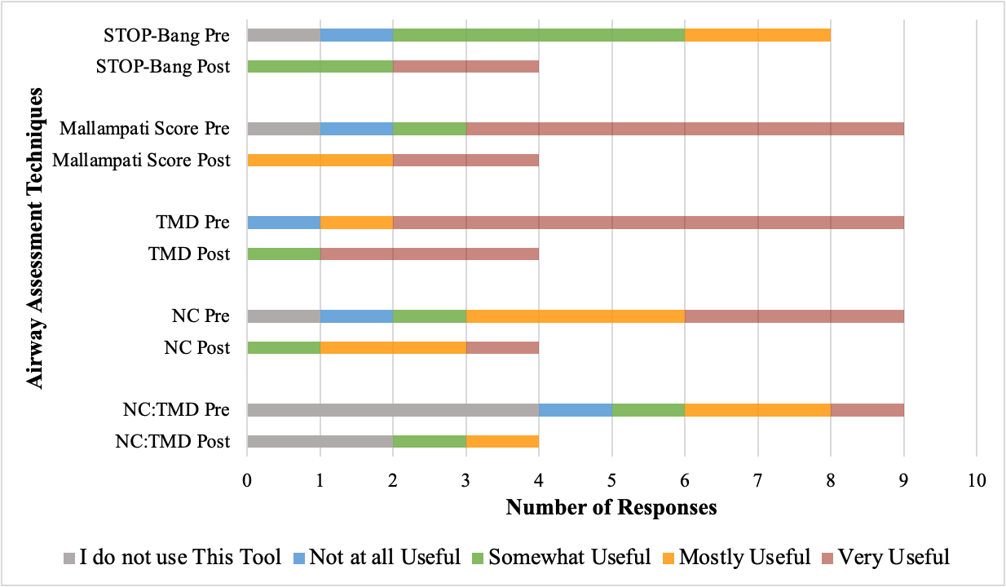
Assessing Certified Registered Nurse Anesthetists’ Perceptions of the Adequacy of a Quick-Reference Guide for Evaluating Airways of Patients with Obesity: A Quality Improvement Project
Amy Nygren, BSN, SRNA
Maura McAuliffe, PhD, CRNA, FAAN, Project Chair
Nurse Anesthesia Program
College of Nursing, East Carolina University
Greenville, North Carolina 27858
nygrena22@students.ecu.edu
INTRODUCTION
RESULTS
DISCUSSION
Obesity is a growing U.S. health problem and increases risk from anesthesia ^{1,2,3}
ASA and AANA require comprehensive patient assessment to identify possible complications ^{4,5,6}
  Quality improvement and fostering a culture of safety are standards
Quick-reference guides (QRGs) present a comprehensive list of most effective airway assessment techniques
Purpose: to assess perceptions of adequacy of a QRG as a tool for airway assessment of patients with obesity
Figure 2
Frequency of Airway Assessment Measure Use Before and After Quick-Reference Guide Use
Figure 3
Perceptions of the Usefulness of Airway Assessment Measures in Predicting Difficult Airways in Patients with Obesity
Analysis
  n=4
  Comparable proportion of patients that had obesity during implementation
Mask ventilation more difficult, not intubation
Mallampati Score, TMD, NC most used and most helpful
STOP-Bang, NC:TMD, ramping least used and least helpful
QRG format effective but could use adjustment
CONCLUSIONS
Limitations:
  Small sample size
  More research needed into which assessments most predictive
    Important to determine which assessment methods work best for patients with obesity
    Likely a large proportion of patients with obesity
QRG had a low-cost implementation with potential to improve quality of patient care
POCUS is an area for future quality improvement and research
METHODS
Plan
Literature review
  21 articles after full-text review
  Levels of evidence: I, V, VI, VII
Four-person group with project chair
  QRG, surveys, and PowerPoint developed
  Emails written
CITI modules/UMCIRB and site approval
Do
Project implemented individually over two-week period
Study
Results analyzed
Act
Conclusions drawn and suggestions for future QI projects disseminated
REFERENCES
Mehta, A. R., Maldonado, Y., Abdalla, M., Roessler, J., Schmidt, M., Pu, X., Skubas, N. J., & Ruetzler, K. (2022). Association between body mass index and difficult intubation with a double lumen tube: A retrospective cohort study. Journal of Clinical Anesthesia, 83, Article 110980. https://doi.org/10.1016/j.jclinane.2022.110980
Moura, E. C., Filho, A. S., de Oliveira, E. J., Freire, T. T., Leal, P., Gomes, L. M., Servin, E. T., & de Oliveira, C. M. (2021). Comparative study of clinical and ultrasound parameters for defining a difficult airway in patients with obesity. Obesity Surgery, 31, 4118-4124. https://doi.org/10.1007/s11695-021-05528-1
National Institute of Diabetes and Digestive and Kidney Diseases. (2021). Overweight & obesity statistics. https://www.niddk.nih.gov/health-information/health-statistics/overweight-obesity
American Association of Nurse Anesthesiology. (2019). Standards for nurse anesthesia practice. https://issuu.com/aanapublishing/docs/standards_for_nurse_anesthesia_practice_2.23?fr=sOGNhNjU2NDAxMjU
American Association of Nurse Anesthesiology. (2020b). Scope of nurse anesthesia practice. https://issuu.com/aanapublishing/docs/scope_of_nurse_anesthesia_practice_2.23?fr=sNDg2MDU2NDAxMjU
Apfelbaum, J. L., Hagberg, C. A., Connis, R. T., Abdelmalak, B. B., Agarkar, M., Dutton, R. P., Fiadjoe, J. E., Grief, R., Klock, P. A., Mercier, D., Myatra, S. N., O’Sullivan, E. P., Rosenblatt, W. H., Sorbello, M., & Tung, A. (2022). 2022 American Society of Anesthesiologists practice guidelines for management of the difficult airway. Anesthesiology, 136(1), 31-81. https://doi.org/10.1097/ALN.0000000000004002

