Slide 1

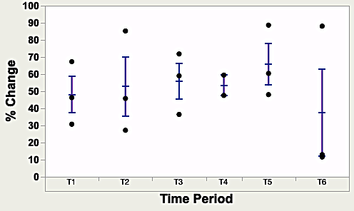
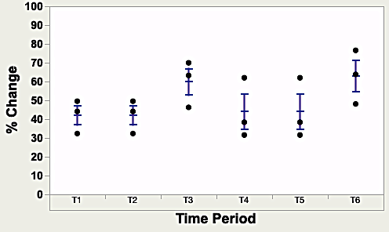
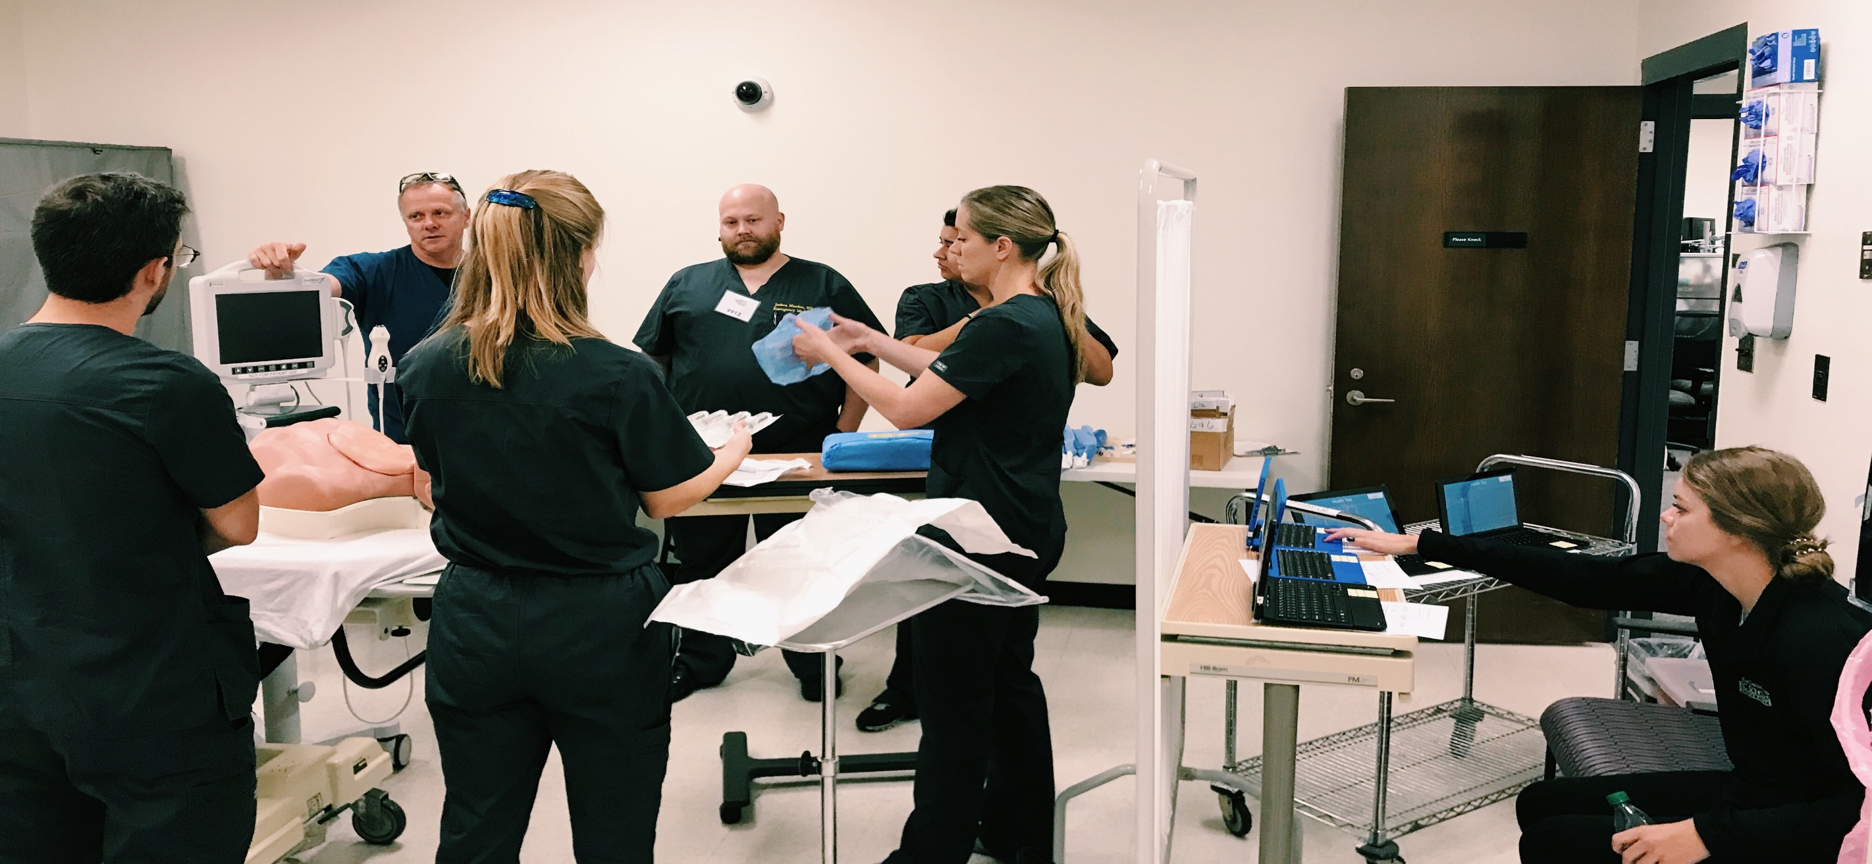
Using Heart Rate Variability to Assess Resident Stress During Central Venous Catheter Simulation
Adelaide Robbins¹, Juan March MD^{1,3}, Carmen Russoniello PhD^{1,2}, Walter Robey MD^{1,3,4} Kori Brewer PhD^{1,3}
¹ East Carolina University, ² College of Health and Human Performance, ³ Brody School of Medicine, ⁴BSOM Interprofessional Clinical Simulation Program
Adelaide Robbins
Honors College, Department of Health and Human Promotion
East Carolina University
Greenville, North Carolina 27858
robbinsad15@students.ecu.edu
INTRODUCTION
MATERIALS & METHODS CONTINUED
DISCUSSION / LIMITATIONS
  Simulation-based central venous catheterization (CVC) training has been shown to result in fewer needle passes and complications.
  Heart rate variability (HRV) has been shown to be effective in identifying stress that is related to self-confidence while completing tasks by surgeons.
  There are no studies examining the effects of stress on task performance during simulation-based CVC training.
  The purpose of this study was to use heart rate variability to identify stress during CVC simulation training.
  Data was analyzed using IBM SPSS with a logistic regression model to determine the association between an individual’s stress and each of the 12 procedural steps over time.
  This small pilot study suggests that stress, as measured by HRV, during simulated CVC training, did not change throughout training, except during the skills assessment for 3 individuals.
  This finding needs further exploration for it is possible that high stress levels without return to baseline could lead to fatigue and possible procedure related error.
RESULTS
  16 participants were enrolled in the study. Stress as determined by SI, SDNN, and RMS-SD was not significantly different across participants prior to beginning the simulation.
  Stress as determined by SI, SDNN, and RMS-SD did not change significantly during any one of the 12 individual procedural steps nor over time.
  3 of the 16 (18%) participants appeared to have increased stress (see Figures 1 and 2) during the final CVC skills assessment, with an average stress index of 51.9 (range 31.4-58.5) at baseline compared to an average of 280 (range 160-360) during the skills assessment indicating a more than 5 fold increase.
CONCLUSION
MATERIALS & METHODS
  This study suggests that stress, as measured by HRV during simulation-based CVC training, did not change throughout skills practice, and did not decrease over time.
  A small but non-statistically significant number of participants did have increased stress during the final skills assessment indicating an increased sensitivity to this type of hands-on skills assessment.
  Future studies examining physician HRV during clinical CVC placement could assist in identifying a relationship between stress and performance.
  This was a prospective cohort study with a convenience sample of resident physicians who enrolled in a simulation-based CVC training course.
  Participants were attached to an HRV monitoring device.
  A 12-step standardized procedural skills checklist was used to measure psychomotor skill performance.
  Participant stress was analyzed in 5-minute intervals using a software program that analyzes heart rate variability.
  The software program used to collect the data analyzed heart rate variability in terms of stress index (SI) or a derivative of:
    Standard deviation of normal-to-normal intervals (SDNN) – a sympathetic nervous system measure
    Square root of the mean normal-to-normal intervals (RMS-SD) – a parasympathetic nervous system measure
    Figure 1:
    Wire-Guided Catheter
    Insertion
    Time vs
    % Change
REFERENCES
  Alsaad, A. et al. Annals of the American Thoracic Society,2017: 14(4), 550-554
  Rieger, A., et al. International Archives of Occupational and Environmental Health 2014: 87(2), 165-174.
  Song, M., et al. Cardiovascular and Thoracic Surgery 2009: 8(6), 639-641.
ACKNOWLEDGEMENTS
    Figure 2:
    First 5 Minutes of Final Exam
    Time vs
    % Change
Special thanks to:
  Brody School of Medicine Interprofessional Clinical Simulation Program
  East Carolina University Center for Applied Psychophysiology
  East Carolina University Honors College faculty

