Slide 1
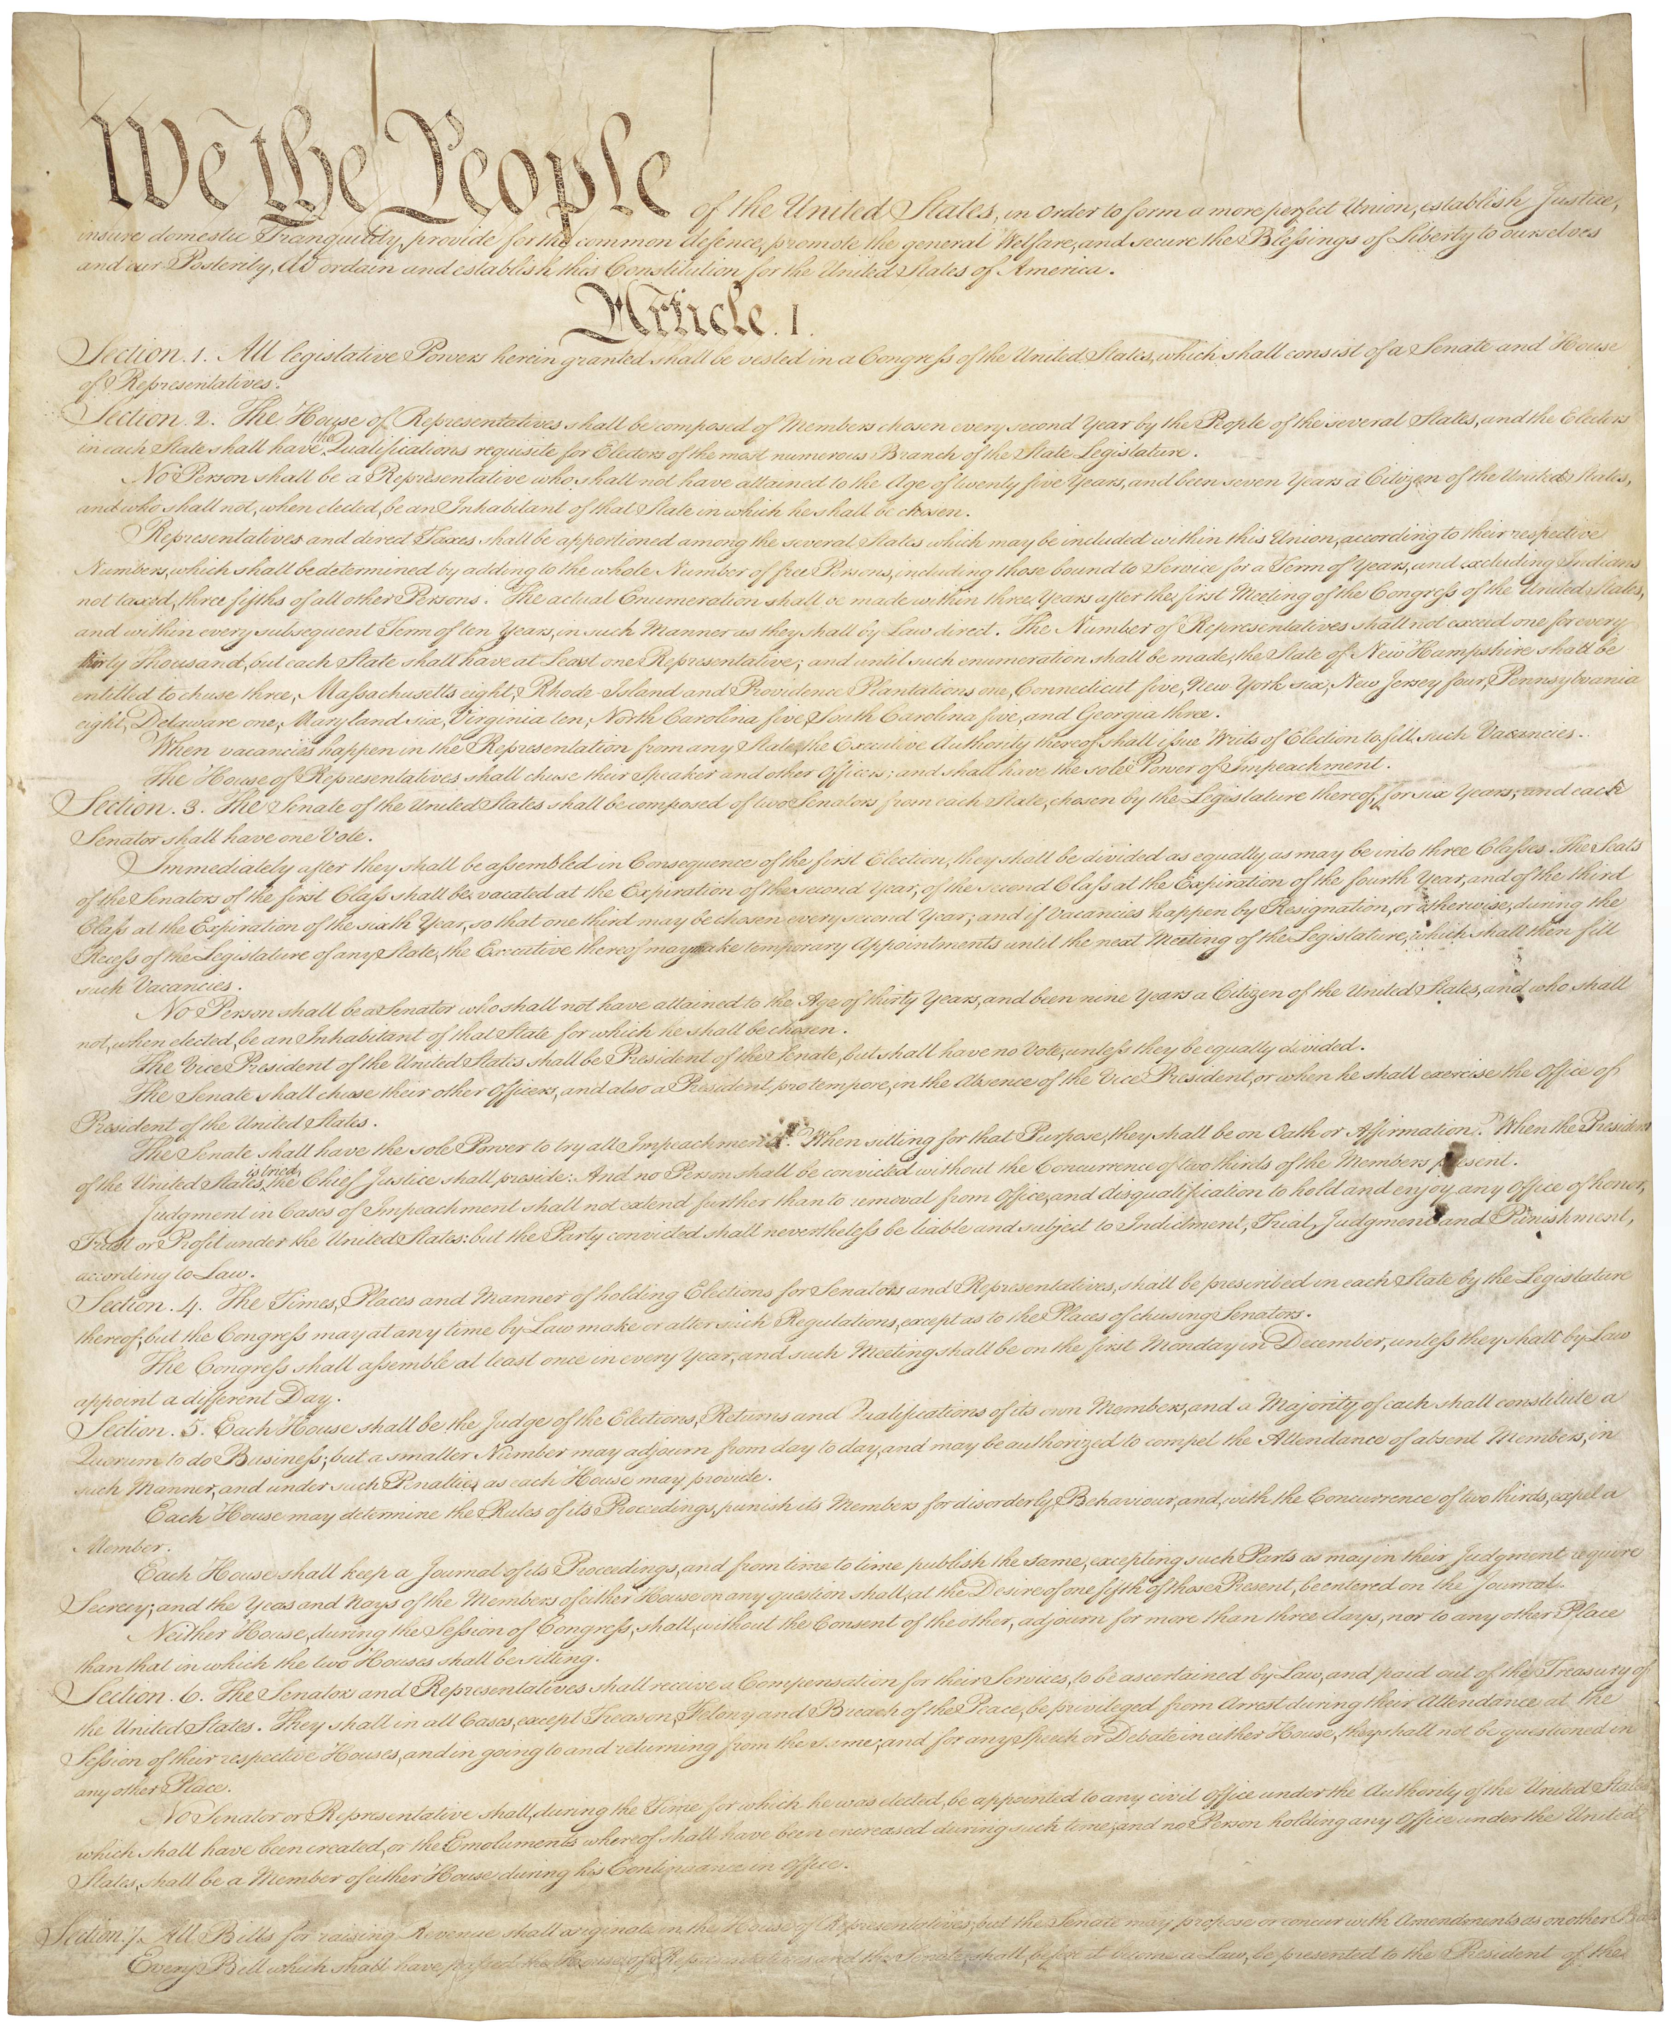
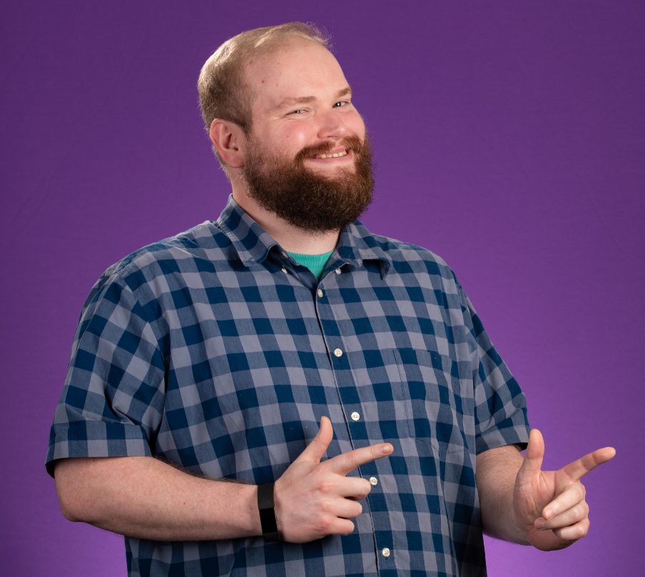
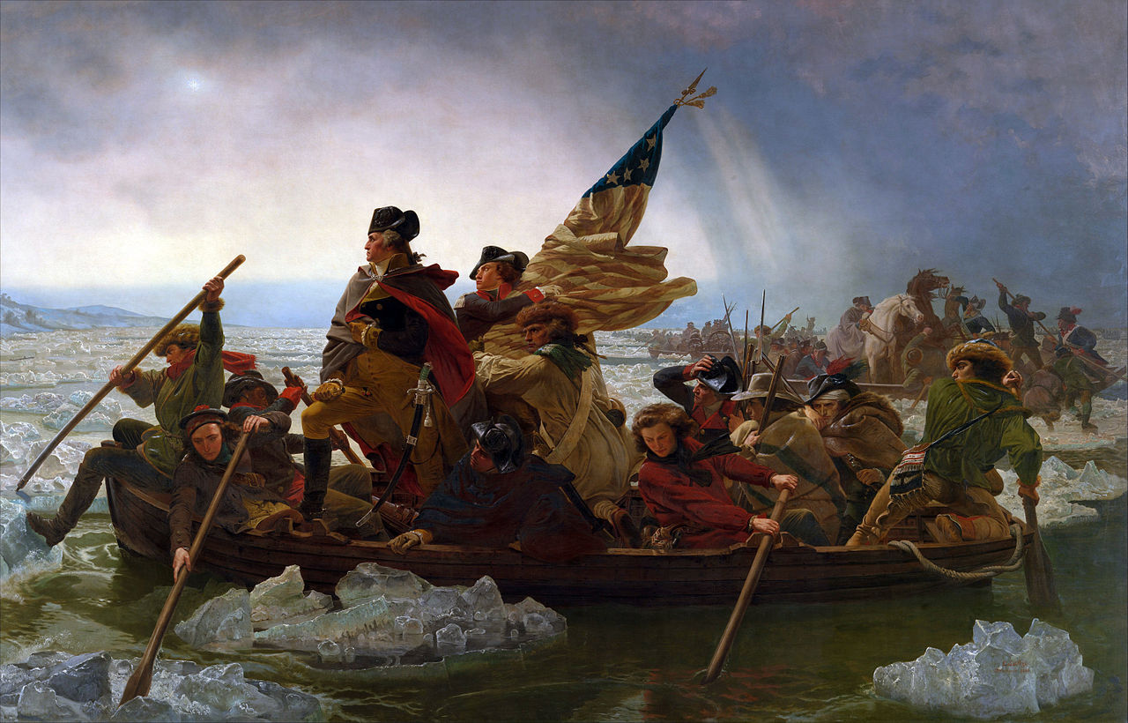
Rediscovering Your Federal Documents or How I Learned to Stop Worrying and Love Docs
Andrew Grace
RIS Department Joyner Library,
East Carolina University,
gracean17@ecu.edu
Andrew says start here!
Helping Patrons and Students Rediscover Federal Documents
Federal Documents are a valuable tool for patrons and students alike! They can be used as a primary source of information for a project, or used to find information about federal grants.
The biggest issue is that so many patrons and students are unaware of the information contained in Federal Documents. Even library staff and librarians may not be fully aware of the information that is contained in an FDLP (Federal Depository Library Program) Member.
Informational Displays are also helpful at spreading the word about Federal Documents.
For Constitution Day 2017, we put up a display providing information about the constitution and handed out free copies of the Constitution to celebrate! I worked with the North Carolina Collection to show the differences between the United States Constitution and the North Carolina State Constitution. Additionally, we had a video on a loop near a display with our copy of the Constitution and other materials. It was a great way to inform our students!
What can Federal Documents and Resources do for you?
Federal Budget information
Planning a trip to a national park
National Health Statistics
Reports from various Federal Departments
Amount of people killed by bears in Yellowstone since 1872
  8 bear induced fatalities
  7 fatalities from Falling trees
Code of Laws of the United States of America
Historical books ranging from United States Architecture to Defense Missions
Congressional Hearings
  Including impeachment hearings
  Committee Meetings
Zombie apocalypse survival solutions
Presidential Papers
Access to the National Archives
How to make fire
  With and without accelerants
How to spread awareness?
Government Documents account for .0048% of all the Joyner Library check outs. The check outs are only a bit higher than the 8 movies of the 2018 Academy Award Nominees in our DVD Collection! The number of checkouts is a little skewed, because many federal documents are available online for personal use!
Presentations
Informational Displays*
Direct students and patrons to them for research and projects
One of the best ways to spread the word of
Federal Documents and Resources is to use them!
Mentioning your Fed Doc collection during instruction sessions or during one on one sessions with students or patrons is a great way to encourage Fed Doc usage! Lots of people just need a little push to find all the great information available to them.
Check out govinfo.gov or any of the great .gov sites available to you when pulling data or information for patrons. If working with a K-12 patron or student, use bensguide.gpo.gov for age appropriate government research!
Presentations are a great way to show what Federal Documents and Federal Resources can provide.
In my time at ECU I have done the following:
Government Docs and US: Doc Hard (Overview of Fed Docs)
Government Docs and US: Doc Harder (Budgets)
Government Docs and US: Doc Hard With a Vengeance (Weather and NOAA)
Government Docs and US: Live Free or Doc Hard (Constitution and Constitution Day)
Government Docs and US: A Good Day to Doc Hard (Patents and Trademarks)
**Affairs of the State: Daring Dalliances and Docs (Illicit and not-as-illicit affairs of our early representatives)
**Live and Let Doc: Using Federal Documents to Survive
Most of these presentations were presented to coworkers in an effort to encourage them to spread the word about Fed Documents. The presentations allowed me to be creative while showing some of the awesome benefits Fed Docs can provide!
FEELING CUTE
Despite all the great information available, not everyone is using the materials!
MIGHT GO TO NEW JERSEY
*Buttons count as displays. Please take a button (limited supply) to show your support and adoration for Federal Documents
**Available for viewing on http://libguides.ecu.edu/federal_government_information

