Slide 1
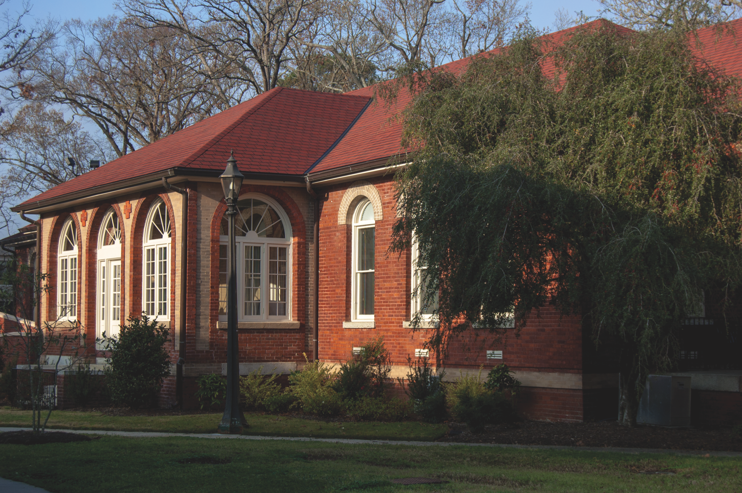

Slide 2
Beliefs about the rehabilitation of aggressive canines:
Development of the canine aggression locus of control and locus of origin scales
Destiny DeHart
Senior Honors College Psychology, Undergraduate Major
Mentor: Dr. Karl Wuensch

Slide 3
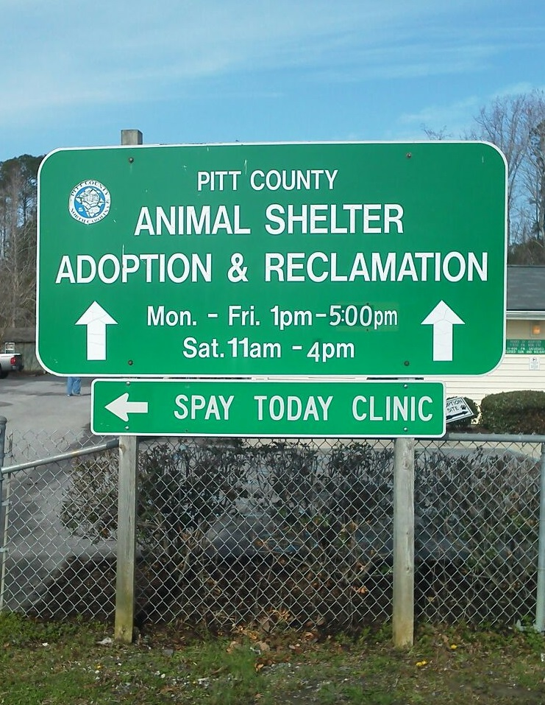
Motivation
“[T]here are almost as many cats and dogs in households as televisions.”
      McKenna 2013
“…right to protect their persons and property from aggressive roaming dogs…”
      Canine Control Ordinance

Slide 4
Introduction
Late1900s:
  Identifying, classifying, and understanding aggressive canine behaviors
  assess treatment methods
              Uchida, Dodman, DeNapoli, & Aronson, 1997; Dodman, Donnelly, Shuster, Mertens, Rand, & Miczek, 1996; Tortora, 1983
Early 2000s:
  applications of aggression rehabilitation for the general public
              Reisner, 2003; Ibanez & Anzola, 2009

Slide 5
Methods
Sample:
  Former Pitt County Animal Shelter adopters
  About 200 invitations
Online survey
  Email invitation
  Questions will be based off of a 6 point Likert scale:
    1 = strongly agree, 2 = agree, 3 = mostly agree, 4 = mostly disagree, 5 = disagree, 6 = strongly disagree

Slide 6
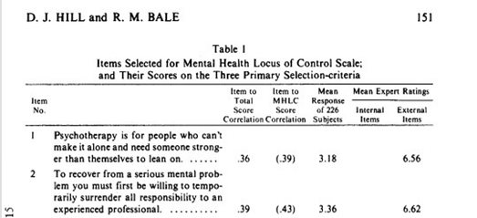
Development of the Mental Health Locus of Control and
Mental Health Locus of Origin Scales
& Implicit Personality Theory
Developed to understand the relationship between expectations of the client and the potential acceptance of treatment methods in the mental health field
        Hill &Bale, 1980
Adaption to the canine aggression locus of control (CALC) or canine aggression locus of origin scales (CALO)
Internal vs External rating:
  “[I]nternal control represents the perception, on the part of the clients, that therapeutic change is a consequence of their own behavior…”
        Hill &Bale, 1980
IPT or Implicit Personality Theory addresses the individual’s beliefs of internal vs. external control of the self, of situations, and by extension rehabilitation of canines.
        Levy, Stroessner, & Dweck, 1998

Slide 7
Results
If data shows a skew towards the developed canine aggression locus of control (CALC) or canine aggression locus of origin scales (CALO), we could be lead to conclude that owners may have particular expectations for the treatments of animal aggression particularly in dogs.
These expectations could influence the application of treatments by owners or even the types of treatments owners consider when faced with and aggressive canine situation.

Slide 8
Implications
By understanding public opinions, understandings, expectations, and often unconscious views, we can elicit change in:
  The general knowledge about canine aggression
  How the public is informed
  How to approach misconceptions regarding aggression and rehabilitation
  What options should be available for individuals dealing with canine aggression problems

Slide 9
Why Should We Care?
Legislation
  Pit Bull Ordinance in Boston
Domestic prejudice
  Breed restrictions in residential areas
Euthanasia practices
  Understanding your options
Veterinary recommendations
  Proper relay of information

Slide 10
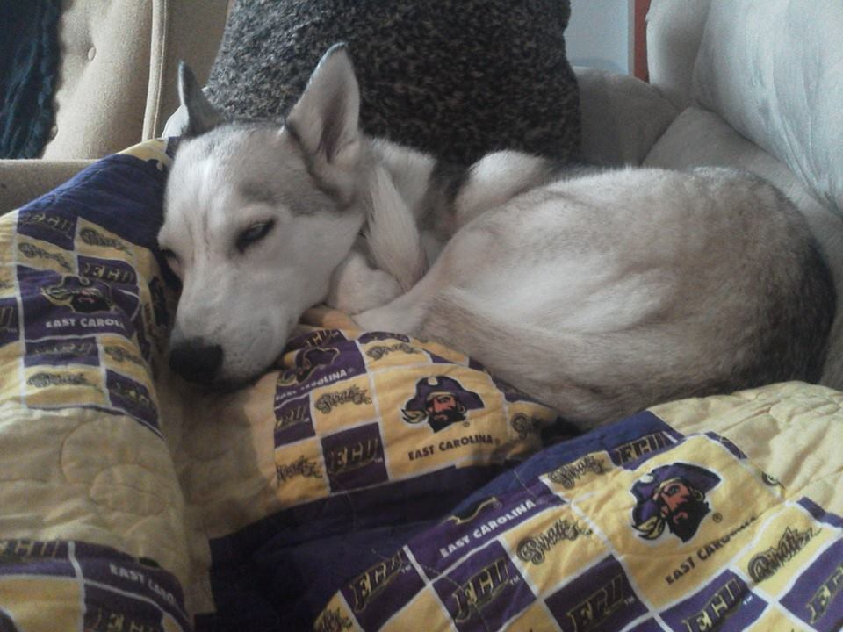
A Special Thank You
Dr. Karl Wuensch
Dr. Fraley
Dr. Edwards
The Honors College
The EC Scholars Program
Pitt County Animal Shelter

Slide 11
Resources
Canine Control Ordinance, Animal Control, Ordinance No. 4. Retrieved From: http://www.pittcountync.gov/bcc/ordinance/amcontrol/4.pdf
Dodman, N., Donnelly, R., Shuster, L., Mertens, P., Rand, W., Miczek, K. (1996). Use of fluoxetine to treat dominance aggression in dogs. J Am Vet Med Assoc, 209(9). 1585–1587.
Hill, D. J., Bale, R. M. (2010). Development of the mental health locus of control and mental health locus of origin scales. Journal of Personality Assessment, 44(2). 148-156
Ibanez, M., Anzola, B., (2009). Use of fluoxetine, diazepam, and behavior modification as therapy for treatment of anxiety-related disorders in dogs. Journal of Veterinary Behavior: Clinical Applications and Research. 4(6). 223-229.
Levy, S. R., Stroessner, S. J., & Dweck, C. S. (1998). Stereotype formation and endorsement: The role of implicit theories. Journal of Personality and Social Psychology. 74(6). 1421-1436.
Reisner, I. R., (2003). Differential diagnosis and management of human-directed aggression in dogs. The Veterinary Clinics. 33(2). 303-320.
Mckenna, E. (2013). Pets, people, and pragmatism. New York: Fordham University Press
Tortora, D. F. (1983). Safety training: The elimination of avoidance-motivated aggression in dogs. Journal of Experimental Psychology: General. 112(2). 176-214.
Uchida, Y., Dodman, N., DeNapoli, J., Aronson, L. (1997). Characterization and treatment of 20 canine dominance aggression cases. Journal of Veterinary Medical Science. 59(5). 397-399.

