Slide 1
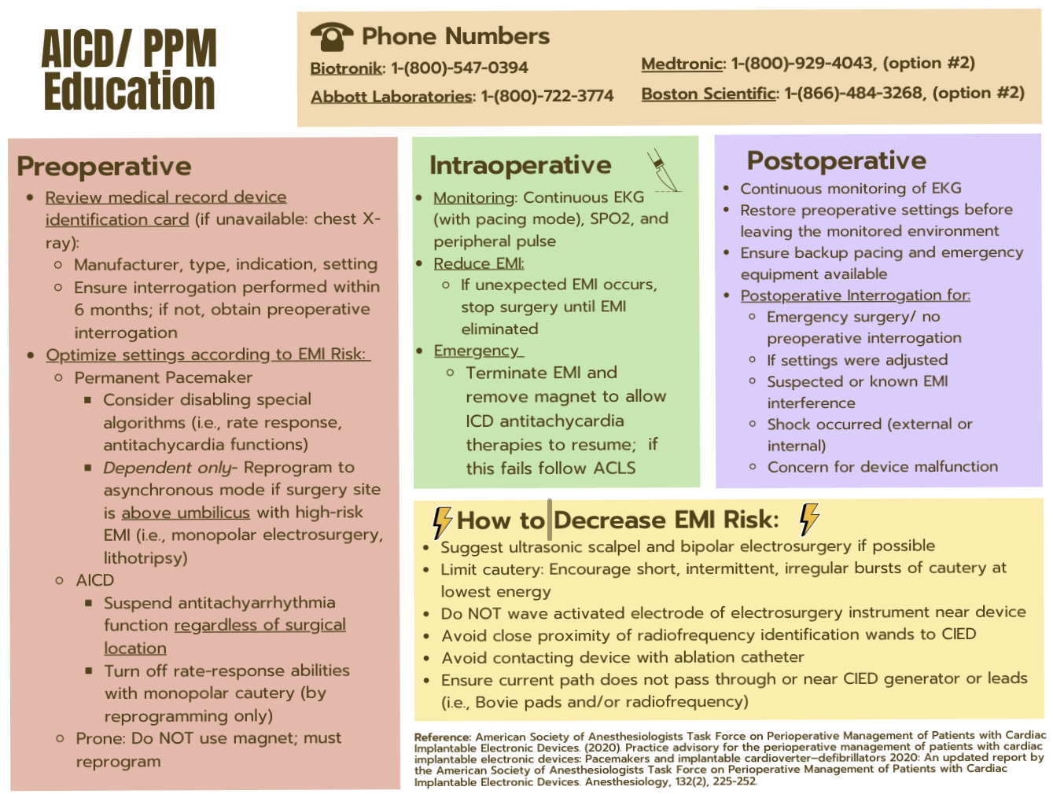
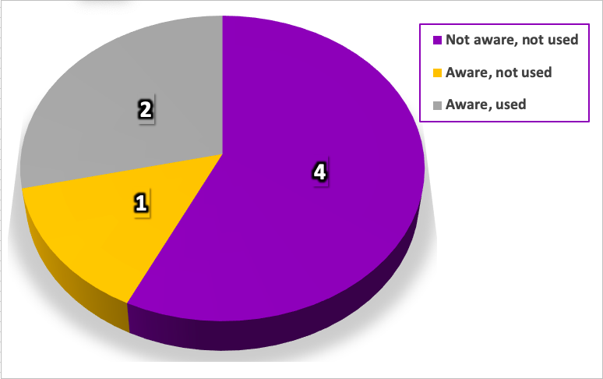
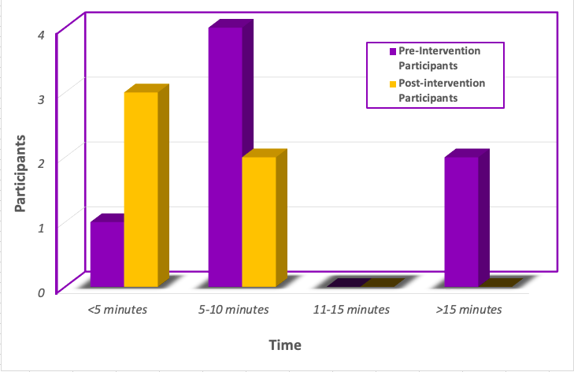
Quality Improvement Project: Perioperative Care for Patients with Cardiac Implantable Electronic Devices
Coley Mizell, BSN, SRNA
Travis Chabo, PhD, CRNA, Project Chair
Nurse Anesthesia Program
College of Nursing, East Carolina University
Greenville, North Carolina 27858
mizellc15@students.ecu.edu
INTRODUCTION
RESULTS
INTERVENTION
Almost a third of a million patients receive cardiac implantable electronic devices (CIEDs) each year in the United States alone (Greenspon et al., 2011).
As the abundance in implantations of CIEDs continues to rise, the demand for healthcare providers to be knowledgeable on properly managing them becomes critically essential (Chakravarthy & George, 2017).
Interventions completed by CRNAs during the perioperative period include: gathering pertinent device information, limiting electromagnetic interference (EMI), and safely adjusting device settings when indicated.
CRNAs deliver crucial care to this population specific to the perioperative period, at a time when these patients may have elevated risk for poor outcomes related to their device/s.
These clinical risks include hypotension, arrhythmias, and myocardial tissue damage which may ultimately result in extended hospital stays, cancellation of surgery, readmission for device malfunction, and additional hospital resource utilization (Feldman & Stone, 2020).
The purpose of this quality improvement project was to assess anesthesia providers’ perceptions of an AID/PPM Handout as an educational tool to improve perioperative CIED management and patient safety.
Figure 1
Awareness and Use of the Facility’s Current Policy (pre-intervention n=7)
Figure 2
Estimated Time to Gather Pertinent AICD/PPM Information (pre-intervention n= 7; post-intervention n= 5)
METHODS
CONCLUSIONS
Potentially harmful insufficiencies in patient care could result from lack of awareness of current practice guidelines and hospital policies.
With the use of a guide, such as an AICD/PPM handout, the amount of time wasted gathering device information, as supported by post-intervention results, can be reduced.
Overall, the respondents acknowledged they had sufficient confidence in pre-op assessment and managing/identifying high risks of perioperative EMI for patients with AICD/PPM.
Confidence in managing these patients for many CRNAs may be high, however, most would agree that adding a supplemental guide during their care approach could potentially reduce negative outcomes and could provide direction in times of difficulty.
Recommendations for future studies include larger sample size, individualized survey links, assessing the staff schedule prior to implementation, decreasing digital file sizes, incorporating a third-party observer, and providing direct access to project materials on facility computers .
Pre- and post-intervention survey design completed through Qualtrics.
Framework adapted from Plan-Do-Study-Act cycle (PDSA; IHI, 2021).
A perioperative AICD/PPM handout guide was created that summarized current ASA and HRS practice guidelines and hospital policy during the perioperative period.
The PPM handout, introductory PowerPoint, and surveys were distributed via email, as well as in print, to CRNAs working in Cardiovascular designated operating rooms located in a Level 1 Trauma Center.
CRNAs utilized the intervention for 4 weeks and 4 days and completed a post-intervention survey.
DISCUSSION
REFERENCES
All respondents in the pre-survey alluded that more education on AICD/PPM would be beneficial in reducing negative outcomes.
It could be a concern that not many respondents were aware of either the facility’s policy or the current ASA and HRS guidelines. See Figure 1.
Prior to using the intervention, some participants responded that they take at least 15 minutes to gather patient/device information, while all participants attained the necessary information in under 10 minutes following the use of the AICD/PPM handout. See Figure 2.
All participants found the AICD/PPM handout to be of benefit and responded its “somewhat likely” to “extremely likely” that they will use the handout in the future.
Connelly, L. M. (2021). Using the PDSA Model Correctly. Medsurg Nursing, 30(1), 61,64. https://www.proquest.com/scholarly-journals/using-pdsa-model-correctly/docview/2497225422/se-2
Chakravarthy, M., Prabhakumar, D., & George, A. (2017). Anaesthetic consideration in patients with cardiac implantable electronic devices scheduled for surgery. Indian Journal of Anaesthesia, 61(9), 736–743. https://doi.org/10.4103/ija.IJA_346_17
Feldman, J. B., & Stone, M. E. (2020). Anesthesia teams managing pacemakers and ICDs for the perioperative period: Enhanced patient safety and improved workflows. Current Opinion in Anaesthesiology, 33(3), 441–447. https://doi.org/10.1097/ACO.0000000000000856
Greenspon, A. J., Patel, J. D., Lau, E., Ochoa, J. A., Frisch, D. R., Ho, R. T., Pavri, B. B., & Kurtz, S. M. (2011). 16-year trends in the infection burden for pacemakers and implantable cardioverter-defibrillators in the United States 1993 to 2008. Journal of the American College of Cardiology, 58(10), 1001–1006. https://doi.org/10.1016/j.jacc.2011.04.033

