Slide 1
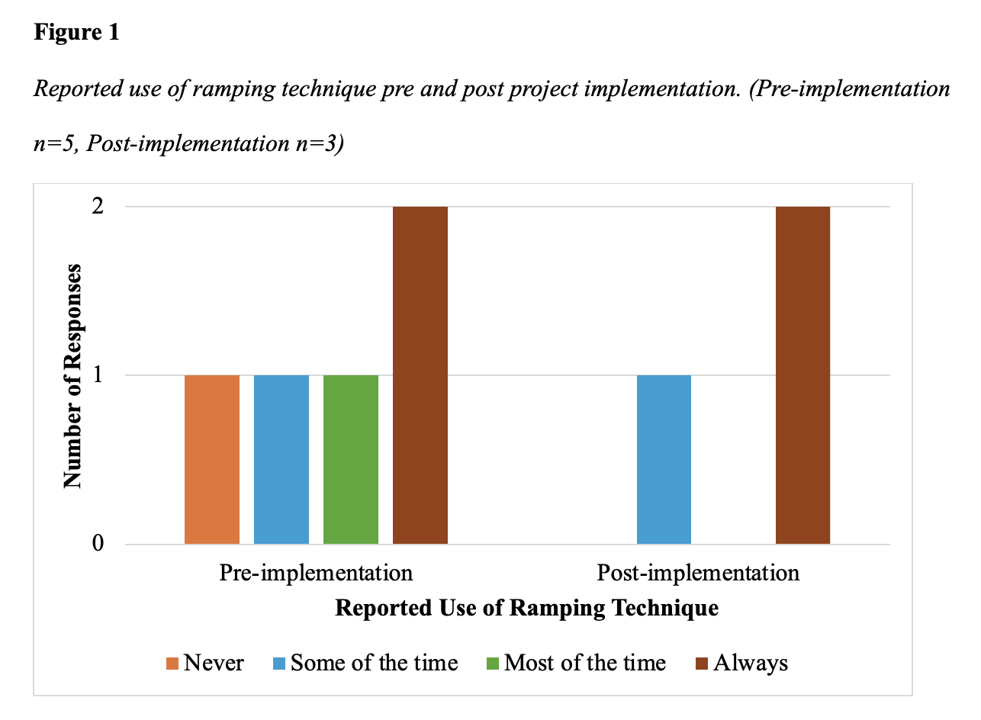
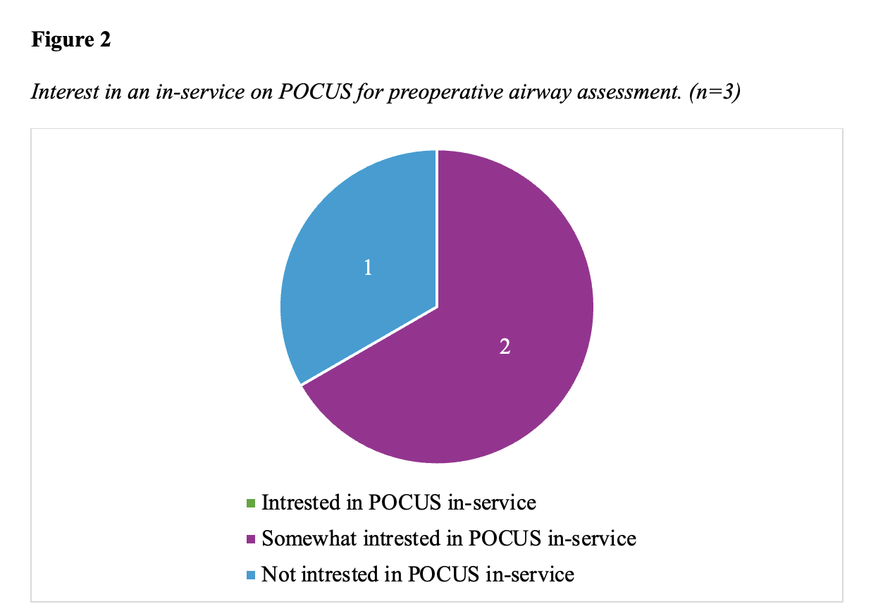
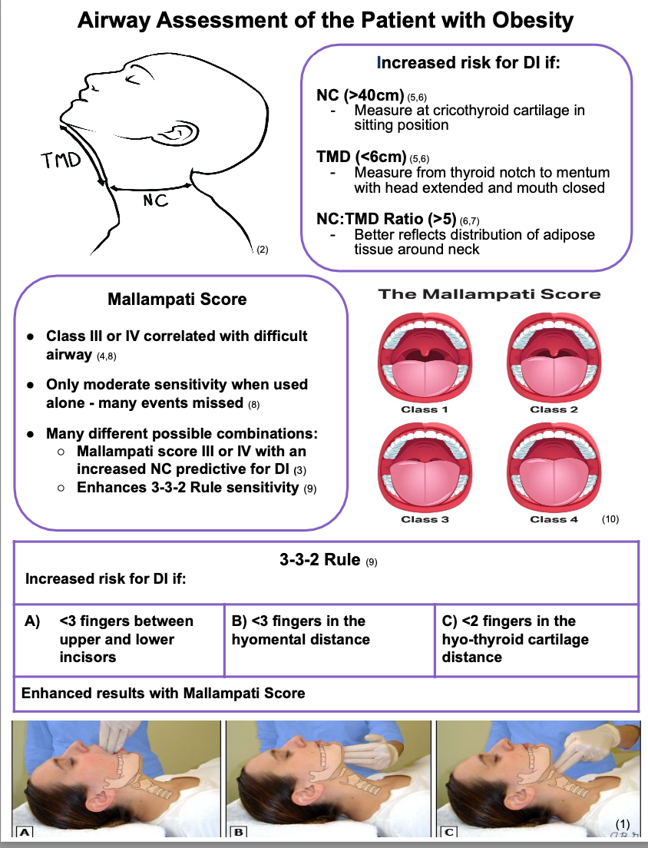
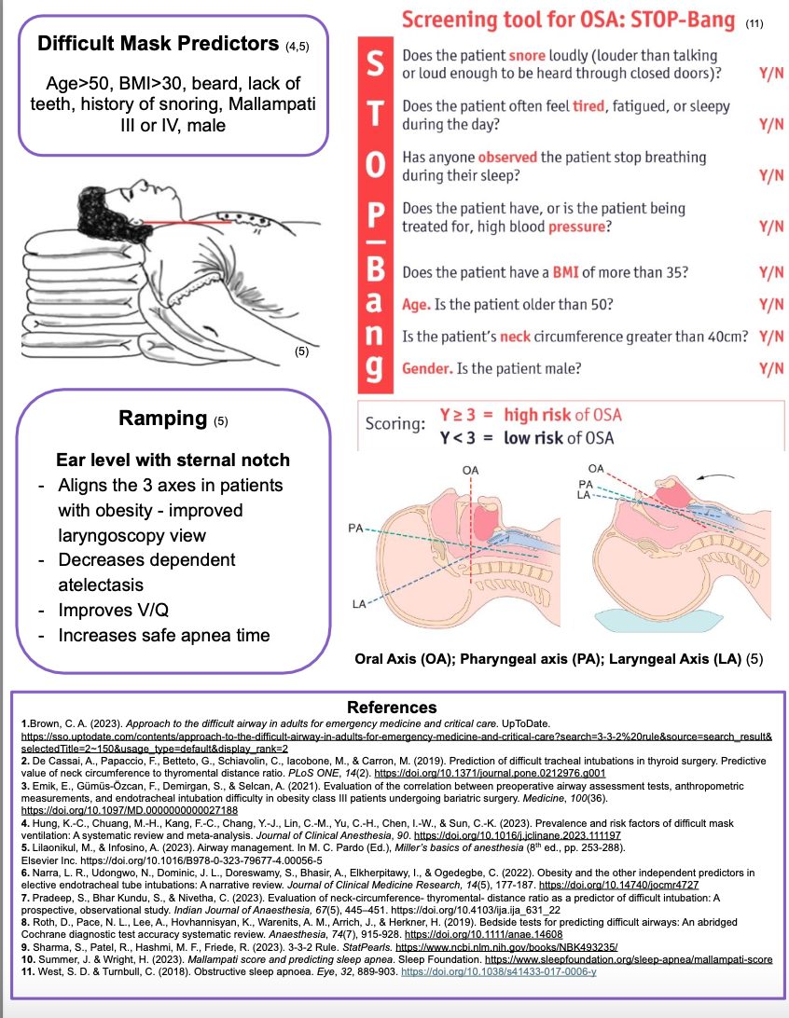
Assessing CRNAs’ Perceptions of the Adequacy of a Quick-Reference Guide for Evaluating Airways of Patients with Obesity: A Quality Improvement Project
Tyler Craney, BSN, SRNA
Maura McAuliffe, PhD, CRNA, FAAN, Project Chair
Nurse Anesthesia Program
College of Nursing, East Carolina University
Greenville, North Carolina 27858
craneyt21@students.ecu.edu
INTRODUCTION
RESULTS
DISCUSSION
The prevalence of obesity in the US is now over 40% (CDC, 2022).
People with obesity face increased risk of morbidity and mortality in the perioperative period, specifically related to airway management (Thota et al., 2022).
About 12% of anesthesia malpractice claims are related to airway and respiratory issues.
The purpose of this DNP QI project was to assess CRNAs’ perception of a newly developed QRG as a useful tool for their practice as it pertains to airway assessment in patients with obesity.
Knowledge gained from this pilot project could be used in future quality improvement and policy efforts aimed at improving anesthesia care of patients with obesity
Seven participants were included in the project
Five CRNAs completed the Pre-implementation survey while three completed the post-implementation survey.
CRNAs reported that at least 50% of their patients had obesity, pre- and post-implementation, which correlates with current population statistics.
All participants rated the QRG at least somewhat useful.
There was mixed data regarding the use of the ramping techniques for positioning patients with obesity; some always ramped while others never.
Most CRNAs indicated that they found the neck circumference to thyromental distance ratio assessment helpful post-implementation
POCUS was not used for airway assessments by any participants pre- or post-implementation, despite its high predictive value for difficult airways.
METHODS
Pre- and post-implementation survey design
A single plan, do, study, act cycle was completed.
The participants were emailed an educational presentation and provided with a QRG for discretionary use for a period of two-weeks
Data was collected via Qualtrics Surveys and analyzed with Microsoft Excel
CONCLUSIONS
The small number of participants and differing number of pre- and post-implementation survey responses making analysis of the data challenging.
CRNAs practice supports current evidence that not a sole assessment method is adequately predictive of a difficult airway
Current CRNA perceptions indicate that patients with obesity are more difficult to intubate despite evidence suggesting otherwise.
No CRNAs surveyed indicated that they currently used US to evaluate airways, while the majority indicated they would be interested in attending an in-service on its use.
Future PDSA cycles should focus on the education of CRNAs on the use of US in airway assessment.
REFERENCES
Centers for Disease Control and Prevention. (2022). Obesity is a Common, Serious, and Costly Disease. Centers for Disease Control and Prevention. https://www.cdc.gov/obesity/data/adult.html
Cook, T. M., Scott, S., & Mihai, R. (2010). Litigation related to airway and respiratory complications of anaesthesia: An analysis of claims against the NHS in England 1995–2007. Anaesthesia, 65(6), 556-563. https://doi.org/10.1111/j.1365-2044.2010.06331.x
Thota, B., Jan, K. M., Oh, M. W., & Moon, T. S. (2022). Airway management in patients with obesity. Saudi Journal of Anaesthesia, 16(1), 76-81. https://doi.org/10.4103/sja.sja_351_21

