Slide 1

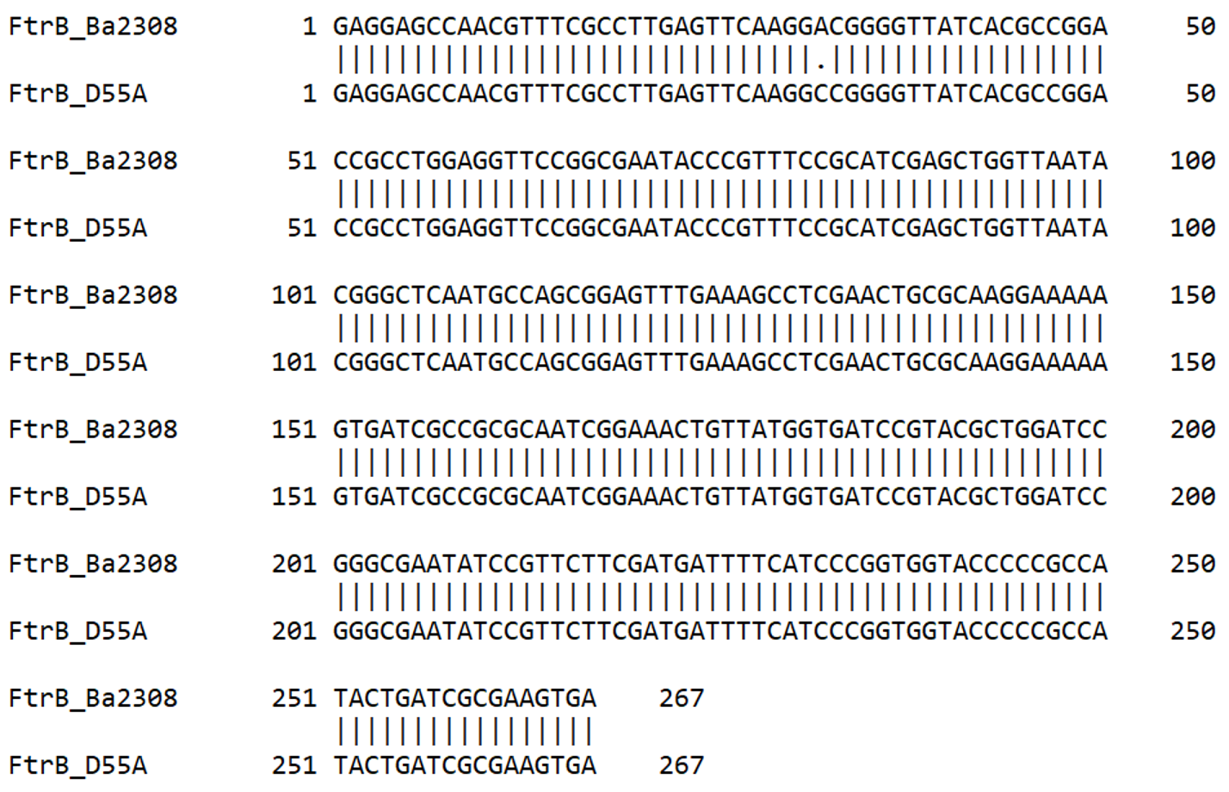
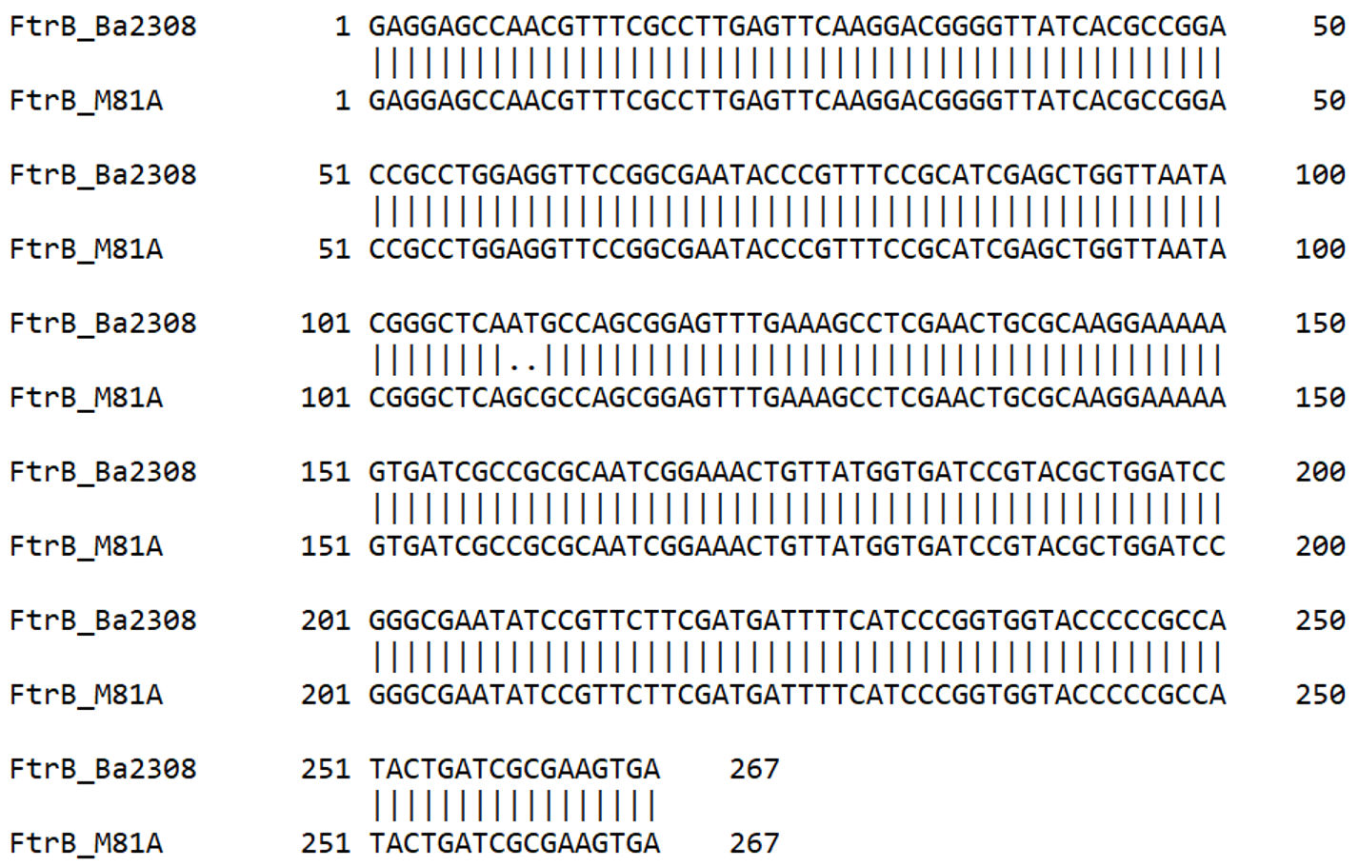
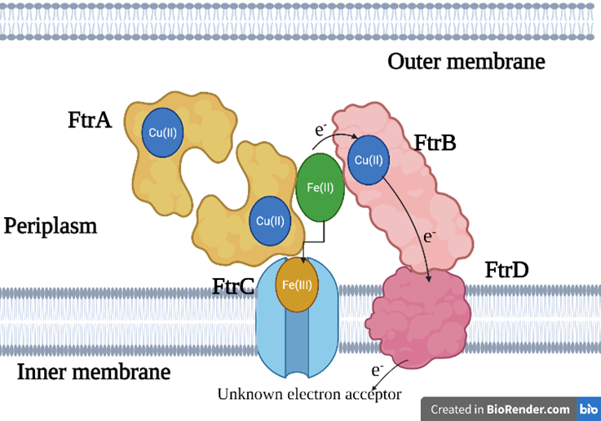
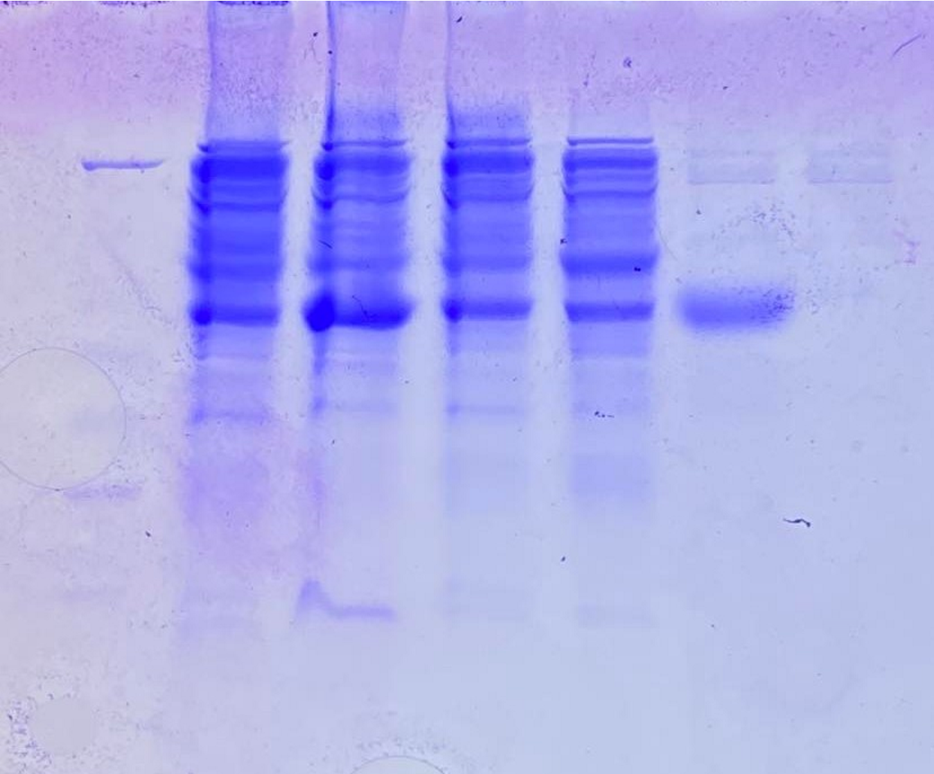
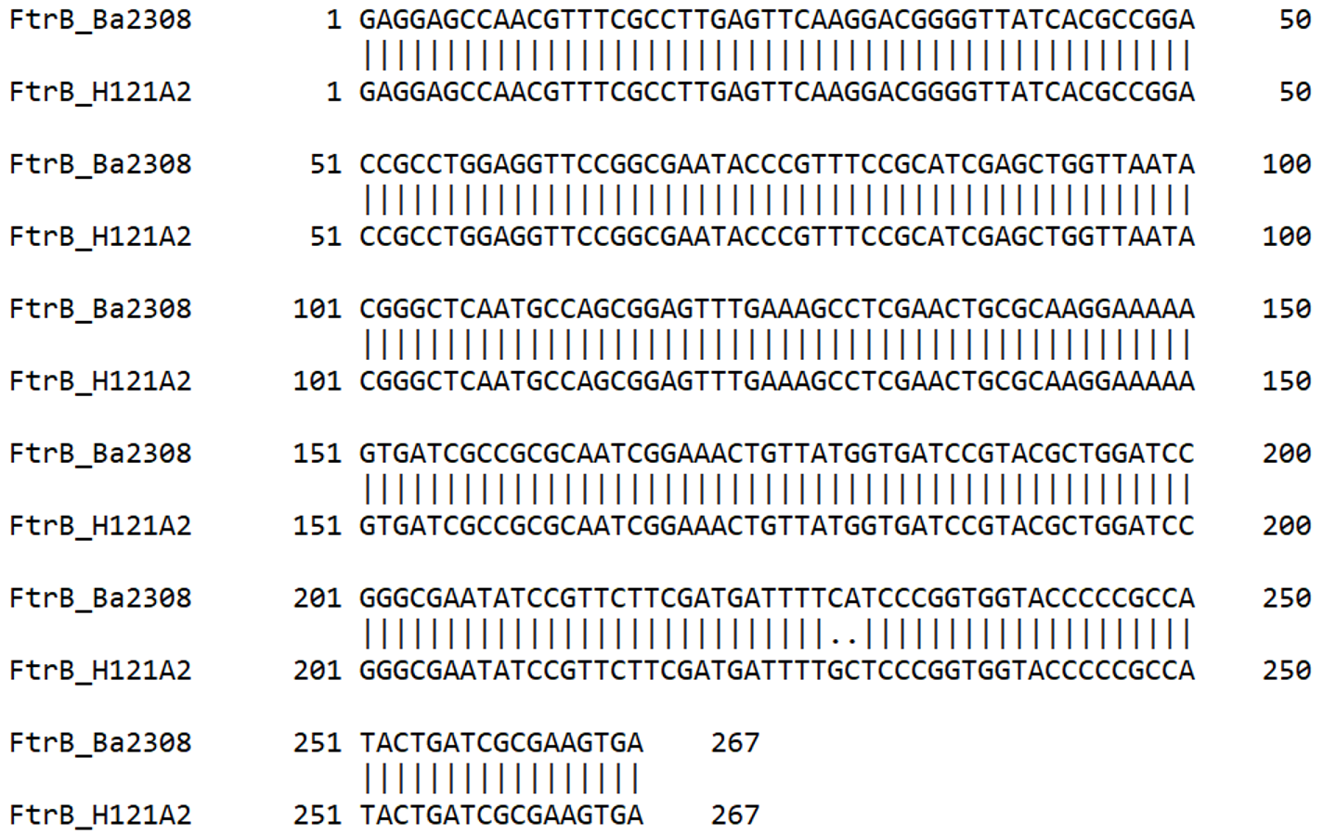
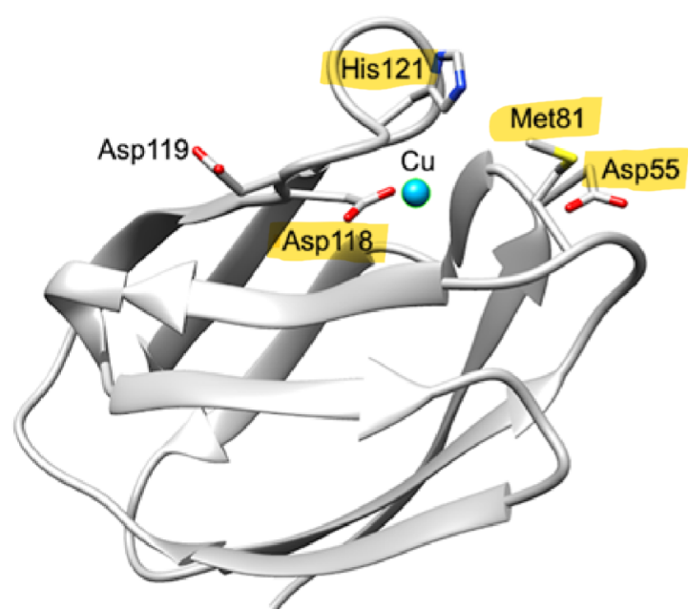
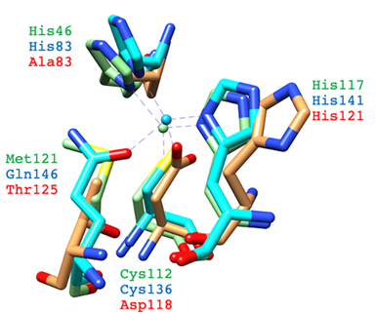
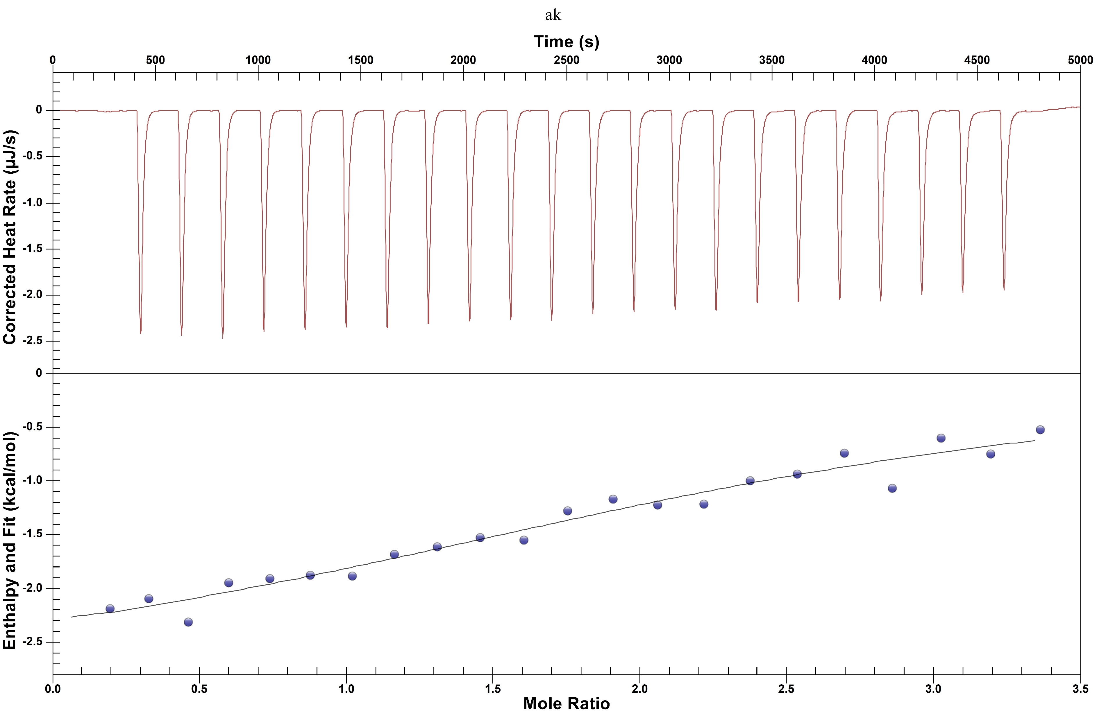
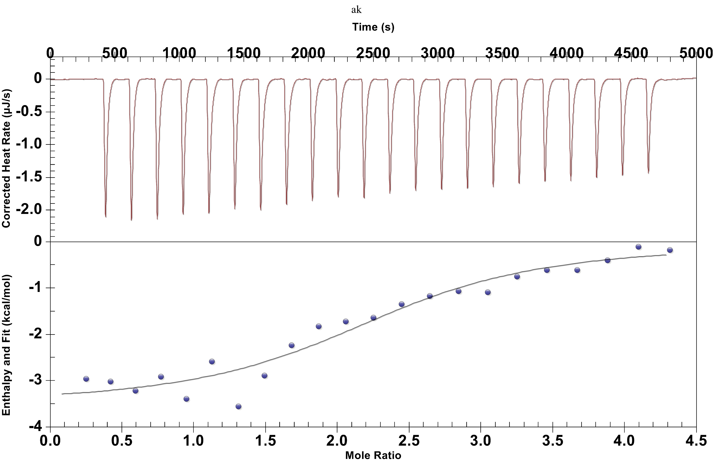
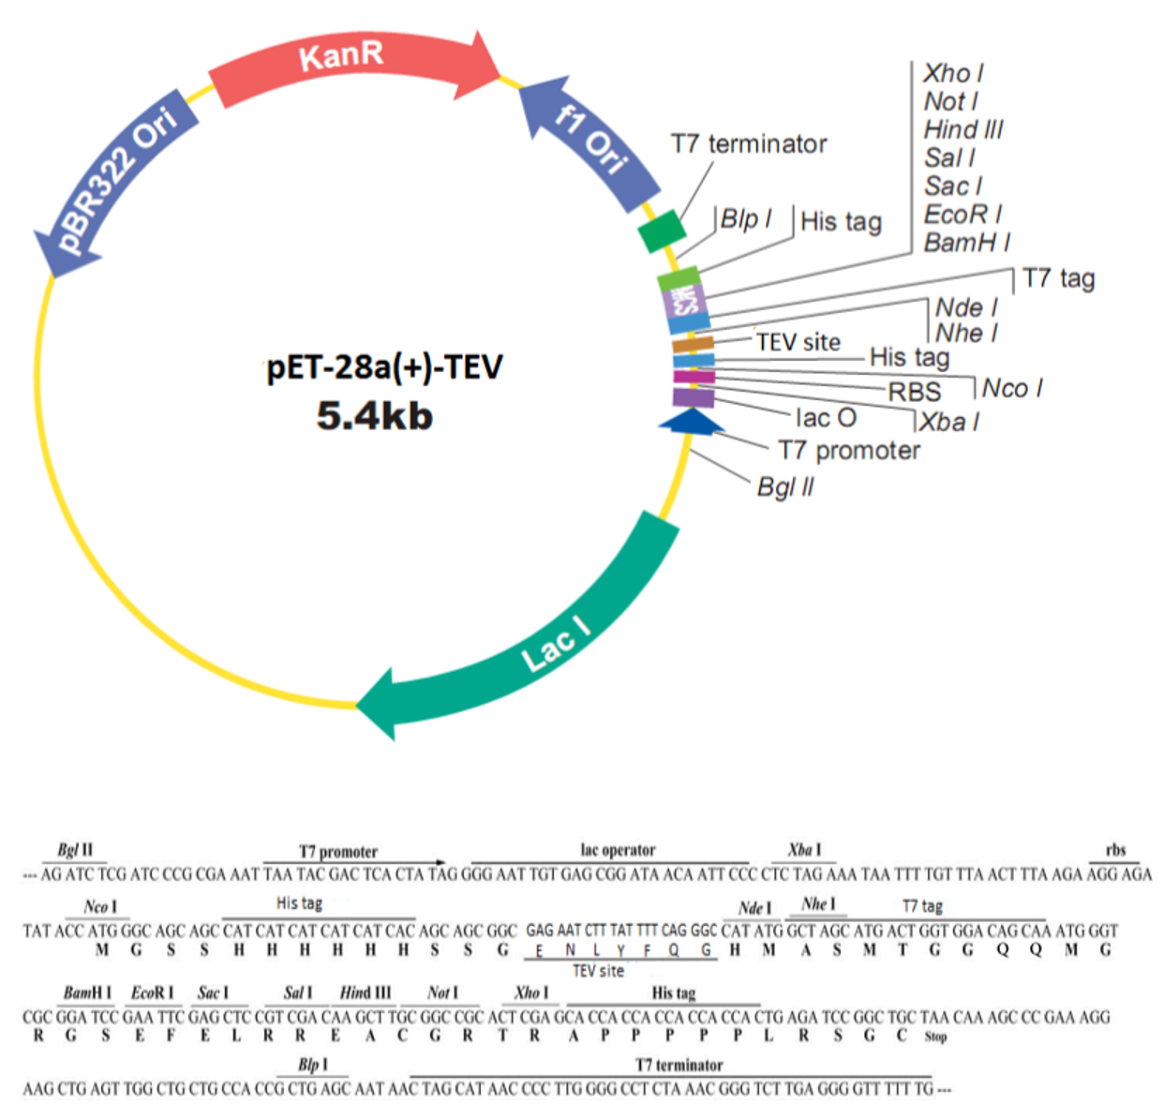
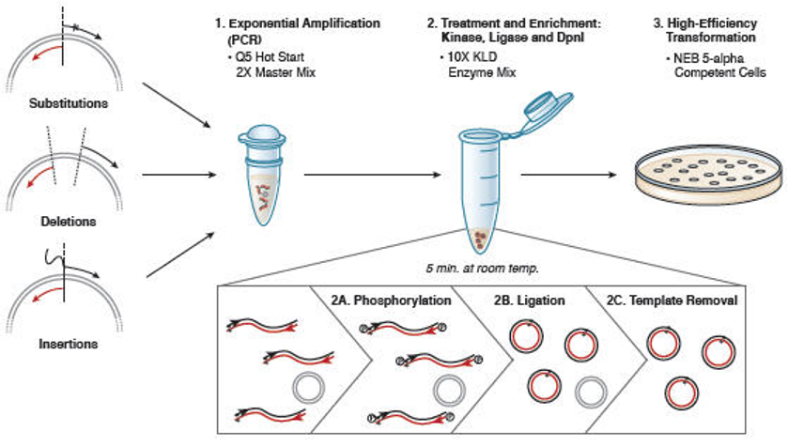
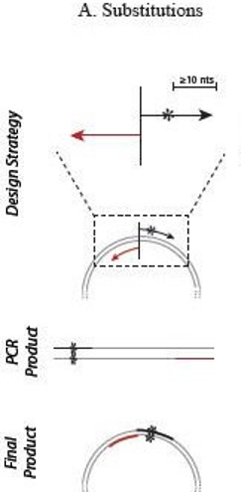
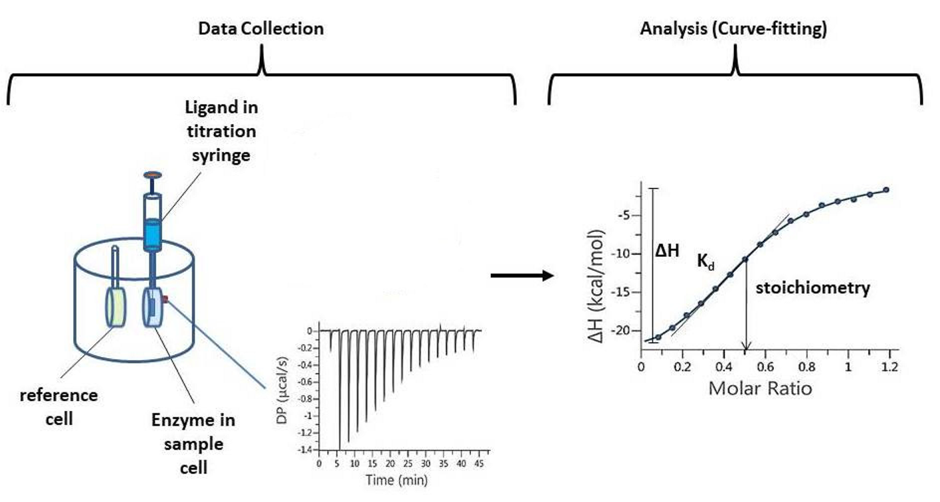
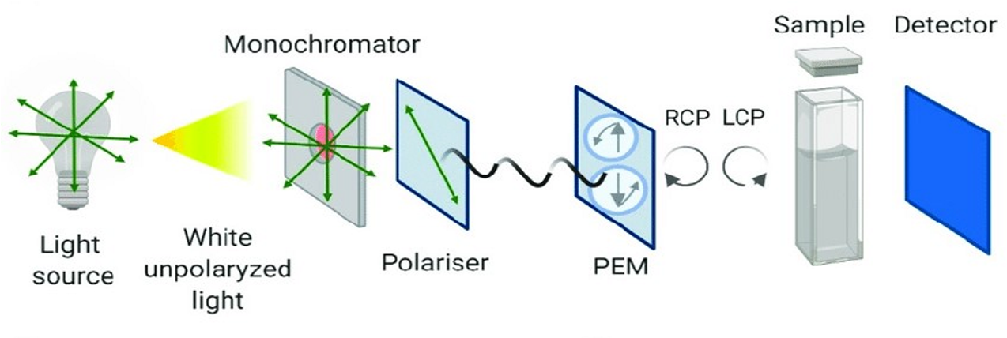
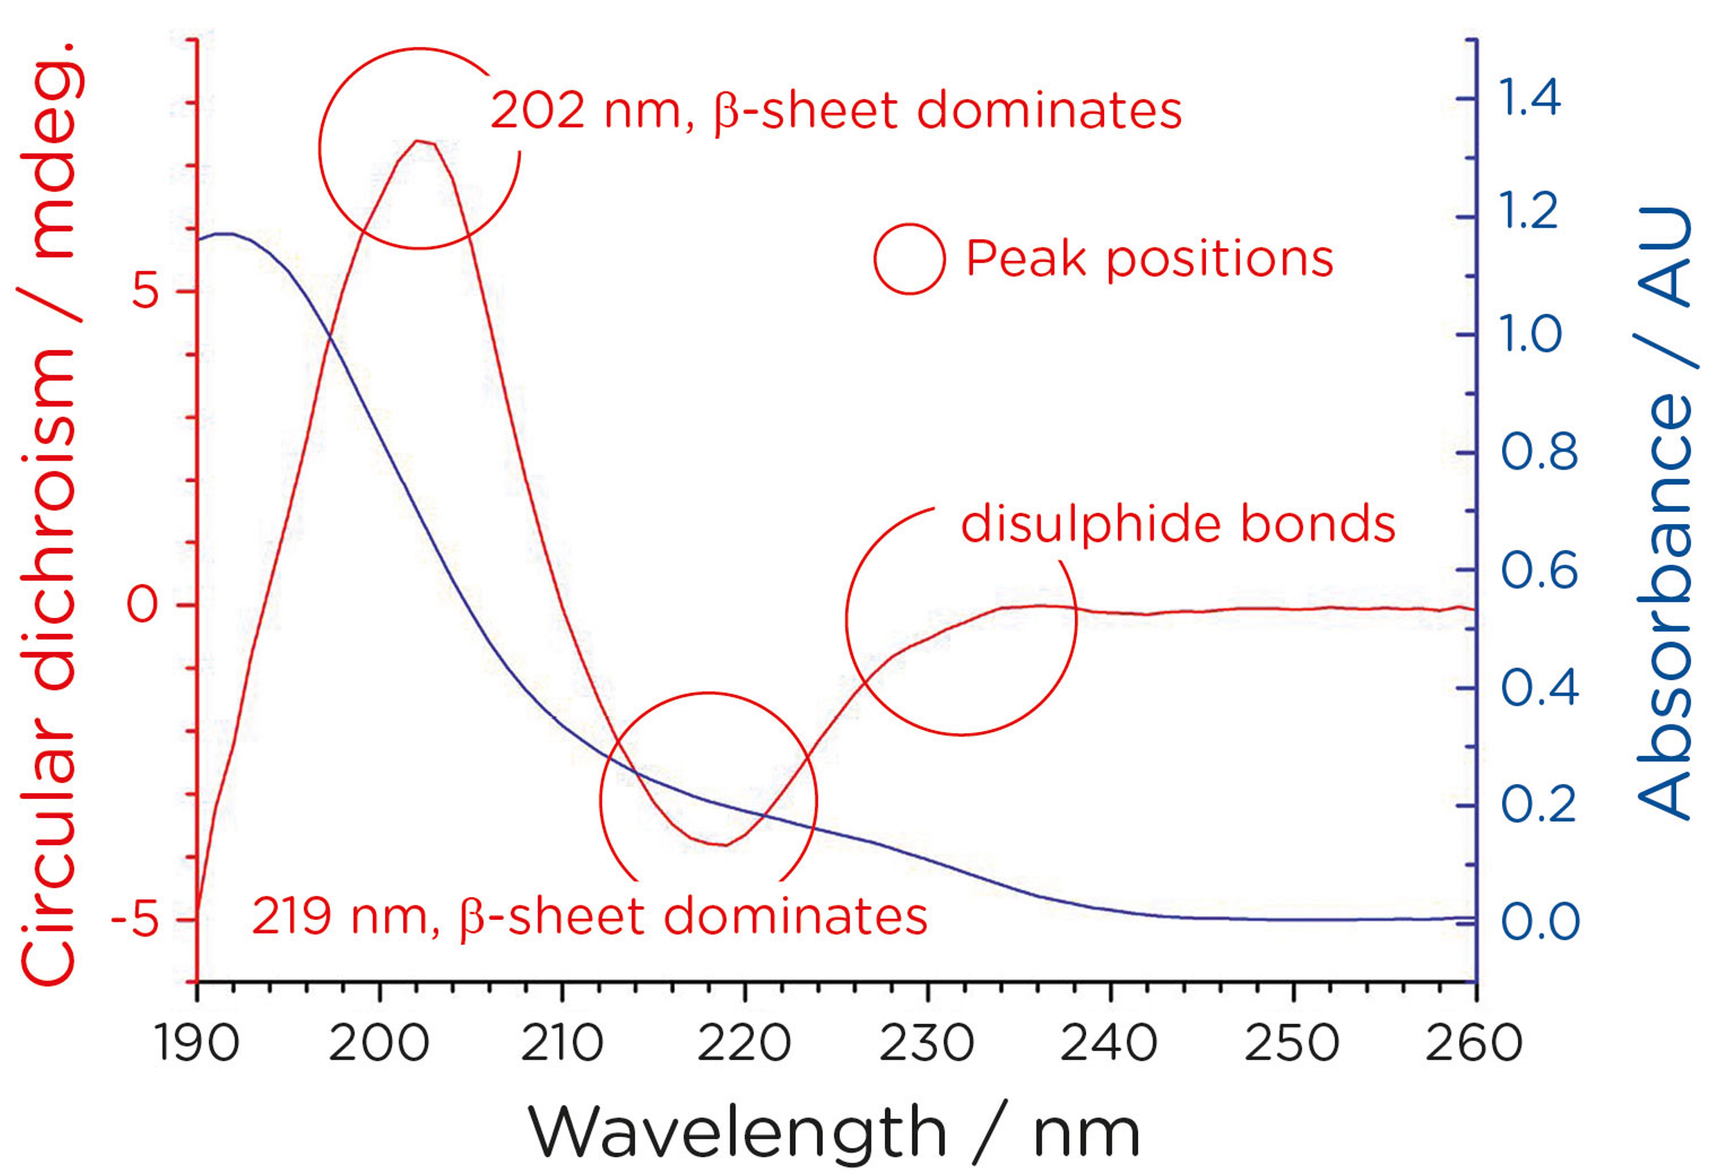
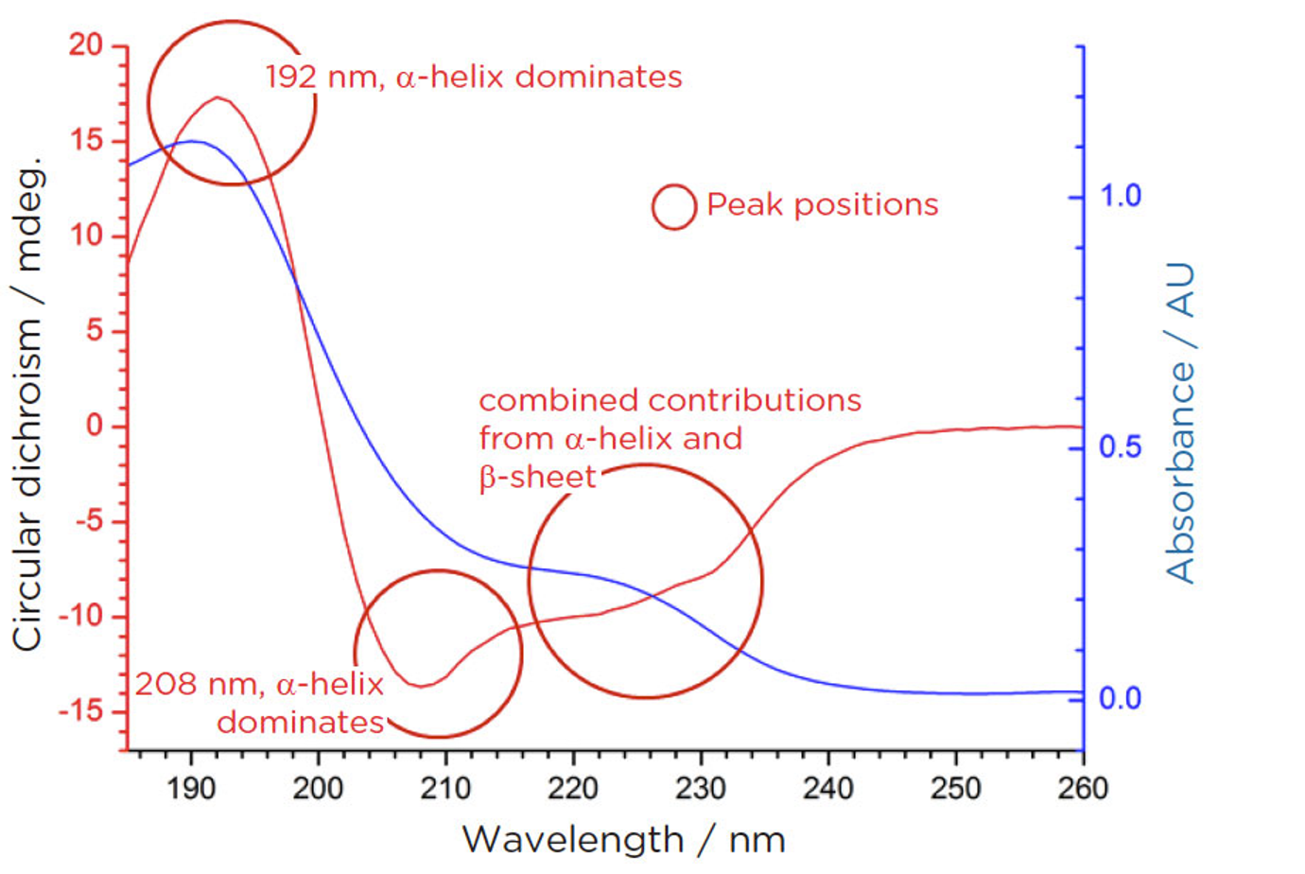








Gene mutation and biochemical characterization of recombinant mutant FtrB: A novel cupredoxin
Jessica Buchanan
Department of Chemistry
East Carolina University
Greenville, North Carolina 27858
buchananj17@students.ecu.edu
Jessica Buchanan
ABSTRACT
RESULTS
DISCUSSION
Brucella is a gram-negative zoonotic pathogen that is commonly passed from livestock to humans. The resulting condition, Brucellosis, is hard to diagnose, hard to treat, and chronic. The FtrABCD system of Brucella is hypothesized to be a novel Fe²⁺ uptake mechanism and contributes to the high virulence of this bacteria. Preliminary studies performed on FtrA show that it contains iron binding sites. FtrB is hypothesized to be novel cupredoxin. To test this, mutations were made at expected Cu²⁺ binding sites: D55, M81, and H121. The M81 protein was not recovered during purification. ITC and CD were performed on D55 and H121. ITC results indicated Cu²⁺ binding at a 1:1 (protein:Cu²⁺) ratio. CD results identified α-helix folding for each protein. These results, however, are only the beginning of the research to characterize FtrB as well as the FtrABCD system. Further studies can use this data to identify the key Cu²⁺ binding sites of FtrB, validating its role as a cupredoxin, as well as identifying the genes important for the secondary structure of protein..
Gene Mutation
ITC
CD
Gene Mutations:
ITC:
CD:
Future Studies:
1
2
Though all mutations were successful, only D55A and H121A were able to be analyzed. This is because the mutated protein was not separated from the cell after French pressing the culture. One explanation for this is that the mutation caused misfolding making the protein insoluble.
Mutant | Forward Primer Sequence | Reverse Primer Sequence
D55 | GAGTTCAAGGcCGGGGTTATCAC | AAGGCGAAACGTTGGCTC
M81 | TACGGGCTCAgcGCCAGCGGAG | TTAACCAGCTCGATGCGG
H121 | CGATGATTTTgcTCCCGGTGGTAC | AAGAACGGATATTCGCCC
INTRODUCTION
Figure 1: Table containing the oligos designed for substitution mutation. The upper-case indicates target-specific primers. The point of mutation is highlighted.
The ITC results indicate that the mutations were still able to bind Cu²⁺ and at a higher rate than the wild-type. For H121A, this could mean that the structural difference of the mutant caused other metal binding sites to be exposed, increasing affinity. However, future studies need to be performed to confirm this hypothesis. For D55A, these results suggest that this site is not the most important Cu²⁺ binding site in the protein. Further ITC studies need to be performed to provide clarification on the binding properties of the mutants by comparing these as-isolated results with results from apo-mutant trials
The FtrABCD system is just one of the iron uptake systems of Brucella. What makes this system unique is that it is the only one that utilizes Fe²⁺ and therefore doesn’t require an outer membrane transporter protein. The second component in this system, FtrB, is predicted to be a novel cupredoxin with unique Type-1 Cu²+ binding site residues. In this proposed mechanism, FtrB oxidizes Fe²⁺ as it transports it from FtrA to FtrC.
Homology models of FtrB were used to identify key binding site residues. The model showed FtrB having β-sheet folds that are characteristic of cupredoxins. Cu²⁺ residues were identified and compared to known cupredoxins. Amino acids D55, M81, D118, H121 were conserved in the FtrB model. Of these, only H121 is a Type-1 Cu²⁺ residue. D118 replaces a cystine conserved in known cupredoxins, and D55 is predicted to bind Fe²⁺ .
Figures 2-4: Sequences of D55, M81, and H121 confirming positive mutations. Sites of mutagenesis are highlighted.
3
5
CD results for H121A did not offer conclusive evidence to determine secondary structure. Literature research on α-helix presentation in CD spectra could provide insight into why the suspected α-helix shape of the mutant spectrum had a positive intensity. The definite folding disparities between the H121A mutant and wild-type FtrB could relate to H121 being the only proposed binding residue that is conserved in all known cupredoxins. If FtrB is a cupredoxin as proposed, it is reasonable that mutating a site conserved in all cupredoxins would significantly alter the protein’s structure. Though the D55A mutant displayed β-sheet folding like wild-type FtrB, the significant difference in band width could indicate some level of structural change. However, further studies are needed to determine the location of these structural differences.
Figure 1: Four component system of FtrABCD. FtrA has been shown to bind two Cu²⁺ ions, FtrB is predicted to oxidize Fe²⁺ as it transport it, FtrC is predicted to transport the Fe ion across the inner membrane, and FtrD is predicted to act as an oxidizer and reset the FtrB mechanism
4
The purpose of this study was to determine if mutants of proposed Cu²⁺ binding residues would still be able to bind Cu²⁺ and if these mutations caused changes in the protein’s secondary structure. Results of this study indicate that the mutations of these binding residues affected Cu²⁺ binding but did not limit it as expected. The secondary structure of the mutants were also significantly different from wild-type FtrB, but the exact structural differences could not be determined. Future studies can use these results as a starting point for further work on characterizing FtrB. These studies could include testing the Mn²⁺ (Fe²⁺ mimic) affinity as well as the ferrous oxidizing properties of these mutants.
1
2
Figure 5: Gel electrophoresis of the M81 mutant. The first lane is a 1Kb ladder, and the third lane is from the pellet produced from centrifuging the lysed cells after French pressing. The circled band identifies the correct size of the mutated gene. This DNA was lost throughout the purification process and no protein was recovered to perform characterization assays on.
REFERENCES
Armstrong, S. K., Brickman, T. J., & Suhadolc, R. J. (2012). Involvement of multiple distinct Bordetella receptor proteins in the utilization of iron liberated from transferrin by host catecholamine stress hormones. Molecular microbiology, 84(3), 446-462.
Banerjee, S., Garrigues, R. J., Chanakira, M. N., Negron-Olivo, J. J., Odeh, Y. H., Spuches, A. M., ... & Dasgupta, S. (2020). Investigating the roles of the conserved Cu2+-binding residues on Brucella FtrA in producing conformational stability and functionality. Journal of Inorganic Biochemistry, 210, 111162.
Chan, A.C.K., Doukov, T.I., Scofield, M., Tom-Yew, S.A.L.,Ramin, A.B., Mackichan, J.K.,et al. (2010) Structure andfunction of P19, a high-affinity iron transporter of the human pathogen Campylobacter jejuni.J Mol Biol401:590–604.
Elhassanny, A. E., Anderson, E. S., Menscher, E. A., & Roop, R. M. (2013). The ferrous iron transporter FtrABCD is required for the virulence of B rucella abortus 2308 in mice. Molecular microbiology, 88(6), 1070-1082.
Gorvel, J. P., & Moreno, E. (2002). Brucella intracellular life: from invasion to intracellular replication. Veterinary microbiology, 90(1-4), 281-297.
Kerkan, A., Banerjee, S., & Martin, D. (2021). Unpublished data.
Murrell, T. G. C., & Matthews, B. J. (1990). Multiple sclerosis—One manifestation of neurobrucellosis? Medical hypotheses, 33(1), 43-48.
Pappas, G., Akritidis, N., Bosilkovski, M., & Tsianos, E. (2005). Brucellosis. N Engl J Med, 352, 2325-2336.
Roop, R. M., Barton, I. S., Hopersberger, D., & Martin, D. W. (2021). Uncovering the Hidden Credentials of Brucella Virulence. Microbiology and Molecular Biology Reviews, 85(1), e00021-19.
Solera, J., Lozano, E., Martínez-Alfaro, E., Espinosa, A., Castillejos, M. L., & Abad, L. (1999). Brucellar spondylitis: review of 35 cases and literature survey. Clinical infectious diseases, 29(6), 1440-1449.
Yagupsky, P., & Baron, E. J. (2005). Laboratory exposures to brucellae and implications for bioterrorism. Emerging infectious diseases, 11(8), 1180.
Figure 1: Homology model of FtrB. Arrows indicate β-sheet folding. Key residues are highlighted.
Figure 2: FtrB homology model compared to two known cupredoxins. FtrB residues are listed in red. His121 is the only Type-1 Cu²⁺ residue conserved. D118 replaces the cystine that is conserved in all known cupredoxins.
MATERIALS & METHODS
1
Gene Mutation
Characterization Assays
FtrB was cloned into pET28(a)-TEV and transformed into E. coli BL21 competent cells. These cells were grown over night in Luria Broth then streaked onto Kan-Agar plates. NEBaseChanger was used to design primers to target mutations at the sites identified in the homology model. NEB’s Q5 Site Directed Mutagenesis Kit was used with each primer to carry out the mutations. Sequencing of the mutants was performed by Eurofins Genomics and used to identify positive mutants. These were then streaked onto Kan-Agar plates and colonies from the plates selected to grow ON in Terrific Broth. The cells were then harvested, resuspended in His-wash buffer, and put through a French press three times. The lysed cells were then ran through a Co-column to recover the FtrB mutant. The eluted proteins retained their His-tags and were dialyzed with His-wash buffer to remove imidazole. The proteins were then digested with TEV and β-marcaptoethanol to remove the His-tag. The isolated proteins were then run over the Co-column again to remove the tag. Purified proteins were collected and stored in ACES buffer pH 6.4.
Figure 1: pET-28(a)-TEV vector containing ftrB. Vector shows Kanamycin resistance and a Lac operon.
ITC nanograms of H121 and D55, respectively. The proteins were prepared at a concentration of 55μM in 100mM HEPES buffer and 100mM NaCl, pH 7.3. Each sample was titrated with 0.5mM Cu²⁺. Injections were 200s apart with a stirring speed of 400rpm and temperature of 25⁰C.
2
ACKNOWLEDGEMENTS
Figure 2: Substitution scheme and mutagenesis protocol from NEB.
East Carolina University Department of Chemistry
300 Science & Technology Building, Greenville, NC 27858
East Carolina University Department of Microbiology and Immunology
Brody School of Medicine , Greenville, NC 27858
East Carolina University Honors College
Mamie Jenkins Building, East 5th Street Greenville, NC 27858
Dr. Sambuddah Banerjee, East Carolina University Department of Chemistry
Dr. Daniel Martin, East Carolina University Department of Microbiology and Immunology
3
4
Figure 3: Schematic of ITC instrument with example of raw data. This example is how an exothermic reaction is expected to look. To the right of the arrow is the data once it has been integrated. The plot of the interpreted data is used to determine the molar binding ratio of the two samples.
Figure 4: Schematic of CD instrument. The bottom left graph indicates peaks characteristic of β-sheet folding. The bottom right graph indicates peaks characteristic of α-helix folding.
CD spectra of H121 and D55 mutants. The proteins were buffer exchanged with PBS pH 7.3 to be analyzed. 300μL of sample was used in a 1.0mm cuvette.

