Slide 1

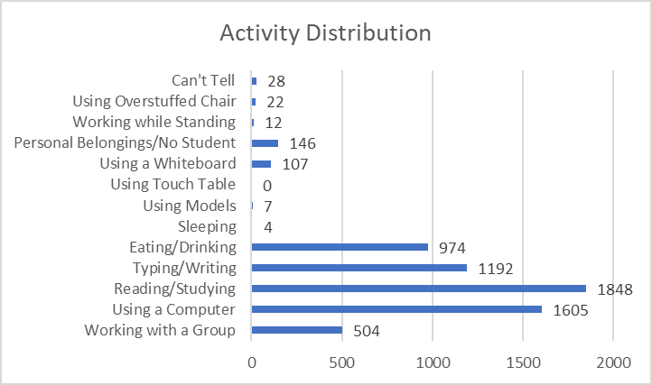
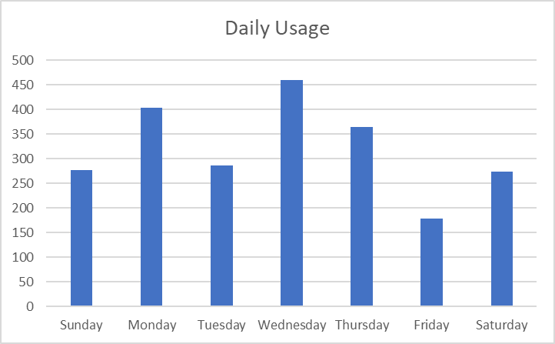
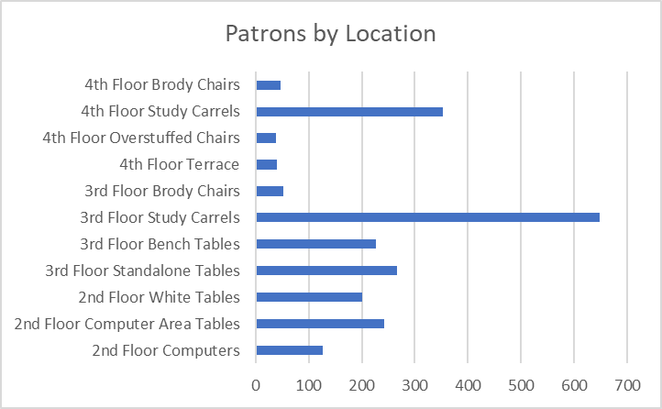
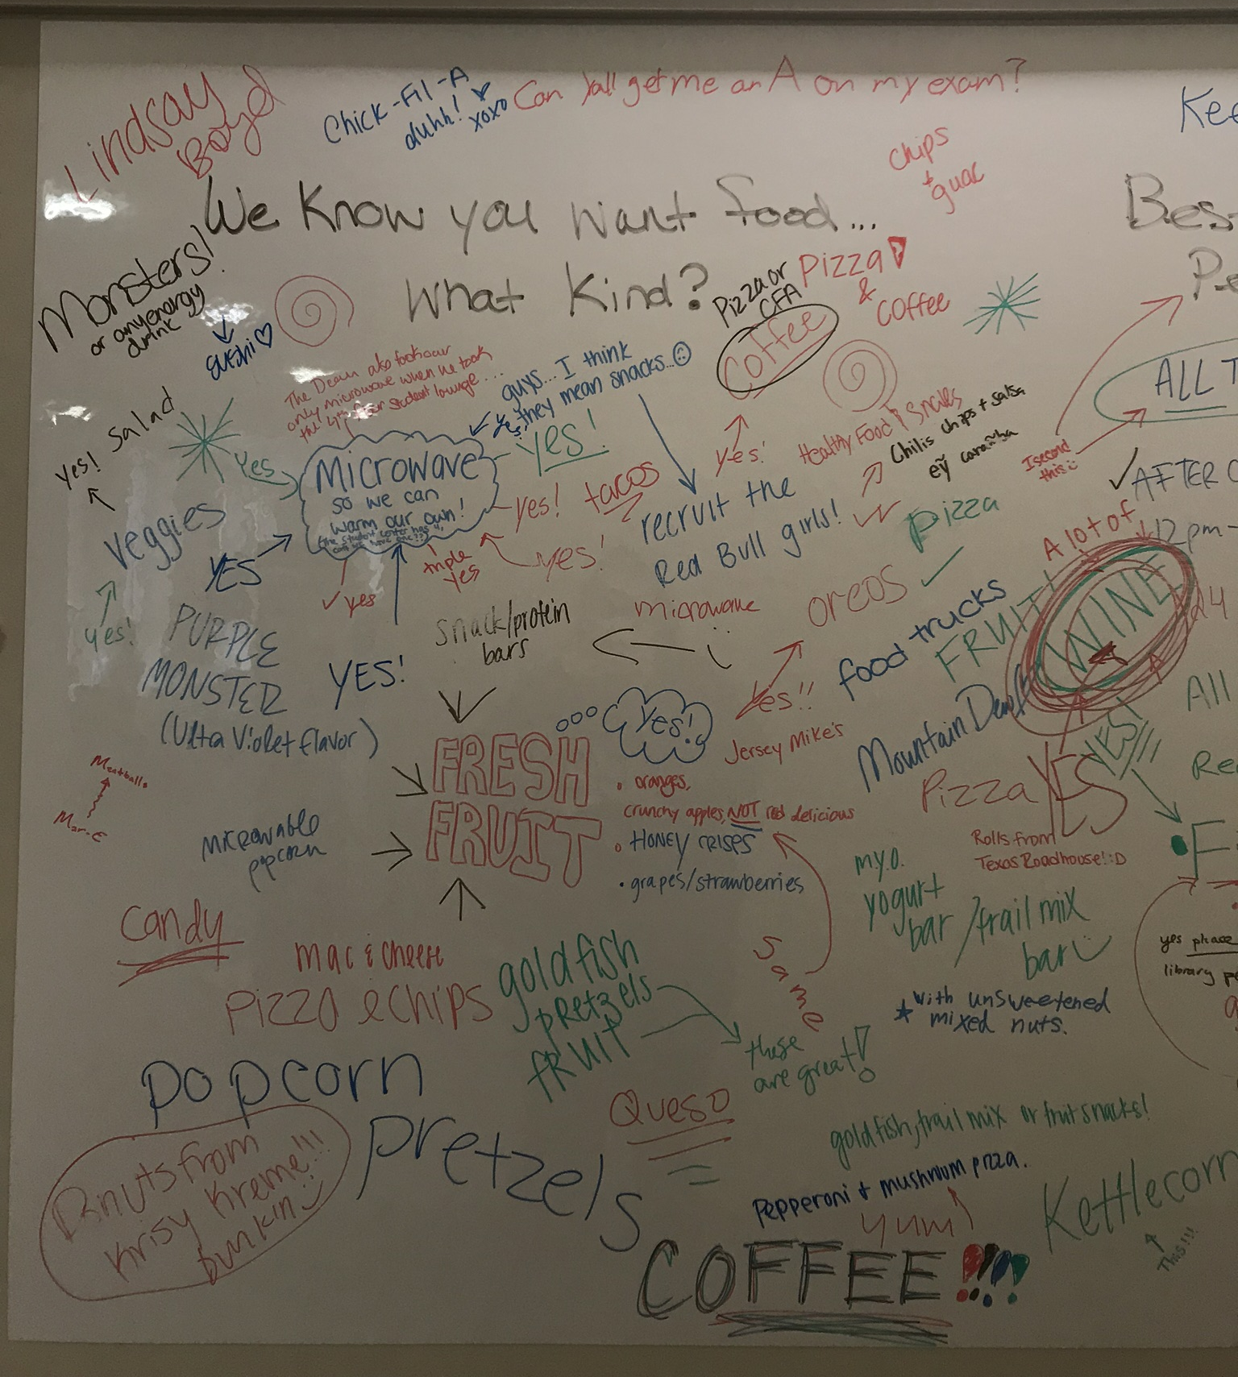
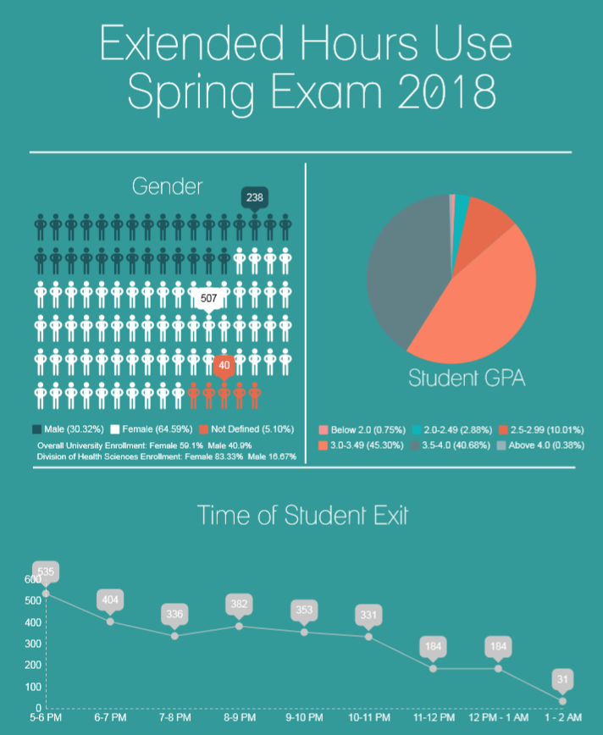
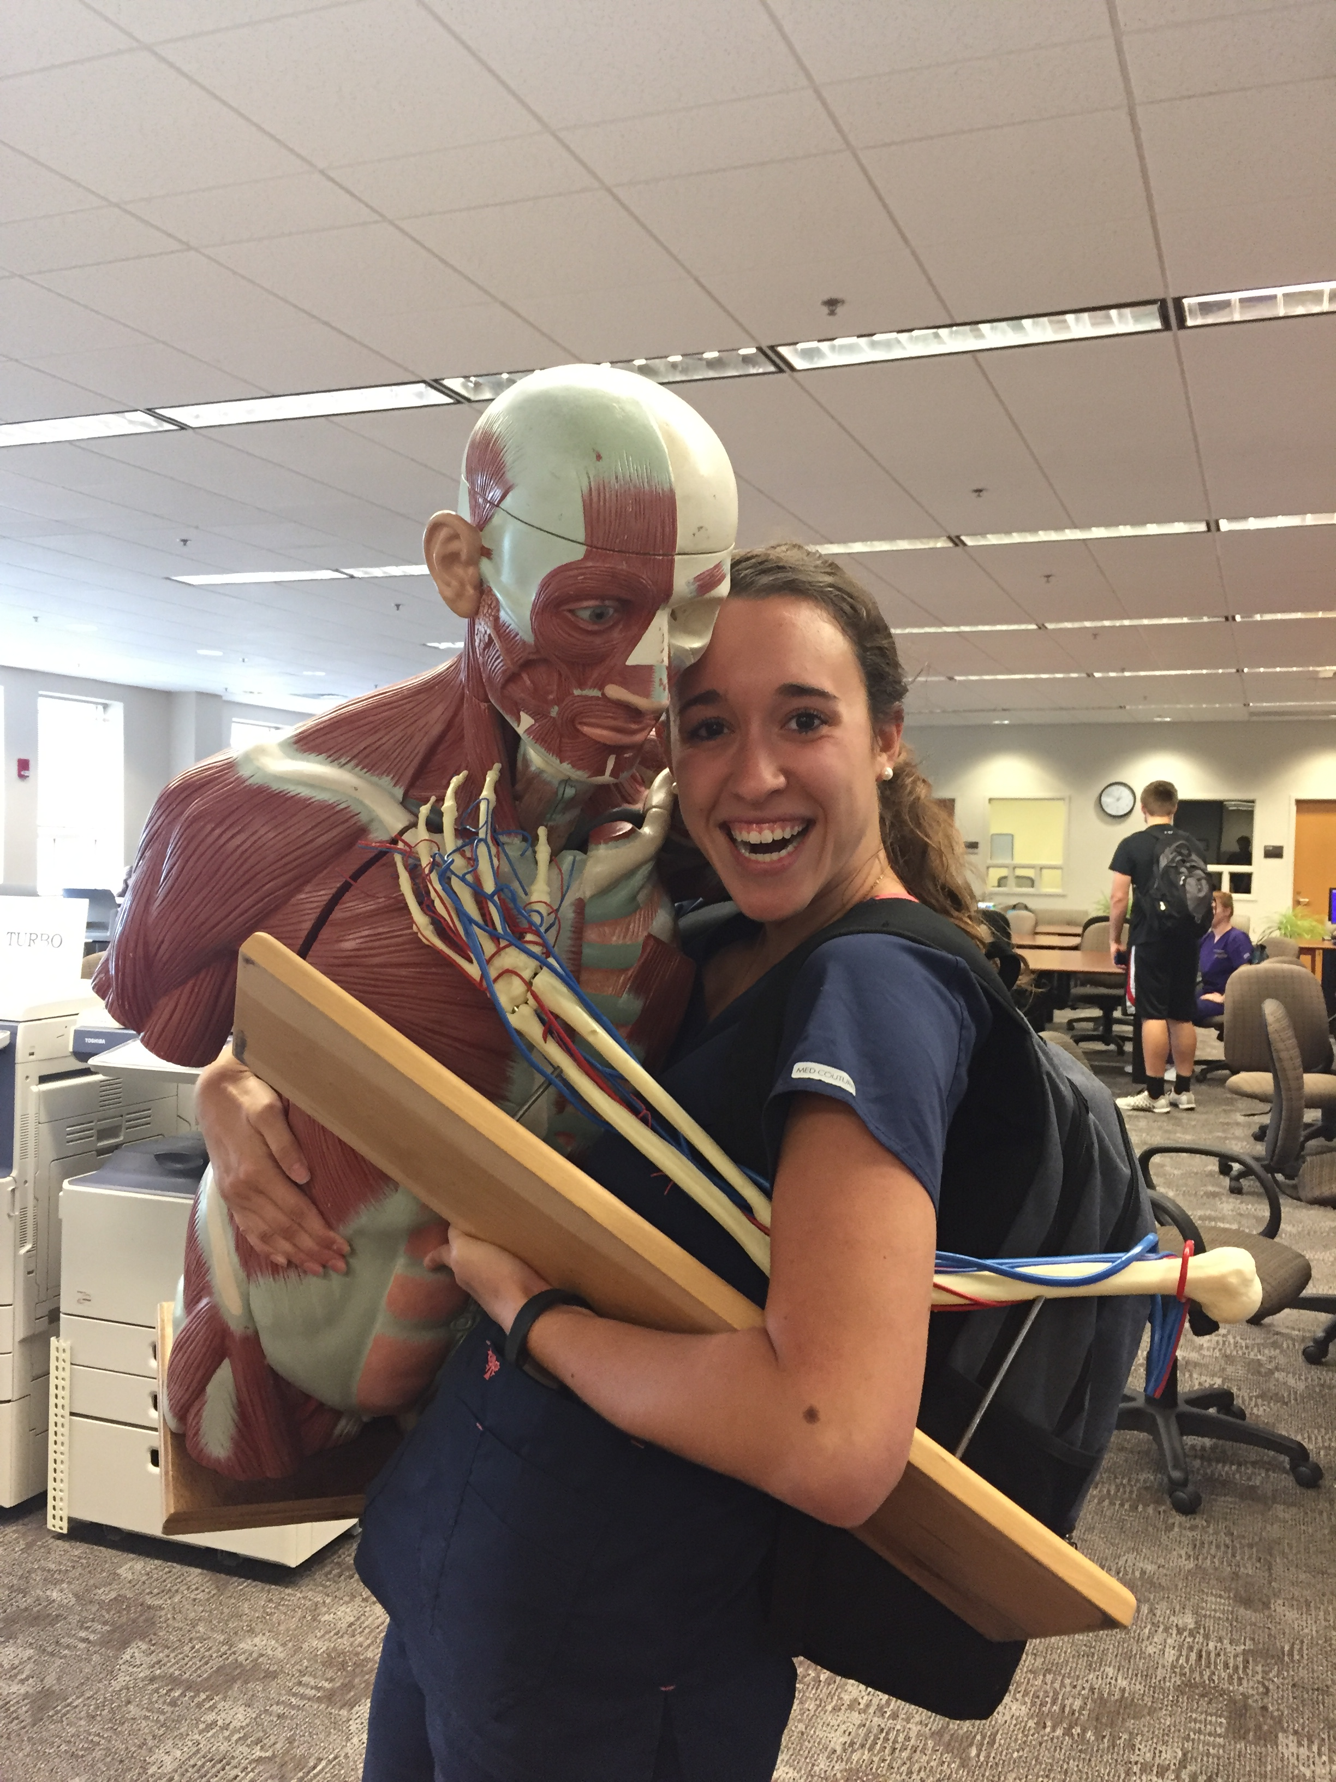
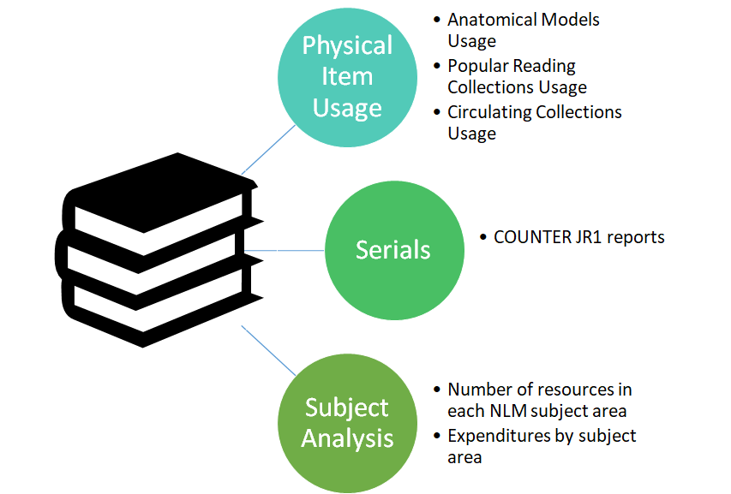

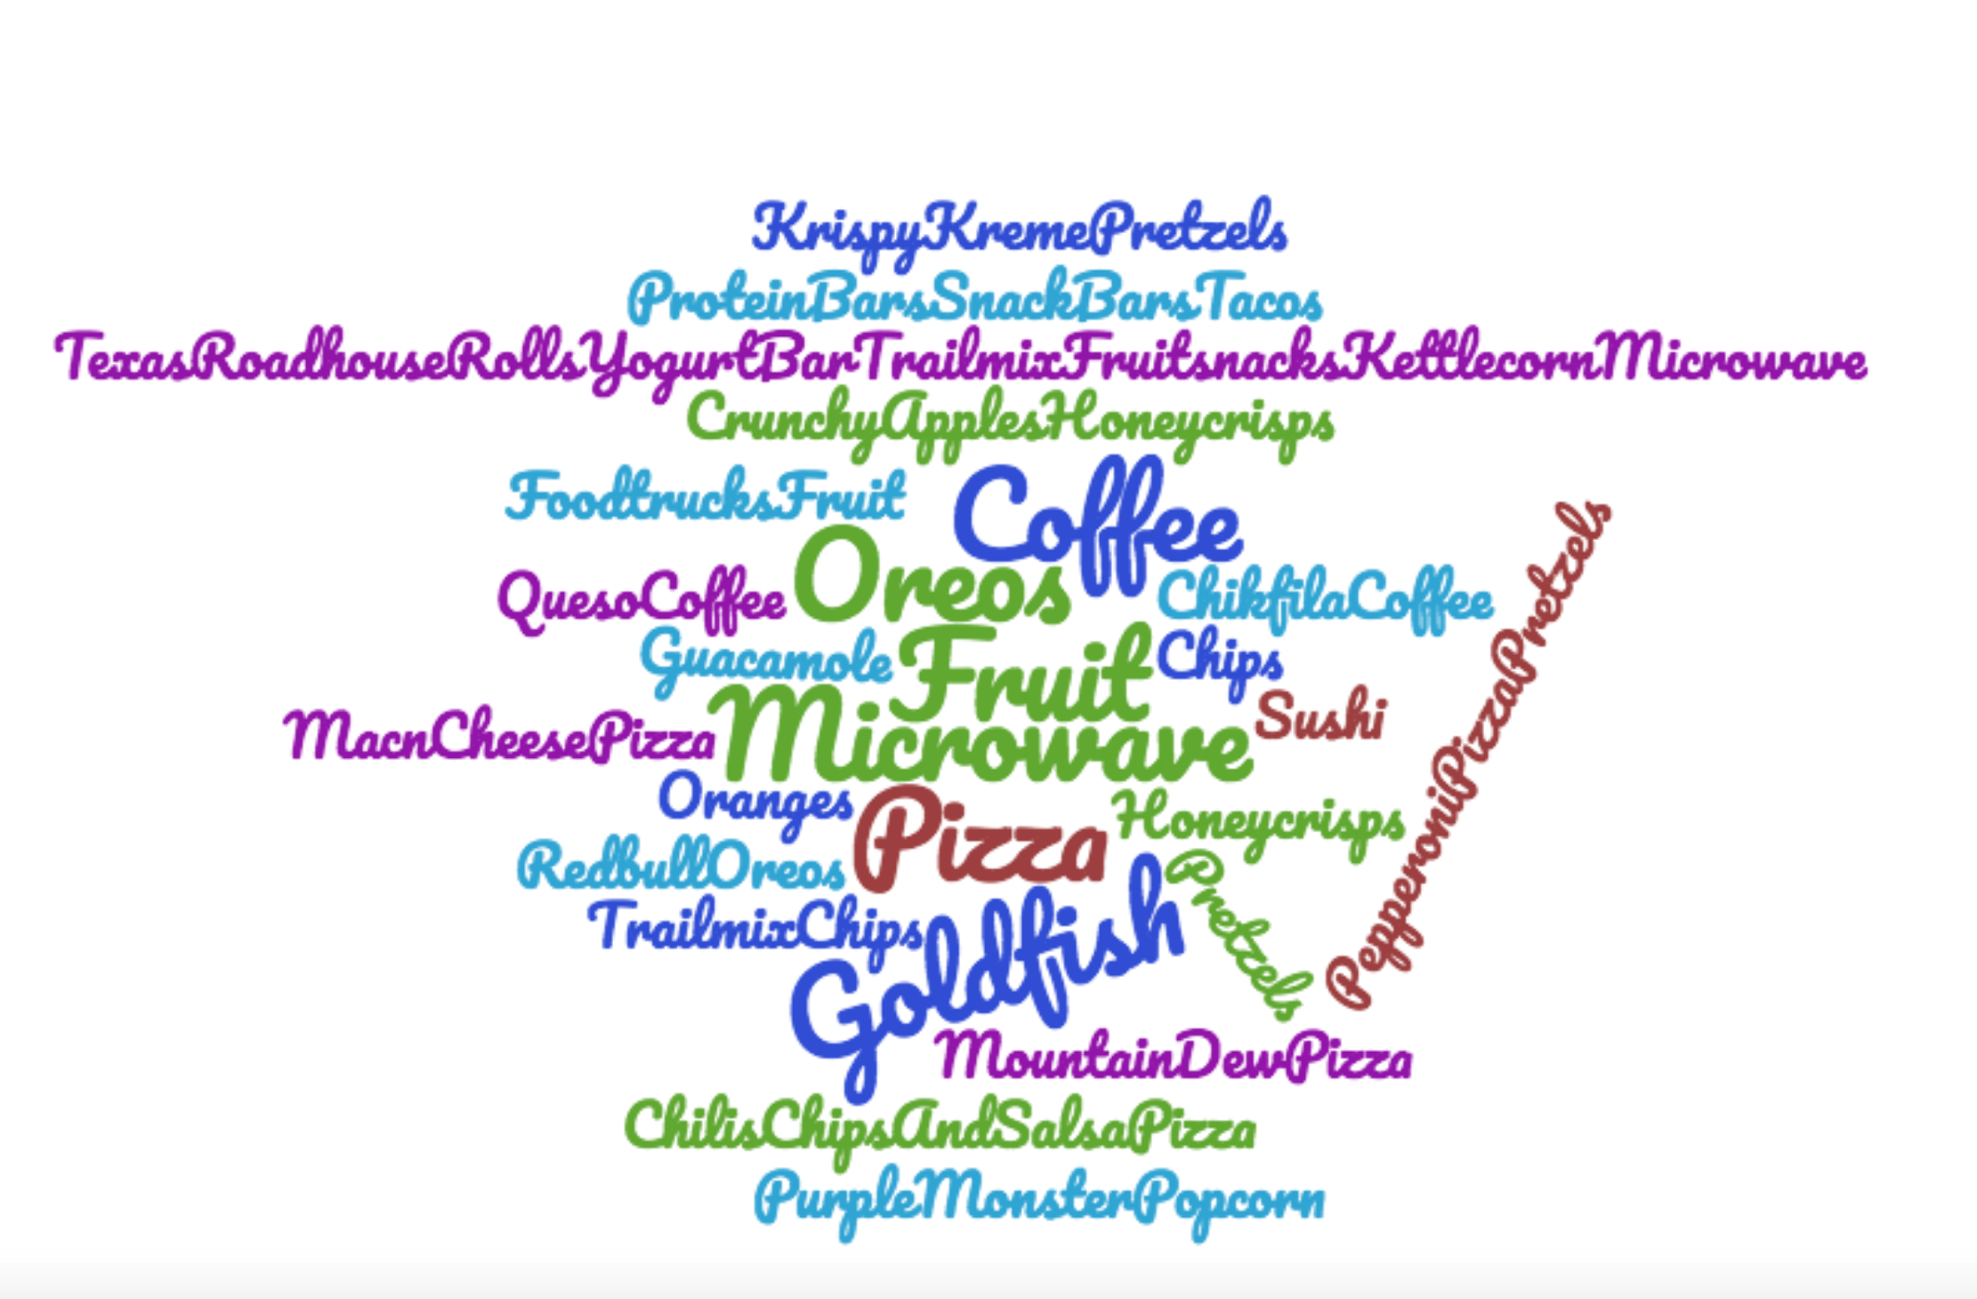
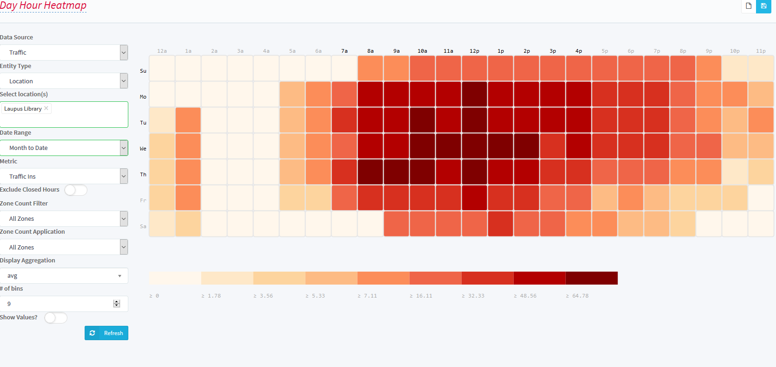
Navigating Uncharted Waters:
Creating a Culture of Assessment
Roger Russell, MLS, Beth Ketterman, MLS, Mary Roby, MLS, and Marlena Barber, MLIS
William E. Laupus Health Sciences Library
East Carolina University
Greenville, North Carolina
USA
Methods:
Over roughly the last five years the administrators and managers at Laupus Health Sciences Library at East Carolina University have worked to integrate assessment and analysis of user data into operational decision making. Initial efforts were begun by a small group of librarians focusing on specific small issues. From these initial projects, more formal support of assessment and data analysis for decision making grew to include committees and the creation of an assessment position. Enculturating assessment into operational decision making fell mainly to library management. This change happened slowly and continues to evolve.
Results:
Nearly all operational decisions at the library now include some evaluation of data. This statistical information is documented evidence of both our good stewardship of funding and resources, and our commitment to good decision making for the benefit of our users. The top results are as follows:
Establishment of UX Committee & User Assessment & Engagement position
Extended Exam & Study Hall Hours
Innovation Spaces – Data viz, 1-Button recording, VR
Equipment & Models Purchases
Heavy Use Collection
Patron-Driven Acquisition Collection Development Model
Increase in electronic resource acquisitions, and decrease in print monograph purchases
Managing limited subscription resource budget through targeted serial acquisitions
Management of targeted subject areas for current resource acquisition
Responsive design and current content on library website
OERs/Curriculum texts
1Card demographic data
Study space enhancements: Dry erase table surfaces, standing desks, mobile privacy walls
Exam break activities
Discussion/Conclusion:
East Carolina University’s Laupus Library was experiencing a shift in user needs, including a move away from physical books and journals, making justification of our physical space a priority. The planning and construction of a large student center next door to the library, with a gym, food options, and study space was a wake-up call that we needed to establish clear plans for ensuring that our user needs were being met. We also needed to integrate data and evidence into decision making. Many decisions were at the time being made by department heads or committees of librarians who often assumed they knew what users wanted and needed. Conducting user assessments showed us that what librarians think users want and what users actually want are often not the same. Our culture change began with establishing a User Experiences Committee and expanded to collecting more granular gate count data, mining collection use data from our catalog, collecting ID card swipe data, conducting Student Advisory Group meetings, and observational surveys to determine space use patterns among users. Establishing a culture of assessment and decision making driven by evidence and not assumptions or gut feelings is not easy, but the results are better and less risky operational decision making in nearly every area of the library from the website to hours of operation.
ENCULTURATING ASSESSMENT
        TOP TIPS:
        You don’t need ALL the data
        Focus on questions you want answered
        Beware of over analysis & creep
        Talk to your users
        Culture change = making diamonds

