Slide 1


Medical Food Pantry Volunteer Training
Module 1: Orientation
September 16, 2018
September 2018

Slide 2
Thank you
for agreeing to be
a Volunteer
September 16, 2018
September 2018

Slide 3
What is the
Medical Food Pantry
at Vidant Medical Center (VMC)?
It is an emergency source of healthy foods for patients of VMC and ECU Physicians
It addresses the immediate need of patients for health-promoting food
It provides trained volunteers to give patients a brief instruction on food as medicine
It links patients to follow-up food resources
in their home community
It is a partnership of the
Food Bank of Central and
Eastern NC,
the Brody School of Medicine
and ECU Physicians
and Vidant Health.
Eastern AHEC is
the training partner.
September 16, 2018
Notes:
This emergency resource a response to detrimental food insecurity of the patients receiving care at Vidant Medical Center and clinics of
ECU Physicians.
Patients who have food insecurity and are being discharged from the hospital

Slide 4
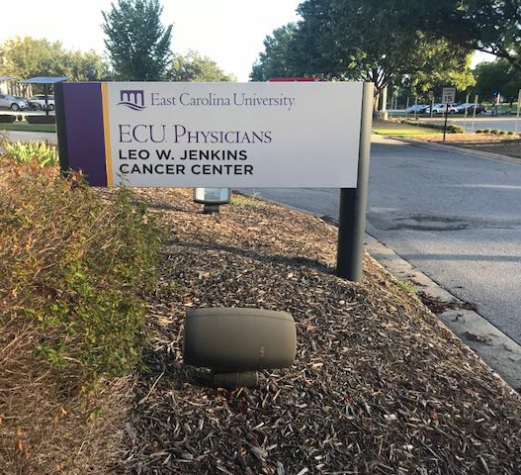
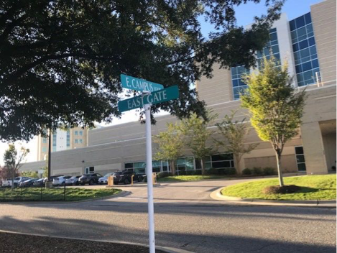
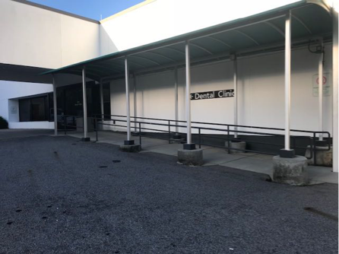
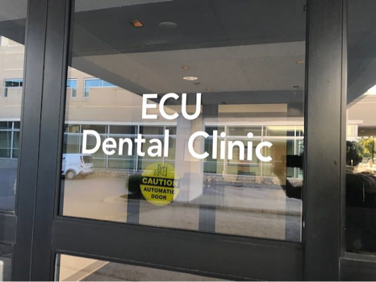
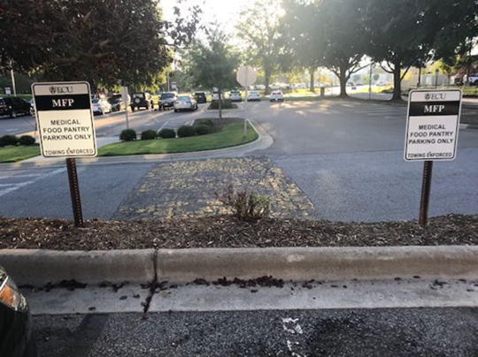
Where is the
Medical Food Pantry
located?
On the VMC Campus off Moye Boulevard
It is inside the ECU Health Dental Clinic (white building) at the corner of East Campus Loop and East Gate and next to the Leo Jenkins Cancer Center (where there are two pantry parking spots).
The hours of operation are Monday through Friday from 10 am to 6 pm.
September 16, 2018

Slide 5
To be a volunteer,
we start with an
Orientation Module
To learn the basics:
protect patient privacy
sign up for a work shift at the pantry
trade a patient’s food voucher for the appropriate emergency food bag that meets their diet prescription, and
give a 5 minute instruction on how to build a healing box/bag
Then a short quiz to earn the certificate that qualifies you to work at the pantry;
and qualifies you to take additional modules to prepare you for other needed tasks at the pantry
September 16, 2018

Slide 6
Topic 1:
Patient Privacy
September 11, 2018
September 16, 2018

Slide 7
Protecting
Patient’s
Identification
Patients with a voucher have been screened to be “food insecure” by a Vidant Health or ECU health professional
Many circumstances lead to a person or family being food insecure for a period of time. You cannot tell a person who is insecure just by looking at them.
Your discussions with them should be limited to meeting patient’s needs
Food Insecurity is a very sensitive topic. ALWAYS treat these patients with RESPECT
NEVER discuss patients served by the Medical Food Pantry with anyone other than Medical Food Pantry staff
September 16, 2018

Slide 8

PRIVACY of
Patient
Information -
The Food Voucher
You will receive a Food Voucher from each patient to redeem for food
This voucher contains:
  Patient Name
  Diagnosis
  Prescribed Diet
This information is PRIVATE and
must be PROTECTED
Vouchers MUST be placed in the designated location (described later)
DO NOT discuss any patient information outside of the Medical Food Pantry
September 16, 2018

Slide 9

Your Commitment
to Privacy
You need to sign our Privacy / Confidentiality Agreement stating that you understand your role in protecting
a patient’s privacy
Any violation of this agreement will result in your dismissal as a Medical Food Pantry volunteer
If you have volunteered through an organization like the Health Sciences Academy, or the Food Bank of central and eastern NC, or the Brody School of Medicine—they will be notified of your violation.
Review the policy on the next page.
To sign, please download the document in your online course, fill in the signature box and email to bullockamy@ecu.edu.
September 16, 2018

Slide 10
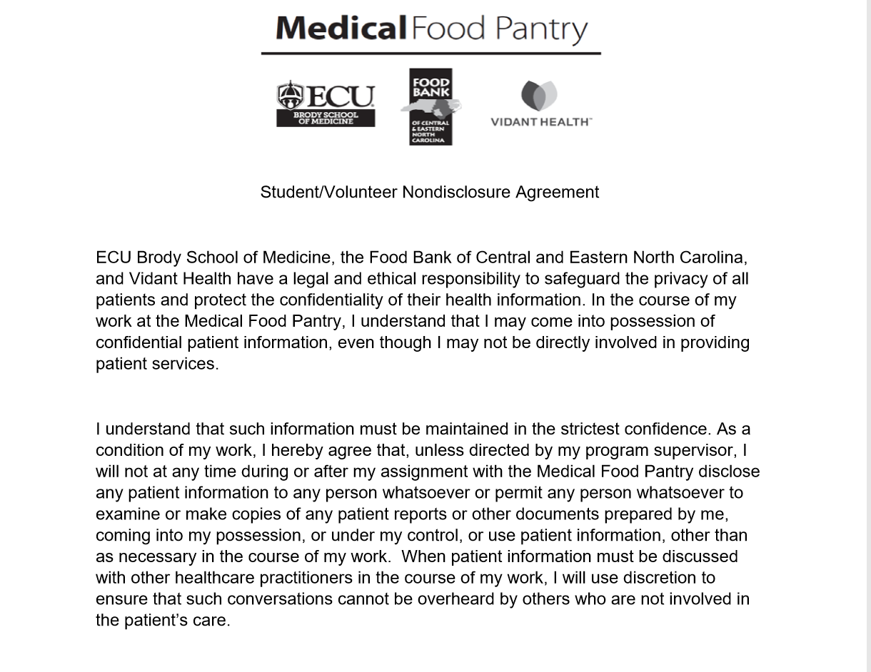
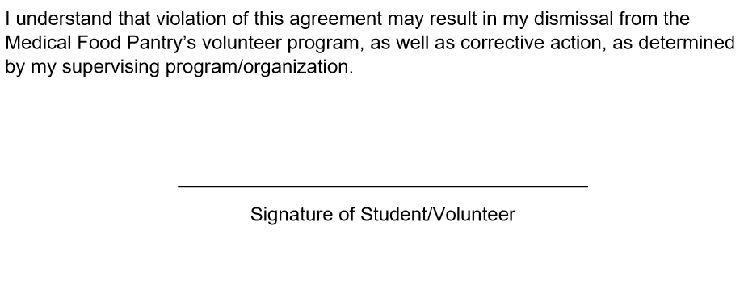
Our Commitment
to Privacy
The Student/Volunteer
Nondisclosure
Agreement
September 16, 2018

Slide 11
Topic 2:
Signing up —procedures & activities
September 16, 2018

Slide 12
What to expect
Checking in and out
1
When you complete this module you will be given a link to the sign up genius and instructions on how to sign up for a shift.
The volunteer coordinator will email:
  a reminder of the day and time of the shift(s)
  you have signed up for;
  how to open or close the food pantry;
  the current code for the key lock box.
Please arrive 10 minutes before the
start of your shift.
Sign up
September 16, 2018

Slide 13
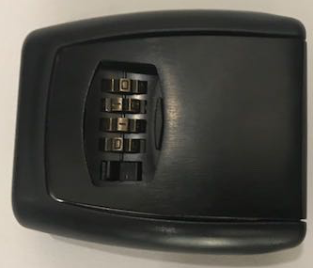
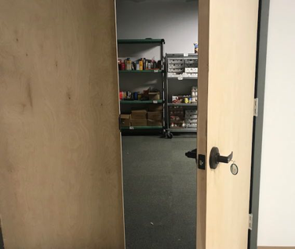
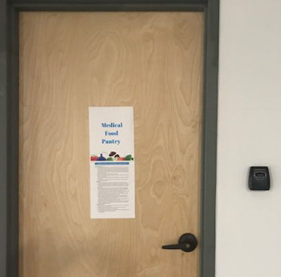
2
What to expect–
Checking in and out
If you have 10:00 am - 2:00 pm, or the first shift of the day, you unlock the medical food pantry.
  To the right of the food pantry door there is a black lock box.
  Dial in the code, push down the latch next to the dial and pull little door toward you.
  Use the key inside to unlock the double door around the corner to the left (not the door right at the box). Return the key to the lock box and spin the numbers so the code is not visible.
Opening the pantry
September 16, 2018

Slide 14
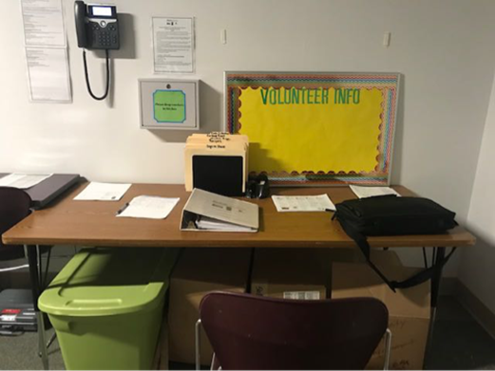
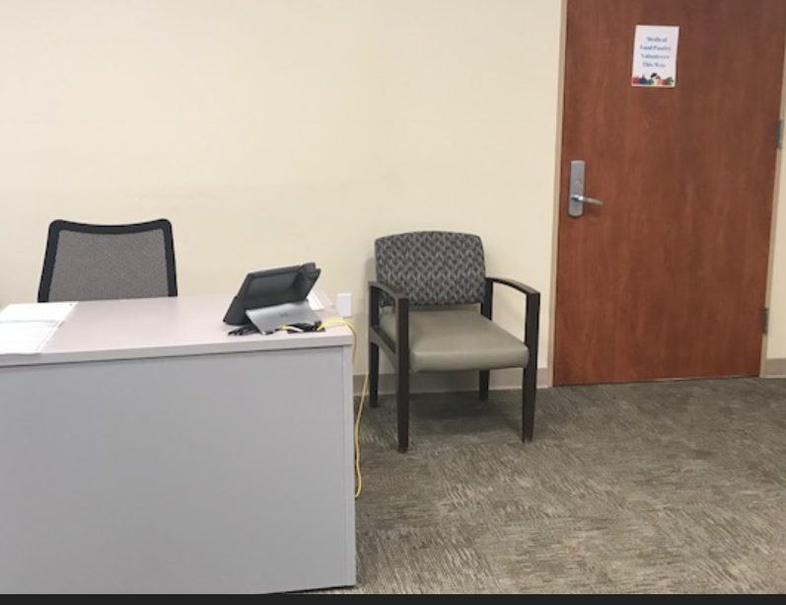
What to expect
Checking in
3
Turn on the laptop (in black bag near desk) and open the sign in icon on the home screen.
Enter your name in Google Docs spreadsheet beside your date/shift. This alerts the volunteer coordinator that you are in the pantry and keeps the coordinator from trying to locate emergency coverage and from hanging a “pantry closed” sign on the door).
(see next slide for step by step how to sign in)
You may take the laptop with you to the front desk in the Dental Clinic lobby where you will wait for patients to drive up with their Voucher.
Do use the time when no patients are present to complete more training and educational modules.
Signing in
September 16, 2018

Slide 15
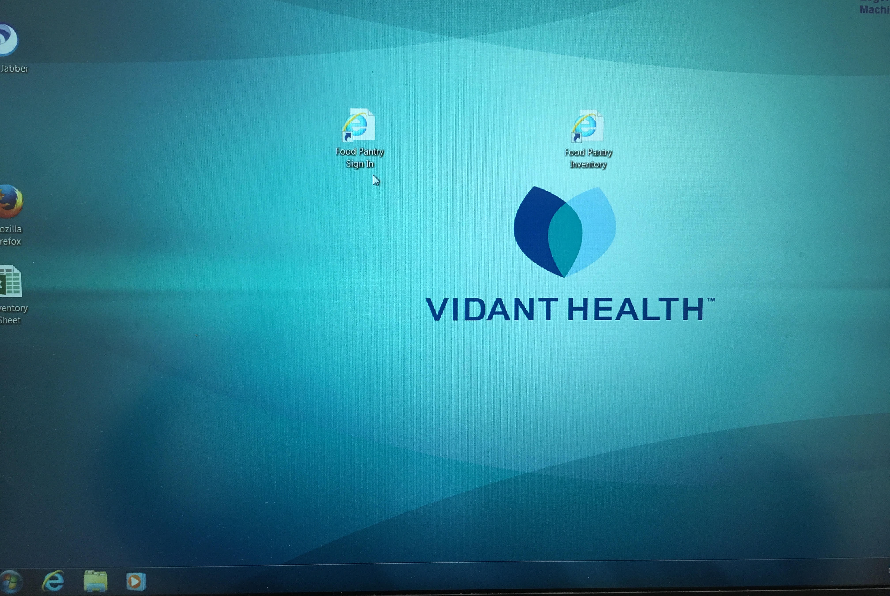
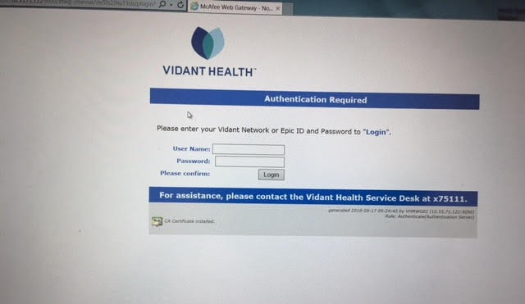
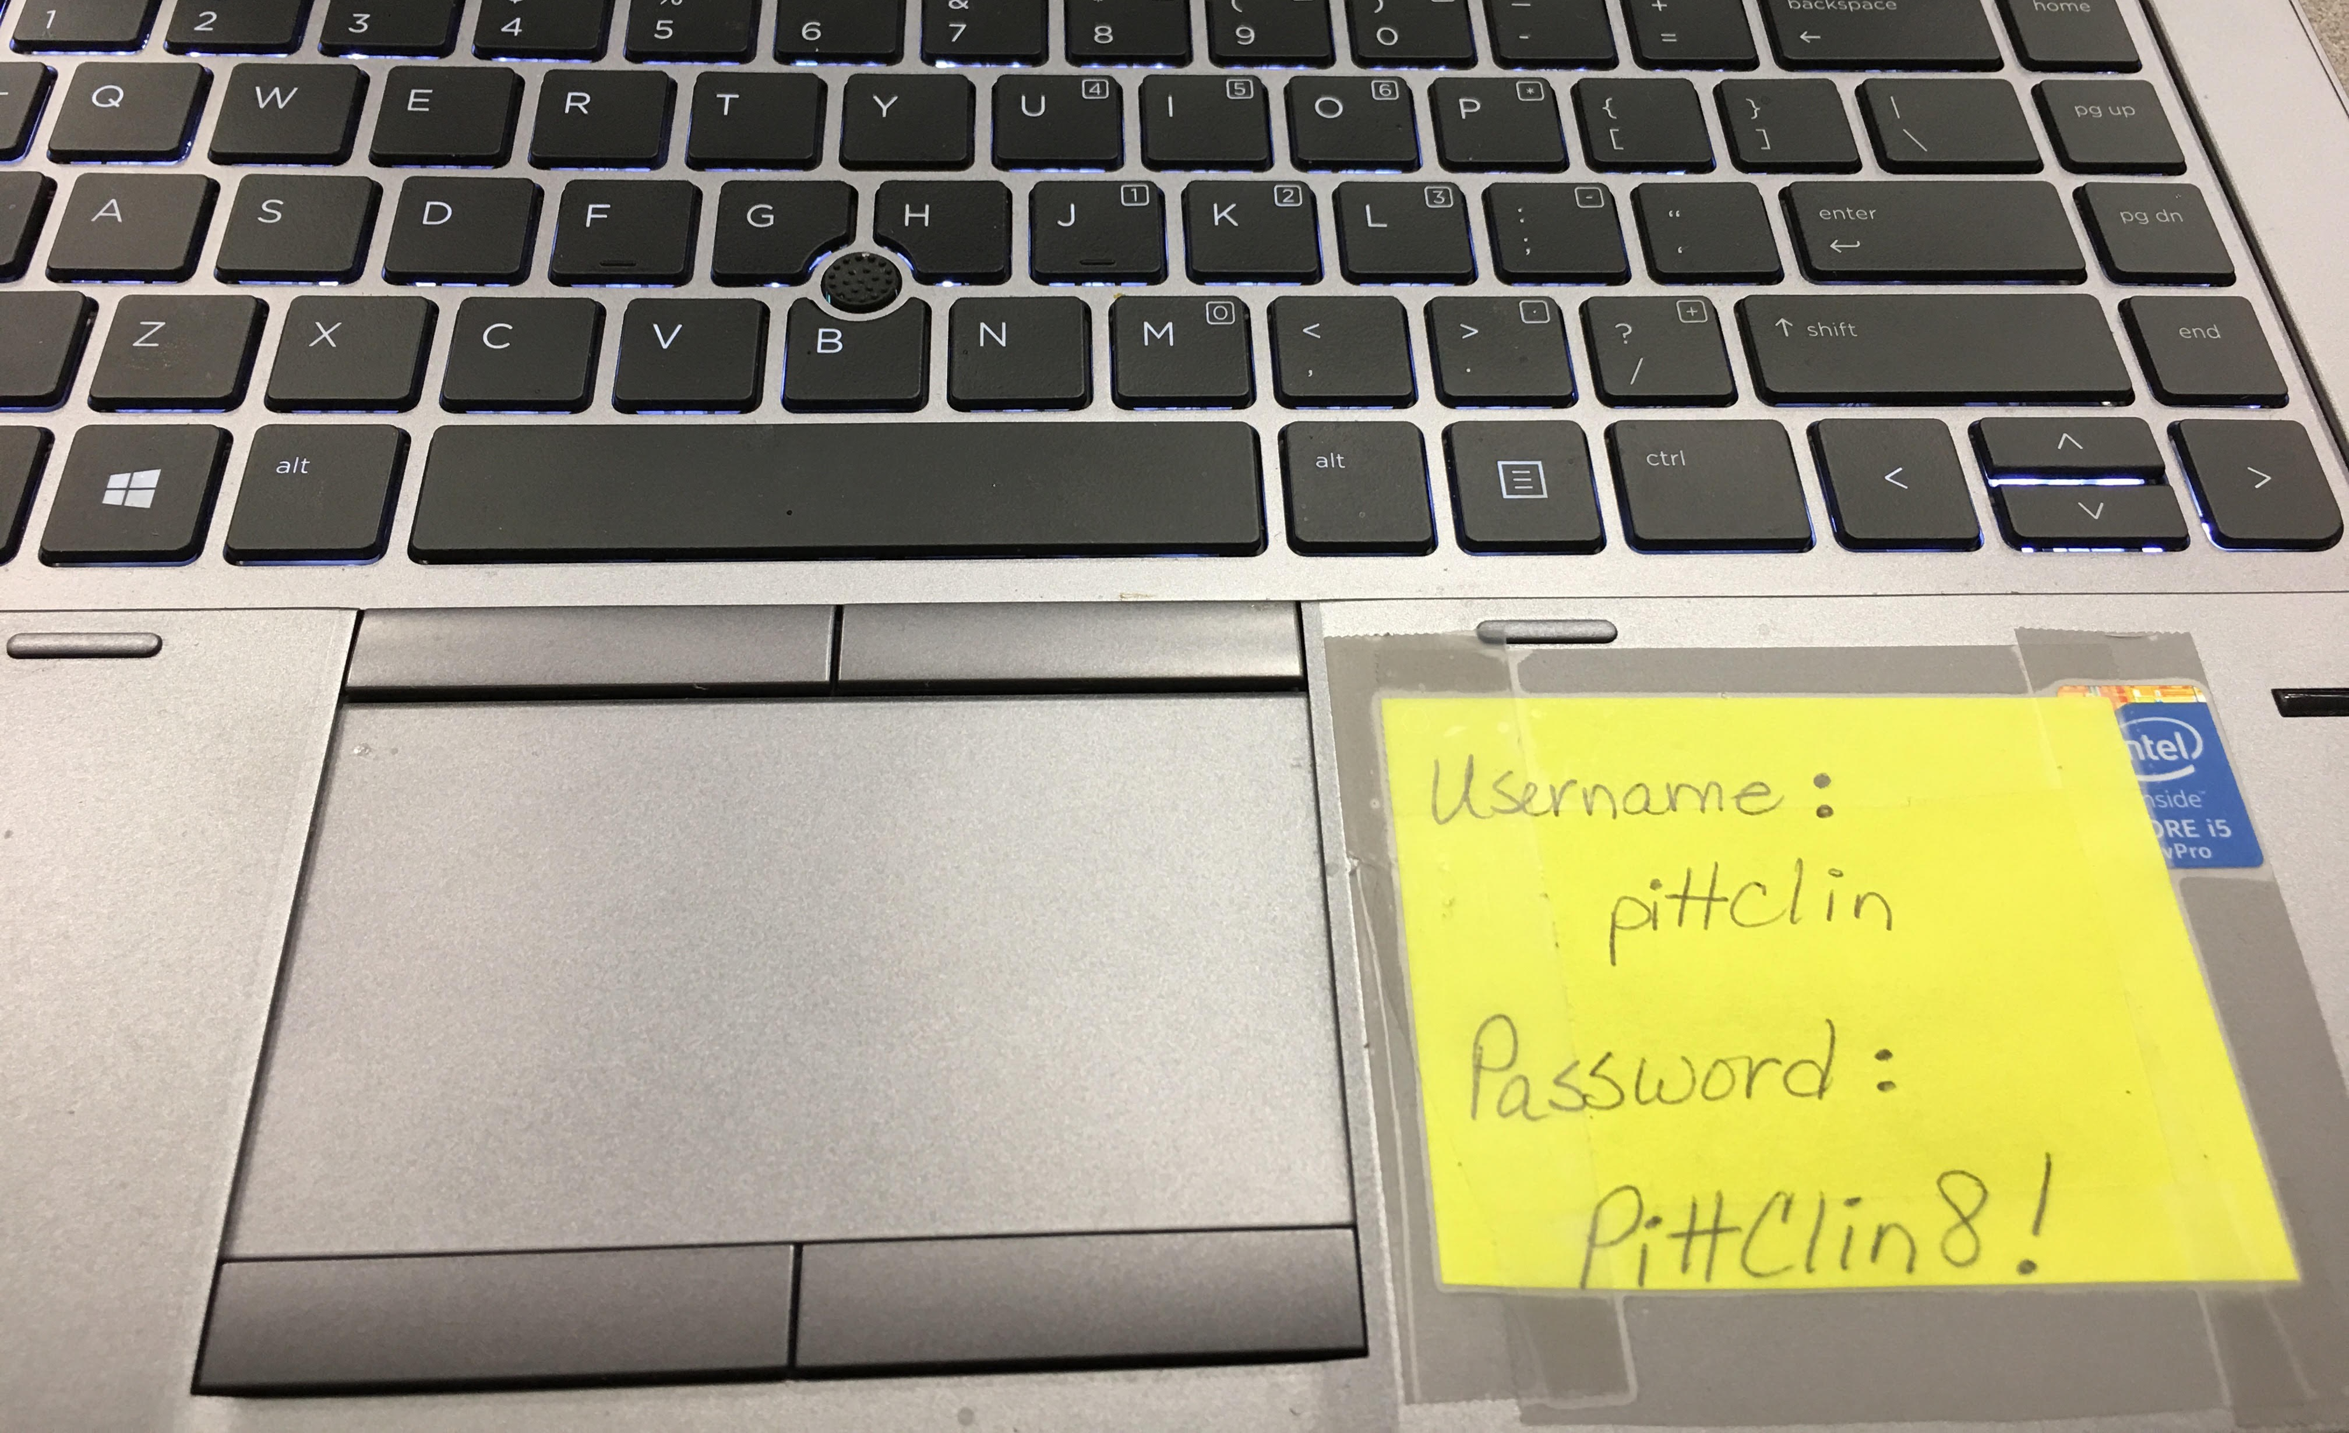
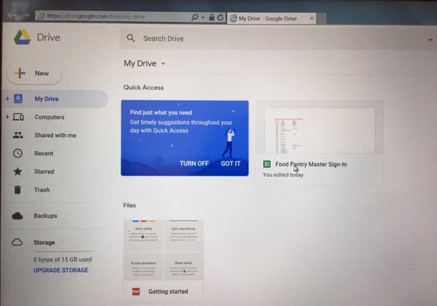
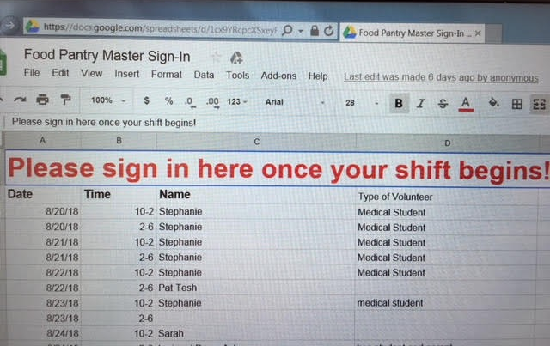
Medical Food Pantry
Signing in
1
Locate laptop and turn on
When screen comes up, there will be
an icon titled: Food Pantry Sign In.
Double click on icon and a sign on box will appear.
Enter the username and password taped
on the lower right side of the keyboard.
Click log in button.
The screen will then show the Google file
with the “Food Pantry Master” name.
Double click on this sign in document.
When file opens, type your name on your assigned shift.
2
3
4
5
September 16, 2018

Slide 16
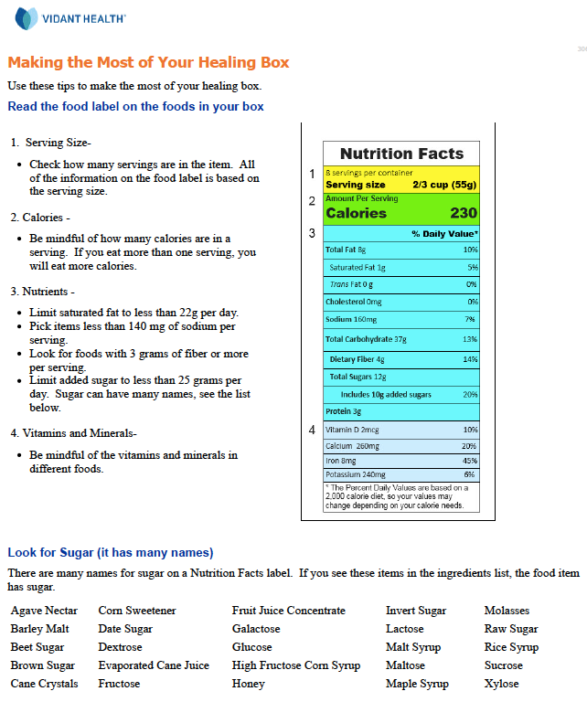
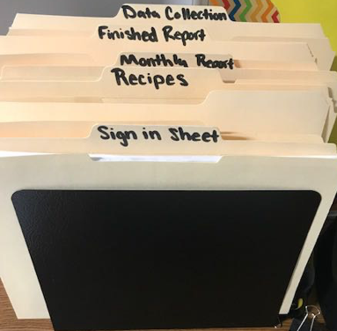
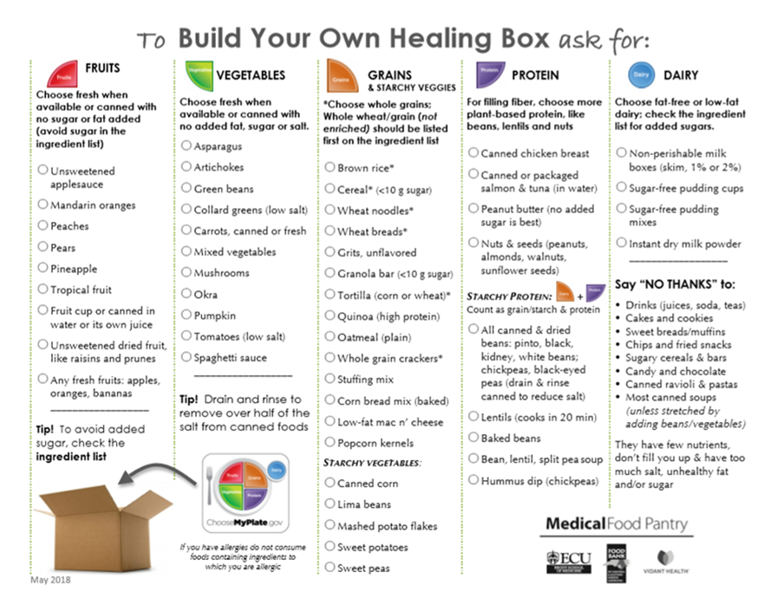

What to expect
Checking in
Review the Food Pantry Manual (white binder) inside the food pantry, before your shift begins.
Locate the important handouts in food pantry the patient should have been given
  Emergency Food Programs (Pantries)
  “Making the Most of Your Healing Box”
  And the one you will give “To Build Your Own Healing Box
  and Plate”
Basics to locate
September 16, 2018

Slide 17

What to expect
Checking in and out
4
If you have the 2:00 pm-6:00 pm shift, you will find a volunteer at the front desk in the lobby of the ECU Dental Clinic when you arrive.
Sign in for your shift as described. If there is no volunteer waiting and/or the pantry is locked follow the instructions (slide 13) to unlock the pantry and sign in.
When you leave, if no one is relieving you,
  return the laptop to the food pantry next to the desk.
  lock the pantry door from the inside and it will lock when you close the door.
Signing out
September 16, 2018

Slide 18
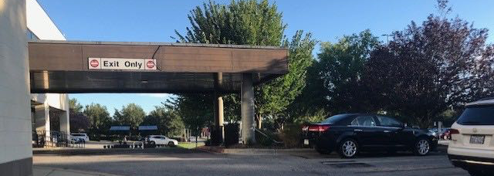
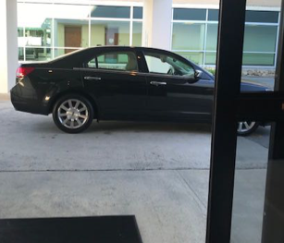
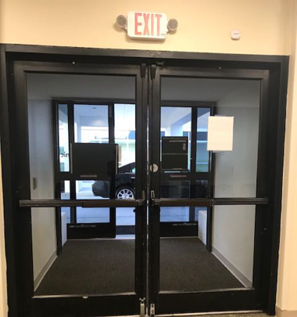
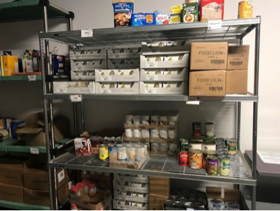
Your duties:
Greeting patient
1
Sit at the desk in the lobby of the
ECU Dental Clinic waiting for patients to drive up to the front door.
Try to greet the driver/
patient at their vehicle.
Patients/drivers are
NOT allowed in the actual pantry
You can only serve patients who
have a Food Voucher issued by a doctor,
nurse or dietitian from Vidant Medical Center or ECU Physicians.
September 16, 2018

Slide 19
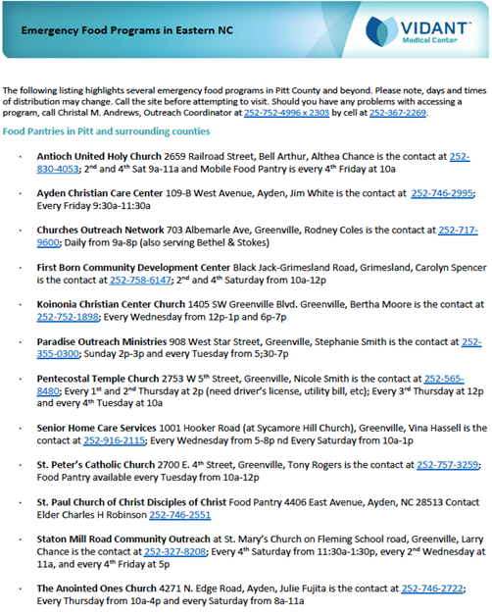

Your duties:
Greeting patient
Welcome script
2
Hi. I am (your name), a volunteer at the Medical Food Pantry and also a (e.g. student at
ECU in the public health program; Health Sciences Academy or medical student or community volunteer).
If you give me your food voucher I can get the appropriate bag for you.
I hope that you had the opportunity to talk with a registered dietitian nutritionist or a nurse about your diet, and received:
  a handout called “Making the Most of Your Healing Box” and
  a list of emergency food programs in your home community where you can get more help if needed.
  If you did not get those two handouts I can get you a copy now when I get your food.
September 16, 2018

Slide 20
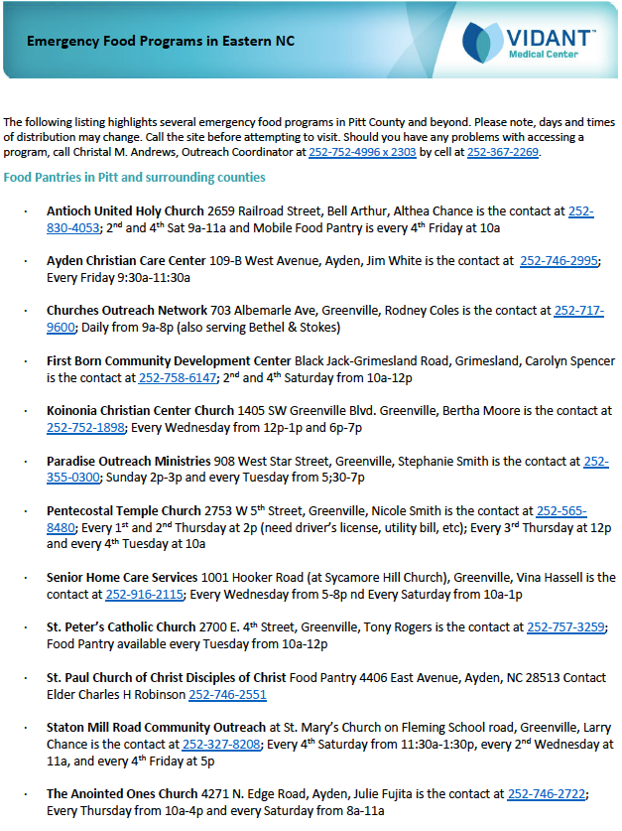
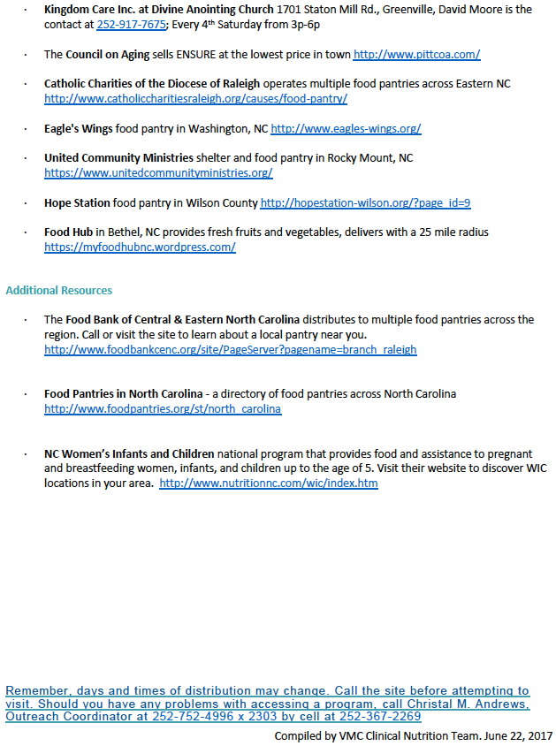
Your duties:
Greeting patient
Without a
Food Voucher
3
If someone who does not have a voucher is seeking help you can politely offer them the community resource list.
September 16, 2018

Slide 21
Your duties:
Greeting patient
About the food
4
We are giving you a bag of healthy food that meets the diet prescription your doctor gave you in case you don’t have enough food at home. This will last a few days until you can link up with resources in your community.
The food has been donated to the Food Bank of Central and Eastern North Carolina by people in our community. The Brody medical students lead food drives that keep the shelves stocked. Vidant Health and ECU Physician employees donate food and money. Some organizations give money to buy these foods.
September 16, 2018

Slide 22
Your duties:
Greeting patient
About the food
5
“This food bag is meant only to get you through a few days. So, I would like to go over a handout with you that shows affordable healthy foods to help you heal. Is that ok? It will only take a few minutes.”
If the patient or driver says they do not have time, just fill the food order and hand them the appropriate handout and recipe and ask them to read the material when they get home.
If the patient has not already given it, take the voucher (see a copy on the next slide) from them.
September 16, 2018

Slide 23
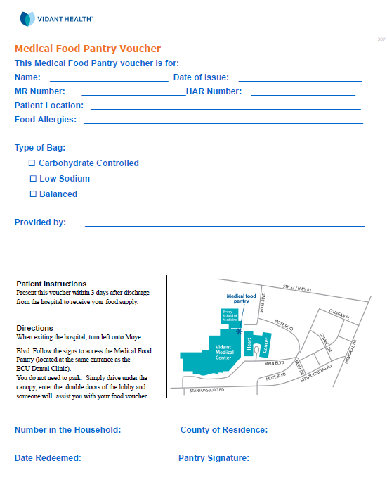
Medical Food Pantry
Food Voucher
Sample
September 16, 2018

Slide 24
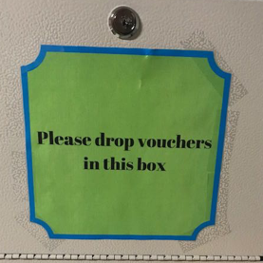
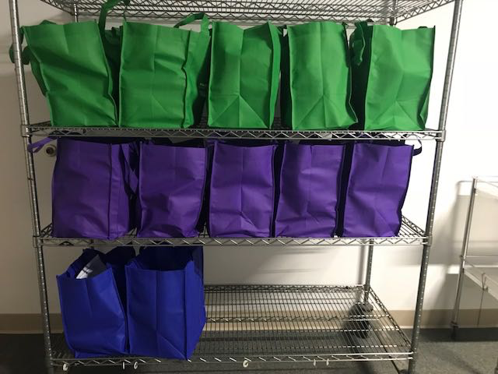
Your duties:
Greeting patient
Give the food
6
The type of bag will be checked: carbohydrate controlled-green,
low sodium-blue or balanced-purple.
  If there is another volunteer ask them to go to the pantry and get the correct colored and filled bag. If not, tell the patient/driver you will be right back with the food.
IMPORTANT:
  Fill in the blanks on the voucher.
  Place the voucher in the gray box with a green label that read “please drop vouchers in this box” attached to the right wall. This is VERY IMPORTANT.
  Select the correct color bag and the correct Healing Plate handout (described in next slide) and take to the patient/driver
September 16, 2018

Slide 25
Topic 3:
Talking with the patient about Healing Food
September 16, 2018

Slide 26
Medical Food Pantry
Healing Food
Shelf stable
Affordable
Healthy
In this orientation module, you learn only the basic information about the foods given by the Medical Food Pantry.
The bags are filled with about 20 pounds of shelf stable, affordable healthy foods.
Each bag has food from these categories: meat or fish, vegetables, fruit, grains, cereal, beans, peanut butter and dairy.
The dietitians from ECU Physicians and Vidant Health approved the amounts of each type of food.
We strongly encourage every volunteer to also to complete Module 2 (which is required for
the volunteers who pack bags).
September 16, 2018

Slide 27
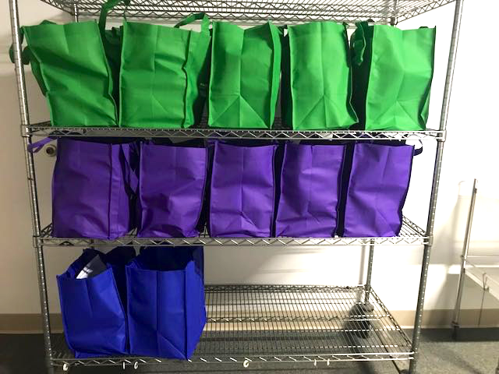
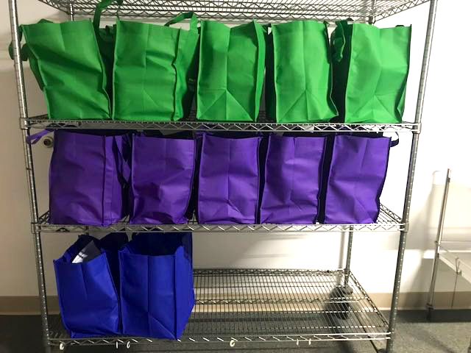
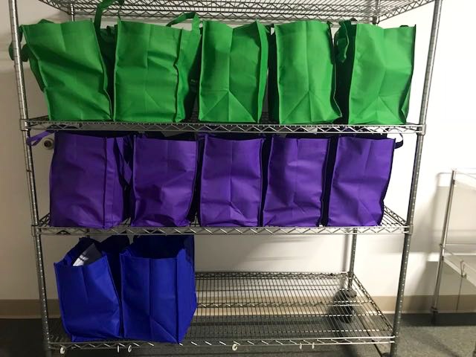
Medical Food Pantry
Healing Food
Color-coded bags
that include:
Food
+
Handout
#1 or #2
+
Recipe
The patient will receive a Healing Food bag which includes one of two different handouts:
  #1- To Build Your Own Healing Box OR
  #2- To Build Your Own Healing Box—Carb Controlled.
The purple bag: no special prescribed diet;
comes with #1 Build Your Own Health Box handout
and a recipe that uses some of the products in the bag.
The blue bag: for a patient with high blood pressure and/or heart failure;
comes with #1 Build Your Own Health Box handout
and a recipe that uses some of the products in the bag.
The green bag: for a patient with diabetes or obesity;
comes #2 Build Your Own Health Box—Carb Controlled handout and recipe that uses some products in bag.
September 16, 2018

Slide 28

Handout #1
Healing Food
Balanced and
low sodium
Points to review with the patient
“Your emergency food bag is filled with healthy, shelf stable and safe foods.
Some items may have a date that has passed, but these foods are perfectly safe for you to eat.”
Show the patient the handout
“This side of the handout shows the foods you can buy or ask others to
give you to help you heal or manage your condition.”
September 16, 2018

Slide 29
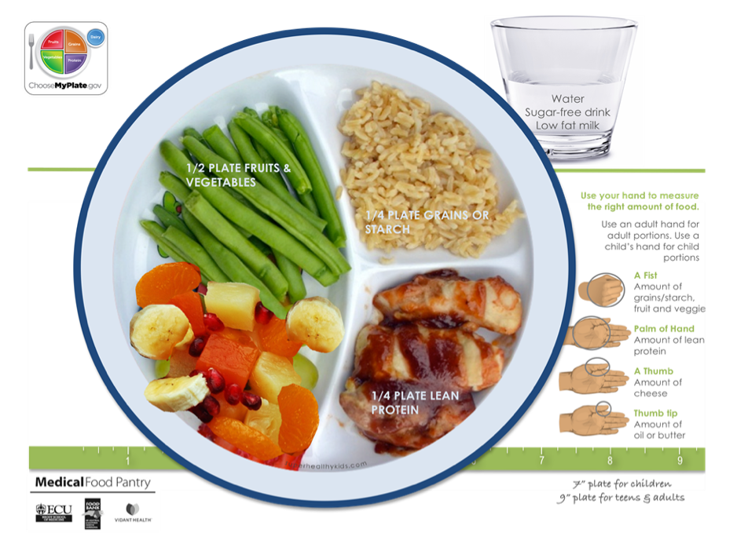
Handout #1
Healing Food
Balanced and
Low sodium
This plate is a reminder
“Adults can fill a 9-inch plate;
children a 7-inch plate
Your dietitian or nurse already explained the diet your doctor prescribed for you
The hands show ways to measure the right amount of food for you
Everyone needs to avoid too much sugar and too much salt
If you are allergic to any foods in the bag, do not eat them.”
September 16, 2018

Slide 30
Handout #2
Healing Food
Carb-Control
Points to review with the patient
“Your emergency food bag is filled with healthy, shelf stable and safe foods.
Some items may have a date that has passed, but these foods are perfectly safe for you to eat.
For patients who receive the Carb-Controlled bag, explain this handout:
“To heal or feel better, your doctor
said you should be eating foods that
are lower in carbs.”
September 16, 2018

Slide 31
Handout #2
Healing Food
Carb-Control
Point to the columns
“When you do get more food
try to get the foods listed
on this side of the handout
Avoid those foods in the column
that says ‘no thanks’.”
It lists foods you should try to say,
“no thanks” to because they will
not help you heal.
September 16, 2018

Slide 32
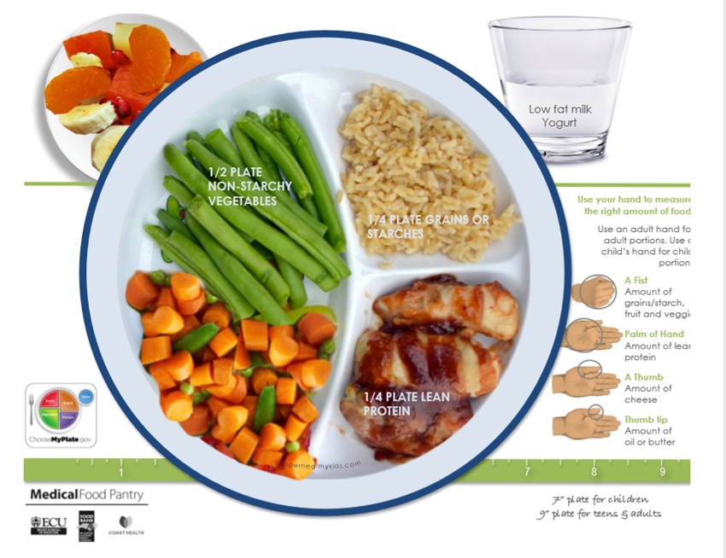
Handout #2
Healing Food
Carb-control
Show the plate.
You should fill more than half the plate with fruits and vegetables.
Canned fruits and vegetables are healthy, if they don’t have added sugar or fat.
You should eat healthy grains and small portions of lean meats, fish, and poultry. Canned products are healthy.
Drink low fat milk or drinks without added sugars.
Use your hands to get the right amount of food for you.
September 16, 2018

Slide 33
Medical Food Pantry
Healing Food
Comparison
The carb-controlled plate (left) has more non-starchy vegetables, and a separate serving of fruit, than the balanced and low sodium plates.
September 16, 2018

Slide 34
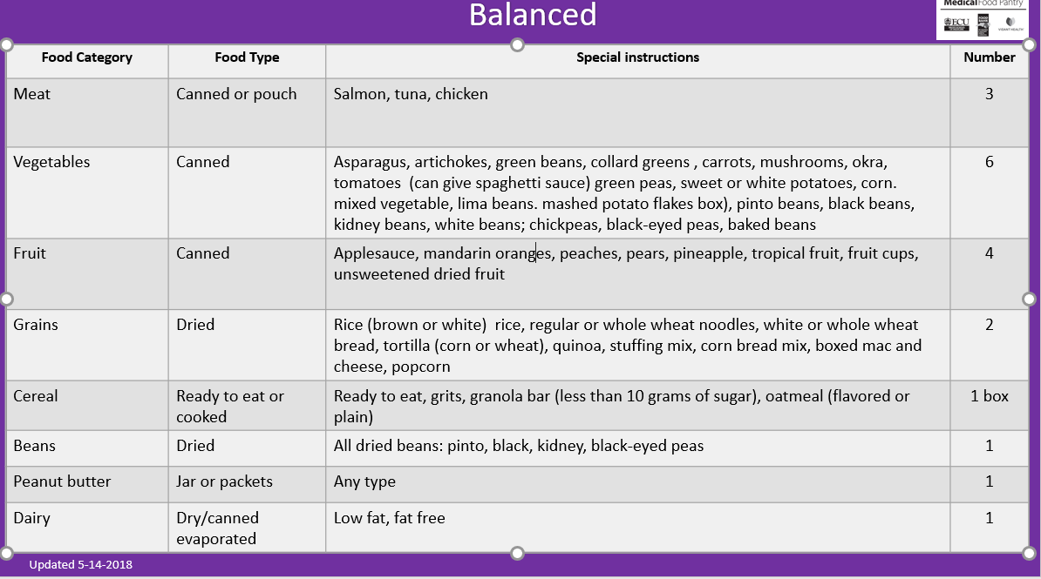
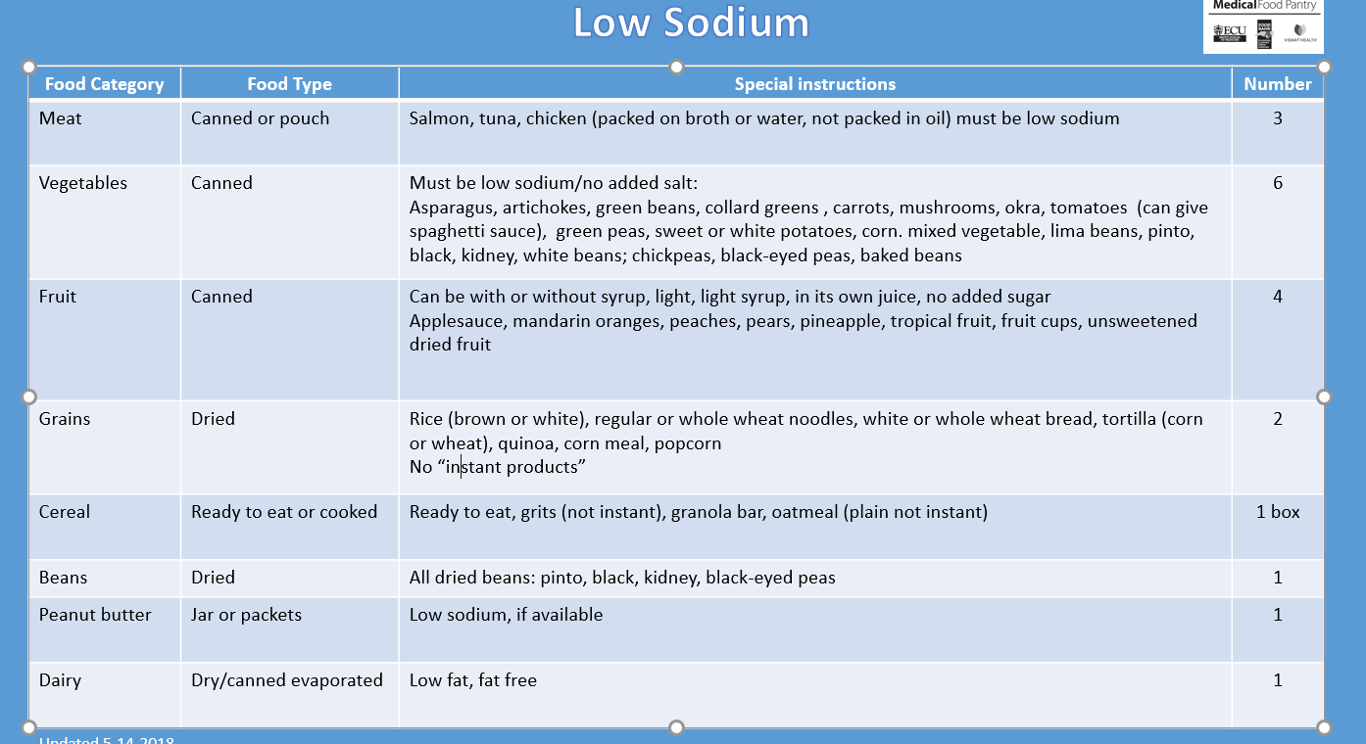
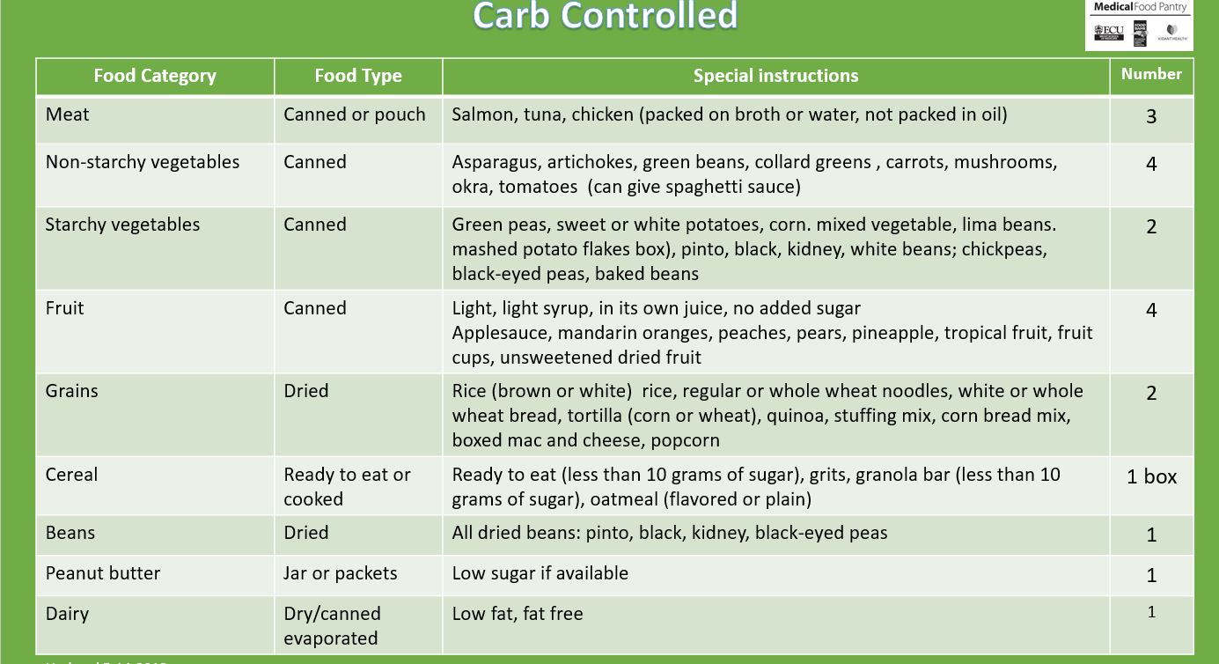
Medical Food Pantry
Healing Food
A great deal of thought and planning
goes into the guides for the volunteers who pack the Healing Food bags.
The dietitians from ECU Physicians and Vidant Health agreed on the amount
and kinds of food to provide.
Learn more in Module 2: Healing Food
September 16, 2018

Slide 35
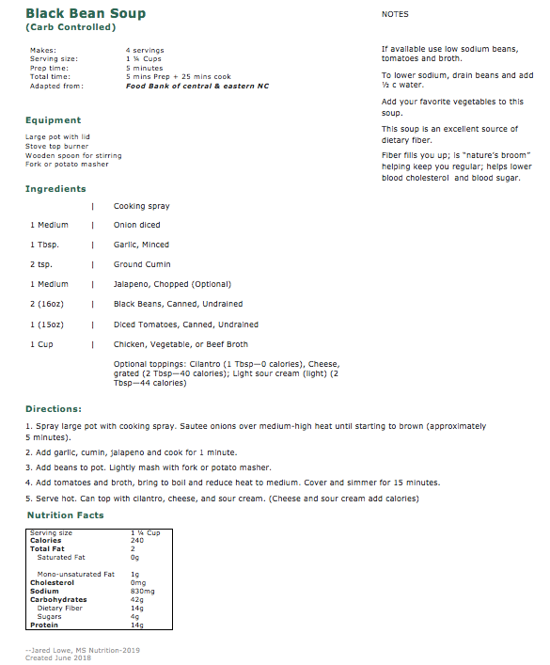
Medical Food Pantry
Healing Food -
Recipes
Each bag will have at least one recipe that uses a main ingredient found in the their bag.
The recipes have been gathered from other food banks, booklets of recipes for people with limited resources including money for food and skills in food preparation.
Each recipe has
  the ingredients,
  the equipment needed to prepare the recipe,
  the directions and
  any special preparation or nutrition notes.
September 16, 2018

Slide 36
Medical Food Pantry
Healing Food -
Recipes
Each recipe has been analyzed for its nutrition value.
  Recipes that have fewer than 45 grams per serving of carbs are Carb Friendly.
  Recipes that have fewer than 700 milligrams
  of sodium if an entrée, and less than 300 milligrams if a side, dessert or snack,
  are Low Sodium.
The calories, fat and fiber are within the limits that meet Vidant Healthy Environment Policy.
That includes:
  Entrees: Calories: <550;
  Sides: <225;
  Soups (8 oz) <225;
  Desserts and Snacks:<200.
  Volunteers are encouraged to submit recipes for consideration.
September 16, 2018

Slide 37
Topic 4:
a few other things you need to know
September 16, 2018

Slide 38

Medical Food Pantry
Volunteers
Call us when…
You are running late for your shift
You are sick and will not be able to work your shift
For any other contingency,
you need to cancel your shift
(Please provide 48 hrs. / 2 days notice)
PLEASE CALL: 252-847-7821
September 16, 2018

Slide 39
Medical Food Pantry
Volunteers
Please bring…
A sweater, if you are cold-natured
Something to read, because there are times when the traffic in the pantry is slow
You may use the laptop to complete other training modules, but not for personal use
Make sure you review the Pantry Policy book—this is a white 3-ring binder located on the table in the pantry
September 16, 2018

Slide 40
Medical Food Pantry
Volunteers
Dress Code
Casual & Respectful – volunteer t-shirt or similar shirt; long pants or shorts at appropriate length;
no tank tops, spaghetti straps, or cut offs
Shoes – no open-toed, high heels, or sandals
No strong perfumes or lotions
Long earrings or necklaces are not recommended
September 16, 2018

Slide 41
Medical Food Pantry
Volunteers
While you’re
working…
No food or drinks
other than water allowed in the lobby.
You may bring a snack
to eat in pantry area
No head phones –
You may use your
cell phone in downtime
as long as
sound is turned off
Do bring a book
or study a further training module
during downtime
No food or drinks other than water are allowed in the lobby -
You may bring a snack to eat in the pantry area
Do not bring
valuables
with you!
September 16, 2018

Slide 42

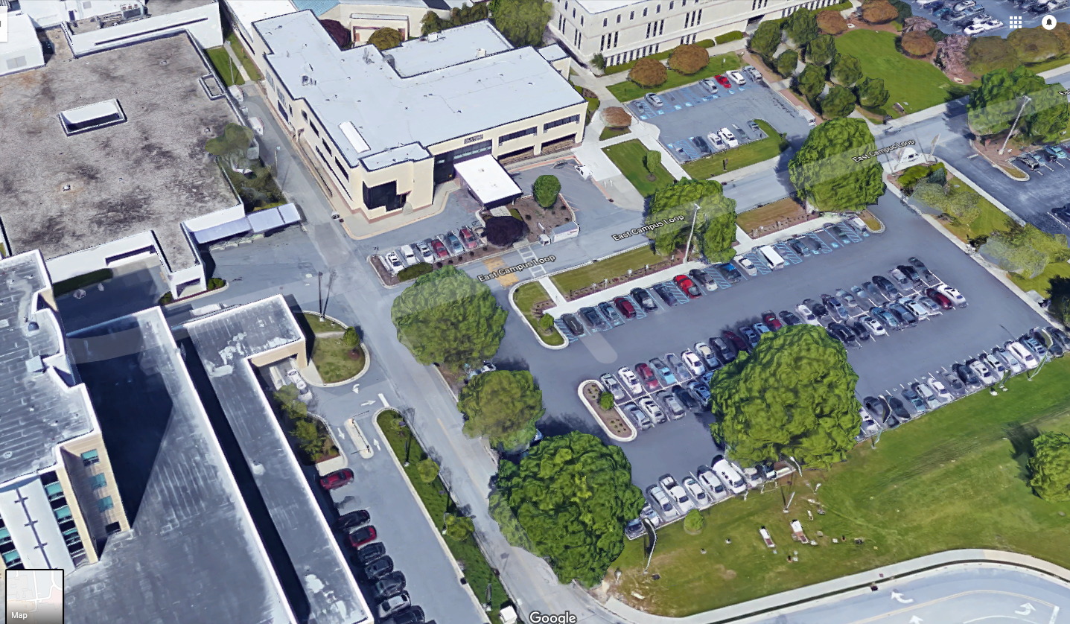
Medical Food Pantry
Volunteers
Parking
Information
Volunteers with
ECU or Vidant stickers:
park as allowed
Medical Food Pantry
Volunteer Parking
Community volunteers:
There are two spaces in front of Leo Jenkins Cancer Center.
Note: You cannot read parking sign from the street side
Moye Blvd
September 16, 2018

Slide 43
Medical Food Pantry
Volunteers
Important
additional
Training Modules
(and more to come)
Healing Food Module
  Volunteers planning to pack bags must complete Healing Food. Others will find it interesting as
  it describes the food the Medical Food Pantry
  is providing and why it is important, how to assemble the bags and select recipes, and types of foods to collect during the food drives
Is My Patient Hungry or Sick. Food Insecurity for the Clinician
  Volunteers interested in learning how to define food insecurity and about how our medical food pantry works will want to complete this module
Your Healing Box
  Nurses and others providing the vouchers are required to complete this module before distributing vouchers to best describe the handout you will also review with the patient: “Making the Most of Your Healing Box”
September 16, 2018

Slide 44
Medical Food Pantry
Volunteers
The Quiz
Next step
To complete this Orientation module you must take the following quiz
Questions are set in True/False or
Multiple Choice formats
You need 8 correct answers.
You may take as many times as needed to pass
We welcome your suggestions on how to improve this orientation or other things you would like to learn.
Once this Orientation presentation is completed, the quiz will be unlocked and available for testing, in your course.
September 16, 2018

Slide 45


Thank you
for volunteering!
September 16, 2018
September 2018

