Slide 1
Predatory Publishers and Conference Organizers: Just Say No!
Kerry Sewell, MSLS, Research Librarian for the Health Sciences, Laupus Library, East Carolina University
Gina Firnhaber, PhD, RN, Clinical Assistant Professor, College of Nursing, East Carolina University
Kathryn Kolasa, PhD, RDN, LDN, Professor Emeritus, Brody School of Medicine at East Carolina University
February 2020
Notes:
Kerry Sewell is a research librarian. She had been doing classes for faculty about publishing
Gina Firnhaber has been a health sciences librarian. On completion of her PhD in Nursing she has accepted a research role in nursing at ECU
Kathy Kolasa has worked in medical nutrition education for medical students, primary care residents, practicing physicians for her entire career. She invited Kerry and Gina to prepare this webinar with nutrition and dietetics examples.

Slide 2
Conflicts of Interest
Kathryn Kolasa is a contributing editor to the journal Nutrition Today

Slide 3

Objectives
At the end of this session, participants will be able to:
  Verbalize an understanding of the term predatory in relation to journals and conferences
  List at least 3 criteria they can use to determine if a specific journal is a trustworthy place to submit a manuscript
  List at least 3 criteria they can use to determine if a conference is legitimate or potentially predatory
  Understand how a health sciences librarian can help you decide if a journal or conference is trustworthy or predatory
Notes:
Kathy noted since they rehearsed this webinar last week, she has had about 18 invitation to submit manuscripts, 12 or so invitations to conferences and 1 request to review an article for a journal she never heard of. She is now better prepared to respond to these requests

Slide 4
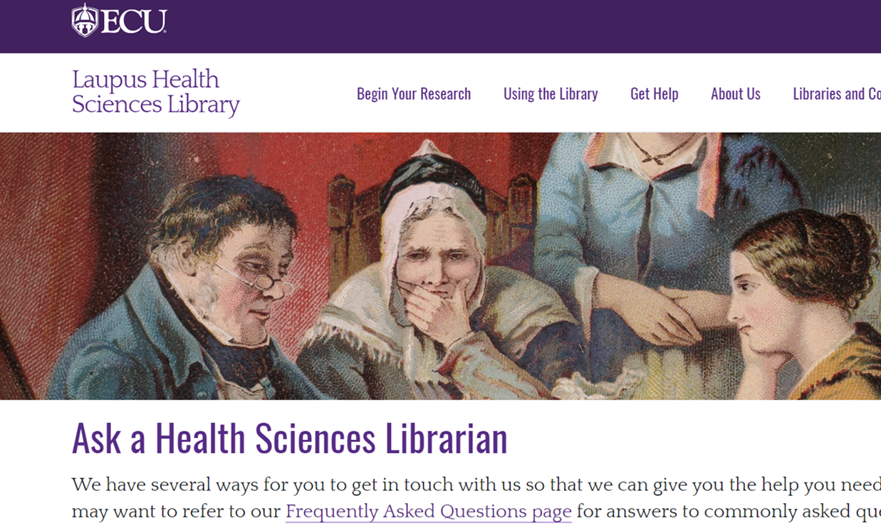
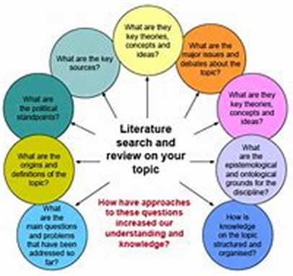

Love a Health Sciences Librarian
Support requests for help with finding literature/clinical evidence for researchers/clinicians (when UpToDate or DynaMed fail to provide an answer)
Teaching information-seeking/searching skills to students, faculty, and clinical staff
Work with researchers on systematic reviews—role is to create a rigorous search and ensure that reporting methods meets national and international standards
Help researchers identify funding opportunities
Assist researchers with evaluating journals for their publications
Support requests for help with gathering impact measures for individuals and departments
Review Data Management Plans for faculty applying for NIH
…and more
Notes:
Kathy’s love affair with heath science librarians began about 25 years ago when she wrote a grant to include a librarian in the teaching of evidence based medicine to primary care residents. She learned there were many ways they could collaborate (see list above)

Slide 5
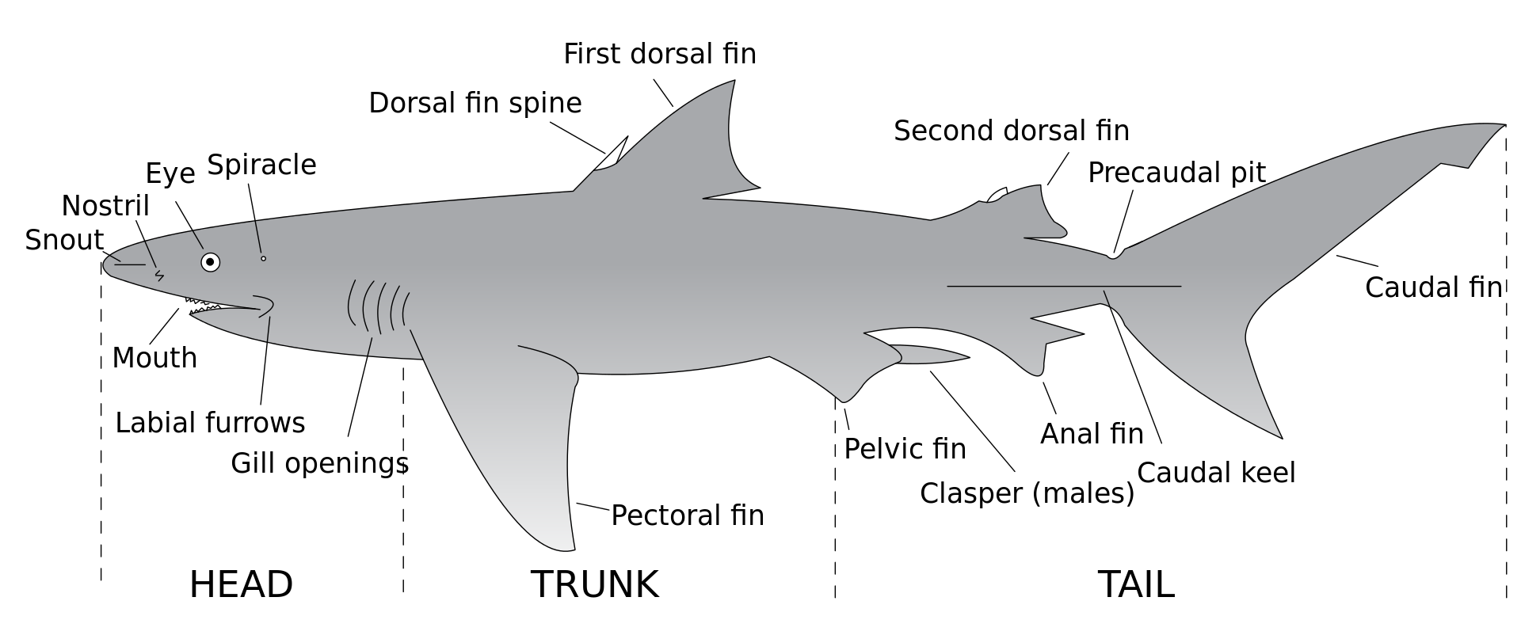
Recognizing a Predator
Notes:
Kerr developed and y presented through slide 36.
It’s not as easy to identify a predatory journal as it is to recognize a shark by its parts

Slide 6
Some definitions
Predatory—in this presentation, journals that use deceptive publishing practices and publish articles in exchange for money
Open Access—a publishing model that makes articles freely available to readers
Hybrid journal—a journal that is normally accessible only for people with subscriptions, but which also publishes some articles in an open access format
PLoS—the Public Library of Science, a publisher pushing for open access to research articles, research data, and open peer review
Notes:
Every discipline has its own jargon, including library sciences so a few definitions are in order to help understand this topic
Predatory journals primary purpose is to make money for its publishers.
PLoS is Public Library of Science. They push for transparency.

Slide 7
Some definitions
Authors rights—the rights an author retains when they publish an article (such as the right to share their article)
Creative Commons license—a license that allows an author/creator to retain copyright while granting others the right to copy, distribute, and make specific uses of the work (Creative Commons, n.d.)
Impact factor—a quantitative measure that is used to represent the importance of a journal within a specific field
Creative Commons: About the Licenses. https://creativecommons.org/licenses/. Accessed January 27, 2020.
Notes:
A specific use for a Creative Commons might be : ok for non commercial use
Not having an impact factor is not a sign that a journal is predatory, but if they have one it is unlikely that they are predatory

Slide 8
Some definitions
ISSN—International Standard Serial Number, a unique number assigned to a published journal
Digital Object Identifiers (DOIs)—a unique number assigned to a published journal article, book, or other digital item
LOCKSS—Lots of Copies Keeps Stuff Safe—an archive created at Stanford and used by publishers to preserve digital items
Notes:
ISBN numbers are for books
Other digital items might be photographs
Preserving digital items is for perpetuity

Slide 9
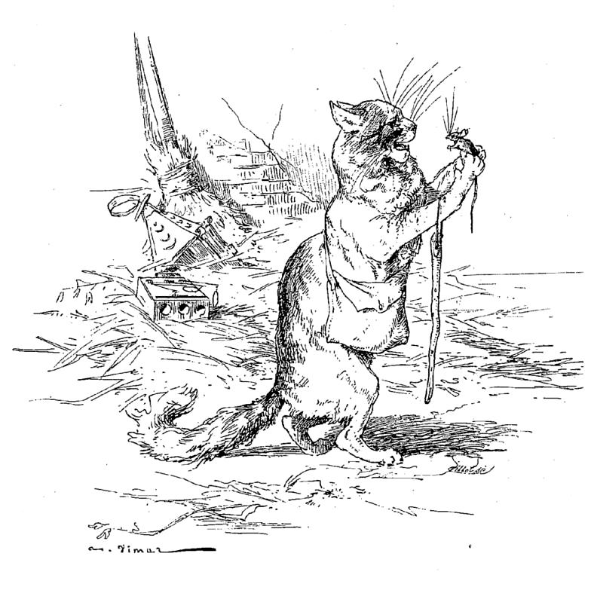
What’s a Predator in the Journal Publishing World?
“Predatory journals and publishers are entities that prioritize self-interest at the expense of scholarship and are characterized by false or misleading information, deviation from best editorial and publication practices, a lack of transparency, and/or the use of aggressive and indiscriminate practices.”
    Consensus definition, Grudniewicz, Moher, Cobey, et al, 2019
Illustration of "Le vieux chat et la jeune souris" by Auguste Vimar (1851-1916) from an 1897 edition of La Fontaine's Fables.
Notes:
Predatory journals were first loosely defined by a librarian, Jeffrey Beall, who began a list of “potential, possible, or probable predatory scholarly open-access journals,” a list which no longer exists. However, a recent consensus meeting attended by journal publishers, research funders, researchers, policymakers, academic institutions, patients and caregivers, and academic institutions came up with the definition on this slide: …
.
Beall took down his list due to legal issues. It is now being updated by an anonymous person (last done December 2019) You can find it at https://beallslist.net/
Full citation for the paper that includes the definition on the slide:go.nature.com/2dndsjf
Grudniewicx A, Moher D, Cobey KD and 32 coauthors. Predatory journals: no definition, no defence. Nature. 2019;576:210-212. Also on line at

Slide 10

Predatory Publishing Practices: Peer Review
Predatory journals will falsely claim to use a peer review process, or if a review process exists, fail to provide adequate and meaningful peer review
“The manuscripts submitted to the journal will be sent out for a thorough peer review and the full decision will be provided to authors approximately within 21 days from the date of submission. Minimum two independent reviewer’s approval and an editor approval is taken into consideration for acceptance or rejection of a manuscript.”
Notes:
A good clue is if the stated peer review time is too short.
It is unrealistic to expect full peer review and acceptance for publication within 21 days. A manuscript might be rejected by a journal editor based on a desk review before it is sent out for reasons such as “outside scope of the journal”………. And returned to an author in less than 21 days, but unusual for it to go out for review and be back

Slide 11


Predatory Publishing Practices: Long-term Preservation of Articles
Predatory publishers do not help preserve articles for future clinicians and researchers
  Clinical practice and science evolve over time and are built upon the evidence from good quality research
Notes:
A good quality journal will preserve its contents for future scholars and clinicians. We know that science and clinical practice evolve over time and are built upon the work of prior research or published evidence. This means that the articles need to be preserved. If research evidence is lost, it means that future clinicians and scholars can’t find it or use it to change practice or knowledge or advance science

Slide 12

Predatory Publishing Practices: Lack of Credibility
Individual journal articles should be evaluated on the quality of the science, HOWEVER:
  Predatory journals are looked upon unfavorably by hiring and tenure/promotion committees
Poor quality articles published in predatory journals may give patients and their caregivers false hope
Notes:
If a researcher is duped into publishing in a predatory journal more than once, on review by a potential employer or tenure committee… they may question the judgment of the researchers
If a patient takes in an article to his/her doctor that was published in a predatory journal, and the doctor says the article is not good, it may undermine the patient’s faith in scienc

Slide 13
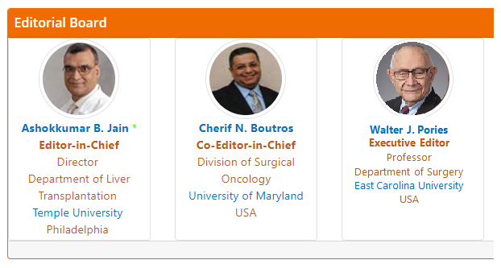
Predatory Publishing Practices
Misrepresentation of editorial board members
* I cut and pasted Dr. Pories profile on this predatory journal’s editorial board to demonstrate how easy it is to harvest someone’s profile
Notes:
Alarmingly simple to harvest Dr. Pories from an ECU site and put it into the banner of the journal.
Hard to verify. Most professionals that serve on editorial boards do not put the list of those boards on their vita or display on their websites

Slide 14
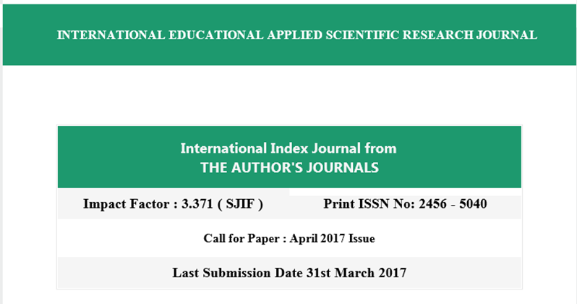

Predatory Publishing Practices
Lying about the impact metrics for the journal
Notes:
This is a screen shot from a journal that invited Kerry to submit.
The Impact Factor on the lower left is fake. SJIF stands for Scientific Journal Impact Factor. No such thing exists. This journal publisher made it up.

Slide 15

Predatory Publishing Practices
Claiming a relationship or affiliation with a relevant professional or publishing affiliation
“This journal is a member of the Committee on Publications Ethics (COPE).”
Notes:
See the handout Professional and Publishing Organizations created by Kerry Sewell
The USDA lists the following:
American Council on Science and Health;
American Society for Clinical Nutrition;
American Society for Parenteral and Enteral Nutrition;
International Society for Behavioral Nutrition and Physical Activity;
Society for Nutrition Education and Behavior;
Academy of Nutrition and Dietetics.
American Society for Nutrition

Slide 16
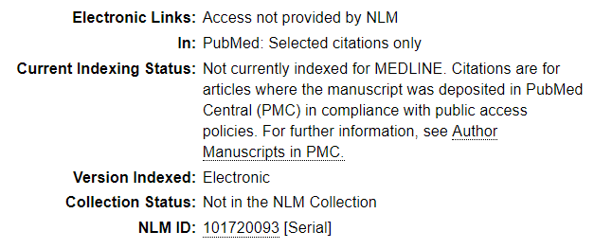
Predatory Publishing Practices
Falsely claiming indexing in MEDLINE (PubMed) or other respected databases
PubMed Central (PMC) ≠ PubMed
Notes:
Medline is the major core of publications found in the National Library of Medicine collection.
It can take years to get included. One journal was first published in 1979 and didn’t get accepted into Medline until 2018.
Noting that just because not in MEDLINE (e.g. Nutrition Today)it is not a predatory journal. Nutrition Today originated as a sponsored journal from the Florida Citrus Commission. It has not been affiliated in many years but even as Nutrition Today has applied for MEDLINE status, this appears to remain a concern
Publishers can freely deposit articles into PubMedCentral.
The content of some predatory journals can be found when you run a search in PubMed. This is because they freely deposit their content into PubMed Central (PMC), which is a full-text repository for open-access health-related research. Items in PMC show up in a regular PubMed search, but those items aren’t necessarily in MEDLINE. Predatory journals using PMC are probably attempting to use the fact that PMC items show up in PubMed searches as a way to make their journal look more legitimate.

Slide 17
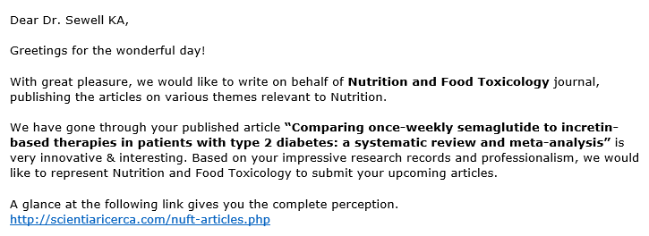
  Most encounters with predatory publishers are through emails soliciting submissions
  Not to be mistaken with calls for submissions for special issues of a known, respected journal!
Notes:
Kerry pointed out some signs that this might be predatory
If you have had Phfishing training, then you would use same principles
Salutation is not correct, she doesn’t have a PhD
Grammar and language are odd
Note that while most well respected journals don’t solicit manuscripts by email, they may if they are having a special issue. Also a recognized publisher may send out emails if it is launching a new journal and solicits papers for its first issue.

Slide 18

Predatory Publishers in the Open Access Publishing Universe
Most predatory publishers are Open Access publishers, charging an Article Processing Charge
Not all Open Access publishers are predatory!
Notes:
The Open Access movement started in 2002
Usually there is an article processing fee

Slide 19
Open Access Publishing
“Open Access is the free, immediate, online availability of research articles, coupled with the rights to use these articles fully in the digital environments.”
  -The Scholarly Publishing & Academic Resources Coalition (SPARC)
Notes:
Open Access officially started in 2002, with the Budapest Open Access Initiative, which brought together stakeholders and publishers from around the world who were interested in “removing access barriers to [scientific and scholarly] literature” in order to “accelerate research, enrich education, share the learning of the rich with the poor and the poor with the rich, make [the] literature as useful as it can be, and lay the foundation for uniting humanity in a common intellectual conversation and quest for knowledge”
The definition by The Scholarly Publishing & Academic Resources Coalition is the most widely accepted definition of open access

Slide 20
Open Access Publishing Universe
Two Models:
  Hybrid Journals
    Only OA articles are freely available
  Open Access Journals
    All articles freely available
* Open Access and Public Access have the same goal, but different routes
Notes:
There is a Federal mandate (US and Europe) that work that was completed with government funding must become open access in 12 months.

Slide 21

Open Access Publishing
Some Open Access journals charge an Article Processing Charge (APC); many do not
  APCs are typically used to cover editorial costs, any costs of administering the peer review system, and costs associated with maintaining websites and storing articles on servers
The APC in hybrid journals can be up to twice as much as the APC for a fully Open Access journal
Notes:
J Acad of Nutrition and Dietetics: OA Fee is 2750 USD(this is a hybrid journal);
American J of Clinical Nutrition: page charges for articles not made freely available, with an additional 5k for publishing Open Access;
Nutrition Today also employs hybrid model--OA APC is 2,570.

Slide 22
Open Access Publishing
The use of an APC does not indicate that an Open Access or Hybrid journal is predatory!
PLoS is an Open Access journal publisher that leads the world in publishing standards around reproducibility and many other principles of scientific research publishing
Notes:
A processing fee by itself is not a red flag. If you pay for acceptance it is a red flag.

Slide 23

Identifying Quality Journals

Slide 24
Finding the Right Journal for Your Manuscript
Finding a few journals you might consider:
You’ll want to find several options; rejections are pretty common
Notes:
Some journals will in fact publicize their rejection rates as a point of pride. Other journals will publish a sort of ‘year in review’ article summarizing basic data about the journal; a 2007 article from the Journal of Nutrition stated it had a steady acceptance rate of about 33%. (JAMA Internal Medicine published an article stating they have a 78% rate of rejection without review). More frequently, rejection or acceptance rates can only be learned by contacting the journal editor. Cabell’s is a resource for locating rejection rates for journals, but unfortunately, it doesn’t cover most health sciences publications.
https://doi.org/10.1093/jn/137.2.303
It can soften the blow of a rejection letter if you have a list of several journals to consider

Slide 25
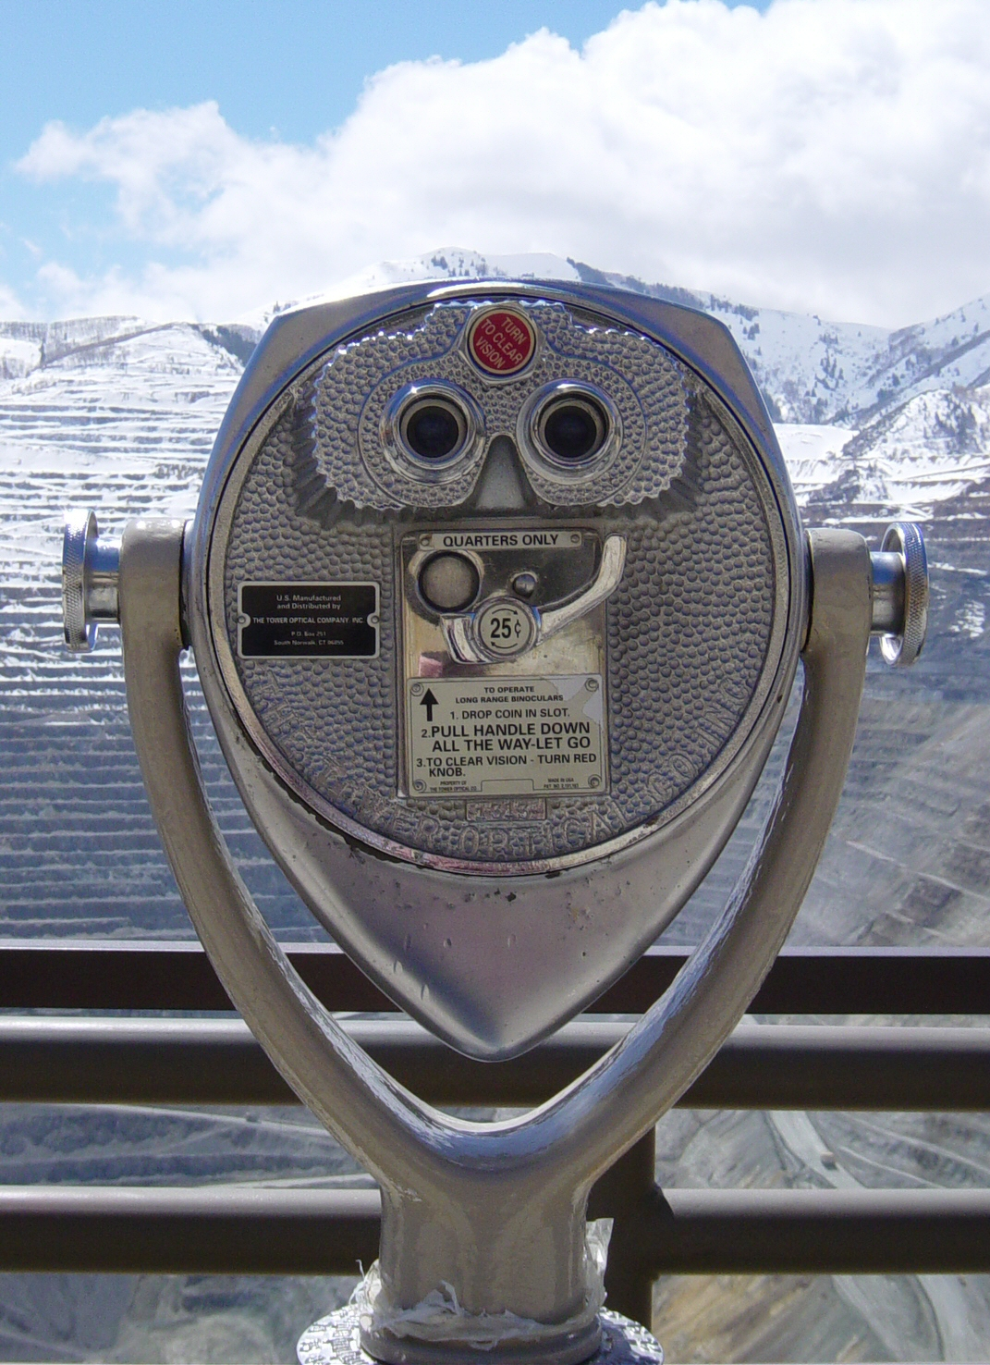
Begin with a search on your topic in PubMed or another relevant research database (CINAHL, PsycINFO, AGRICOLA) to see what journals have published similar articles
Notes:
Relevant databases for nutrition and dietetics would include:
CINAHL (subscription); AGRICOLA (free); PsycINFO (paid)
If any of you use Google Scholar, you could potentially use it to try to find journals as well by running a search for articles on your general topic area. Just keep in mind that there’s no quality control in Google Scholar and its search results will also include articles from predatory journals. If you’re not familiar with Google Scholar, it’s a nice resource for looking for information through Google that will just give you scholarly results. You get to it by googling ‘google scholar’. And again, it will unfortunately include some untrustworthy results as well, which means you have to take extra time to determine if the article you pull up is good science or not.
Don’t ignore PsychINFO it also covers social and behavioral aspects of health
Look for journals that have published articles like the topic of your paper

Slide 26

Use existing tools that help match your abstract to a journal:
  Journal/Author Name Estimator (JANE) http://jane.biosemantics.org/ [30482210]
  Publisher-specific tools
    Elsevier Journal Finder: https://journalfinder.elsevier.com/
    Wiley Journal Finder: https://journalfinder.wiley.com/search
    Springer Journal Suggester: https://journalsuggester.springer.com/
Notes:
Use: 31728505 [pmid]
Kerry demonstrates use of JANE here…live
She copied the abstract for the paper and pasted it into JANE
Sometimes authors fear their work will be stolen, so use the scramble feature which puts all the words from the abstract in alphabetical order
JANE will produce a list that ranks journals (confidence), notes if in Medline or not; gives basic citation. This search is run in Pub Med.
The publisher specific tools only gives names of the journals they publish.

Slide 27
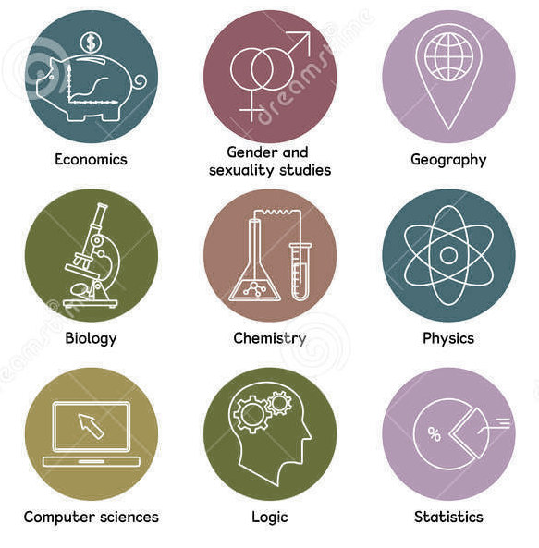
Use tools let you browse journals by subject area:
  Journal Citation Reports https://www.lib.ecu.edu/databases/go/253
  Scimago https://www.scimagojr.com/
Notes:
J Citation Reports is the official resource for Impact Factors (it is subscription)
Kerry demonstrates the use of Scimago which is free
Nutrition and dietetics is not a subject category but is housed under NURSING.
Will give a list of journals
Gives Scimago ranking which is similar to an Impact Factor
The Impact Factor depends on the field.
In this case they list the journals by quartiles… you can see a big spread in the factor in one quartile

Slide 28

Criteria for Quality in Journals

Slide 29

1. Relevance and fit
  Does the journal publish in your general topic area?
  Does the journal accept the type of study you’re doing/have completed?
Notes:
For example, may not take reviews or case reports

Slide 30


2. Affiliation of the journal
Is this publisher affiliated with an established discipline-related association?
Is this publisher affiliated with other scholarly publishers, such as:
  the Association of American Publishers (AAP)
  Committee on Publishing Ethics (COPE)
  the International Association of Scientific, Technical, and Medical Publishers (STM)
  Open Access Scholarly Publishers Association (OASPA)?
If published singly, is it published by a reputable university or research center?
Notes:
See Professional and Publishing Organizations for nutrition, dietetics, obesity compiled by Kerry.
Kerry offers to provide list on request
The USDA lists the following:
American Council on Science and Health;
American Society for Clinical Nutrition;
American Society for Parenteral and Enteral Nutrition;
International Society for Behavioral Nutrition and Physical Activity;
Society for Nutrition Education and Behavior;
Academy of Nutrition and Dietetics.
American Society for Nutrition

Slide 31

3. Editorial Practices
Is information about peer review and author’s rights/publication agreements easily findable?
Are editorial board members / reviewers recognized experts in their fields?
Does this publisher adhere to a code of conduct such as the one for COPE, OASPA, or STM?
Does peer review alone determines the publication status (that is, the opportunity to publish is not determined only by paying a fee)?
Notes:
A good quality journal should adhere to the code of conduct from publishing organizations such as those from the Committee on Publication Ethics, the Open Access Scholarly Publishing Association, and the International Association of Scientific, Technical, and Medical Publishers. Ideally, the journal website should state that they adhere to a code of conduct from one of these publisher associations and also be officially listed on the association’s website among their list of members.
Shows live the authors rights agreement from J of Academy of Nutrition and Dietetics
This is the type of detail you would expect from a good quality journal
Kerry notes this is the MOST CRITICAL criteria
Demonstrates using JAND here.

Slide 32
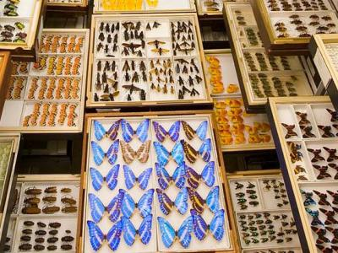
4. Indexing
Butterfly collections at the National History Museum
Are this publisher’s journals indexed by well-known databases like Web of Science or Scopus?
Are this publisher’s journals described in standard serials directories, like Ulrichsweb Periodicals Directory, the Serials Directory, or Cabell’s Directories, WorldCat, or DOAJ?
Are articles in this publisher’s journals indexed by content-area databases?

Slide 33

5. Publishing Activity
How recent is the first edition? (new journals are not automatically suspect!)
How regularly are articles or issues published?
Does the journal adhere to industry standards? (eg., ISSN registration, Digital Object Identifiers (DOIs) assigned for articles, OpenURL linking, etc.)
Is the journal committed to archiving electronic versions of articles? (look for use of Stanford’s LOCKSS or CLOCKSS, and/or JSTOR’s program Portico)
Notes:
Pay attention to the publisher, especially if it is a first edition
LOCKSS: Journal of Nutrition/Oxford Academic Submit>Author Guidelines>General Information NOTE: can sometimes be hard to find
Notes that all real journals should have ISSN, they are free to the journal.
Also need DOI
You want a journal that commits to keeping paper available even if cease publication.

Slide 34
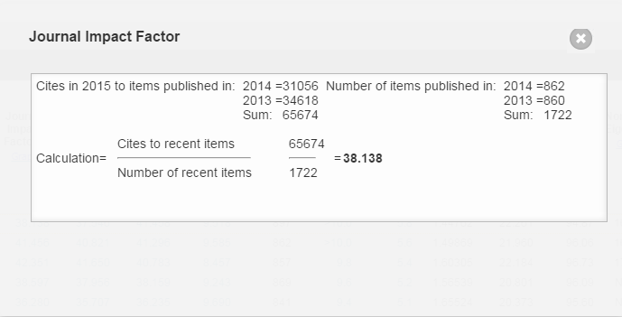
6. Impact
Located in Journal Citation Reports, a database owned by Thomson Reuters, and uses journals in ISI Web of Knowledge.
Focuses on sciences and social sciences.
Provides a list of “top” journals in the field.
Other ‘impact’ measures with unique calculations exist, including those in Scimago
Notes:
It may take a journal 3-5 years to get an impact factor
If not science or social science there will not be an impact factor
Using the Scimago measure is a good alternative if no impact

Slide 35
Assessing Journals: Example 1:
Journal of Food, Nutrition, and Population Health
Notes:
Did a live review of this journal.
Do a “sniff test”: Looked at graphics, misspelling, aims and scope (if includes all health sciences, the journals focus is meaningless)
This journal asked Kerry to submit a paper.. Surprising because she doesn’t work in the
areas that are in the title.
When she looked at the author guidelines she found they misspelled the name of the journal (Failed sniff test)
Notes that the Directory of Open Access (doaj.org) lists journals that meet 50 criteria they set.
Kerry typed the title of the journal into the search box. No Match. Concludes that this is a predatory journal.

Slide 36
Example 2:
Annals of Family Medicine
Notes:
Kerry Demonstrates this journal live. There is nothing concerning
In the guide to authors, there is an impact factor; notes it is in Medline; has nice level of detail in the author and policy documents; affiliations are listed
Can verify the affiliation by going to the website of the organizations listed.
Kerry showed this and that AAFP does list the Annals.
This is a trustworthy journal.
.

Slide 37
What’s a Predator in the Conference World?
Predatory Conference: n. Conference claiming to be scholarly but organized by an entity with greater focus on financial gain than quality scholarship, often with a very wide topical focus, inadequate vetting of materials and poor or no archiving of conference proceedings.
Illustration of "Le vieux chat et la jeune souris" by Auguste Vimar (1851-1916) from an 1897 edition of La Fontaine's Fables.
Notes:
Gina Firnhaber takes over the discussion here.
There is no a great definition of predatory conferences so we put this one together, hence no citation.
Conferences vary widely and we’re focusing on criteria associated with scholarship. A conference may be classified as predatory but it doesn’t mean they aren’t good or that you wouldn’t enjoy them.

Slide 38

Why do you want to attend a conference?
Exposure to current information?
Disseminate your work?
Network?
Continuing education?
Requirements of your job?
Travel and leisure?
Time and money to burn?
Notes:
Think of this as dating. You have tons of offers but it’s all about what works for you.
Your goal is to avoid a bad one. You might miss a few good “dates” by being selective but…you want to go to a conference that meets your purposes

Slide 39

Simply travel and leisure or money to burn?!Just go for it!
https://www.flickr.com/photos/nasacommons/8981696958/in/photostream/

Slide 40

Other reasons important?
Do a little sleuthing before signing up
Maybe call on your favorite librarian!
Notes:
If in doubt throw it out!
You may know a librarian who can help you investigate. Librarians LOVE this kind of thing!

Slide 41
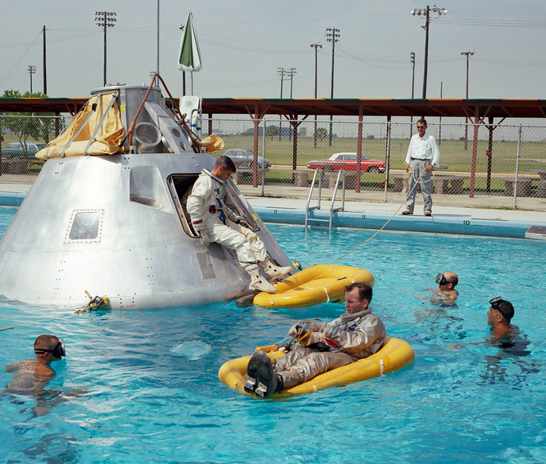
Like predatory journals, predatory conferences often:
Aggressively solicit
Have an unreasonable aim and scope
Misrepresent affiliations
Have inadequate or no review process
Charge high fees
https://www.flickr.com/photos/nasacommons/33512444548/
Notes:
As Kerry mentioned, you get emails from legitimate conferences too, they do need to advertise.
Need a focused aim and scope…..really cant cover all of health care
Check out affiliations, some are false news.
Read their description so their review process.
Compare cost with similar conferences.

Slide 42
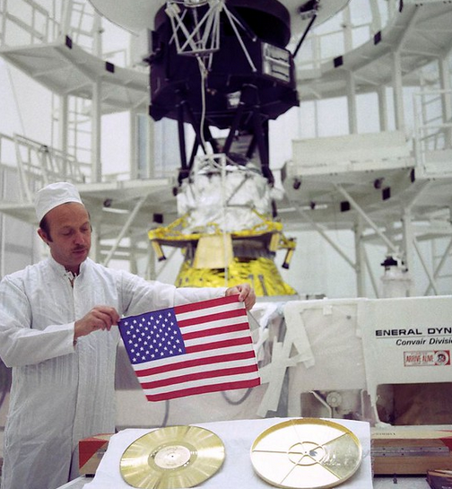
Unlike journals, however, conferences can’t be verified through:
Trustworthy databases or indexes
Respected lists of offenders
Impact factors
Reputation of the publisher (in most cases)
https://www.flickr.com/photos/nasacommons/42474045021/in/photostream/
Notes:
If they have an affiliation with a publisher they may show up on Beall’s list or other sites that list predatory publishers.
There is no index for conferences
Can google and you might be surprised whatyou will find.

Slide 43
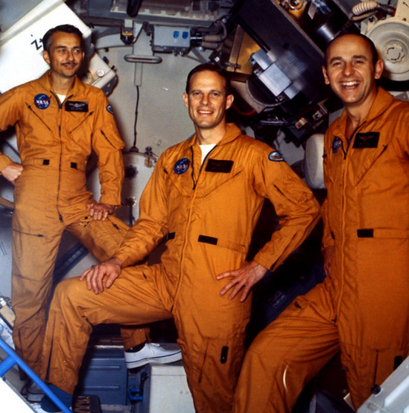
And of specific concern with conferences:
Abstract/proceedings publication
Continuing education credits
Human connections
https://www.flickr.com/photos/nasacommons/7678546866/in/photostream/
Notes:
Academic work should be made available to benefit science. If it isn’t made available how will anyone else benefit?
Accrediting organization for CE…double check they really are available.
Who do you want to hang out with…

Slide 44
Criteria for Quality in Conferences

Slide 45

1. Solicitations
  Did you learn of this conference through unsolicited email?
  Did the email give you any reasons to be a little suspicious?
https://www.flickr.com/photos/nasacommons/7584827568/in/photostream/
Notes:
Email marketing is easy and cheap. Everyone does it, not just the bad ones, but they do tons of it. Look closely at the email. Some of them are really entertaining. Words, grammar, spellings, punctuation, names, etc.

Slide 46

2. Aim and Scope
  Do the aim and scope seem reasonable?
  Are the aim and scope within your area of interest?
https://www.flickr.com/photos/nasacommons/39951531800/in/photostream/
Notes:
Is there an actual focus or are they just out to save the whole world?

Slide 47
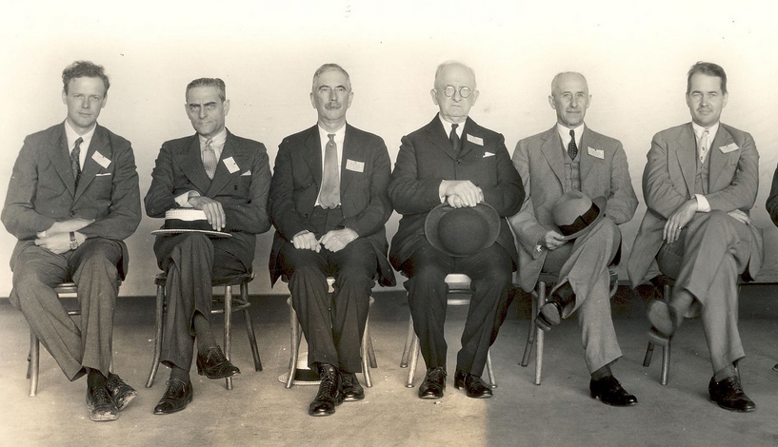
3. Affiliations
  Are they affiliated with a legitimate organization or educational entity?
  Are people with known expertise presenting?
  Does any affiliated publisher show up on Beall’s list?
  What does Google say?
https://www.flickr.com/photos/nasacommons/7584802406/in/photostream/
Notes:
You should be somewhat familiar with the prominent organizations/programs/people in your field. Do you see any of them? If so hopefully they approved this affiliation. Sometimes they didn’t.
Sometimes experts don’t do their own homework so it’s possible people with known expertise could be presenting at predatory conferences.
The predatory lists of publishers are based on criteria, not opinion, they aren’t perfect but they are a start. And Google can be a treasure trove of opinions. Just be sure to see if they come from what looks like a trusted source.

Slide 48
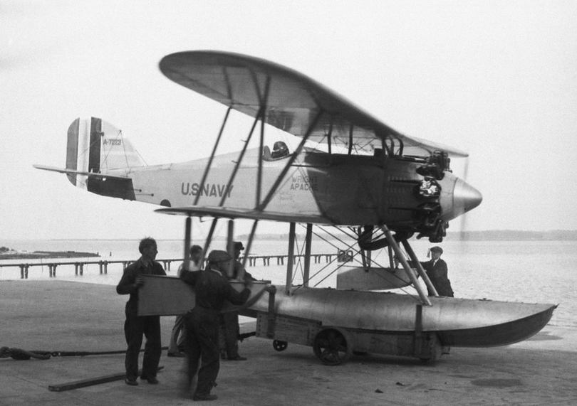
4. Vetting of submissions
  Is there a reasonable and clearly described vetting process for presentations and posters?
https://www.flickr.com/photos/nasacommons/7605906586/in/photostream/
Notes:
Some conferences let anyone willing to pay present, including industry representatives. Quite lucrative.

Slide 49
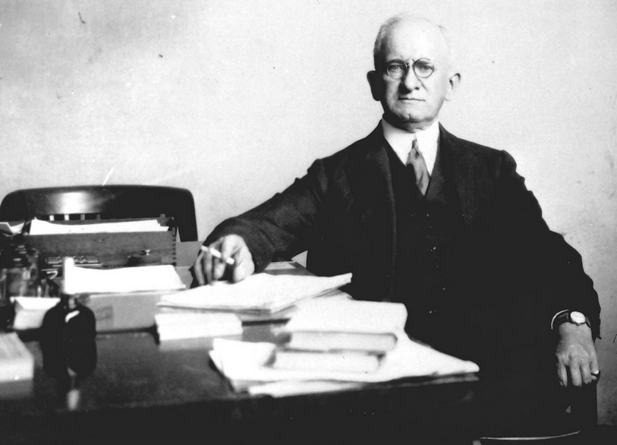
5. Cost
  Is the cost reasonable?
  If you would be reimbursed for presenting, does the amount offered seem reasonable?
https://www.flickr.com/photos/nasacommons/13971006106/in/photostream/
Notes:
Costs vary widely. Pricing structure including all costs should be transparent.

Slide 50
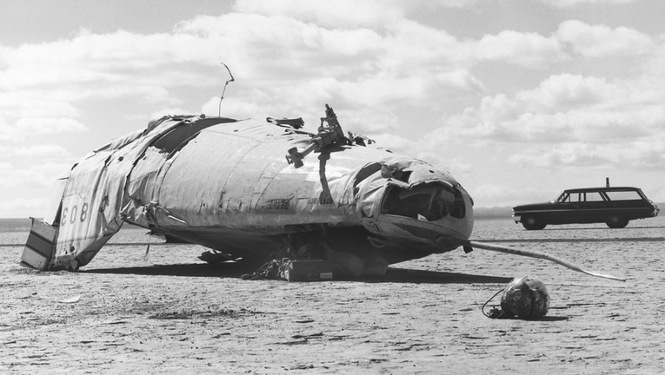
6. Availability of abstracts/ proceedings after conference
  Will abstracts or proceedings be published?
  Are abstracts or proceedings from previous years available?
  Are abstracts or proceedings from previous years discoverable (i.e. show up in Google Scholar searches)?
https://www.flickr.com/photos/nasacommons/9458149229/in/photostream/
Notes:
Publishing abstracts and proceedings gives the science a shot at making it into practice. If others aren’t aware of new discoveries and ideas how will they be of benefit? They must also be discoverable. Google is good at finding things. If Google can’t find it not many people probably will see it.

Slide 51
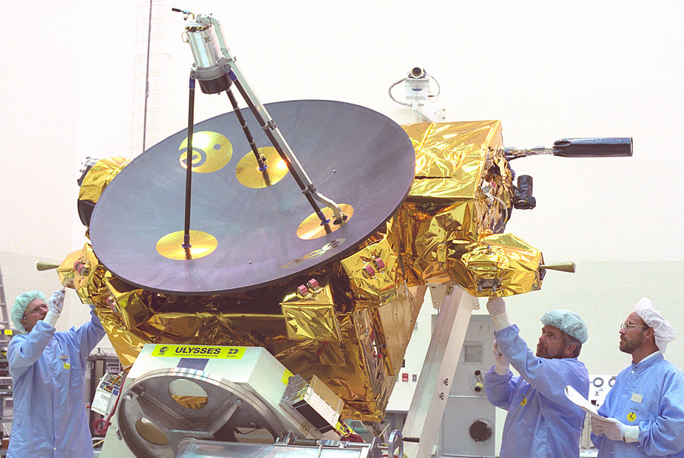
7. Continuing education
  Are continuing education credits offered?
  If yes, are they certified by an entity recognized in your field?
  If yes, has this entity actually agreed to provide these continuing education credits?
https://www.flickr.com/photos/nasacommons/9457931519/in/photostream/
Notes:
Continuing education credits are required for many professionals. Accreditation status is important.
Example from one conference that falsely claimed CE, the entity stated as approving the CE went on Twitter and said to avoid them.

Slide 52

8. Target audience
  Does the targeted audience seem appropriate for the (appropriate) aim and scope?
  Does the target audience include some diversity but mainly people you would learn from and wish to network with?
https://www.flickr.com/photos/nasacommons/9460178394/in/photostream/
Notes:
If you’re interested in networking the speakers and audience may be extremely important to you. You are most likely interested in attending a conference with your peers. Interprofessional is good. International is good. But it depends on the conference. A conference not clearly aimed at students but presented and attended primarily by students may not be a great choice for a seasoned professional.

Slide 53

Some examples
Can you say “clear as mud”?

Slide 54
Dear Your Name,
I would like to welcome you to The Nursing 2020 Orlando, USA conference which will take place during 28-30 May 2020 in Orlando, USA. The Nursing 2020 Orlando, USA conference will provide an informative scientific and clinical platform for all Healthcare professionals, Registered nurses, Practitioners, Professionals, Researchers, Faculties, and Clinicians in Healthcare, Nursing and associated areas.
Program: https://exceleve.com/nursing/ <https://ijbk.maillist-manage.in/click.zc?od=2573bc7da3e92eab5f3e6a858e48c551a1185630859ca1fd0&repDgs=13fe54321553314&linkDgs=13fe543214e72bd>
DAY1: Scientific Program | DAY2: Scientific Program | DAY 3: Local Tour
Looking forward to hearing from you to answer your further queries.
Please ignore this mail, if you already confirmed your participation.
Sincerely,
Program Director
The Nursing Congress 2020
Notes:
Unsolicited. Name of conference is not descriptive at all. Huge goals and aim and audience, no focus whatsoever. English is not first language. Capitalizations and sentence structure is off.

Slide 55
Investigation revealed…
Solicitation: unsolicited email Excel Global Conferences (listed in one place as predatory)
Aim and scope: Global review on Next Gen Nursing & Human Well-being
Affiliations: Canadian Academy of Sciences (CAS) (found CAHS…)
Vetting of submissions: Not clear
Cost: $100-$500
Availability abstracts/ proceedings after conference: Published in “conference souvenir” with DOI (discoverable?)
Continuing education: Only mentioned on homepage of website
Target audience: Nurses of any kind or non-nurses
Notes:
Excel Global website: “The conference comprises of…” ;Infinity Long Term Care Consulting LLC website: “ILTCC is an long term care…”Also, not sure if Canadian Academy of Sciences (CAS) is legitimate or not. CAHS (Canadian Academy of Health Sciences) is and it really sounds similar…to a real organization

Slide 56
Dear Dr. Your Name,
We are not sure if you have received our previous emails regarding your published work on “Your Journal Article Title". We tried to reach you several times but could not get a response, so we thought to try one last time.
We would like to know if you or someone from your team would be interested to give a presentation at 3rd International Conference on Obesity and Chronic Diseases scheduled for July 23-25, 2018 in Los Angles, United States. (ICOCD-2018)
Please do not hesitate to contact us with any of your queries. We would be responding within 24 hours. Best regards,
Conference Manager
Plano, TX 75024, USA
https://unitedscientificgroup.com/unsubscribe.php or Please reply with "Not Interested" as subject line if you do not wish to receive any further emails.
Notes:
More specific to you, notes name of your work. Recruiting for speaking. Not first language English. We have experience with this one! But is it good or bad?
United Scientific Group is an interesting example

Slide 57
Investigation revealed…
Solicitation: unsolicited from United Scientific Group (just Google!)
Aim and scope: Present and discuss new info in obesity field
Affiliations: Committee members
Vetting of submissions: Accept/reject within 4-5 days (option to pay to deliver a talk)
Cost: $250-$1000
Availability abstracts/ proceedings after conference: Published in Journal of Obesity & Chronic Diseases (not in Medline, no indexing, says peer-reviewed, few things pull in Google Scholar, by USG)
Continuing education: Not sure
Target audience: Students, academics, researchers (international)

Slide 58
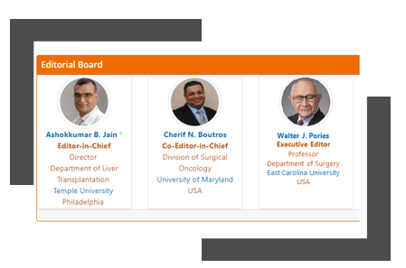
But the plot thickens…
Notes:
Kerry was easily able to place our esteemed faculty member into a fake editorial board.
He also shows up on this conference website as a presenter. But it’s true. He presents at this conference. He is a leading voice in obesity and has over 300 citations in PubMed.

Slide 59
Hawaii Dermatology Seminar conferences.globalacademycme.com
Save $250 - 31.5 CME/CE Credits - February 16-21, 2020
Having trouble reading this message? Click here <http://send.globalacademycme.com/link.cfm?r=g2siWP2dhk6UXm8Ba75NbA~~&pe=OreKFZyT2OW-ZcsCQUE2PXhWIKwHqYT3STKRu98FO97gWv102mgTzoLOIzrAgy_oiib8pX8NIXRDsMapYkrn6A~~&t=ZyLQ00vWnKQEi33TiFWwCg~~> for the web version.
SAVE $250 UNTIL MONDAY, DECEMBER 16! Join us at the 44th Annual Hawaii Dermatology Seminar® presented by the Skin Disease Education Foundation (SDEF) as we explore the latest advances in the treatment and management of common and complex diseases of the skin, both for adults and children, as well as new developments in aesthetic medicine.
REGISTER BY MONDAY, DECEMBER 16 TO SAVE $250!
Conference Directors
Joseph F. Fowler, Jr., MD
Clinical Professor and Director
University of Louisville School of Medicine Louisville, KY Linda F. Stein Gold, MD Director of Dermatology Research Henry Ford Health System Detroit, MI Christopher B. Zachary, MBBS, FRCP Professor and Chair, Dermatology University of California, Irvine School of Medicine Irvine, CA
Notes:
Hawaii? December? I’m there!

Slide 60
Investigation revealed…
Solicitation: Skin Disease Education Foundation (known to me)
Aim and scope: Latest advances skin diseases
Affiliations: Tons (legitimate ones)
Vetting of submissions: Peer review, also take industry sponsored
Cost: $400-$1000
Availability abstracts/ proceedings after conference: appear in Cutis (indexed in Medline)
Continuing education: 31.5 CME/CE AAFP, ANCC, ACPE, MOC-D
Target audience: MDs, PAs, NPs, Pharms, Residents/Fellows
Notes:
Solicitation but from known entity.
Conference director has 152 citations in PubMed.
Cutis is a well respected journal.

Slide 61


And it’s Hawaii!

Slide 62
In closing…
Publishing your work and attending conferences are both important
Your time, effort, and work are also important
Be sure to check out journals and conferences before investing your time and money
Or contact your local librarian to check them out for you!
And when asked to serve as a reviewer or on an editorial board or as a speaker or as a conference committee member or…
Notes:
Kathy does the closing, basically commenting about the bullets above.
Makes note that we didn’t discuss the last bullet point of being asked to be a reviewer for a journal….. Same issues apply.

Slide 63
And just a little self promotion…
Sewell, K. A., & Firnhaber, G. C. (2019). Predatory publishers and conference organizers: Just say no. Nutrition Today, 54(6), 261-270. doi:10.1097/NT.0000000000000384
Notes:
This is the paper we published in Nutrition Today that has some but not all of what is presented in this webinar.

Slide 64

Questions?
Kerry Sewell browderk@ecu.edu
Gina Firnhaber firnhaberg@ecu.edu
Kathy Kolasa kolasaka@ecu.edu

