Slide 1
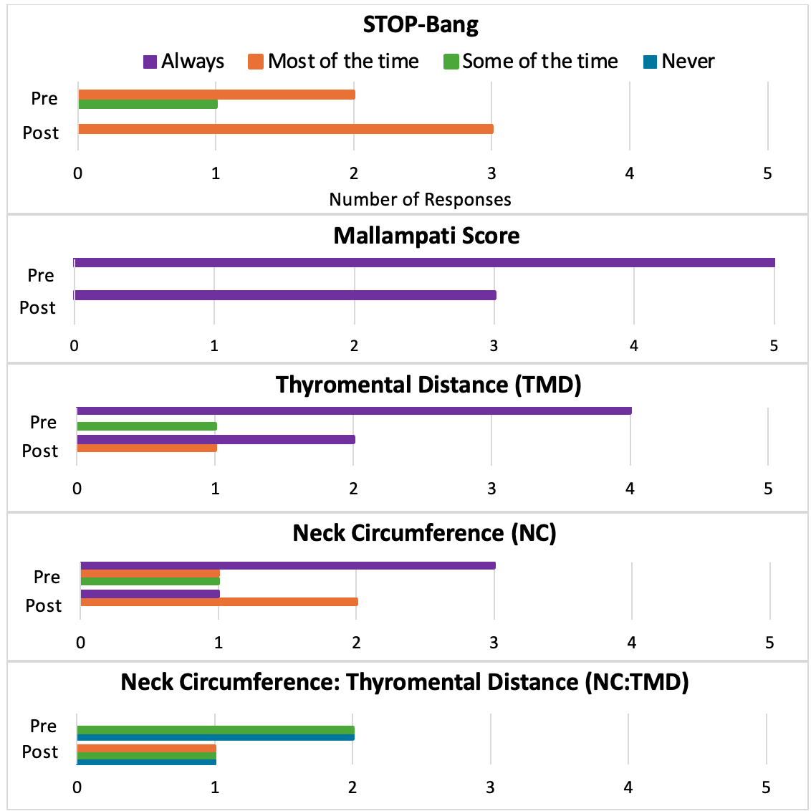
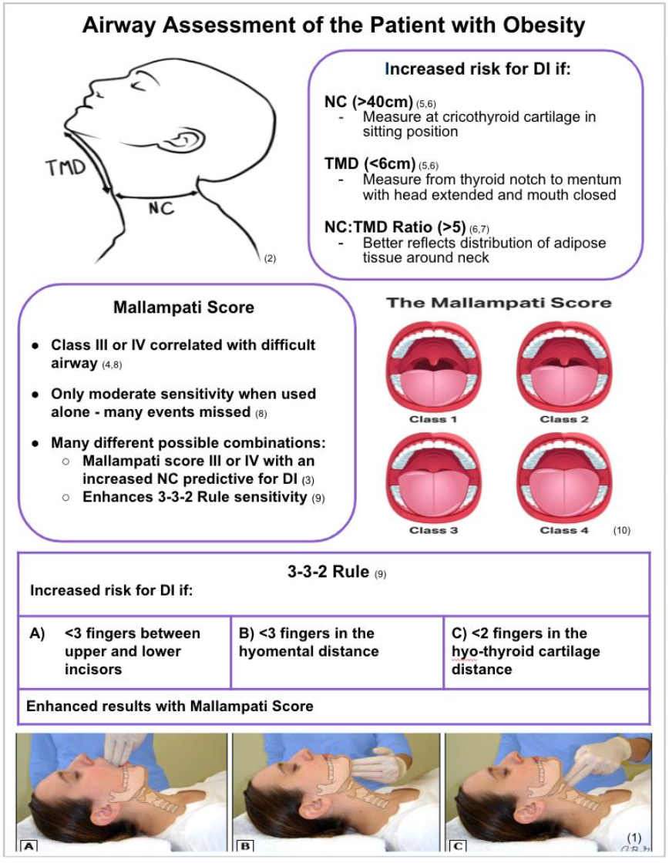
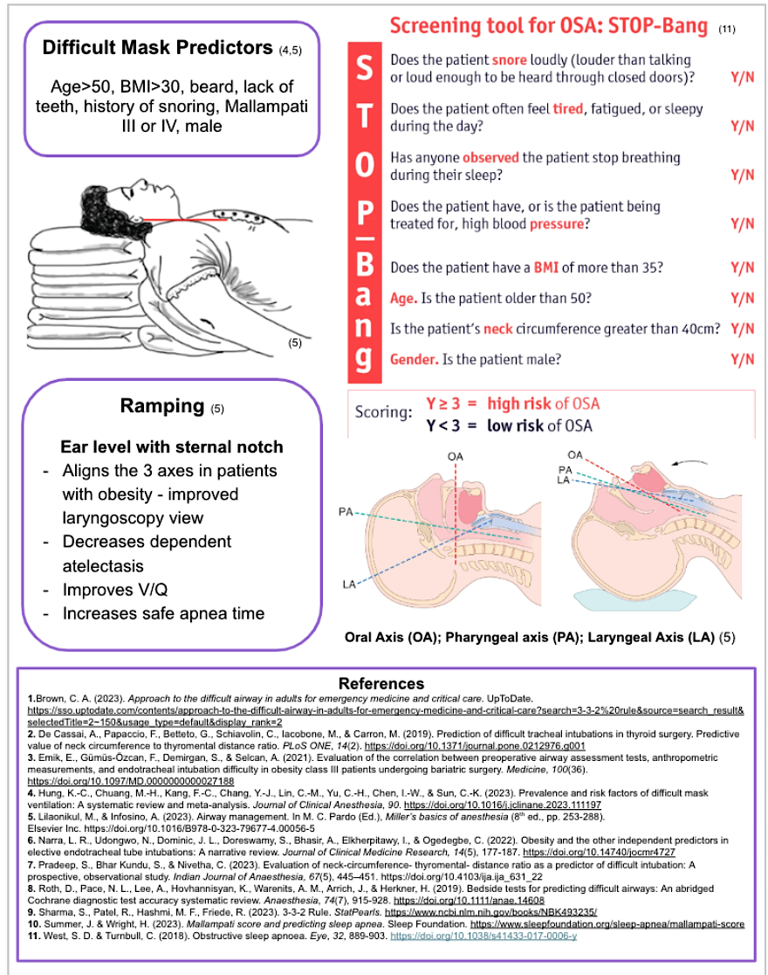
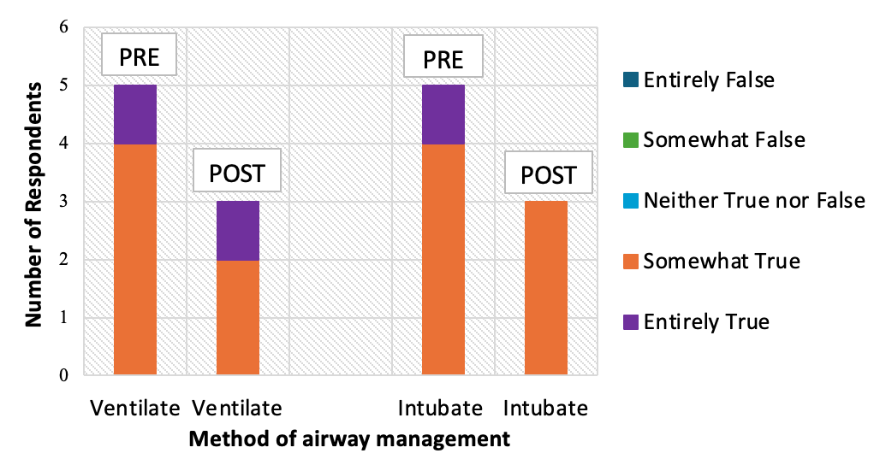




CRNA Airway Assessment in Patients with Obesity: A Quality Improvement Project
Lauren Powell, BSN, SRNA
Maura McAuliffe, PhD, CRNA, FAAN, Project Chair
Nurse Anesthesia Program
College of Nursing, East Carolina University
Greenville, North Carolina 27858
powellla22@students.ecu.edu
INTRODUCTION
RESULTS
DISCUSSION
42% of Americans are considered obese (BMI ≥ 30kg/m²) ¹
Americans with a BMI ≥ 40kg/m² has doubled in the last 20 years.
Patients with obesity are not harder to intubate but can be harder to ventilate.³
50% of intraoperative cardiac arrests are due to issues during intubation
The purpose of this quality improvement (QI) project was to assess CRNAs’ perception of adequacy of a newly developed quick reference guide (QRG) as a useful tool for their practice as it pertains to assessment of the airway of patients with obesity.
Figure 1
When evaluating the airways of patients with obesity, to what extent do you use the following assessment methods? (pre-survey n=5, post-survey n=3)
Pre-implementation survey (n=5) & post-implementation survey (n=3).
51% or more of respondents' total patient population were obese.
The assessment tool used the most by CRNAs was the Mallampati score.
        The Mallampati score was found be be very useful for predicting DI.
All but one participant reported using ≥ 2 assessment techniques.
The perception of DI in patients with obesity did not change after implementation of the QRG.
CRNAs found the QRG to be very useful or mostly useful.
The main limitation identified was low post-implementation survey responses.
METHODS
PDSA was used as the model for the QI project. ²
PowerPoint presentation, QRG, and pre-implementation survey were emailed to participants.
CRNAs used the QRG during the 2-week implementation period.
Participants were then emailed a post-implementation survey after the 2 weeks were complete.
Survey Assessed
CONCLUSIONS
A longer implementation period should be considered.
Implementation of this QI project at a facility with higher acuity patients with a larger BMI.
The survey format of the first 2 questions should be changed from a drop-down option.
Further advancement for education and training in POCUS for airway assessment.
Advancement with AI in predicting DI.
QUICK REFERENCE GUIDE
Note. In the pre-survey 2 respondents did not answer the STOP-Bang question and 1 respondent did not answer the NC:TMD ratio question.
Figure 2
CRNA perception of the difficulty of intubating and/or ventilating patients with obesity. (pre-survey n=5; post-survey n=3)
REFERENCES
1. Centers for Disease Control and Prevention. (2022). Overweight and obesity. U.S. Department of Health & Human Services. https://www.cdc.gov/obesity/index.html
2. Institute for Healthcare Improvement. (2023). Plan-do-study-act (PDSA) worksheet. https://www.ihi.org/resources/Pages/Tools/PlanDoStudyActWorksheet.aspx
3. Menon, S. M., Sampangiramaiah, S., & Mathew, M. (2017). Cross sectional observational study performed to see for relation of Mallampati score and extended Mallampati score with body mass index. Journal of Clinical and Diagnostic Research, 11(5), UG01-UG03. https://doi.org/10.7860/JCDR/2017/23937.9865

